Slide 1
Cybersecurity and Personal Finance
Jack and the Giant Digital Footprint
Deborah Kozdras, Ph.D.

Slide 2
Visual 1 Digital Footprint
What are some of the activities you do online?

Slide 3
Handout 1: Jack’s Letter Part 1
Hi Students,
My name is Jack III and my grandfather was the “Jack I” who traded beans for a cow and ended up with a goose that lays golden eggs. Our family has been living happily ever after for years; however, I recently read on the Internet that the giant is back. Apparently, giants live for a very long time!
For those of you not familiar with the story of my famous family, here goes. My grandfather, Jack I, was supposed to sell the cow to make money to feed his family. He met a guy who convinced him to trade his cow for some “magic” beans. His mom, my great grandmother, was not very happy because she didn’t believe in magic beans. She said, “The cost of your decision is that we don’t have money to buy food this week.”

Slide 4
Handout 1: Jack’s Letter Part 1(continued)
She threw the beans out of the window and made Grandpa Jack clean his room.
The next morning, when Jack I looked out the window, he saw a giant beanstalk. You see, in fairy-tale land, magic happens. After he climbed to the top of the beanstalk, he saw a beautiful giant castle. Then he went inside. Obviously he had never heard the story of Goldilocks and the Three Bears. Walking into a strange family’s house and messing with their stuff is never a good idea.

Slide 5
Handout 1: Jack’s Letter Part 2
You know the drill, giant arrived, giant fell asleep, and Grandpa Jack made the decision to take the hen that lays the golden eggs. The giant woke and shouted, “Fee, Fi, Fo, Fum.” Grandpa Jack ran toward the beanstalk and raced down as fast as his little legs would carry him. The giant followed and when Grandpa Jack cut down the beanstalk, the giant crashed to the ground and was never heard of again—at least not by Grandpa.
But I recently found out that the giant is still alive! I saw postings on the Internet! Apparently giants live for a very long time.
So I have a problem. I don’t want the giant to find my house. I imagine he is not happy with the decision Grandpa Jack made to take the goose. Grandpa took a big risk and now I may have to pay for it.

Slide 6
Handout 1: Jack’s Letter Part 2 (continued)
I heard that you were learning about digital footprints. Someone told me that my online digital footprint might lead the giant right to my house if I’m not careful. I spend a lot of time online. I like to use the Internet and play games with friends. My mom also likes to share photos. Please help us make informed decisions about the things I post online so we don’t lead the giant right to my house!
Sincerely,
Jack III

Slide 7
Handout 2: Digital Footprint Notes
Video Questions
What is a digital footprint?
What is private information? Why is it very risky to share?
What is personal information? When can it be risky to share?
Close Reading of Article Questions
How can photo sharing add to your digital footprint?
What is geotagging and why can it be risky?

Slide 8
Handout 3a: Article on Digital Footprints and Photo Sharing (Lexile 750)
Taking cute and funny pictures isn’t new. However, the digital world changes how photos are shared. When you post a photo, you might be sharing private information. And that can be a problem because most children have some kind of digital footprint.
A digital footprint is like a trail of everything you do online. A trail is created when you upload content, surf websites, or play on apps. In fact, your digital footprint may have started before you even posted anything! Parents enjoy sharing cute photos of your young life. This can be a problem for you when the photos are embarrassing. But that isn’t the only problem.

Slide 9
Handout 3a: Article on Digital Footprints and Photo Sharing (continued)
Did you know that your location might be shared when you post a photo? For example, if you take a photo at a baseball game, the photo is tagged to share the location. This is called geotagging. Smart phones automatically add tags to photos. You have to turn it off in settings. This is very important for online safety. What would happen if Little Red Riding Hood posted selfies with geotags?
Remember, posting photos can affect your digital footprint. Digital footprints can become real footprints when someone can track you and your location. Ask your parents to help you research photo sharing. Remember to think before you share!

Slide 10
Handout 3b Part 1: Article on Digital Footprints and Photo Sharing (Lexile 900)
Have you or your parents ever posted a photo to social media? Taking cute and funny pictures isn’t new. However, the digital world changes how photos are shared. Did you know when you post a photo other people know where you are? And that can be a problem because most children have some kind of digital footprint.
According to Common Sense Media, a digital footprint is a record of everything you do online. You leave a trail of footprints when you use social media, surf websites, answer quizzes, or sign into apps and games. In fact, your digital footprint may have started before you even posted anything! A recent survey found that over 90% of parents have posted about children by the time they were two! Parents enjoy sharing cute photos of your young life. This can be a problem for you when the photos are embarrassing. But that isn’t the only problem.
Notes:
This is very crowded. How about putting on 2 slides?

Slide 11
Handout 3b Part 1: Article on Digital Footprints and Photo Sharing (continued)
Did you know that when you post images on social media, you give companies permission to use your photos? For example, when you join photo-sharing apps, you give permission to share and use your content. The only solution is to read the policy of social media accounts before you post. Do you want people to be able to use your photos?
A bigger problem can happen due geotagging. What is geotagging? Common Sense Media defines geotagging as a feature that allows you to add locations to uploaded content. For example, when you take a photo at a baseball game, the photo can be geotagged to share your location. Most smartphones are equipped with location-based services. Geotagging automatically is attached to photos taken by smartphone cameras.
Notes:
This is very crowded. How about putting on 2 slides?

Slide 12
Handout 3b Part 2: Article on Digital Footprints and Photo Sharing (continued)
Geotagging can impact your digital footprint by leaving a real-world location trail. For example, what would happen if Little Red Riding Hood posted selfies with geotags to her social media account? So what can you do if you don’t want someone to know your location? You can search online to find out how to disable geotagging on your smartphone.
You can also teach your parents and guardians. Remember, posting photos creates a digital footprint. For example, what would happen if Little Red Riding Hood posted selfies? Those photos would include a geotag with location and time. This could alert the wolf to where Little Red Riding Hood was going!
Photos can affect your digital footprint. However, there are ways you can protect your privacy. Don’t post to social media unless you know how they can use your images. Ask friends and family for permission before they post images of you. Finally, make sure that you disable geotagging when you don’t want to share your location with strangers. Remember, digital footprints can become real footprints when someone can track your location through geotagging.
Notes:
Sources need titles (put on second slide?)

Slide 13
Sources for Readings on Digital Footprints and Photo Sharing
Sources:
Visualizations to Teach about Mobile Online Privacy http://mediasmarts.ca/sites/mediasmarts/files/games/secure-comics/publications/PT2014_PosterAbstract.pdf
Young Children and Digital Footprints https://www.commonsensemedia.org/file/case-family-tip-sheet-2/download
Is it Safe to Post Pictures of My Kids Online? https://www.commonsensemedia.org/privacy-and-internet-safety/is-it-safe-to-post-pictures-of-my-kid-online

Slide 14
Handout 4: Footprint

Slide 15
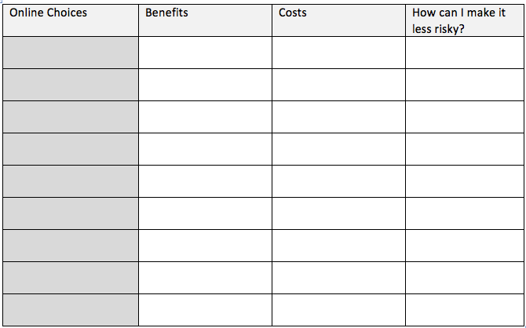
Handout 6: Digital Footprint Analysis

