Slide 1
Presented by: Kathleen Brennan
Email: kmbrennan108@gmail.com
Date: January 23, 2024
12:30- 2:00 PM ET
2024 Winter Institute
Global Economics and Policy
A Macroeconomic Exploration

Slide 2
Objectives
Develop an understanding of how governments can influence the business cycle.
Explain monetary policy is implemented.
Analyze the effects of government policies on inflation, employment and economic growth.
Compare and contrast policy approaches used in selected countries.
Understand the importance of globalization.
Use demand and supply analysis to explain how exchange rates are determined.

Slide 3
Agenda: January 2, 2024 12:30-2:00 PM
I. Business Cycles and the Role of Government 12:30- 12:35
II. Fiscal Policy 12:35-12:40
III. Monetary Policy 12:45- 1:15
IV. Effects of fiscal/monetary policy on the U.S. economy 1:15- 1:30
V. Fiscal /monetary policy approaches outside the U.S. 1:30-1:35
VI. Exchange rates and international trade 1:35-2:00
​

Slide 4

I. The Business Cycle

Slide 5
The Business Cycle
Real GDP
Inflationary Gap
Recessionary Gap
Peak
Real GDP
Trough
Full Employment
Recession
(Contraction)
Recovery
(Expansion)
Time
Copyright
ACDC Leadership 2018
5
Notes:
A short-term fluctuation in economic activity
Tendency of economy’s actual output to deviate from potential output
Potential Output- the level of output that occurs when all its resources are fully employed
Four phases of the business cycle
Recession
Trough
Expansion
Peak

Slide 6

The Economy is Like a Car
- Driving 20 mph is too slow (recessionary gap)
- RGDP growth- low or declining
- Unemployment rate- high
- Inflation- low, declining (disinflation),
or negative (deflation)
- Driving 120 mph is too fast (inflationary gap)
- RGDP growth- high
- Unemployment rate- very low
- Inflation- rising
- Driving 65 mph speed limit (at potential)
-RGDP- growing at sustainable rate
-Unemployment rate- close to/at NRU
-Inflation- close to/at 2%

Slide 7
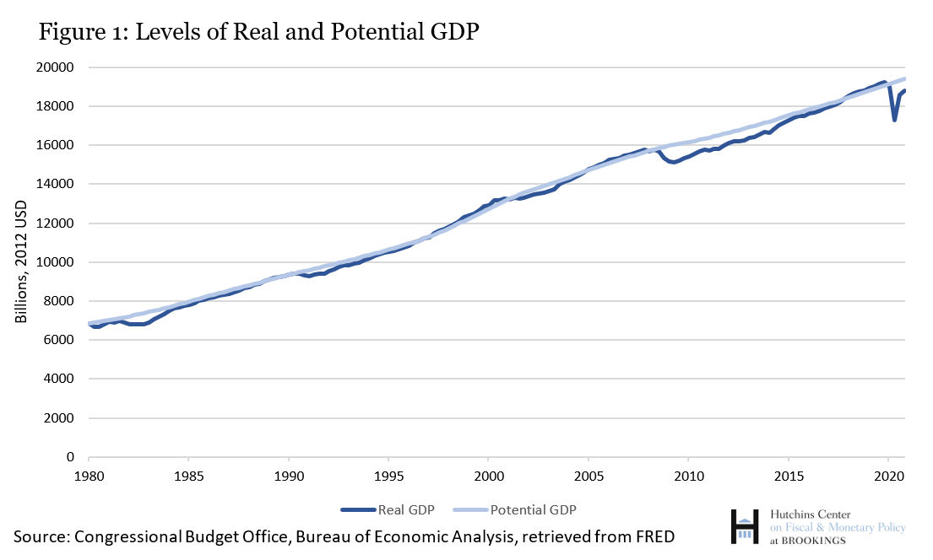
The Business Cycle: 1980- 2020
Notes:
The level of gdp at which all resources are fully employed (i.e. on the ppf)
Depends on the available supply of labor, human and physical capital, and technological progress
Actual- can fall short of potential

Slide 8
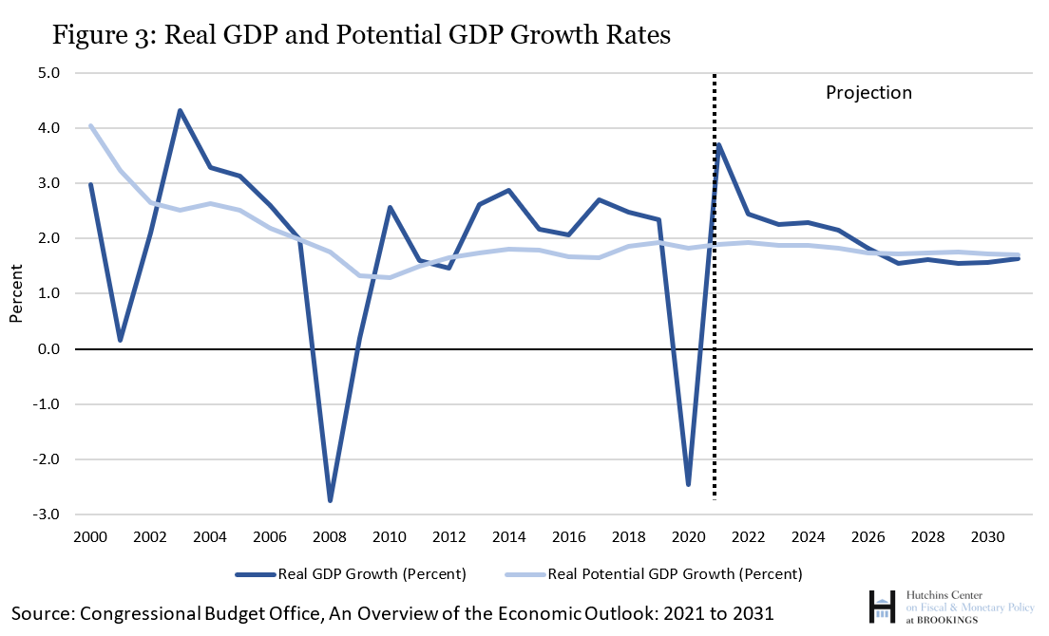
Real and Potential GDP Growth Rates

Slide 9
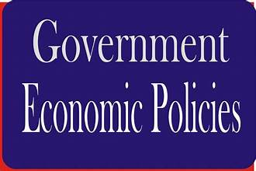
Fiscal Policy
Monetary Policy

Slide 10
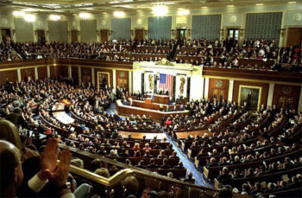
II. Fiscal Policy

Slide 11
AUTOMATIC STABILIZERS
Policies that are automatically triggered during the expansionary and contractionary phases of the business cycle.
Contractionary stabilizers
- decrease in taxes
- increase in spending on social programs such as unemployment insurance,
Medicaid, SNAP
Expansionary stabilizers
- increase in taxes
- decrease in spending on social programs

Slide 12
DISCRETIONARY FISCAL POLICY
The government’s use of discretionary tax and spending policies for the purpose of stabilizing the economy.
Increase government spending
Decrease taxes
CONTRACTIONARY
EXPANSIONARY
Decrease government spending
Increase taxes

Slide 13
Expansionary Fiscal Policy Effects
LRAS
SRAS
Aggregate Demand- AD increases, how much will depend on the size of multiplier
Real GDP- Output increases due to increase in AD; firms produce more.
Employment- in short-run, firms will need to hire more workers, decreasing unemployment
Price level- increases in spending can lead to increases in the scarcity of resources, driving up their prices, leading to demand-pull inflation.
PL
P_{fe}
P₂
AD₁
AD₂
Y₂
Y_{fe}
real GDP
Recessionary Gap
Source: Welkernomics

Slide 14
Contractionary Fiscal Policy Effects
LRAS
SRAS
PL
Aggregate Demand- AD decreases, how much will depend on the size of multiplier
Real GDP- Output decreases due to decrease in AD; firms cut back on production.
Employment- in short-run, firms will hire fewer/lay-off workers, increasing unemployment
Price level- decreases in spending will put downward pressure on prices, resulting in a lower price level (disinflation).
P₂
P_{fe}
AD₁
AD₂
Y_{fe}
Y₂
real GDP
$100 million

Slide 15
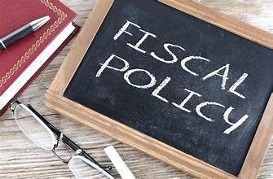
Limitations of Fiscal Policy
Recognition lag
Decision lag
Implementation lag
Effectiveness lag
Difficult to target
Uncertainty about size of multiplier
Impact on government deficit/debt
Crowding out

Slide 16
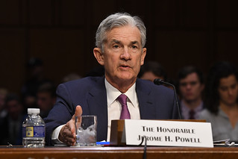
III. Monetary Policy

Slide 17
MONETARY POLICY OVERVIEW
The Federal Reserve’s policy goals and decision-making framework
How the Fed implements monetary policy decisions
Monetary policy tools before and after the Great Recession
Sources: Marginal Revolution University, Federal Reserve of St. Louis, Christopher J. Neely, Federal Reserve

Slide 18
THE FEDERAL RESERVE SYSTEM
“The Fed”
Created by an act of Congress in 1913
Originally a lender of last resort to prevent bank panics
Responsible for monetary policy
Central bank* to the United States
* A government agency that oversees the banking system and is responsible for the amount of money and credit in the economy

Slide 19
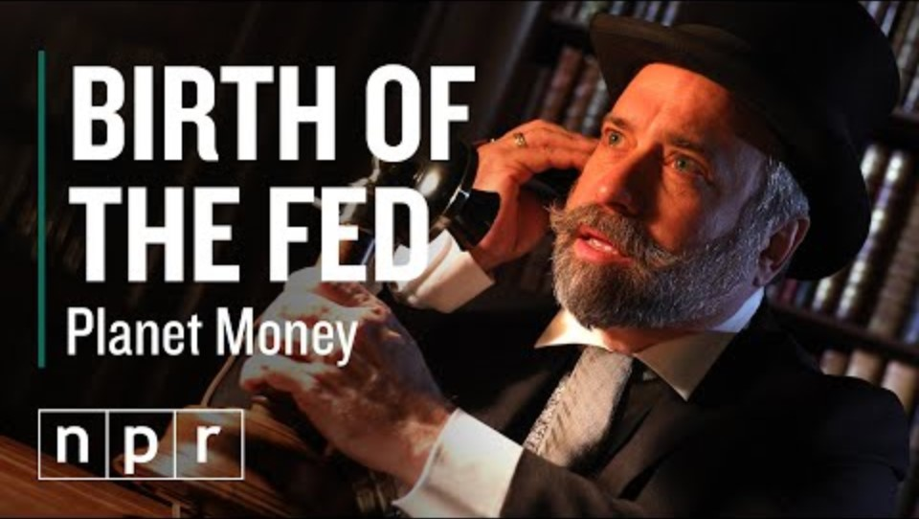

Slide 20
RESPONSIBILITIES OF FEDERAL RESERVE
Regulate bank holding companies and state-chartered banks.
Supply money and credit to the economy to maintain stable prices and full employment.
Ensure the smooth functioning of the payments system.
Act as the government’s bank
Be the lender of the last resort.

Slide 21
How does the Federal Reserve differ from other central banks?
Responsible for monetary policy, bank regulation, and payments system
Exceptionally decentralized
Independence from elected officials

Slide 22
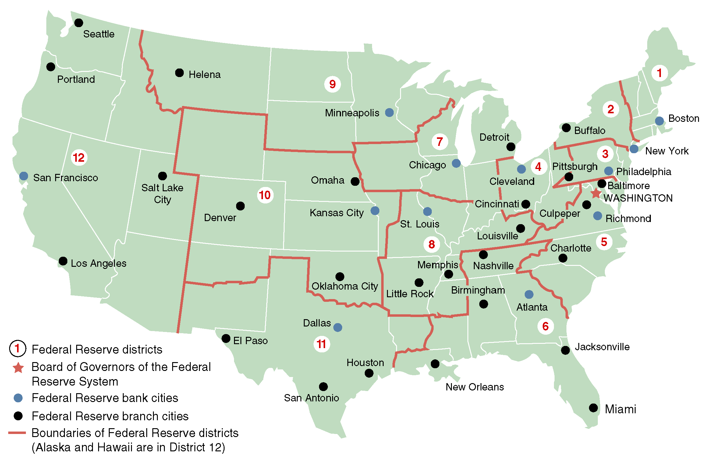
TWELVE REGIONAL BANKS OF THE FEDERAL RESERVE

Slide 23
Framework of the Federal Reserve System
Board of Governors
Federal Open Market Committee
12 Federal Reserve Banks
Commercial Banks
Thrift Institutions
The Public
  BOARD OF GOVERNORS
  Seven members
  Appointed by President, confirmed by Senate
  14-year nonrenewable terms, staggered every two years
  Chair &vice chair appointed by President /Senate for renewable 4-year terms
FEDERAL OPEN MARKET COMMITTEE (FOMC)e
Twelve members
    -7 members of Board of Governors
    -President of NY Fed Reserve Bank
    -4 of remaining Fed bank presidents rotate on yearly basis
    Meets every 6 weeks to vote on monetary policy
    NY Fed implements monetary policy

Slide 24
GOALS OF THE FEDERAL RESERVE
The Federal Reserve Act mandates that the Fed conduct monetary policy to promote effectively the goals of:
Maximum employment
Stable prices
Moderate long-term interest rates
*Known as the dual mandate.
Stable prices: longer term inflation expectations well-anchored at 2%
Unemployment: depends on dynamics and structure of the labor market

Slide 25
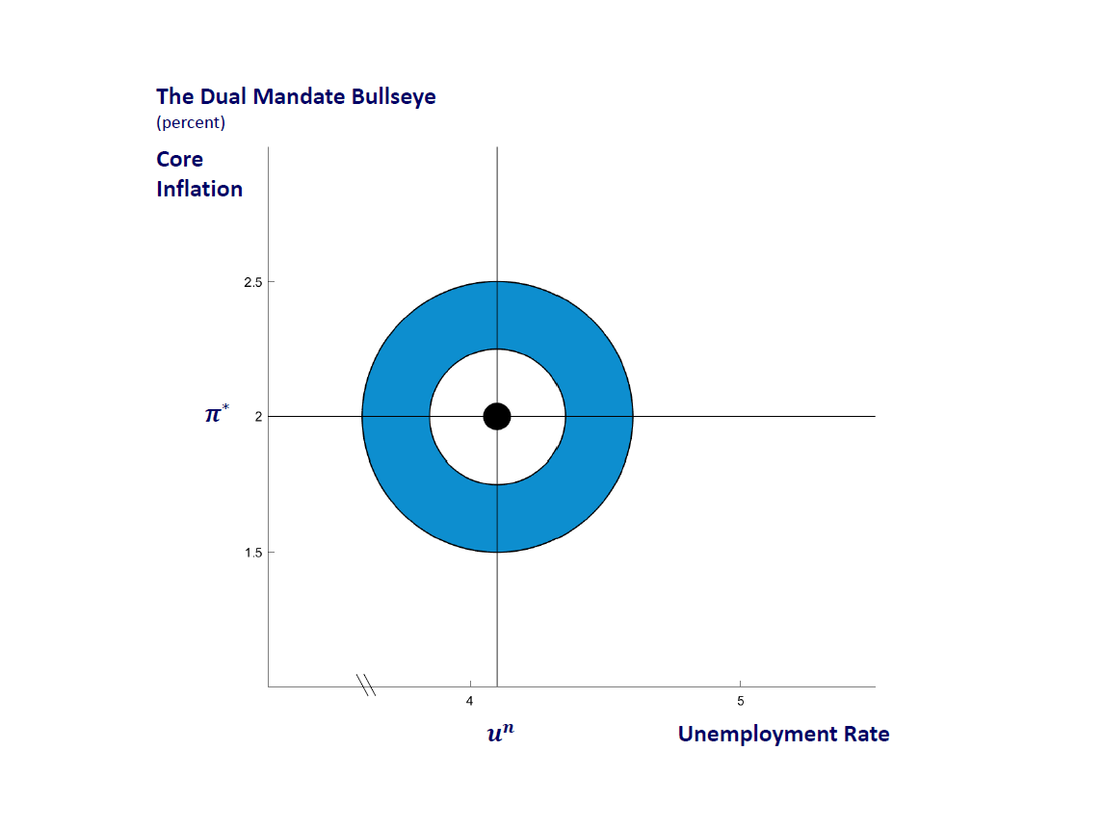
The Federal Reserve’s Dual Mandate
Stable prices:
- Annual inflation rate of 2% measured by the PCE index
- Longer term inflation expectations well-anchored at 2%.
- Inflation target is one that averages 2% over time.
Unemployment:
- dependent on nonmonetary factors that affect the dynamics and structure of the labor market
Source: Federal Reserve Bank of Chicago

Slide 26
The Fed’s Tools of Monetary Policy
Open Market Operations/Quantitative Easing
Changes to Administered Rates
Forward Guidance
Lender of Last Resort

Slide 27
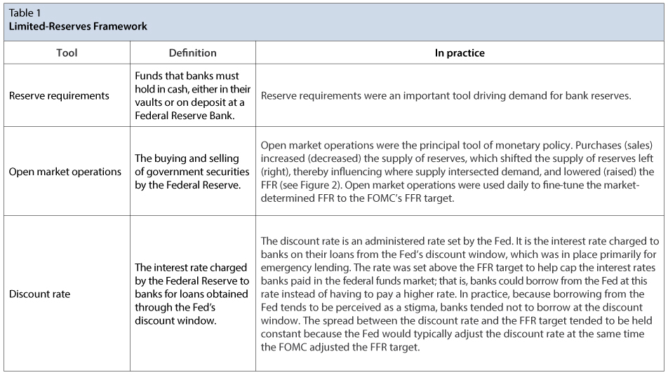
Monetary Policy Prior to the Great Recession
Source: Page One Economics August 2020 Federal Reserve of St. Louis

Slide 28
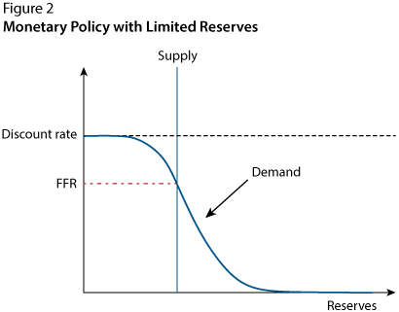
Monetary Policy with Limited Reserves
Source: Page One Economics August 2020 Federal Reserve of St. Louis

Slide 29
The Fed’s Response to the 2008 Financial Crisis
FFR target rate lowered to near zero.
Quantitative easing implemented to lower long-term interest rates.
Total level of reserves in banking system increased from around $15 billion (2007) to $2.7 trillion (2014).
Banking reserves were no longer limited, but “ample.”
Source: The Fed's New Monetary Policy Tools

Slide 30
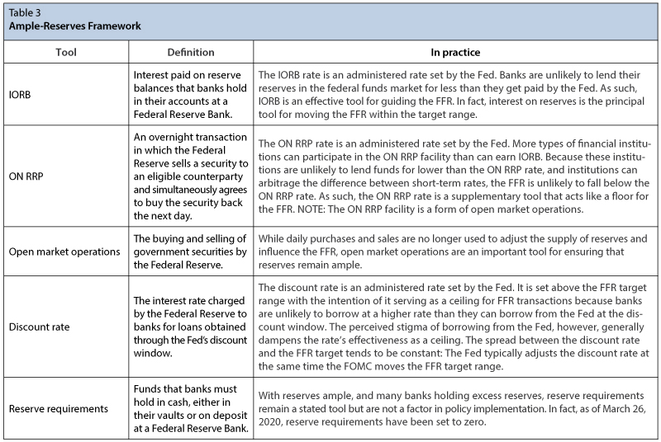
Monetary Policy After the Great Recession
Source: Page One Economics August 2020 Federal Reserve Bank of St. Louis

Slide 31
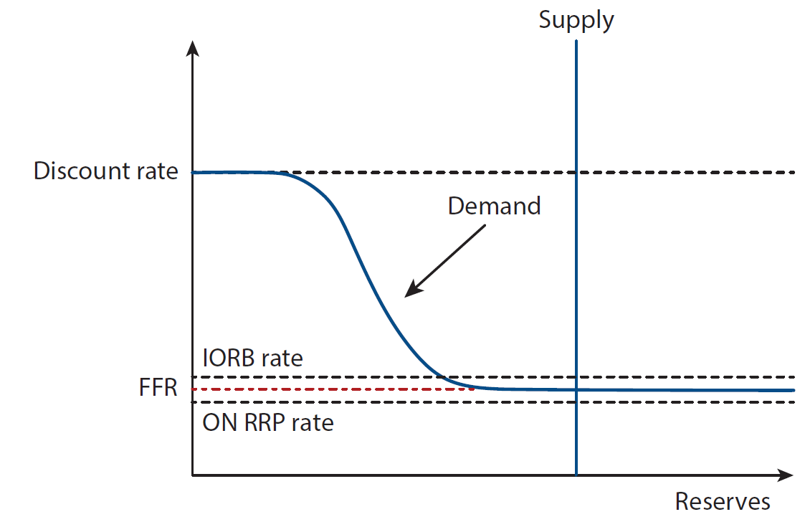
Monetary Policy with Ample Reserves
Source: How the Federal Reserve Implements Monetary Policy

Slide 32
Monetary Policy When Banks Have Ample Reserves
When the FOMC sets the target range for the federal funds rate, the Fed then chooses a level of the interest on reserve balances rate that will encourage the market determined federal funds rate to be within the target range.
When the FOMC raises the target range for the federal funds rate, the Fed raises the interest on reserve balances rate, which moves the federal funds rate up into the new target range. | When the FOMC lowers the target range for the federal funds rate, the Fed lowers the interest on reserve balances rate, which moves the federal funds rate down into the new target range.
Source: How the Federal Reserve Implements Monetary Policy

Slide 33
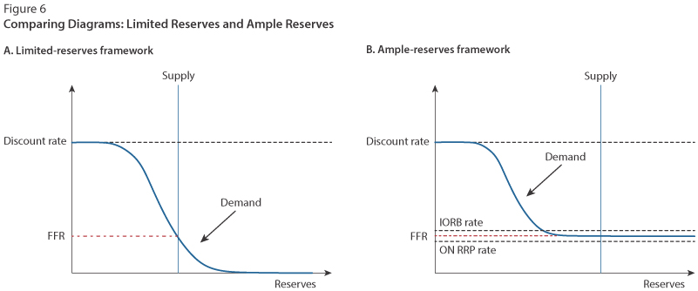
Limited Reserve vs. Ample Reserves

Slide 34
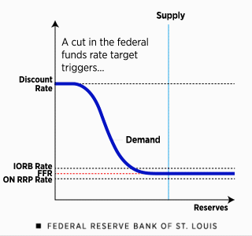
Expansionary Monetary Policy
Fed lowers the FFR by decreasing administered rates:
- Interest on Reserve Balances
- Overnight Reverse Repurchase Rate
- Discount Rate
Source: How the Federal Reserve Implements Monetary Policy

Slide 35
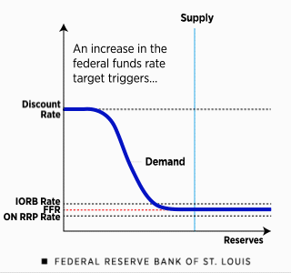
Contractionary Monetary Policy
Fed increases the FFR by increasing administered rates:
- Interest on Reserve Balances
- Overnight Reverse Repurchase Rate
- Discount Rate
Source: How the Federal Reserve Implements Monetary Policy

Slide 36
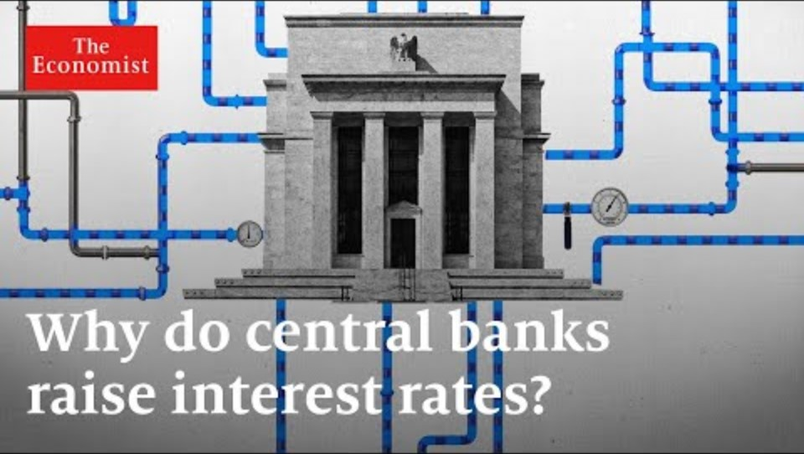

Slide 37
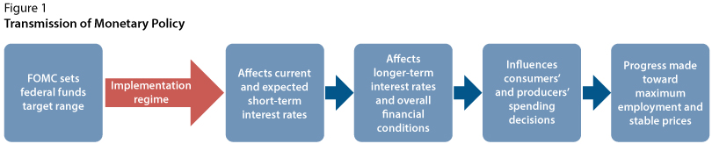
Transmission of Monetary Policy
Source: How the Federal Reserve Implements Monetary Policy

Slide 38
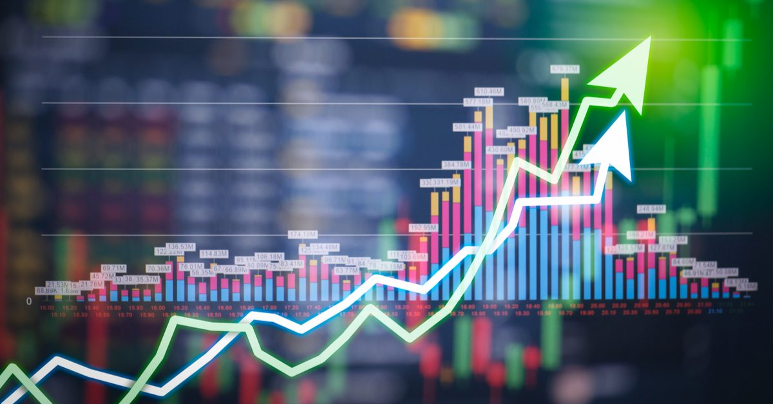
IV. Policy Impacts
IV. Economic Indicators
This Photo by Unknown Author is licensed under CC BY-NC

Slide 39
The Business Cycle: 1980- 2020
Notes:
The level of gdp at which all resources are fully employed (i.e. on the ppf)
Depends on the available supply of labor, human and physical capital, and technological progress
Actual- can fall short of potential

Slide 40
Real and Potential GDP Growth Rates

Slide 41
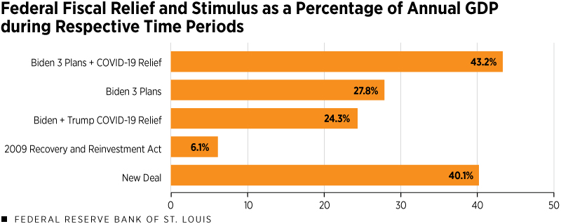
Fiscal Policy Comparisons
SOURCES: Bureau of Economic Analysis, Congressional Budget Office, "The Multiplier for Federal Spending in the States During the Great Depression" by Fishback and Kachanovskaya, the White House and author’s calculations.
NOTES: The respective periods used in these calculations are 1929 for the New Deal, 2006 for the Recovery and Reinvestment Act and 2019 for the remaining calculations. Fiscal costs for proposals not yet passed (i.e., the American Jobs Plan and the American Families Plan), are as initially proposed by the Biden administration.

Slide 42
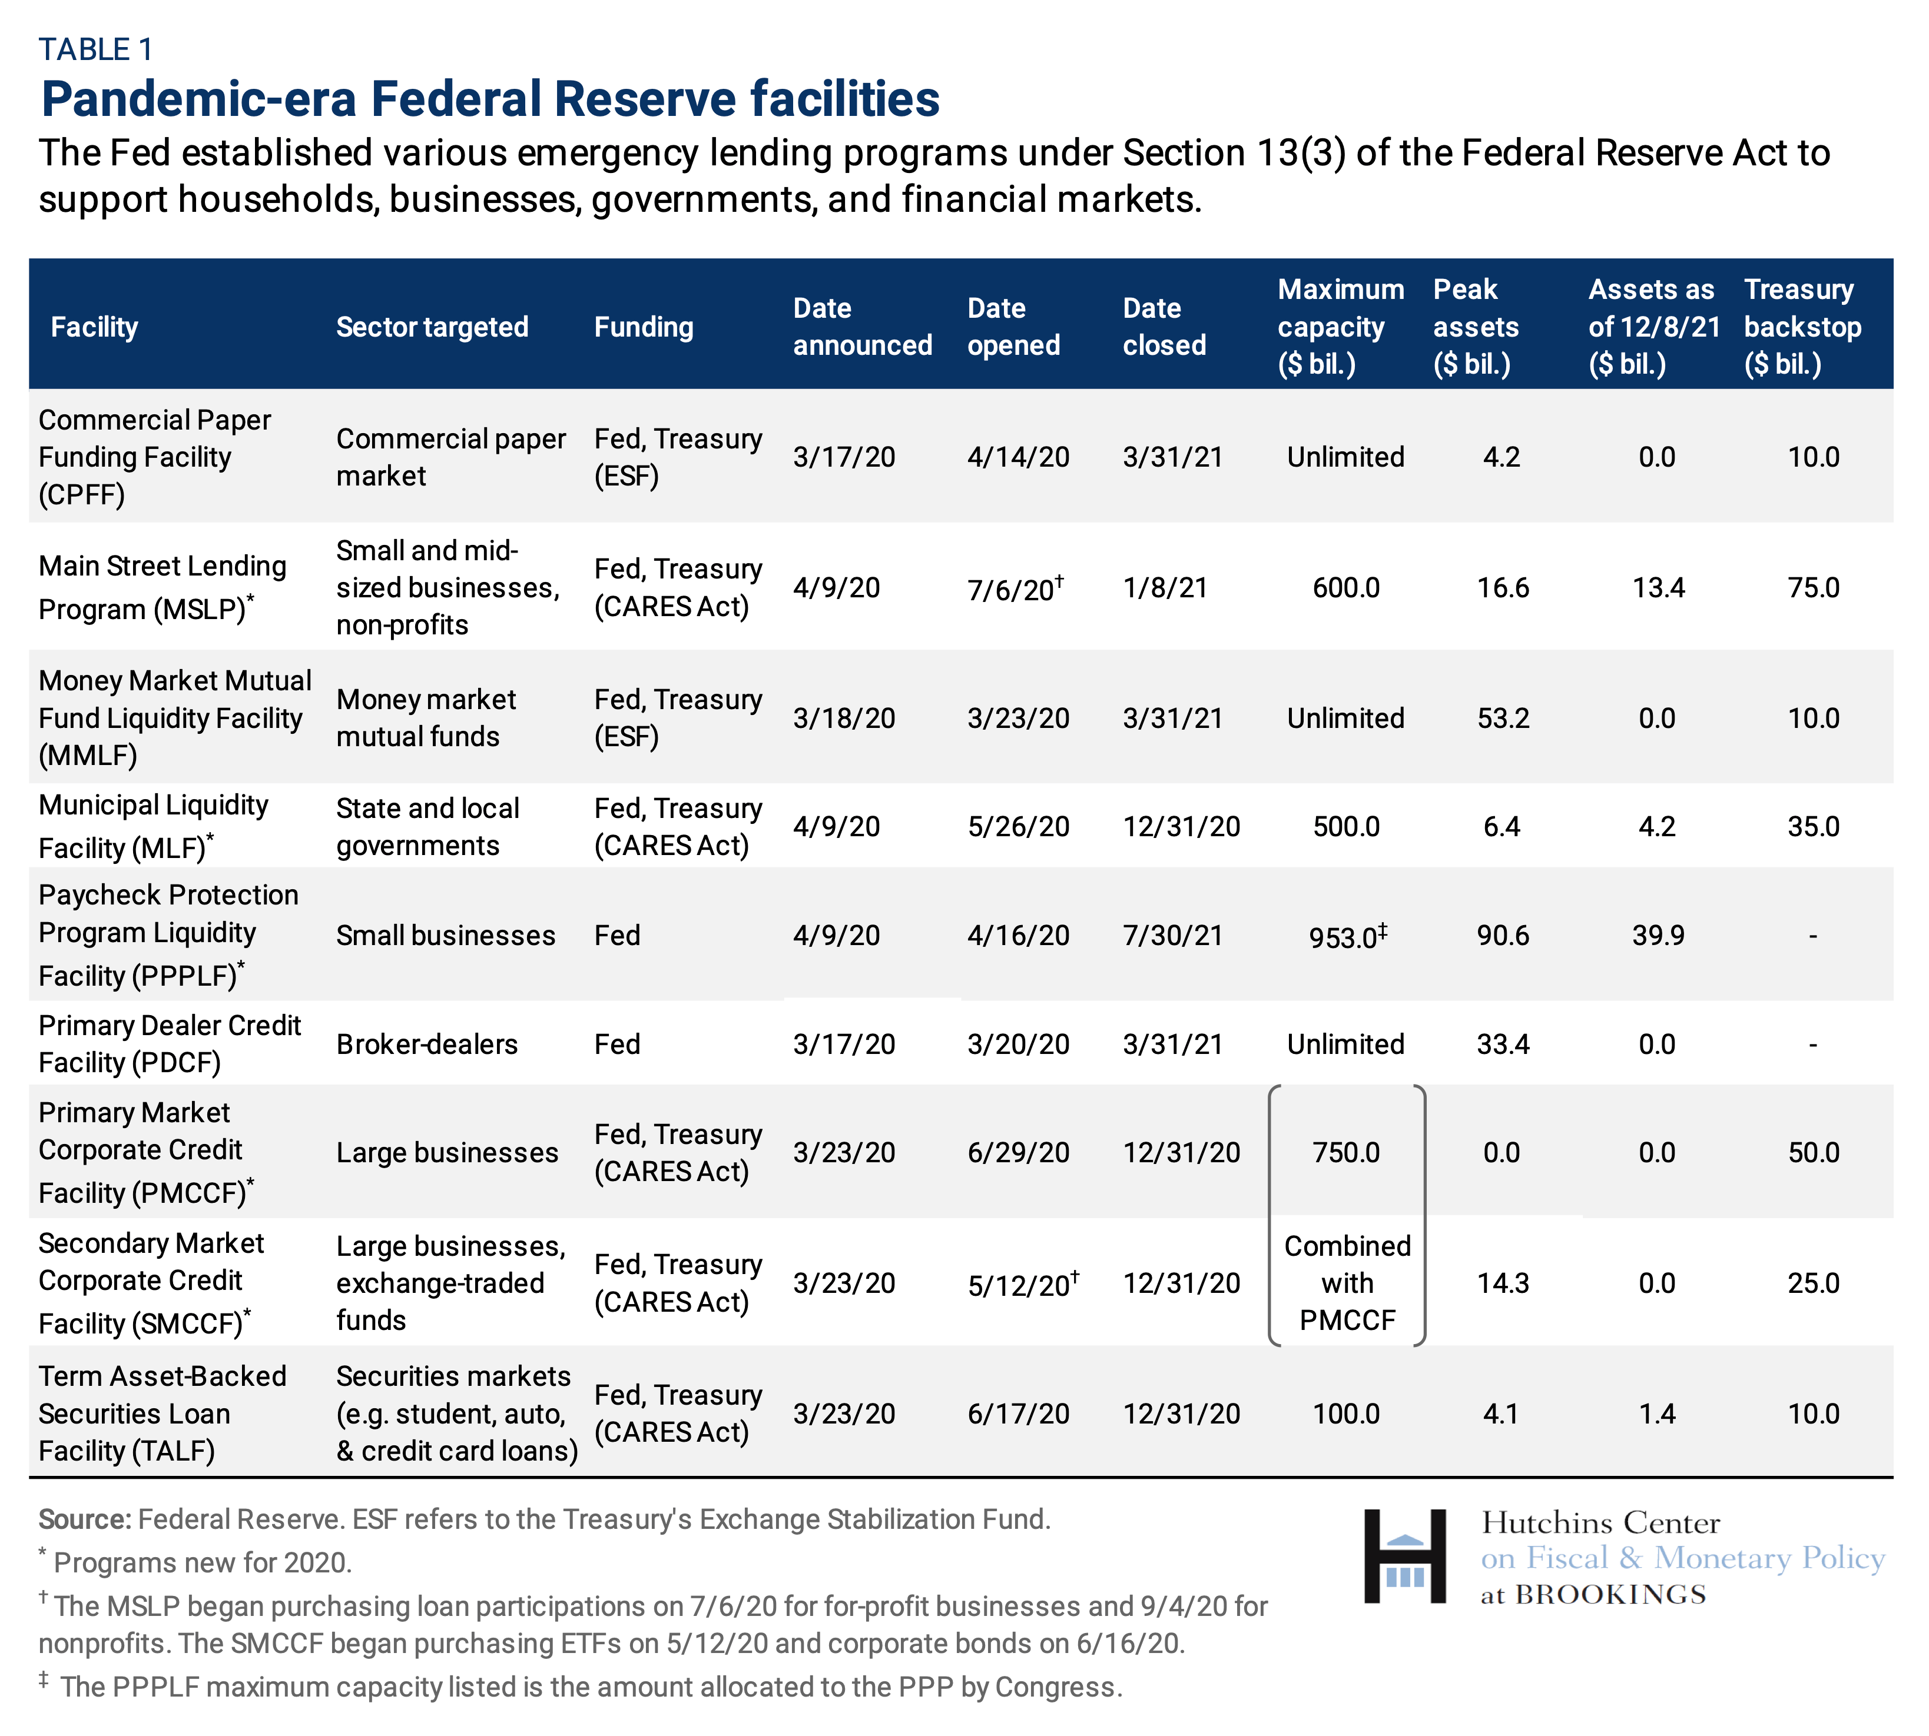
Fed’s Response to Covid-19 Crisis

Slide 43
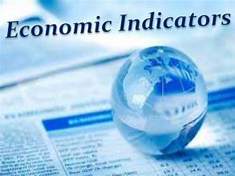
Top Ten Economic Indicators
Real GDP growth
Real GDI growth
Change in nonfarm payrolls
Unemployment rate
Inflation rate
Business confidence
Consumer confidence
Employment Cost Index
Stock market

Slide 44
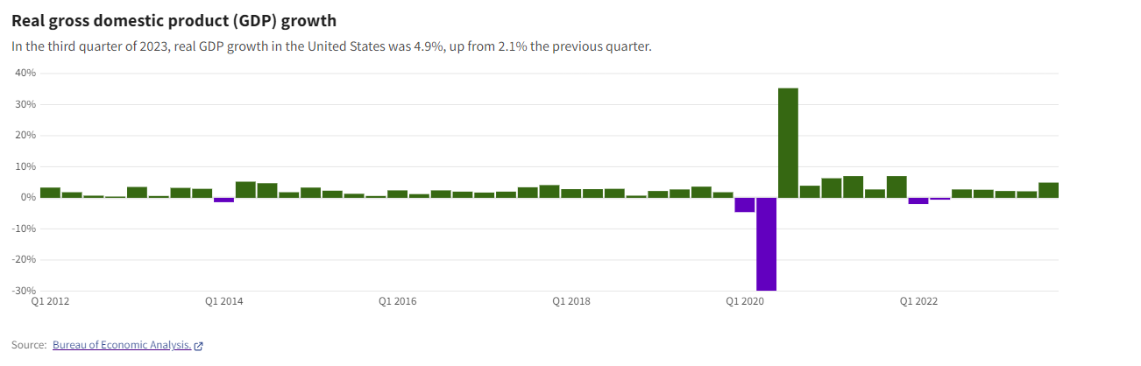
Real GDP Growth
Source: US Facts

Slide 45
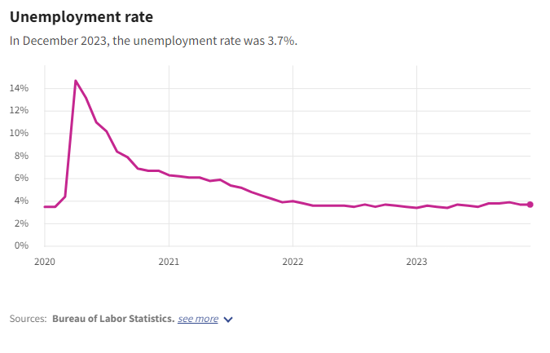
Unemployment Rate
Unemployment rate spiked to 14.7% in April 2020.
Unemployment rate has been under 4% since January 2022.
Source: US Facts

Slide 46
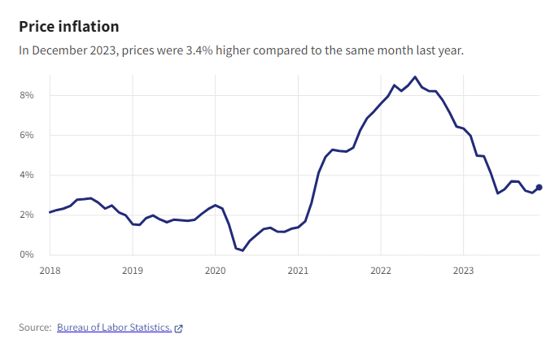
Inflation- CPI
Supply chain disruptions and pandemic stimulus contributed to the increase in inflation from 2021 through mid 2022.
Inflation has moderated but is still above Fed’s 2% target.
Source: US Facts

Slide 47
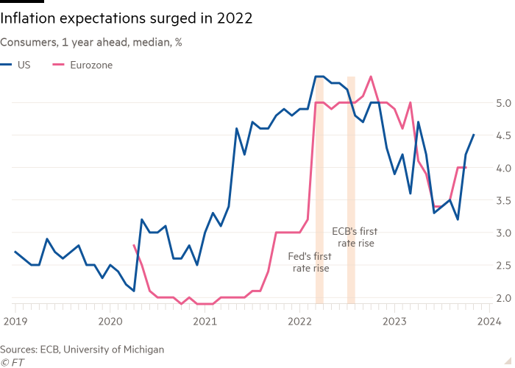
Inflation Expectations
Source: Financial Times

Slide 48
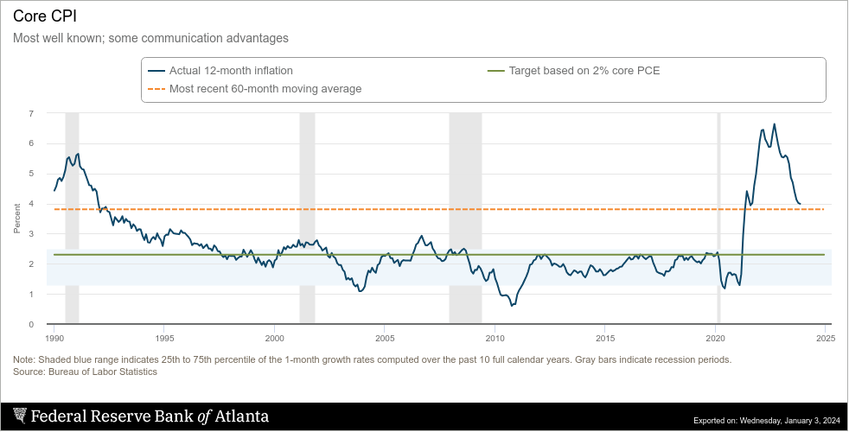
Core CPI Dashboard
https://www.atlantafed.org/research/inflationproject/underlying-inflation-dashboard

Slide 49
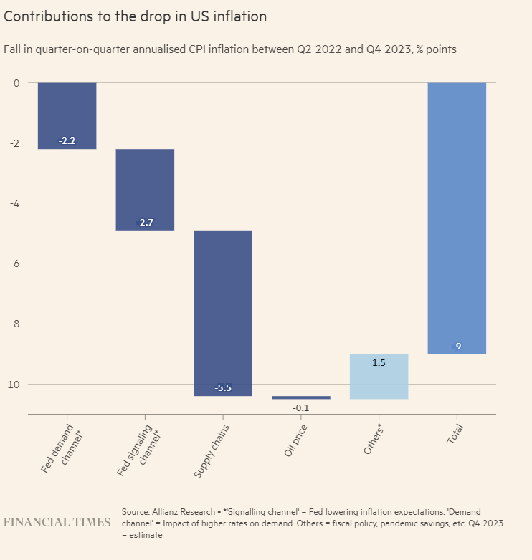
US Inflation

Slide 50
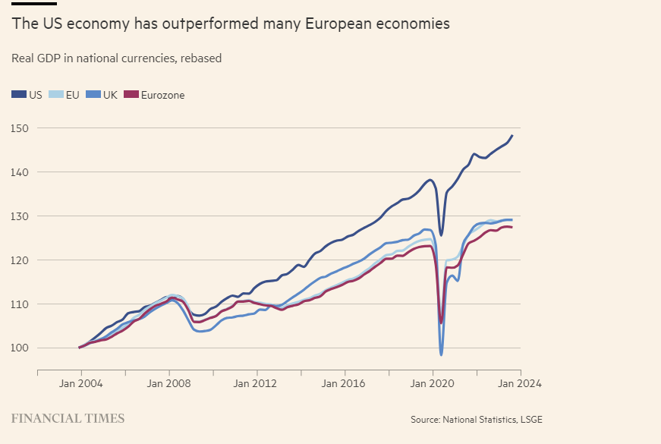
Comparison of United States and European Economies

Slide 51
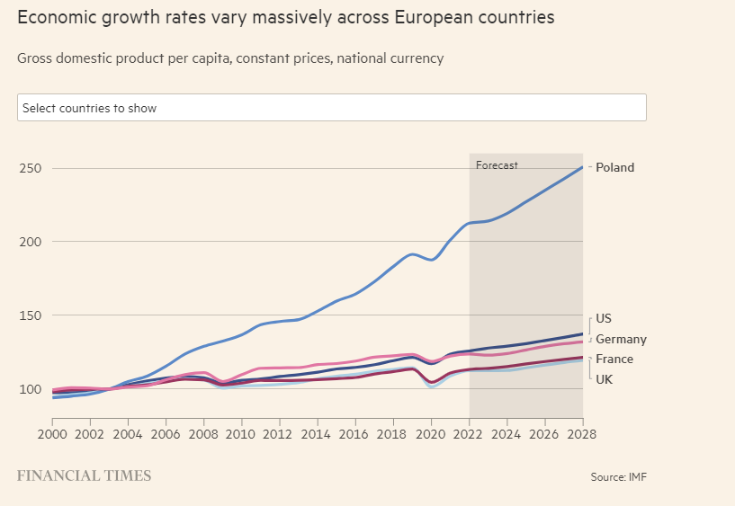
Economic Growth in Selected European Countries

Slide 52

V. GLOBALIZATION

Slide 53





Globalization
Increasing integration of economies, cultures, political institutions, and ideas across the world.

Slide 54
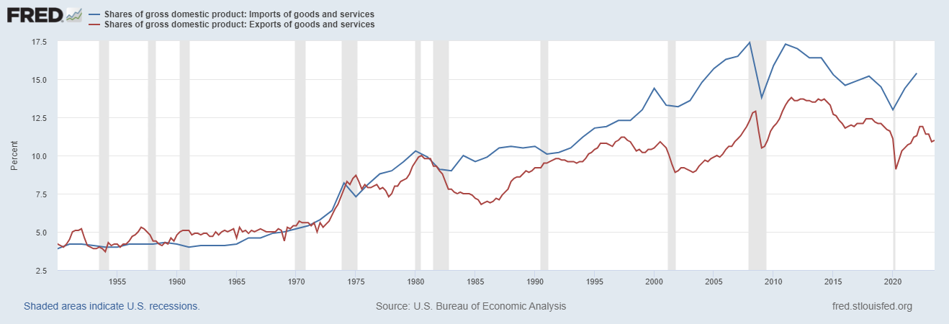
Exports and Imports as % of GDP

Slide 55
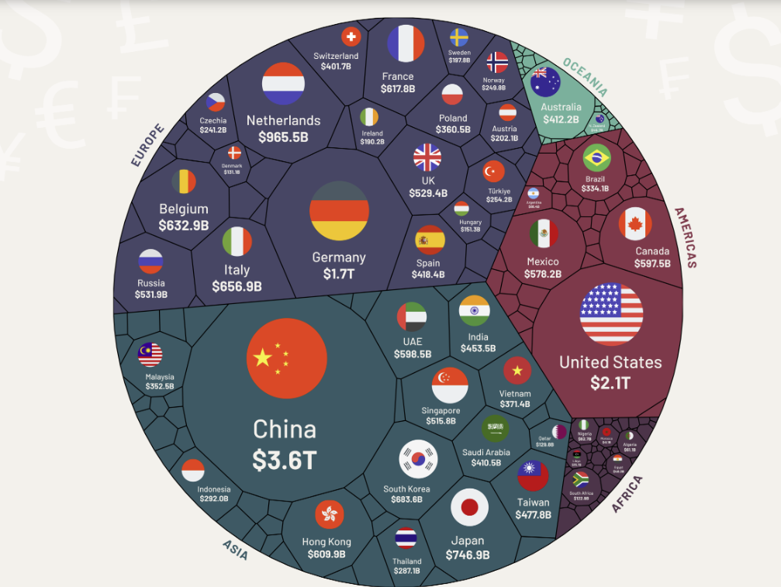
International
Trade
Top 11 countries export more than the rest of the world combined.
Top 11: $12.8 T
Rest of world: $12.1T
Source: All of the World’s Exports by Country in One Chart Visual Capitalist WTO data 7/8/23

Slide 56
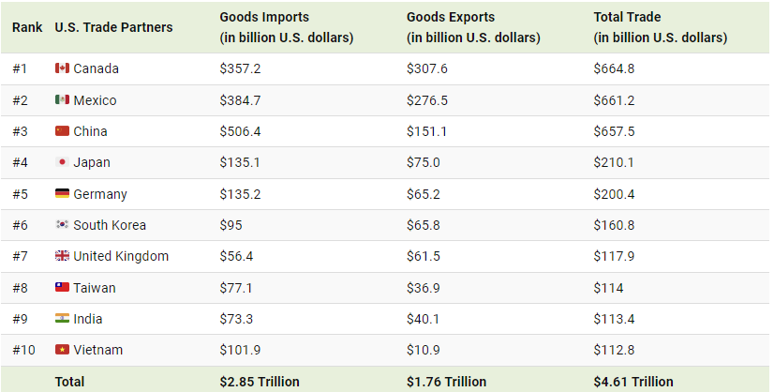
U.S. Trading Partners
Source: Visual capitalist 2021 data

Slide 57
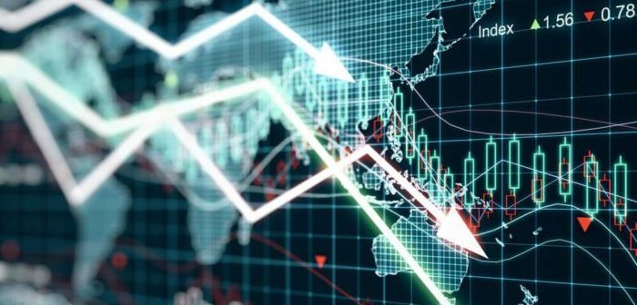
VI. EXCHANGE RATES

Slide 58
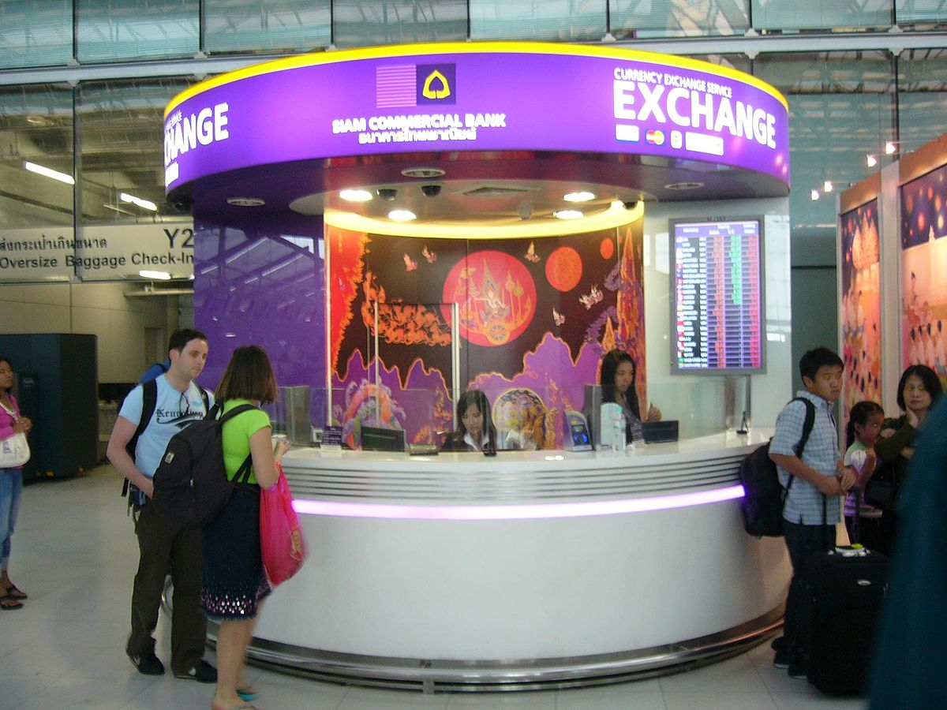
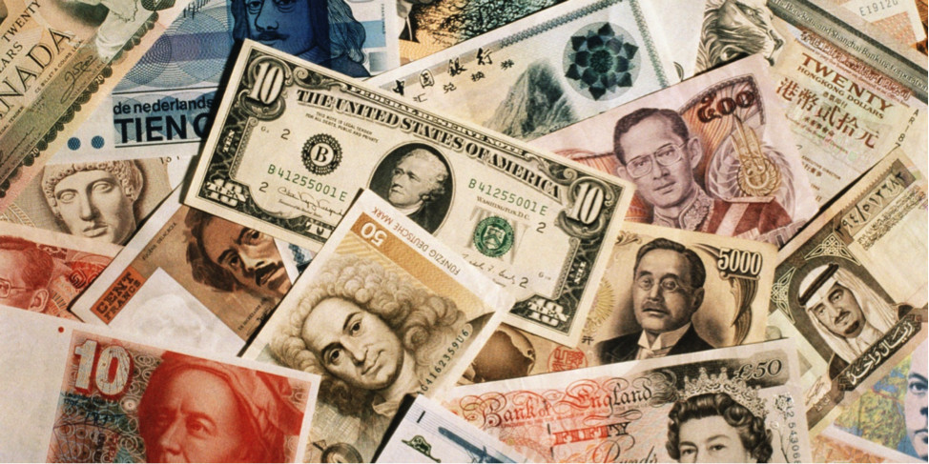
Exchange Rates
The price of one currency in terms of another country’s currency.
International trade and travel requires the purchase of money with money.

Slide 59
Exchange Rates
Facilitate international trade and travel.
Are determined in foreign exchange markets where individuals, businesses, and governments buy and sell currencies.
Fluctuate due to the changes in the demand for and the supply of currencies.
Influence the actions of importers and exporters.

Slide 60
Exchange Rate Regimes
Floating exchange rates: currency’s value determined by demand and supply. The government or central bank does not intervene to manipulate the value.
Fixed exchange rates: currency’s value is set by the government or central bank to achieve macroeconomic objectives.
Managed exchange rates: the currency’s value is allowed to fluctuate between a specific range to achieve macroeconomic objectives.
*In fixed and managed exchange rate systems, the government enters the FOREX market to buy or sell the currency to achieve the desired exchange rate.

Slide 61
Fluctuations in Exchange Rates
Appreciation- when a country’s currency increases in value relative to another country’s currency. Appreciation means the currency is stronger.
Depreciation- when a country’s currency decreases in value relative to another country’s currency. Depreciation means that the currency is weaker.

Slide 62
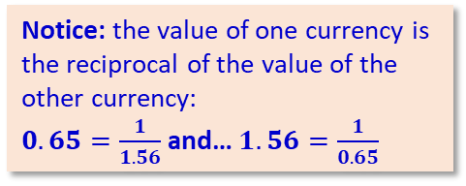
The Foreign Exchange Market
Exchange rates, or the “prices of currencies” are determined in a market, just like the price of anything else in a market economy. The market for a currency is known as the foreign exchange market, or, more simply, as the forex market. Consider the two Forex markets below:
₤/$
US$ in Britain
$/₤
British ₤ in the US
S$
S₤
Notice: the value of one currency is the reciprocal of the value of the other currency:
$0.65=\frac{1}{1.56}$and… $1.56=\frac{1}{0.65}$
0.65
1.56
D$
D₤
Q_{e}
Q$
Q_{e}
Q₤
DOLLAR MARKET
(price is number of £’s per $)
POUND MARKET
(price is number of $s per £ )
Source: Introduction to Exchange rates by Welker’s Wikinomics

Slide 63
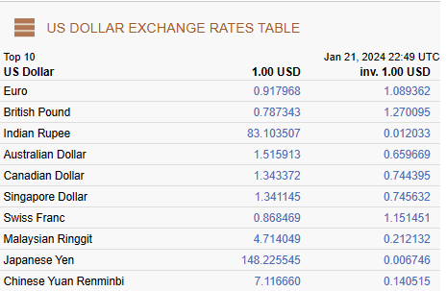
Calculating Exchange Rates
$1.00 = 0.917968€
1.00/0.917968 = 1 €
$1.089362 = 1 €
The value of one currency is always the reciprocal of the other currency’s value
Exchange Rate Table

Slide 64
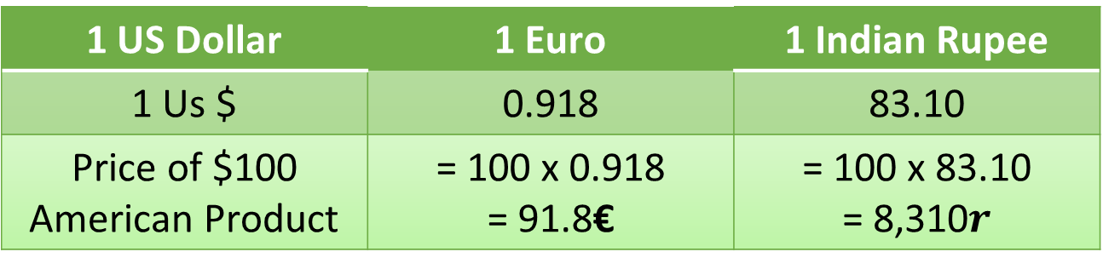
Calculating Prices Using Exchange Rates
1 US Dollar | 1 Euro | 1 Indian Rupee
1 Us $ | 0.918 | 83.10
Price of $100 American Product | = 100 x 0.918 = 91.8€ | = 100 x 83.10 = 8,310$r$
If the dollar appreciates, the price of the $100 product would go up for people who use the Euro. Ceteris paribus, dollar appreciation leads to a decrease in U.S. exports.
If the dollar depreciates, the price of the $100 product would go down for people who use the Euro. Ceteris paribus, dollar depreciation leads to an increase in U.S. exports.

Slide 65
Exchange Rates – Demand and Supply
₤/$
US$ in Britain
S$
DEMAND FOR $’S
British households, firms, banks, and the British government demand $ for international transactions.
SUPPLY OF $’S
American households, firms, banks, and the US government supply $’s for international transactions.
Note: At the same time, there is a market for the British pound. Here, Americans demand pounds and British supply pounds. The values on the y axis would be the reciprocal of the ₤/$ value on the y axis in the dollar market, that is “$/₤.”
0.65
D$
Q_{e}
Q$
Dollar Market

Slide 66
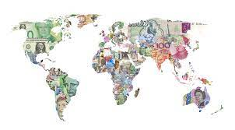
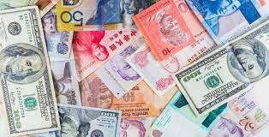
Determinants of Floating Exchange Rates
Tastes and preferences
Relative incomes
Relative prices
Relative interest rates
Speculation

Slide 67
Evaluating Changes in Exchange Rates
Example: Incomes in Great Britain rise, leading to an increase in demand for American goods
₤/$
US$ in Britain
$/₤
British ₤ in the US
S$
S₤
S_{₤1}
0.80
$ appreciates
0.65
1.56
₤ depreciates
1.25
D_{$1}
D$
D₤
Q_{e}
Q₁
Q$
Q_{e}
Q₁
Q₤
Dollar Market
British Pound Market
Demand for $’s shifts right; the $ appreciates. Supply of £’s shifts right; the £ depreciates.
Source: Welker’s Wikinomics

Slide 68
SOURCES
Page One Economics
https://research.stlouisfed.org/publications/page1-econ/2020/08/03/the-feds-new-monetary-policy-tools
Teaching the New Tools of Monetary Policy
https://www.stlouisfed.org/education/teaching-new-tools-of-monetary-policy
Economist – you tube- how does raising interest rates control inflation
https://www.youtube.com/watch?v=R8VBRCs2jTU
Feds Response to Covid
https://www.brookings.edu/articles/fed-response-to-covid19/
Fiscal Interventions
https://www.stlouisfed.org/publications/regional-economist/third-quarter-2021/how-recent-fiscal-interventions-compare-new-deal
Monetary Policy Strategies of Major Central Banks
https://www.federalreserve.gov/monetarypolicy/monetary-policy-strategies-of-major-central-banks.htm
BEA GDP
https://www.bea.gov/data/gdp/gdp-state
USA FACTS
https://usafacts.org/topics/economy/#what-is-the-current-state-of-the-us-economy
Financial Times
FRED
https://fredblog.stlouisfed.org/2021/05/savings-are-now-more-liquid-and-part-of-m1-money/
https://fred.stlouisfed.org/graph/?g=f1cZ
Brookings- Hutchinson Center
https://www.brookings.edu/wp-content/uploads/2021/02/potential-GDP-fig-3-1.png
Marginal Revolution University
https://mru.org/
Planet Money
https://www.npr.org/sections/money/
Visual Capitalist
https://www.visualcapitalist.com/

Slide 69
Thank you!
Any questions?

