Slide 1
Lesson: Product Differentiation + Advertising
Check In: Shoes
Warm Up: Wings Video
Background: Product Differentiation Defined
Overview of Product + Examples
Group Task Work

Slide 2
If you could only take 1 pair of shoes on your next vacation, which would you take and why?
Let’s Connect:
SEL

Slide 3
Background: Product Differentiation
Monopolistic Competition
Relatively large number of firms
Ease of entry and exit
Advertising
Differentiation
Example Industries: Shoes and Restaurants

Slide 4
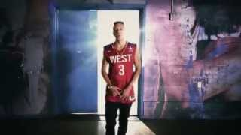
Music Media about Product Differentiation
What words in this song explain the impact of product differentiation and market power?

Slide 5
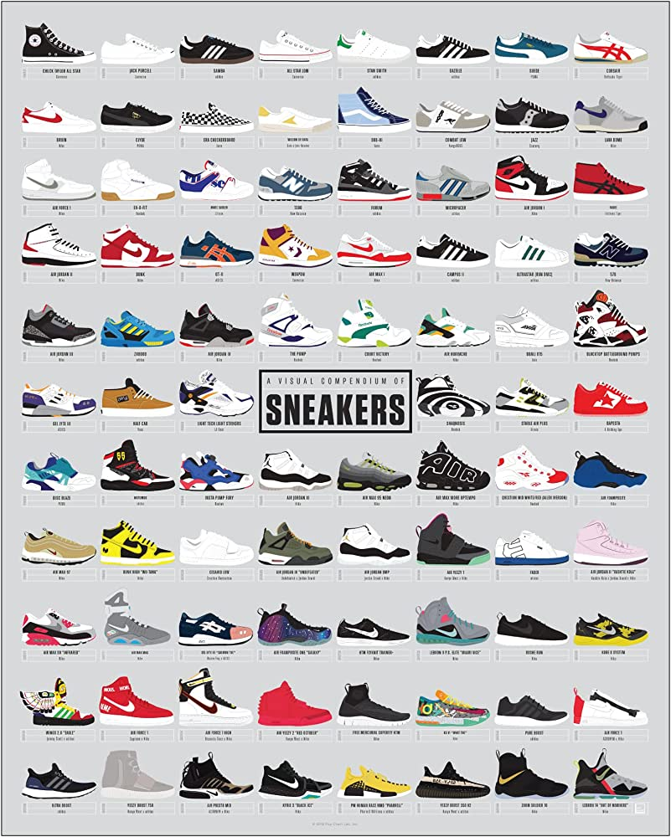
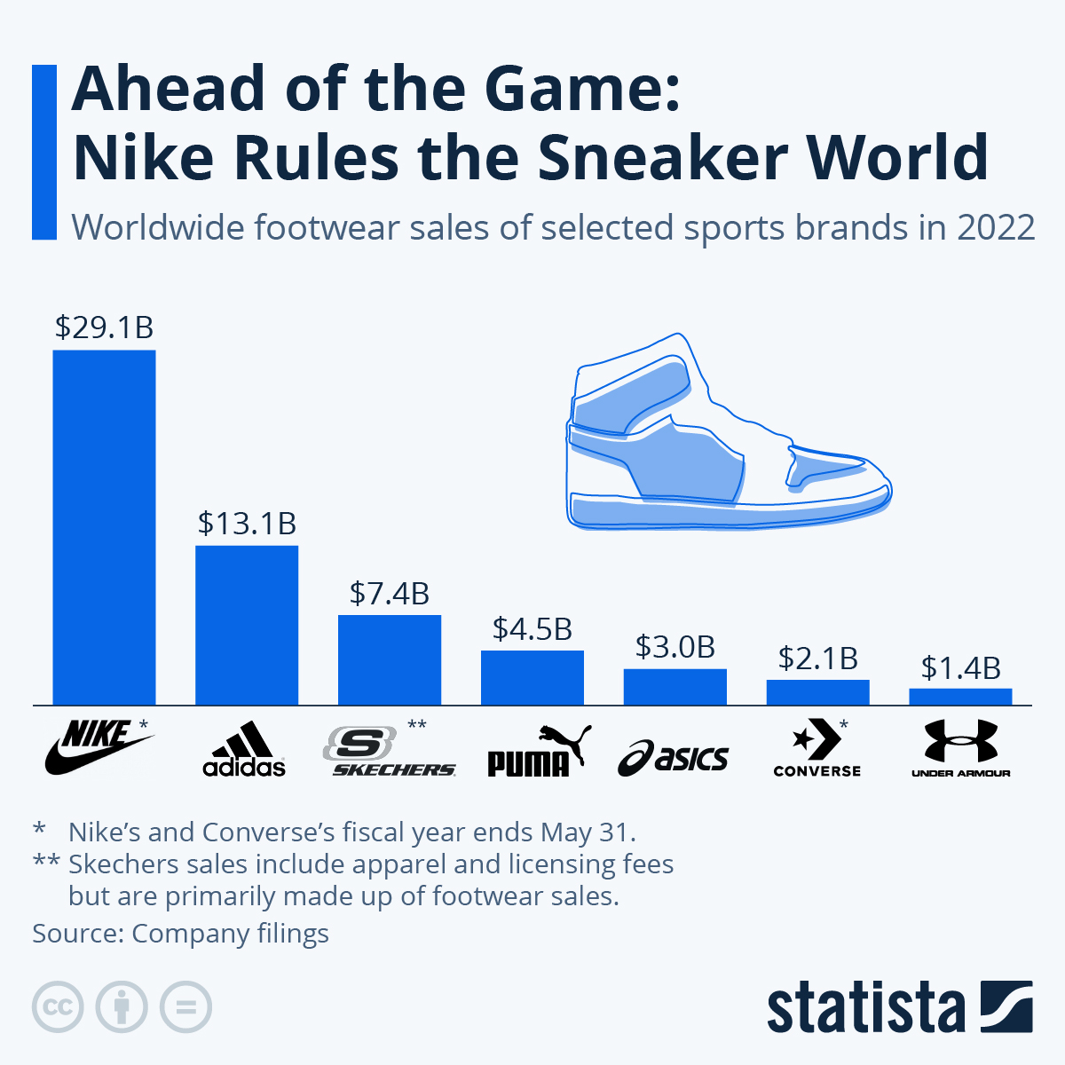
Media Connection

Slide 6
Look around and see if you can find anyone in the class wearing the same shoes as you.
Classroom Check In
What type of shoes are you wearing right now?

Slide 7
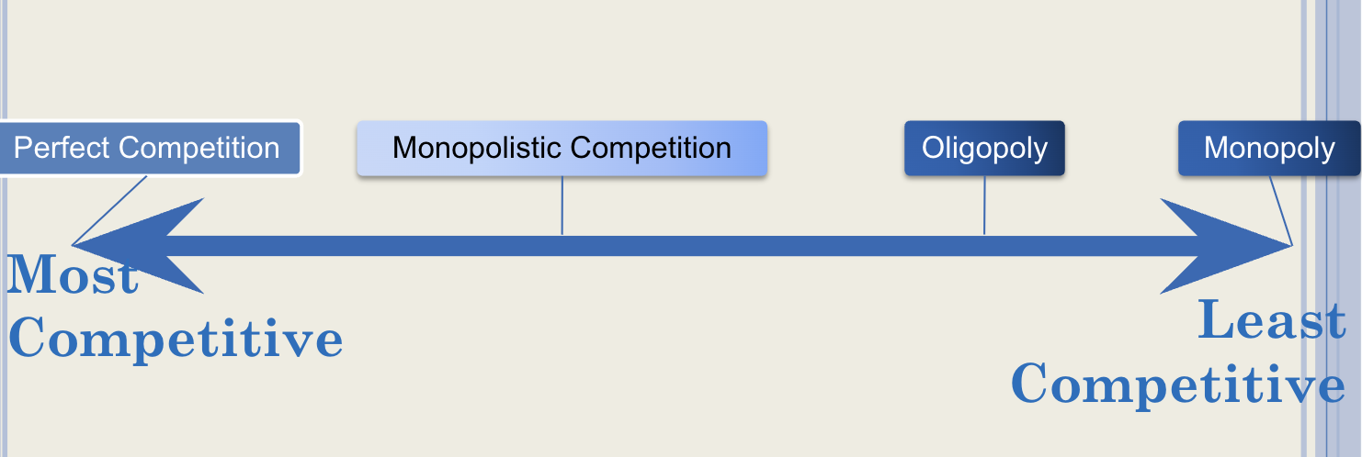
Background Product Differentiation
Product Differentiation
ways that companies make their product unique
What feature do your shoes offer?
function, style, comfort, price
objective: to give more market power

Slide 8
Group Designing Challenge
Product Differentiation: Design and Advertise a Shoe

Slide 9
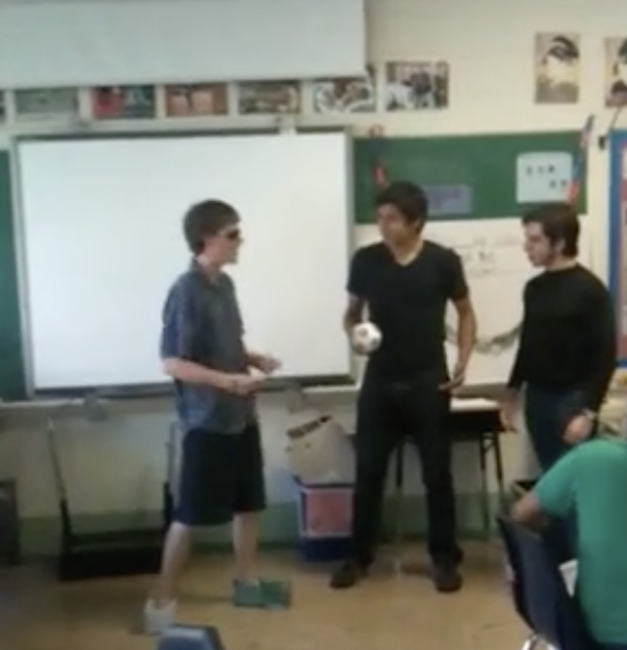
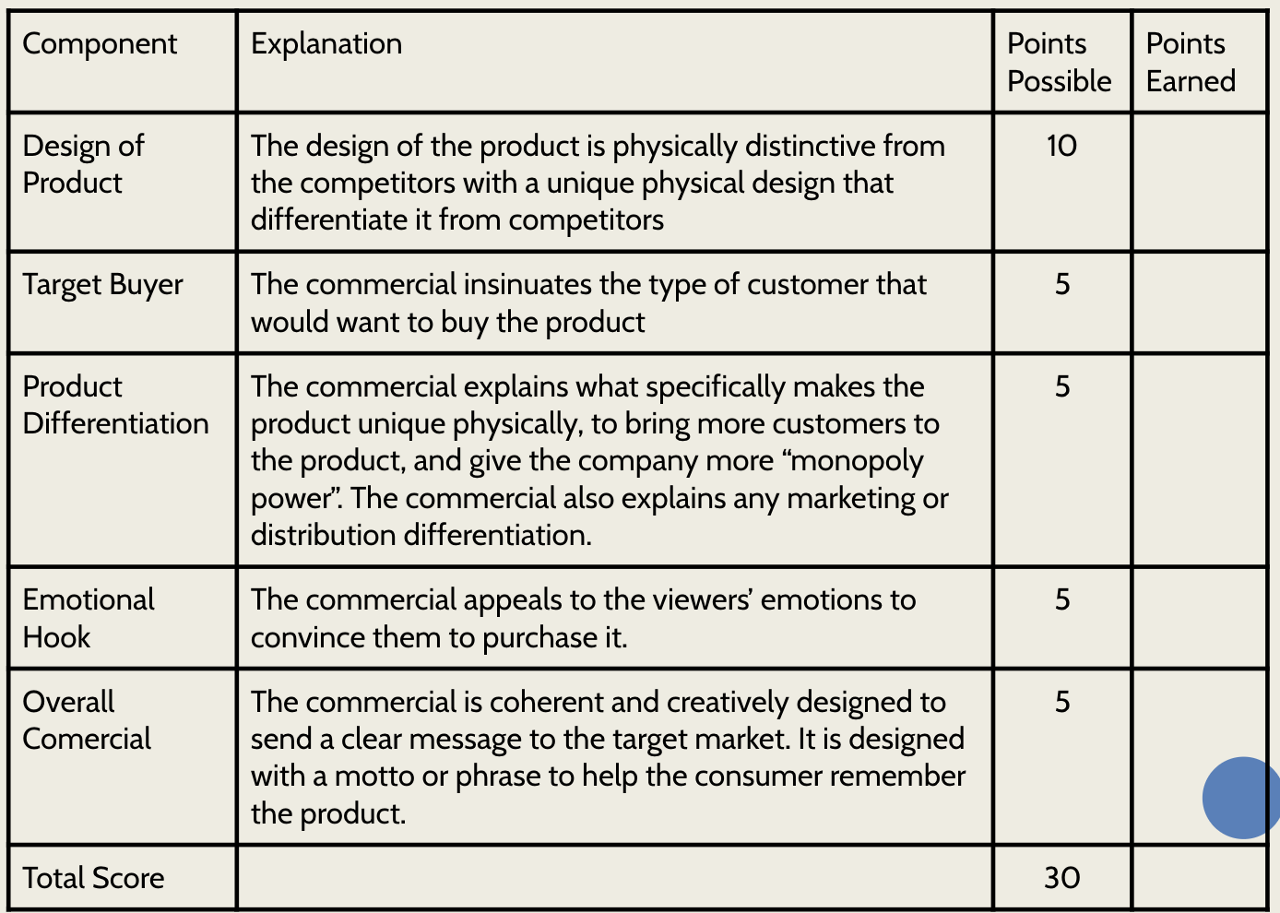
Design Your Shoe!
First Iteration
Zane's Rap (2011)

Slide 10
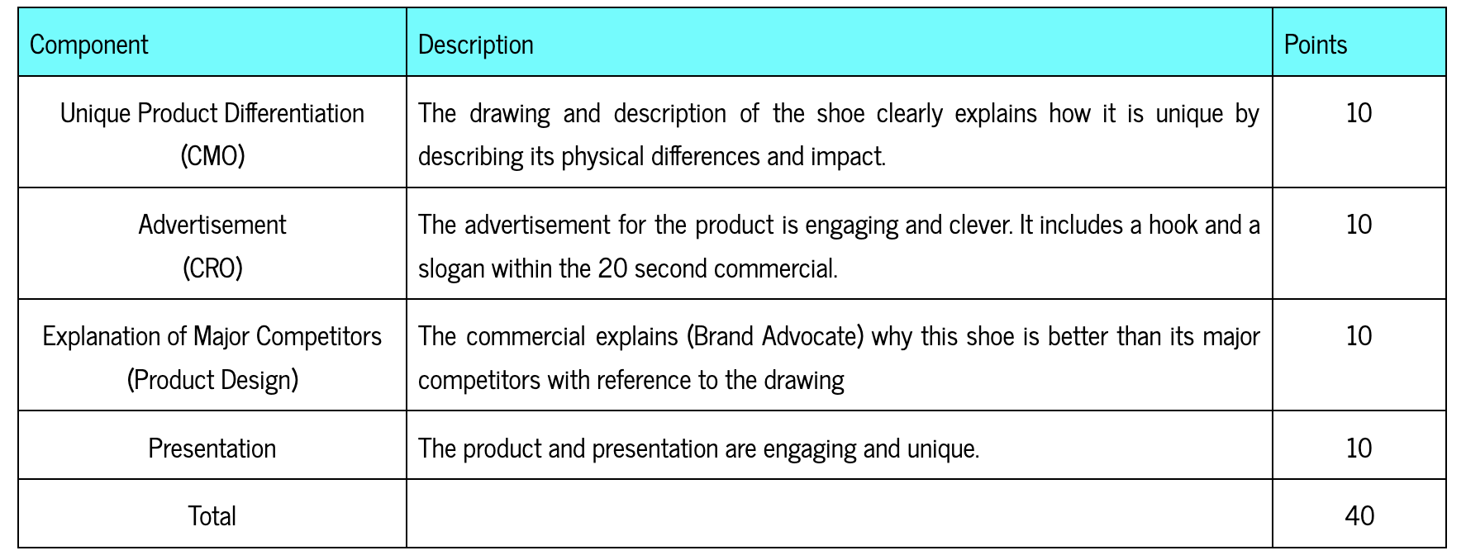
Overview
Your group is hired to design a shoe that is differentiated and advertise it in a short commercial.
Decide your role, then brainstorm and design the shoe.
Brainstorm and write your commercial.

Slide 11
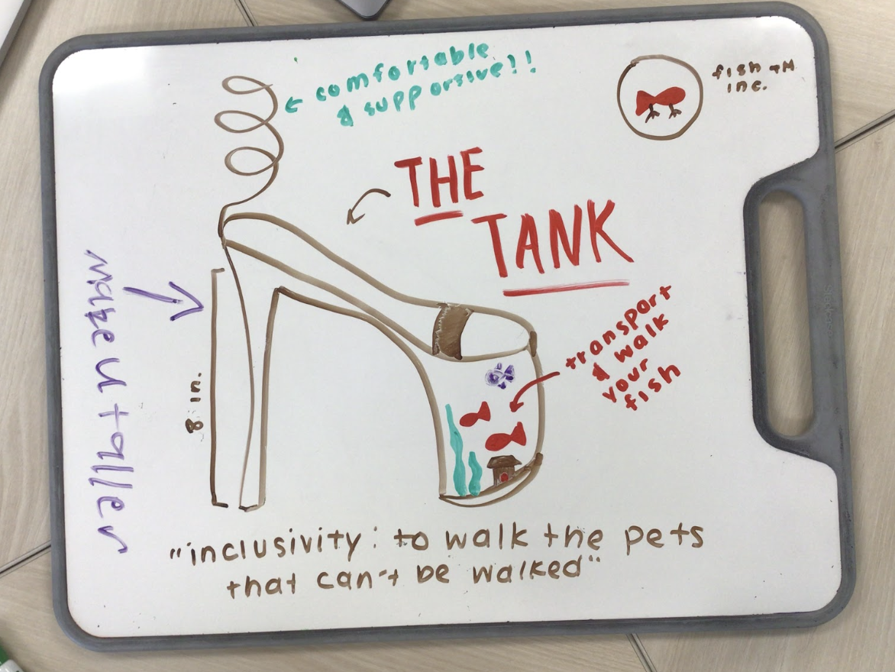
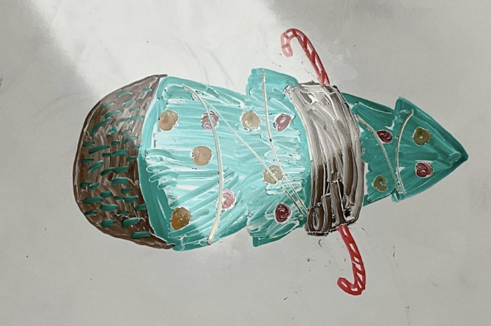
Example Products

Slide 12
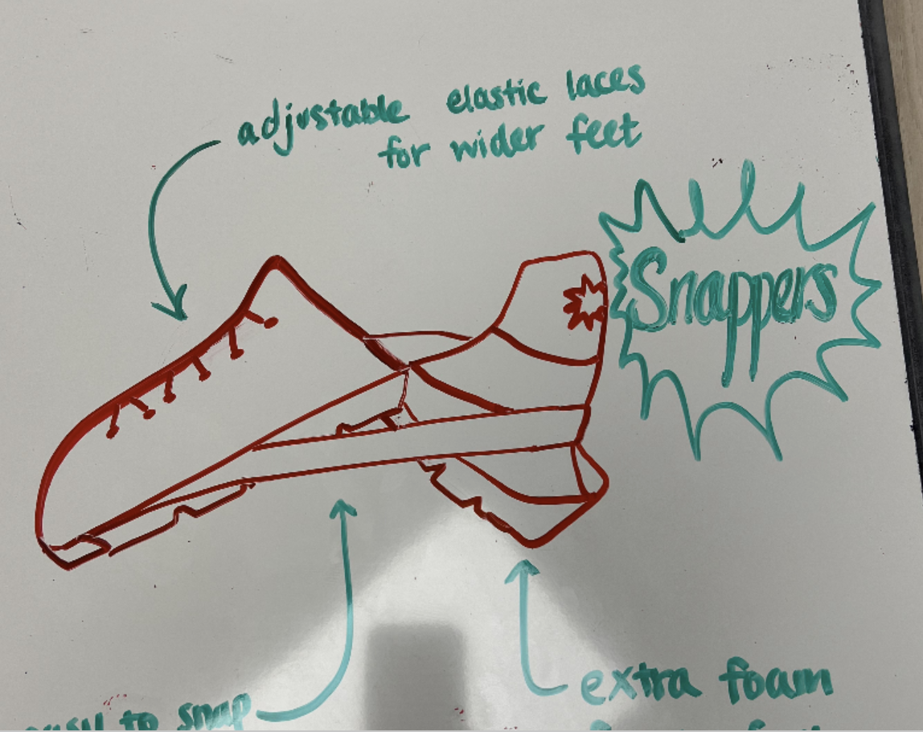
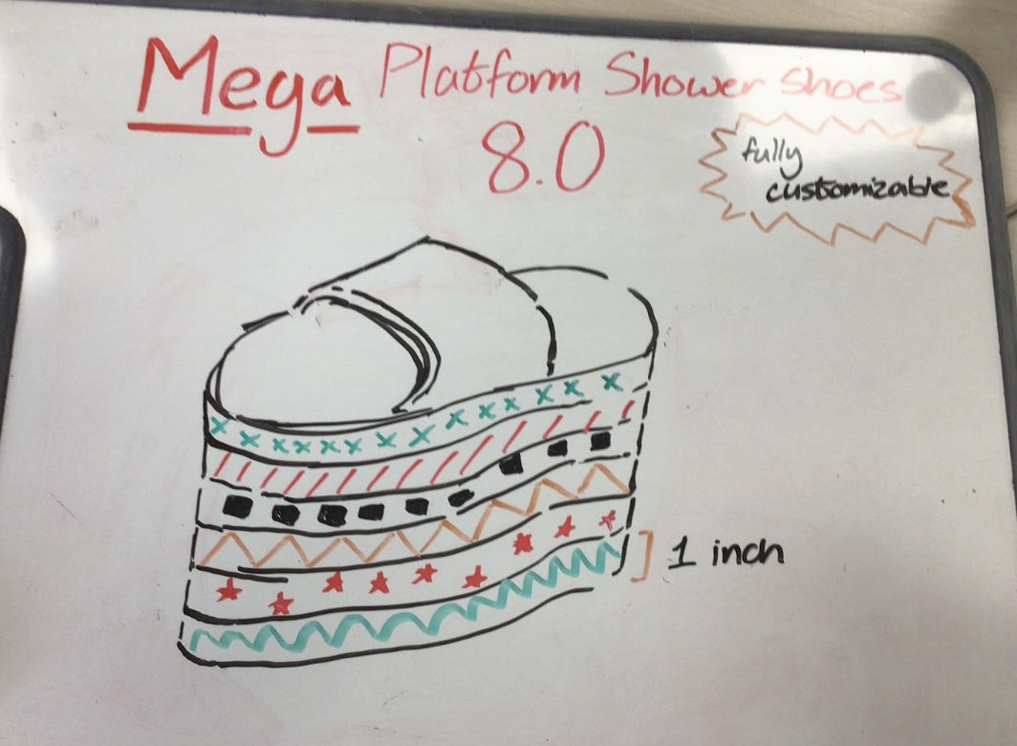
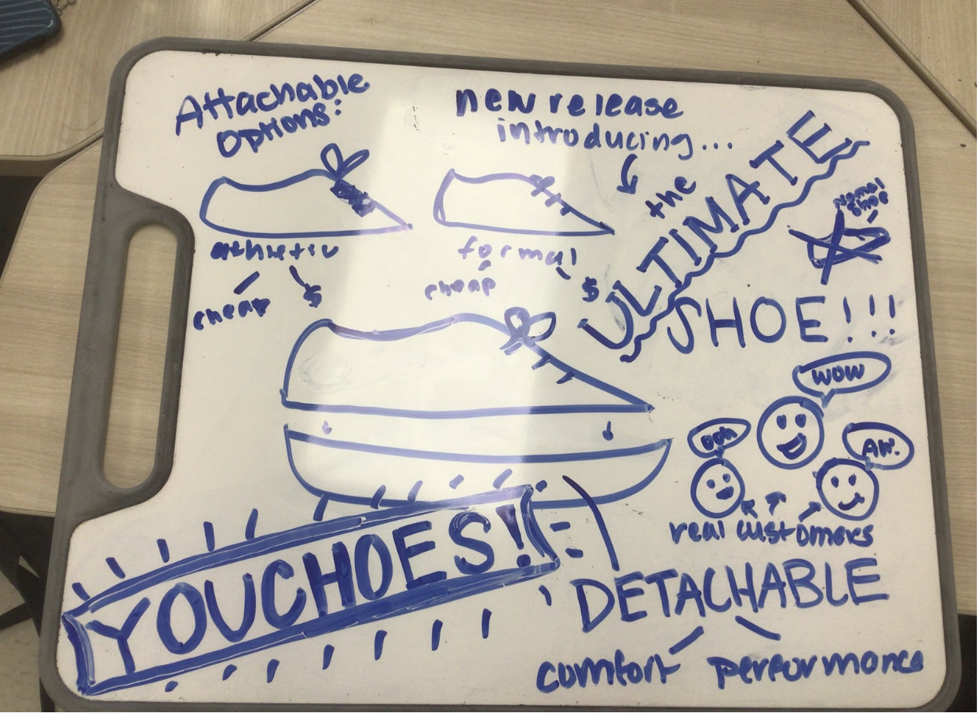
Example Products

Slide 13
Rest of Class
Decide your roles.
Brainstorm your target audience and unique traits of your shoe.
Design your shoe.
Brainstorm your commercial.
Write your commercial.
Practice your commercial.

