Slide 1


How Do Information
and Ethics Impact
Decision Making?
Chandler Jordan
South Carolina Council on Economic Education
Chandler.Jordan@moore.sc.edu

Slide 2
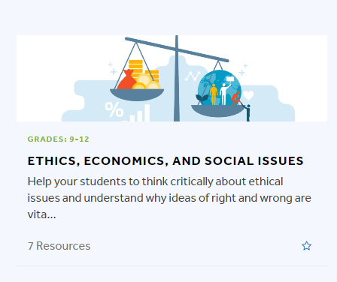

Available NOW on EconEdLink
Ethics, Economics, and Social Issues

Slide 3
Lesson Breakdown
    Lesson Name Author Webinar
Do Businesses Have a Social Responsibility? Chris Cannon On-Demand
Can you Conduct Research Ethically? Matt Pierson
How does Information and Ethics Impact Decision Making? Chandler Jordan
Is Efficiency Ethical? Stephen Day On-Demand
Should I Join the Sweatshop Boycott? Stephen Day May 10, 2023
Does Self-Interest Prevent Economic Justice? John Kruggel
Can You Allocate Ethically? Chandler Jordan April 19, 2023
Should We Allow a Market for Transplant Organs? Jamie Wagner April 26, 2023
Should We do Something About Income Inequality? Chris Cannon
What is the Most Ethical Way to Fund Public Schools? Matt Pierson
Should We House the Homeless? John Kruggel
What Can We do About Pollution? Stephen Day
Can You be Fashionable and Ethical? Jamie Wagner
Should Private Companies Operate Prisons? Chris Cannon
How Can I Apply Ethics to Any Issue? Jamie Wagner
HIGHLIGHTED lessons available NOW!

Slide 4
Authors, Contributors, and Editors
Project Manager and Editor
  Dr. Jamie Wagner
    Associate Professor of Economics and Director of the Center for Economic Education, University of Nebraska at Omaha
Curriculum Authors
  Dr. Chris Cannon
    Associate Director and Chief Program Officer, Georgia Council on Economic Education
  Dr. Stephen Day
    Director, VCU Center for Economic Education
  Ms. Chandler Jordan
    Program Director, South Carolina on Economic Education
  Mr. John Kruggel
    Director, James Madison University Center for Economic Education
  Mr. Matt Pierson
    Social Studies and Economics Instructor, Omaha Bryan High School
  Dr. Jamie Wagner
    Associate Professor of Economics and Director of the Center for Economic Education, University of Nebraska at Omaha
Curriculum Editors
  Dr. Jennifer Davidson
    President, Nebraska Council on Economic Education and Associate Professor of Practice, University of Nebraska –Lincoln
  Ms. Ruth Cookson
    Senior Director of Educational Content, Council for Economic Education

Slide 5



Thank You Sponsors!

Slide 6
How Do Information
and Ethics Impact
Decision Making?

Slide 7
Description and Objectives
Students will play the roles of doctors and patients, demonstrating the motives of self-interest, duty, and character in economic transactions. By experiencing first-hand how the lack of asymmetric information can impact choice, students will then have the opportunity to see how new information would alter their decision making. After the role play, students will see how an ethical framework can impact decision making and have the opportunity to apply this learning across multiple professions.
After completing this lesson students will be able to:
investigate how access to information can impact a person's decision making.
explain how asymmetric information can affect someone's fiduciary responsibility.

Slide 8
Standards
Voluntary National Content Standards in Economics
Standard 4: Incentives
  People usually respond predictably to positive and negative incentives.
Standard 7: Markets and Prices
  A market exists when buyers and sellers interact. This interaction determines market prices and thereby allocates scarce goods and services.

Slide 9
Key Terms
Decision making is reaching a conclusion after considering alternatives and their results.
Asymmetric information is when one party has more information than the other.
Incentives are something that motivates or encourages one to do something.

Slide 10

Doctors and Patients: Round 1
Select 3 students to play the role of Doctor A, Doctor B, and Doctor C for Round 1.
All other student will play the part of a patient in Round 1.

Slide 11
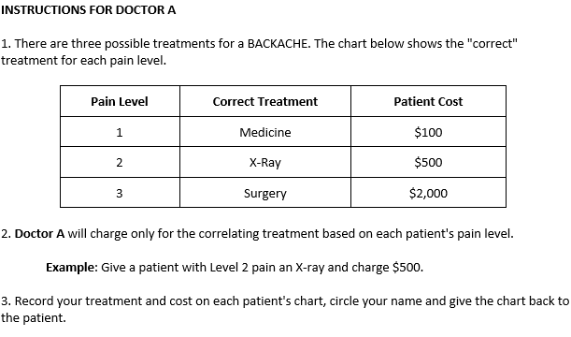
Instructions for Doctor A

Slide 12
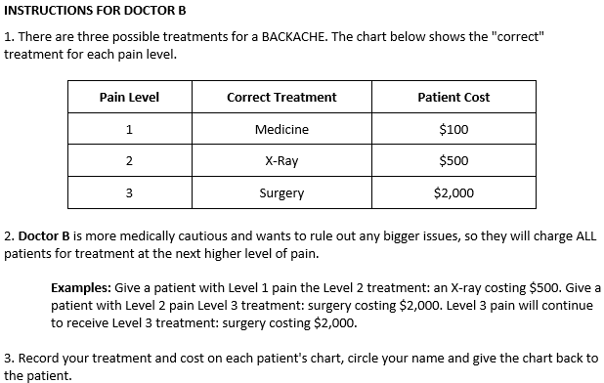
Instructions for Doctor B

Slide 13
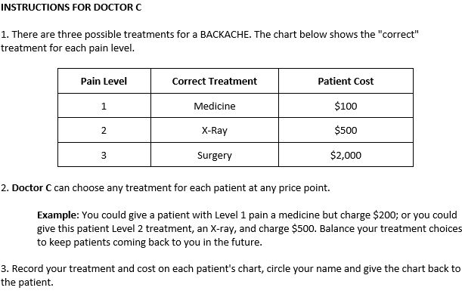
Instructions for Doctor C

Slide 14
Patient Symptom Chart
PATIENT CHART
1. Patients: You are suffering from a BACKACHE with the pain level shown below.
Present this chart to a doctor for treatment.
Pain level: (Low) 1 2 3 (High)
2. Doctor: A. Circle ONE Treatment: Medicine X-ray Surgery
B. Patient Financial Responsibility: $__________
C. Circle your name: Dr. A Dr. B Dr. C
3. Patients: After visiting the doctor, please turn this sheet in to the record keeper.

Slide 15

Round 1: Patients visit a Doctor
Position the doctors around the room so that there is space for patients to line up and visit their doctor.
Randomly assign patients to the doctors in roughly equal numbers.
Doctors will examine each patient’s chart and fill in treatment and cost based on the instructions given.

Slide 16
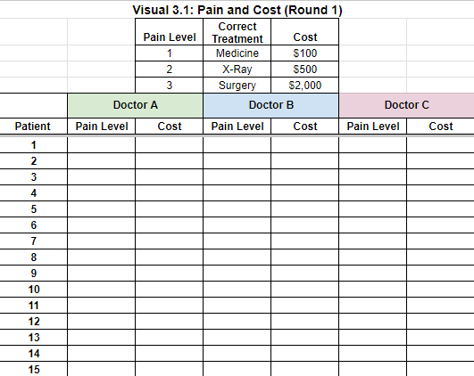
Pain and Cost Spreadsheet
Once a patient has their chart filled in, they will bring their charts to you, the record keeper, where you will fill in the pain level and cost information on the provided spreadsheet and ask students to return to their seats.
*DO NOT* display the spreadsheet until you have filled on all the data.

Slide 17
Round 1: Discussion Questions
How was your interaction with your doctor?
    Raise your hand if you’re happy with your result.
    Raise your hand if you are not happy with your result.
Do you think the doctor prescribed the appropriate treatment plan for you given your pain?
Do you think you everyone was treated the same? Why or why not?

Slide 18
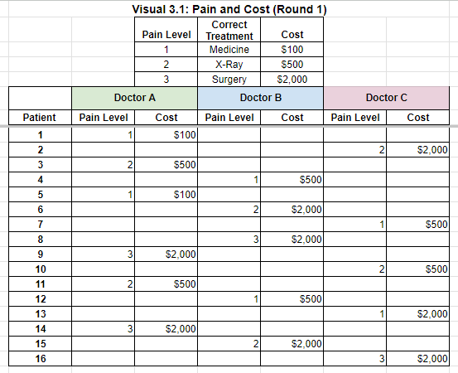
Round 1: Pain and Cost Spreadsheet

Slide 19
Information and Decision Making
Did you notice that there was asymmetric information, or a difference in information, during the activity?
Compared to doctors, how much do patients know about the correct treatments for backaches?
How can patients get better information?
What search costs (the time, energy, and money it takes to engage in a transaction) do patients have when they are in pain and seeking medical advice?
If insurance is paying 95 percent of your cost, are there any incentives to get pricing information?
How transparent (consumers can see what other patients are paying for similar services) are the transactions in a doctor’s office, in terms of treatments ordered and prices charged?

Slide 20
Duty-based Ethics
A moral philosophy that discerns right or wrong based on the analysis of one’s obligations.
Doctors (and many other professions) must follow a code of ethics. Following ethical guidelines is key to a doctor’s job and to the health and well-being of their patients.
Doctors practice duty-based ethics by being cautious about their actions, what procedures they suggest and perform, and the end result of the patient.
Additionally, doctors are highly concerned with making decisions that are right or wrong and work hard to make sure they operate in a way to not harm patients.
As a culminating event in their licensing, doctors must take the Hippocratic Oath.

Slide 21
Summary of Hippocratic Oath
The physician pledges to prescribe only beneficial treatments, according to his abilities and judgment;
to refrain from causing harm or hurt;
and to live an exemplary personal and professional life
We mostly know the Hippocratic Oath as an oath to do no harm to a patient which is true, but it focuses on acknowledging the patient as a whole person and understanding that the decisions they make for the patient can have long-term impacts.

Slide 22
Hippocratic Oath
How does the Hippocratic Oath, an oath of ethics historically taken by physicians to treat the ill to the best of their ability, preserve patient’s privacy, and to teach the next generation, incentivize doctors?
Did Dr. A or Dr. B fail to follow the Hippocratic Oath?
If there was no Hippocratic Oath, how might doctors act differently?

Slide 23
Fiduciary Responsibility
The fiduciary responsibility of a doctor is to act in the best interest of the patients and treat them with the best care they can provide.
Fiduciary responsibility means a person or organization acts on behalf of another person or persons, putting their interest ahead of their own.
The Hippocratic Oath holds doctors to this level of responsibility.

Slide 24
Doctors and Patients: Round 2
Select 3 new students to play the role of Doctor Mary, Doctor Jorge, and Doctor Taylor for Round 2.
All other student will play the part of a patient in Round 2.

Slide 25

Instructions for Doctors: Round 2
Assign the new Doctors the same Doctor A, B, and C roles from Round 1 at random and position them in different areas of the room.

Slide 26
Patient Symptom Chart
PATIENT CHART
1. Patients: You are suffering from a BACKACHE with the pain level shown below.
Present this chart to a doctor for treatment.
Pain level: (Low) 1 2 3 (High)
2. Doctor: A. Circle ONE Treatment: Medicine X-ray Surgery
B. Patient Financial Responsibility: $__________
C. Circle your name: Dr. A Dr. B Dr. C
3. Patients: After visiting the doctor, please turn this sheet in to the record keeper.

Slide 27
Round 2: Patients visit a Doctor
Start by having only one patient visit each doctor.
Doctors will examine each patient’s chart and fill in treatment and cost based on the instructions given.
Immediately record their pain level and cost each doctor chargers on the Pain and Cost Round 2 spreadsheet and project the information for all students to see.
Allow the remaining students to select their own doctor they want to visit.

Slide 28
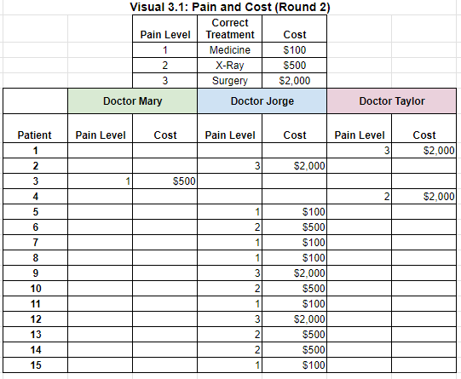
Round 2: Pain and Cost Spreadsheet

Slide 29
Round 2: Discussion Questions
What was different about the doctors’ behavior in round 1 and round 2?
What was different about the patient’s behavior in round 1 and round 2?
Even though Doctor B might increase the amount of tests or treatment by prescribing the next pain level up, can you explain or think of reasons why people might choose someone like Doctor B even if there is more cost and they know another doctor will not do the same thing?
Are there any written or unwritten rules that would likely affect a doctor's ethical behavior?
How does someone's duty, moral or legal obligation, impact their behavior?

Slide 30
Review Questions
What are incentives?
What are some ways access to information can impact an individual’s decision making?
How do ethical standards set by a business or producer, such as the Hippocratic Oath, incentivize employees to act ethically in situation where they have more information than the consumer?
Other than the medical field, what are other jobs that require you to act in a way that will benefit someone else?

Slide 31
Assessment: Professional Codes of Ethics Research
Many professions have ethical codes of conduct. These are usually a set of general guidelines or values, to give guidance on how to respond in certain situations.
Your assignment is to select a career that has an ethical code of conduct, such as an accountant, lawyer, teacher, doctor, engineer, police officer, journalist, financial advisor, or religious leader.
Once you have selected the career, you will research the ethical code of conduct for that career and create a 5 slide presentation that explains the following:
Slide 1: Identity basic Information about the career.
Slide 2: Interpret the code of conduct in your own words.
Slide 3: Analyzes how the code of conduct incentivizes people in that career to act ethically.
Slide 4: Apply real-world examples where the code of conduct could come into play within that career.
Slide 5: Develop suggestions for improving or modifying the code of conduct to reflect the current demands of the career.

Slide 32
Questions?
Thank You!
Chandler Jordan
SC Council on Economic Education
Chandler.Jordan@moore.sc.edu

