Slide 1


Do Businesses
Have Social
Responsibility?

Slide 2
What is the Role of Business?
To make a profit? What is profit?
  The money that remains after all costs have been paid from the revenues of the business. Profit is the incentive for the entrepreneur to take the risk to start the business in the first place.
To serve the community? How?
  Businesses serve the community with goods and services that we pay for.
  Serve the community by volunteering and donating.
Do any local businesses donate or serve the community through volunteer work?

Slide 3
Add Your Local Business Example Here

Slide 4
Businesses Experience Scarcity, Too
What is scarcity?
  A permanent condition where unlimited wants exceed limited productive resources.
When resources are dedicated to things like volunteering, donating, in-kind gifts instead of being used for production of goods and services, their next best alternative, what is this next best alternative called?
  Opportunity Cost

Slide 5
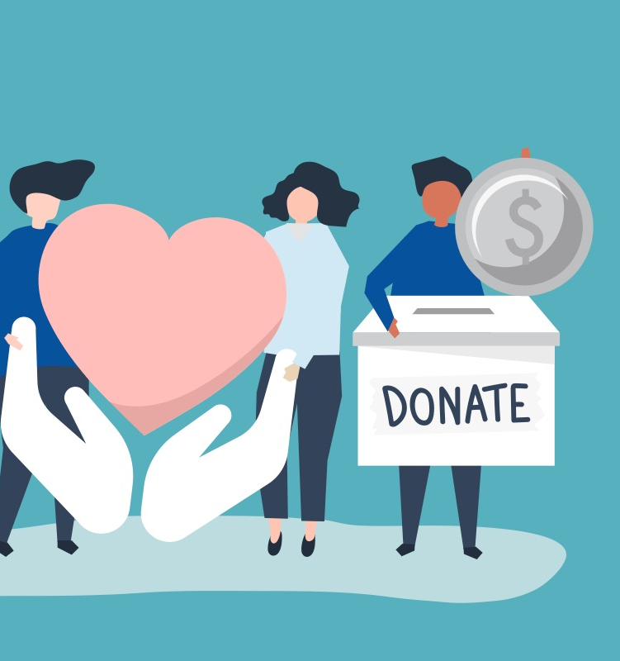
Why Donate?
Have you ever used your scarce income to donate to a cause? Why?
Why might a company use resources for things like community service instead of increasing production?
While many companies engage in these activities, people differ on what degree companies are obligated to “give back” to the community. That is the focus of today’s lesson.
Notes:
Have you ever used your scarce income to donate to a cause and if so, why? Answers will vary, but remind students that even things like buying wrapping paper/popcorn/candles/cookie dough from a friend in chorus or band is a form of donation because you’re paying over the market price for the product to help an organization.
Why might a company use resources for things like community service instead of increasing production? Answers may vary but include: Companies often see value in having a positive public image and doing positive things for communities improves that image. Furthermore, sponsoring local events like school functions help support the community AND give brand recognition to the company so it is not always purely altruistic in nature.

Slide 6
All In A Day’s Work
In just a moment you will simulate a business producing various shaped widgets. To produce them, you need to NEATLY trace the shape with your marker or highlighter. Only neatly and completely traced items can be sold.
Each item you trace can be sold for $10. If you trace all the items on your sheet you can “order” a new sheet by raising your hand and requesting a delivery.
Each piece of paper costs the company $20, each marker costs $5 and each worker is getting paid $10. So, for example, a group of 4 has initial startup costs of $140.
You must follow the instructions on your Company Information Sheet. As a group, review the information sheet NOW.

Slide 7
All In A Day’s Work
At this time, please read your Company’s information sheet and decide who is going to Volunteer (if required) or who is the Company’s CEO (if required).
If you have any questions, please ask them at this time.
I am about to start a 5-minute timer.
I will announce each minute as it passes and your company should work according to your Company information.
If there are no further questions, you may begin your work NOW.”

Slide 8
How Much Did Each Company Make?
Count how many neat and completed shapes your group traced. Multiply that number by $10 as we are going to assume they sell all of them. This is your total revenue.
Next, add up all the pieces of paper you used and multiply by $20, multiply the total number of markers by $5 and pay each worker $10. This is your total cost.
Finally, calculate your profit by subtracting your total cost from your total revenue.
    Number of shapes x $10 = Total Revenue
    Number of sheets of paper x $20 + Number of Markers x $5 + Number of workers x $10 = Total Cost
    Total Revenue - Total Cost = Profit.

Slide 9
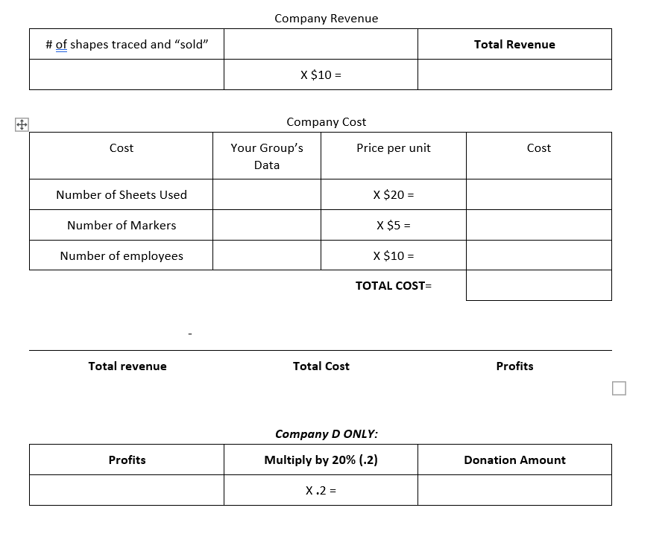

Slide 10
Total Profits
Company A = $
Company B = $
Company C = $
Company D = $

Slide 11
Social Responsibility vs. Opportunity Cost
How do you perceive company D?
How do you perceive company A?
Should company A be required or incentivized by the government to behave like B, C, or D?
For the volunteers in companies B and C, how did you feel when you were doing your volunteer work?
Notes:
How do you perceive company D? Answers will vary depending on the student’s personal expectations of company responsibilities. Some will think what company D did was foolish and wasteful. Others may find it inspiring or may even be jealous that you gave them such high praise.
How do you perceive company A? Answers will vary. Similar to company D, answers will be colored by personal opinions. Company A likely made the most money and the employees might be happy about that initially, but point out that they don’t necessarily get to share in those profits. In fact, we’re not sure what Company A will do with those profits. They could reinvest them, they could share them with stockholders, or possibly the CEO could pay himself a big bonus!
Should company A be required or incentivized by the government to behave like B, C, or D? Answers will vary may may include: Yes they should have to give back or no it’s not the government’s responsibility to oversee this.
Teacher note: Point out that some industries do face such regulatory actions. Banks, under the Community Reinvestment Act, are expected to make certain business decisions to help communities. Community Development Block Grants also usually require some quid-pro-quo, meaning an action that must be taken by the business in return for grant funding. These can usually be done in the normal course of business, but still require resources to be used in less than the most profitable means.
For the volunteers in companies B and C, how did you feel when you were doing your volunteer work? Answers may vary but include: stressed because I needed to get back to work, like I was doing something positive, but I don’t know if it helped me personally, and I enjoyed it. It felt good helping others and getting away from work for a bit.
Teacher note: In real life, volunteer opportunities also include things like free t-shirts or goodie bags. In those cases, there may be blurred lines between promoting the cause and self-interest. Point out that often companies create policies and leave time to encourage their employees to volunteer. There’s more about this in the extension activity.

Slide 12
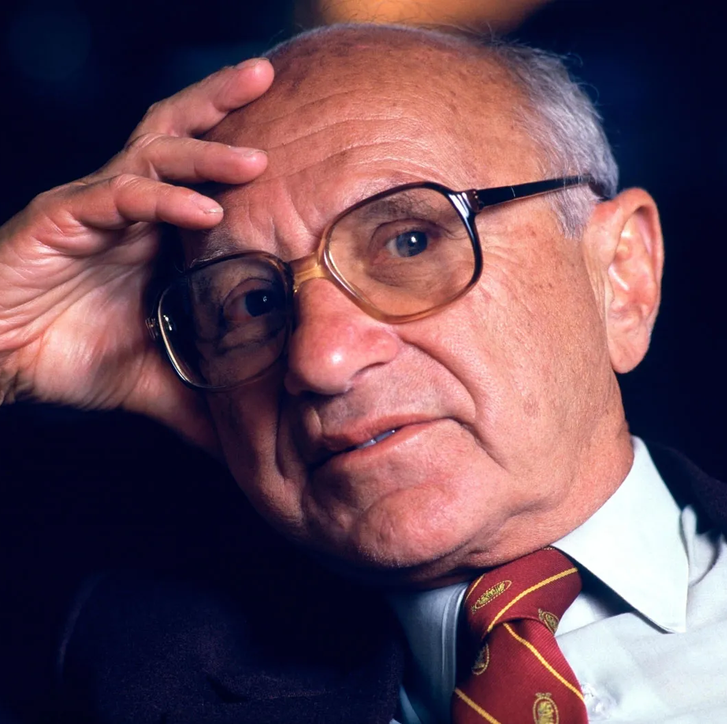
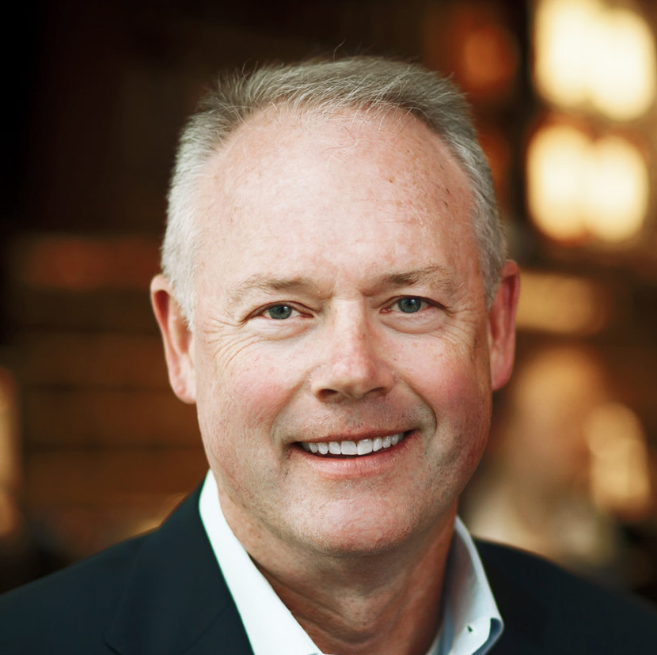
Two Views on the Social Responsibility of Business
The authors you are going to read are notable figures in the debate about corporate social responsibility.
What are their views on corporate social responsibility?
Milton Friedman won the 1976 Nobel Prize in economic sciences.
Kevin Johnson is the president and CEO of Starbucks, a business that has billions of dollars of sales each year.

