Slide 1
Presented by: Christina Ramos Email: cramos@goddard.org Date: January 24, 2023
Professional Development
Master Deck
Evaluating a College List

Slide 2
EconEdLink Membership
You can now access CEE’s professional development webinars directly on EconEdLink.org! To receive these new professional development benefits, become an EconEdLink member. As a member, you will now be able to:
Automatically receive a professional development certificate via e-mail within 24 hours after viewing any webinar for a minimum of 45 minutes
Register for upcoming webinars with a simple one-click process
Easily download presentations, lesson plan materials and activities for each webinar
Search and view all webinars at your convenience
Save webinars to your EconEdLink dashboard for easy access to the event
Access our new Professional Development page here

Slide 3
Professional Development Opportunities
To earn professional development credit for CEE webinars found on EconEdLink, you must:
Watch a minimum of 45-minutes and you will automatically receive a professional development certificate via e-mail within 24 hours.
Attendees can learn how much credit they will earn per workshop.
Accessing resources:
You can now easily download presentations, lesson plan materials, and activities for each webinar from EconEdLink.org/professional-development/
Local resources:
Insert your local professional development opportunities (if applicable)

Slide 4
About Options
A program of Goddard Riverside​ (based in NYC)
Founded 1986 as direct service access center ​
Today​
Access Program​
Success Program​
Professional Development Program

Slide 5
Housekeeping
Evaluation
One Mic
Cameras on is Highly Encouraged
Participation Highly Encouraged
Step Up, Step Back

Slide 6
Objectives
After this workshop, attendees will be able to…
Develop and/or support students to develop well balanced list of good-fit postsecondary
Guide students in assessing postsecondary options to determine good-fit and appropriate path

Slide 7
Agenda
Overview of Options Institute & Presenters
What is a Balanced List?
Researching Colleges
College Timeline
Questions & Answers

Slide 8
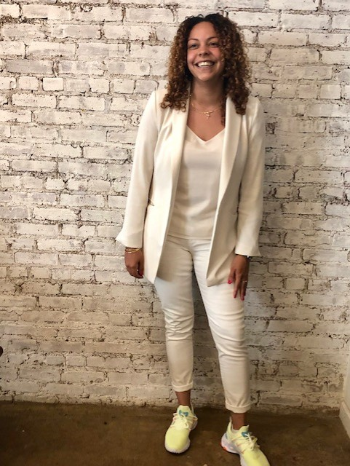
Presenter
Christina Ramos
Trainer/College Access Counselor, Options Institute
Born and raised in the Bronx, New York.
Worked with the Department of Education for about 7 years, as a math teacher, mentor, and coach.
Passionate about bridging the academic achievement gap and supporting students with college and career readiness.
Enjoys traveling, trying new restaurants, drawing and binge-watching Netflix series.

Slide 9
A Balanced List

Slide 10
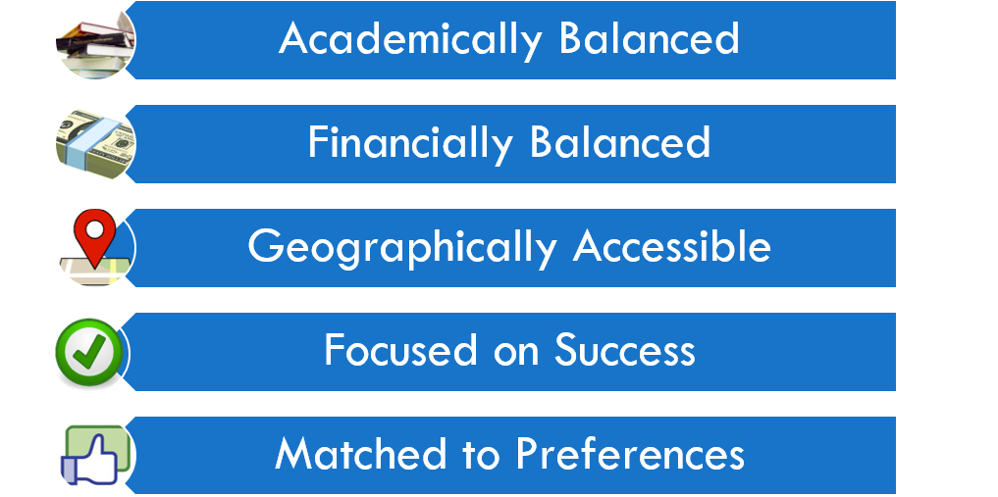
A Balanced List is …

Slide 11
An Academically Balanced List
Admission Rate​
GPA ​
SAT/ACT Scores

Slide 12
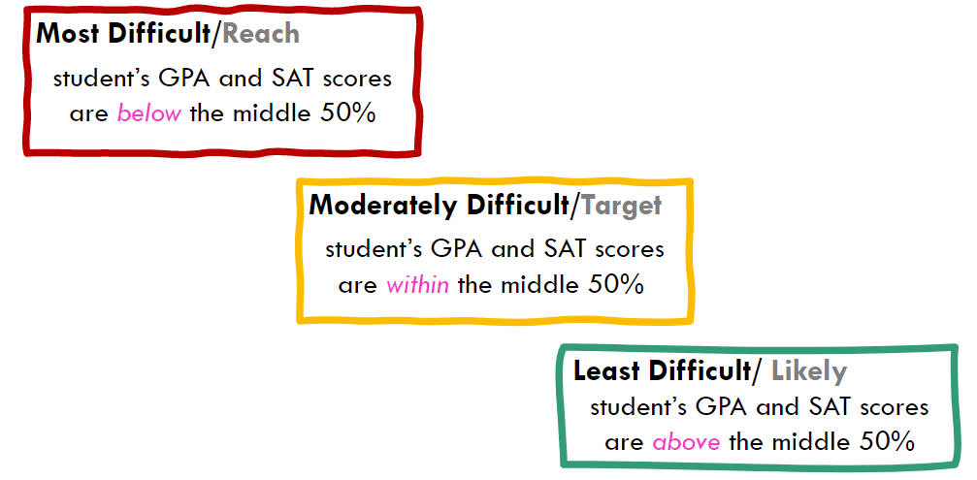
An Academically Balanced List

Slide 13
An Academically Balanced List
Chelsea
GPA: 68
Mike
GPA: 84
}
82
88
Jerry
GPA: 78
Lisa
GPA: 94
Options University
Notes:
Admission Rate
GPA
SAT/ Score
Chelsea – reach
Jerry – lower target?
Mike – target
Lisa – safety

Slide 14
A Financially Balanced List

Slide 15
A Financially Balanced List: Helpful Resources
Net Price Calculator on each college’s web site​
College Navigator http://nces.ed.gov/collegenavigator ​
Loan Burden https://ticas.org/our-work/student-debt/
College Scorecard https://collegescorecard.ed.gov/
Notes:
​Begin Your Estimate for Federal Student Aid​
Before you complete the FAFSA form, the Federal Student Aid Estimator can help you understand your options to pay for college or career school by providing an early estimate of your Expected Family Contribution (EFC) and eligibility for federal student aid.​
https://studentaid.gov/aid-estimator/

Slide 16
A Geographically Accessible List
Commuting Distance?
Cost of travel?
Accessibility of Services?

Slide 17
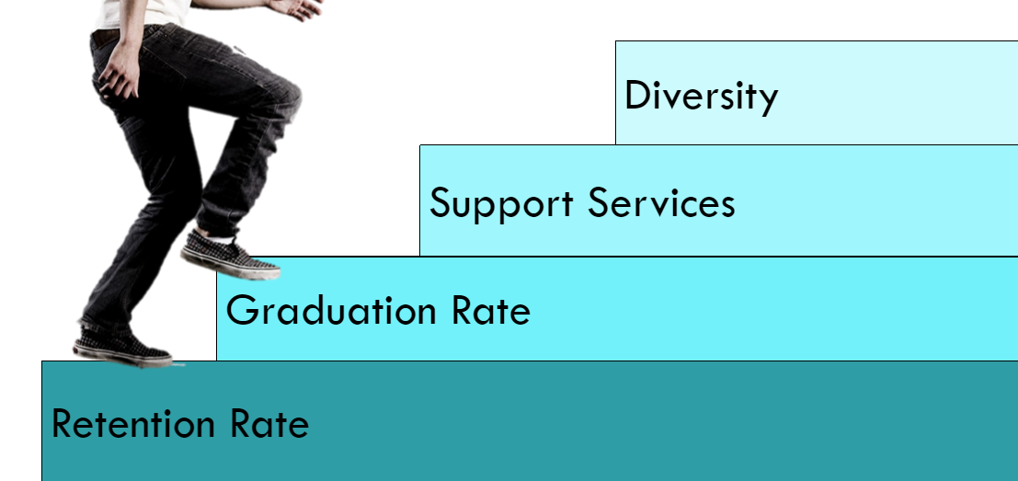
A List Focused on Success

Slide 18
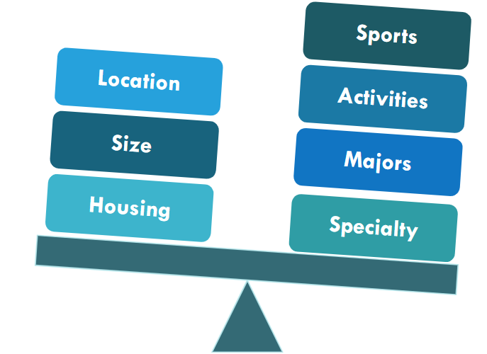
A List Matched to Preferences

Slide 19
Ana's College List
Ana has an 80 GPA and a combined (RW+M) 950 SAT score.
The list she brings to your first meeting is:
LIKELY
SUNY Binghamton, CUNY Baruch
TARGET
NYU, Vassar
REACH
Harvard, Georgetown
Notes:
College List Scenarios
**not a balanced list/miscategorized**
Ask for each scenario:
What do you think about this list? -b not balanced, needs more target/safeties
What could happen if the student applies to this list? - will likely not get into many because they are competitive

Slide 20
Brianna's College List
Brianna has an 85 GPA and combined (RW+M) 980 SAT.
The list of colleges she brings to your first meeting is:
Colleges to apply to:
University of Virginia
University of Maryland
Spelman
Rutgers
Mt Holyoke
Notes:
College List Scenarios
**brianna has no NY colleges** point out – not only does she not have 'back ups' incase going out of state does not work out, she is also missing out on EOP/HEOP since she is eligible but isnt applying to any NY schools
Ask for each scenario:
What do you think about this list? - need to know admit criteria, what about public colleges? Has she looked into HEOP at these colleges?
What could happen if the student applies to this list? - may get in but may be costly to attend?

Slide 21
Cat's College List
Cat has an 82 GPA and combined (RW+M) 1000 SAT.
They come in with the following list.
College List
College of Mt St Vincent
New York Institute of Technology
CUNY Brooklyn
St Bonaventure University
CUNY City College
St Francis College
CUNY Hunter
St Joseph’s College
CUNY Medgar Evers
SUNY Cortland
CUNY Queens
SUNY Farmingdale
Fordham University
SUNY New Paltz
Long Island University (Bklyn) ​
SUNY Old Westbury​
Manhattan College ​
SUNY Purchase​
Manhattanville College ​
SUNY Stony Brook​
Marist College ​
Notes:
College List Scenarios
**way too long, cost of applying (fees)
**can you tell me soething you like for each school?
Ask for each scenario:
What do you think about this list? - big list, try to narrow down, what are her interests/needs? Good mix of schools
What could happen if the student applies to this list?

Slide 22
Researching Colleges

Slide 23
Researching Colleges
What tools/resources can you use to research colleges?
Notes:
​
Collegeboard - https://bigfuture.collegeboard.org/​
Niche - https://www.niche.com/colleges/compare/​
College score card https://collegescorecard.ed.gov/​
School websites​
Insta pages!!
reach out to admission officers

Slide 24
Professional Development Opportunities
NACAC – National​
State​
Local​
Counselor Tours​
Annual Updates​
Counselor Breakfasts
Notes:
NACAC – National Association for College Admissions Counseling​
NACAC is an organization of over 13,000 professionals from around the world who work with students around postsecondary education. They hold an annual conference in the fall.​
​
NYSACAC – New York State Association for College Admissions Counseling​
NYSACAC is the state affiliate of NACAC. It is the only professional association composed of members from secondary schools, community-based organizations, colleges and universities. They sponsor professional developments, Summer Institute, Camp College, and an annual conference. The conference includes Coming Together which focuses on low income, underrepresented, and first-generation college students.​
​
CACNY – College Access Consortium of New York​
CACNY is a network of community-based organizations, high school counselors, and colleges involved in helping New Yorkers get into college and apply for financial aid. CACNY has monthly meetings during the school year, hosts professional development workshops, and sponsors a student scholarship.​
​
Counselor Tours ​
These tours are designed to familiarize counselors with the colleges their students may apply to and attend. Counselors have the opportunity to see the school campus first-hand, speak with students and staff, and review their impressions with other counselors.

Slide 25
College Timeline

Slide 26
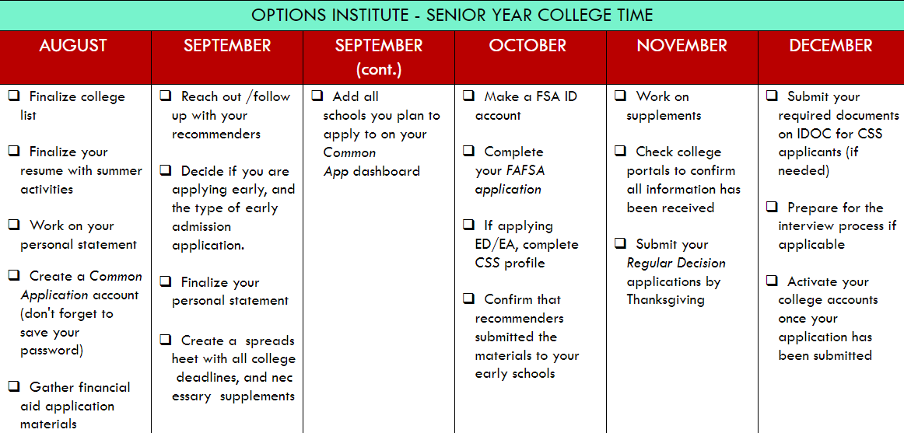
College Timeline

Slide 27
Q & A
Notes:
Evaluation link: https://forms.gle/1mSh8tcWYyrJezAh8

Slide 28
Optionsinstitute@goddard.org
Thank You

Slide 29
Invest In Girls

Slide 30
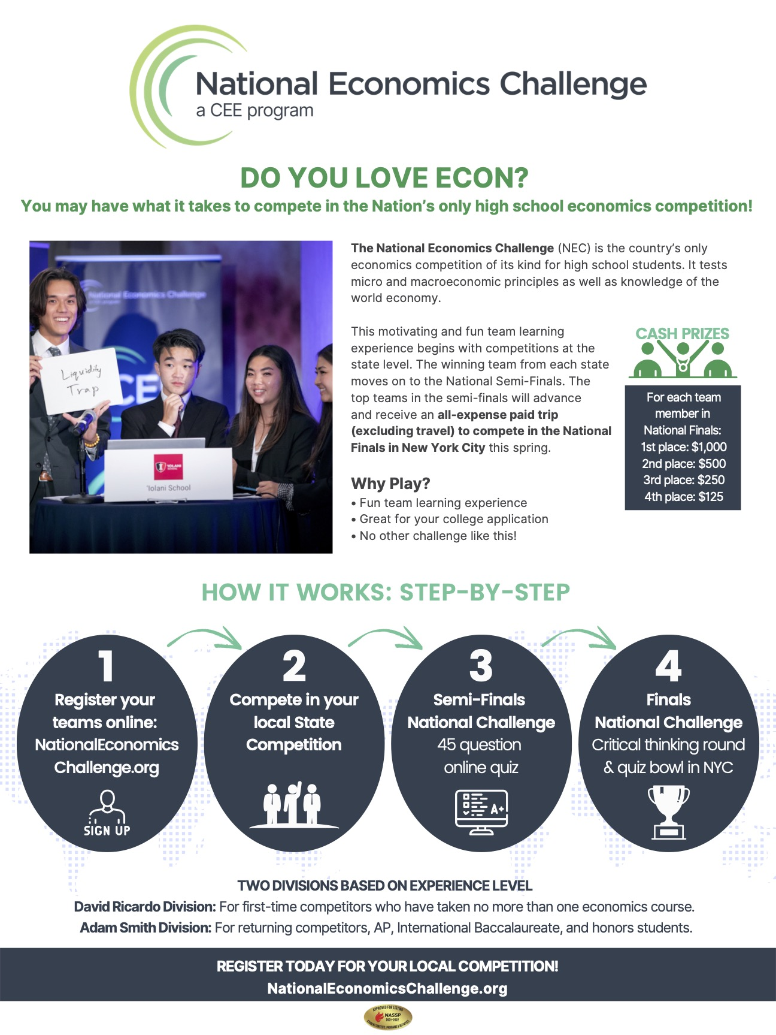
NEC

Slide 31
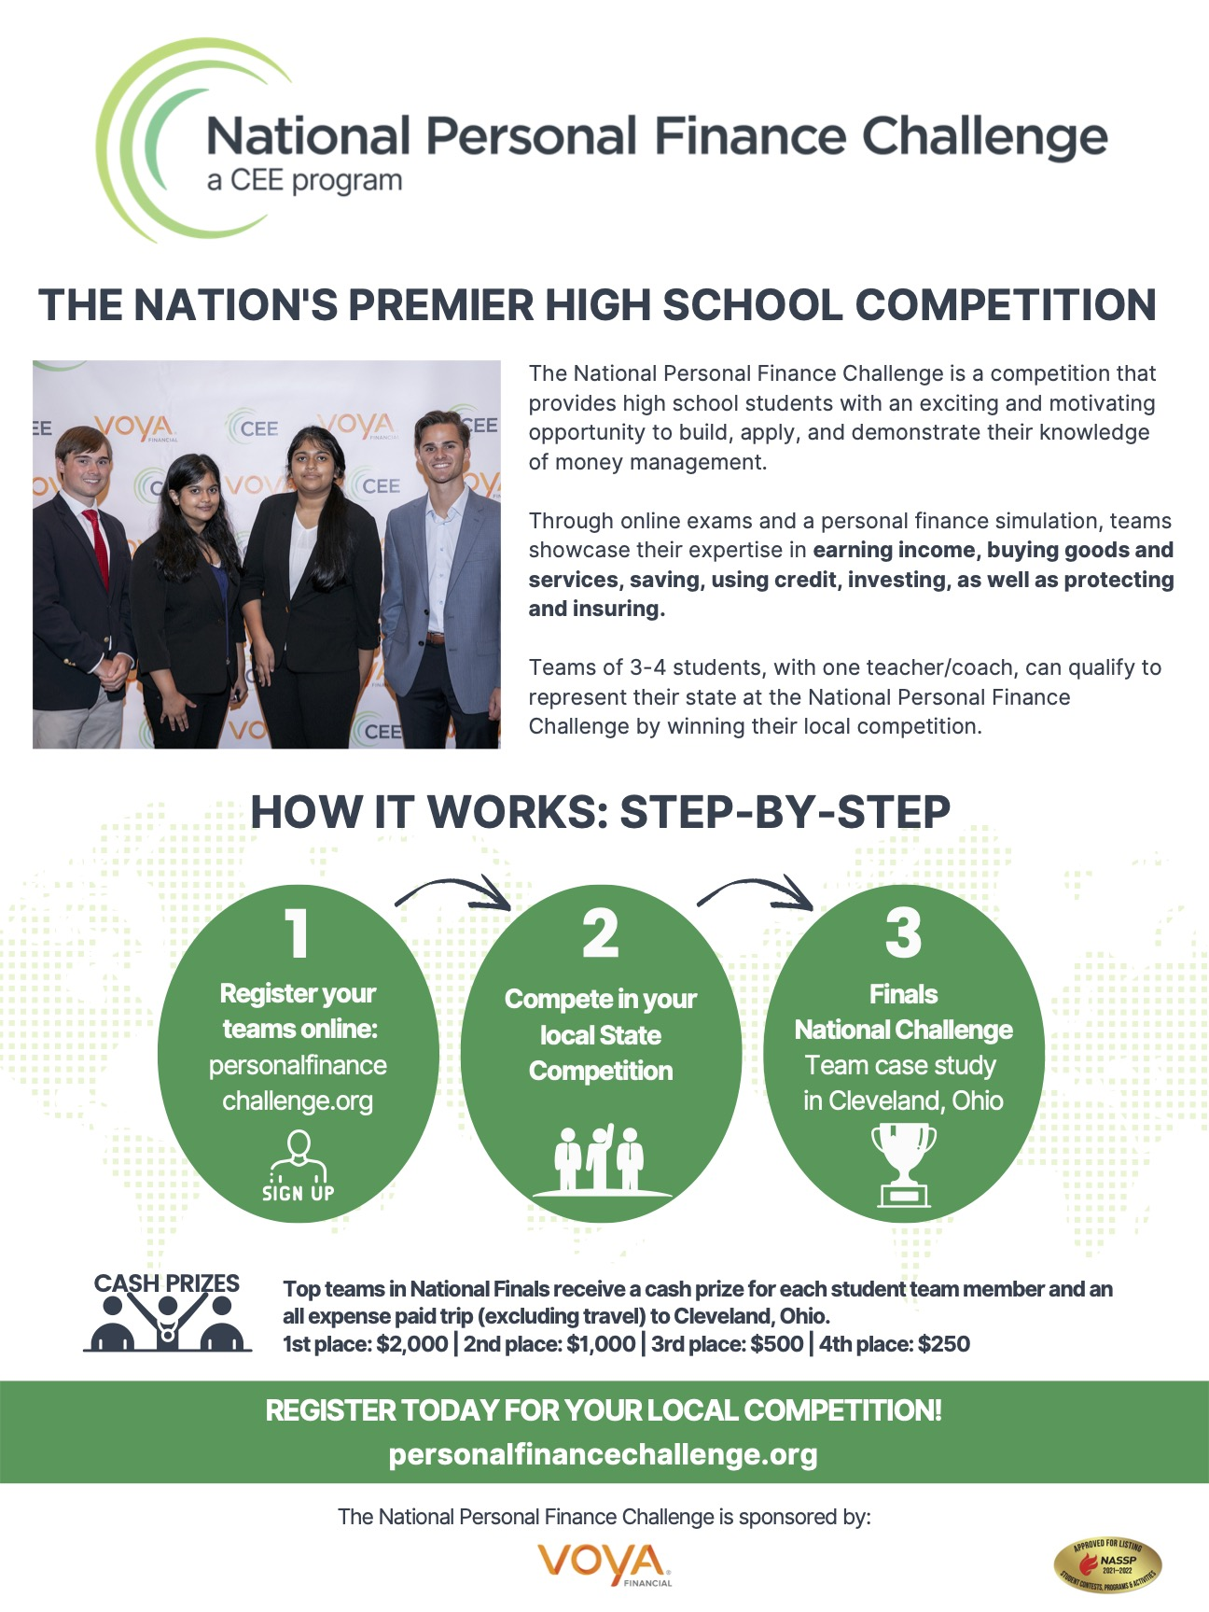
NPFC

Slide 32
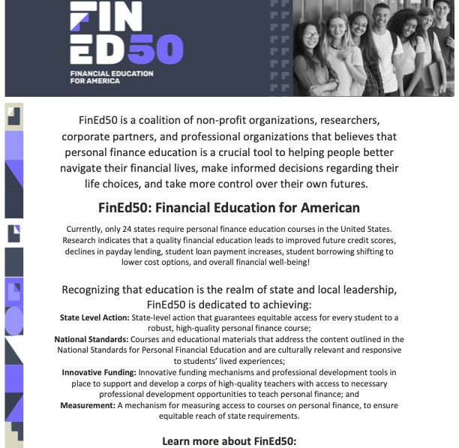
Advocacy

Slide 33
Thank You to Our Sponsors!

