Slide 1
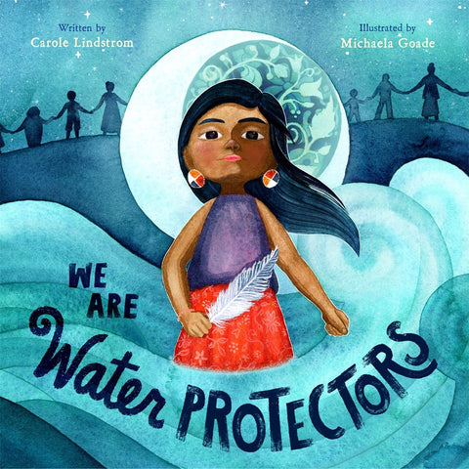
Lauren H Shifflett shiffllh@jmu.edu Lynne F Stover stoverlf@jmu.edu March 28, 2023
A Parched Nation:
Drought, National Disasters, and Contamination

Slide 2
EconEdLink Membership
You can now access CEE’s professional development webinars directly on EconEdLink.org! To receive these new professional development benefits, become an EconEdLink member. As a member, you will now be able to:
Automatically receive a professional development certificate via e-mail within 24 hours after viewing any webinar for a minimum of 45 minutes
Register for upcoming webinars with a simple one-click process
Easily download presentations, lesson plan materials and activities for each webinar
Search and view all webinars at your convenience
Save webinars to your EconEdLink dashboard for easy access to the event
Access our new Professional Development page here

Slide 3
Professional Development Opportunities
To earn professional development credit for CEE webinars found on EconEdLink, you must:
Watch a minimum of 45-minutes and you will automatically receive a professional development certificate via e-mail within 24 hours.
Attendees can learn how much credit they will earn per workshop.
Accessing resources:
You can now easily download presentations, lesson plan materials, and activities for each webinar from EconEdLink.org/professional-development/
Local resources:
Insert your local professional development opportunities (if applicable)

Slide 4
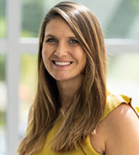
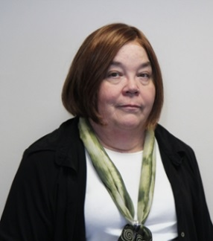
Presenters
Lauren Hensley Shifflett is the new Associate Director at the James Madison University Center for Economic Education. Prior to joining the Center, she spent twelve years in early elementary education where she enjoyed prospering young minds as a classroom teacher. Lauren became nationally known as an elementary economic educator when she received the John Morton Award of the national Council for Economic Education in 2021. Her love for economics guides her lessons to prepare students for life.
shiffllh@jmu.edu
Lynne Farrell Stover is currently a Teacher Consultant at the James Madison University Center for Economic Education. Prior to this, she spent thirty-three years in public education where she enjoyed various teaching assignments including classroom teacher, gifted education specialist, and librarian. She is the author of over fifty educational articles and eight teacher resource books. She is the recipient of the 2022 NAEE Platinum Curriculum Award for her lessons developed for Virginia’s Reading Makes Cents Program.
stoverlf@jmu.edu

Slide 5
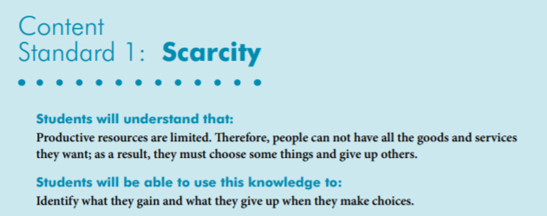
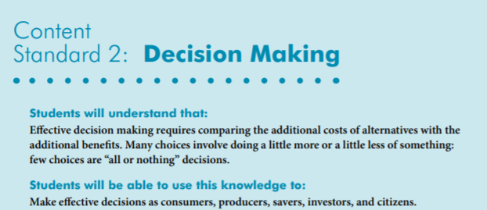
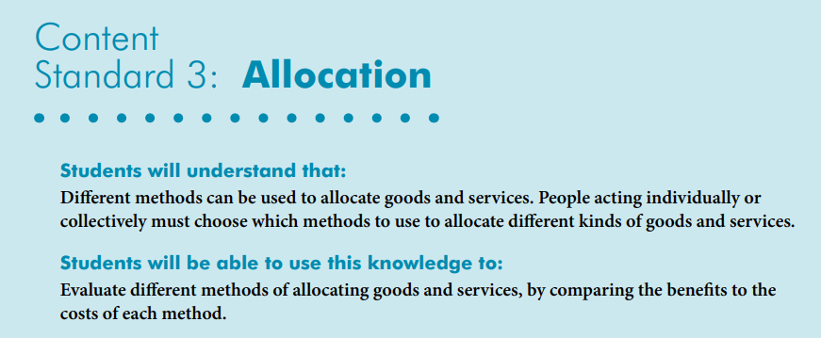
National Content Standards
https://www.councilforeconed.org/wp-content/uploads/2012/03/voluntary-national-content-standards-2010.pdf

Slide 6
Agenda
Introduction [5 mins.]
Review information concerning the current water crisis. [10 mins.]
Examine related children’s books and review lessons and activities based on the featured titles. [40 mins.]
Discuss the costs and benefits of promoting environmentally themed books. [5 mins.]
Conclude with discussion questions, book list review, and webinar survey [5 mins.]

Slide 7
Objectives
In this webinar teachers will:
Review information concerning the national safe water crisis.
Relate the concepts of scarcity, allocation of limited resources, opportunity cost, and decision-making to the topic of water scarcity.
Learn how climate change will likely intensify a national water crisis.
Examine children’s books and classroom activities featuring water scarcity.
Discuss class and wealth differences in relation to clean water accessibility.
Discuss the costs and benefits of promoting environmentally themed books.

Slide 8
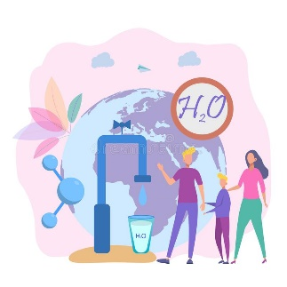
PART I Introduction & Quick Overview
In the United States, water scarcity occurs when communities are unable to fulfill their basic water needs. This can be due to drought, limited supplies, or a failing infrastructure. In this webinar educators will learn that the lack of safe water has dire consequences.

Slide 9
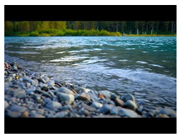
Standing next to the river,
what questions would you ask it?
River White Noise
https://www.youtube.com/watch?v=w9qpsiQvI2c

Slide 10
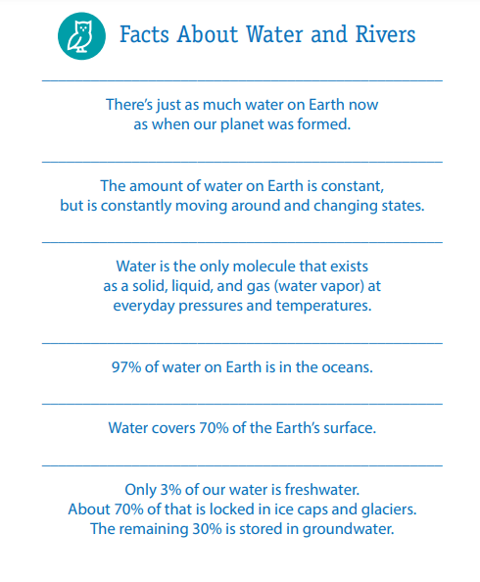
https://www.startwithabook.org/sites/default/files/river-rangers-toolkit-dc-metro.pdf

Slide 11
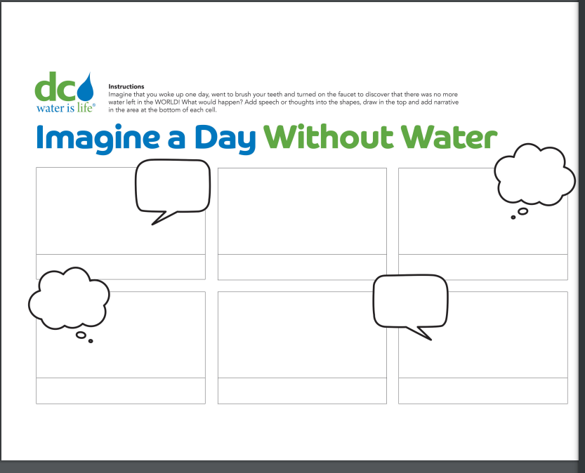
Thinking About Our Water (Rivers)

Slide 12
Water Facts
According to the EPA, a full bathtub requires about 70 gallons of water, while taking a five-minute shower uses 10 to 25 gallons.
Less than 1% of the water supply on earth can be used as drinking water.
Bottled water can be up to 2000 times more expensive than tap water and it may not be as safe.
On average, women in developing countries walk 3.7 miles (6 kilometers) a day to collect water. In Africa alone, women spend 40 billion hours a year walking for water.

Slide 13
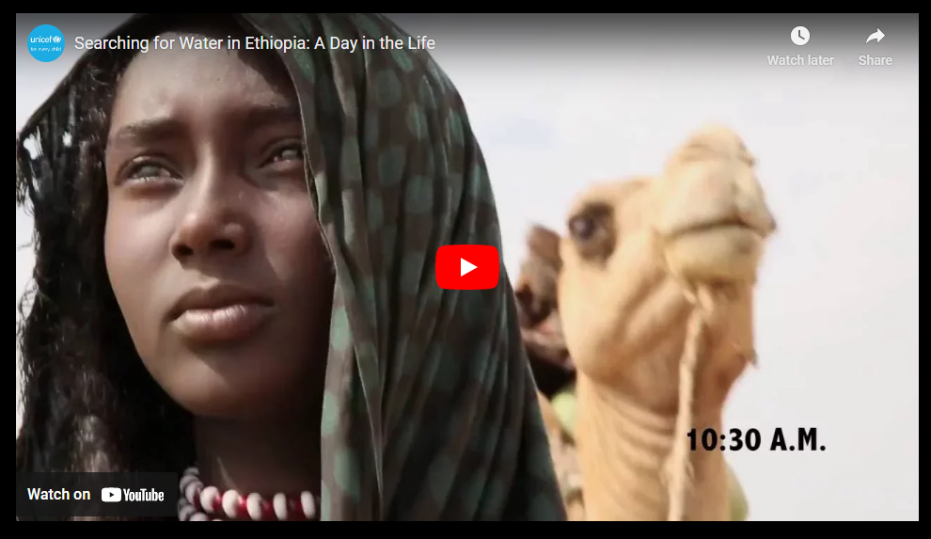
https://www.unicefusa.org/stories/how-long-does-it-take-get-water-aysha-eight-hours-day

Slide 14
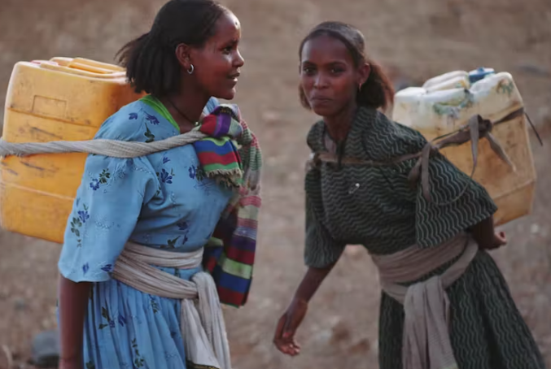
Thinking about Water Collection
It's a physically demanding, time-consuming responsibility and one that almost always falls to females.
There are an estimated 13.54 million women (and 3.36 million children) who are responsible for water collection trips that take 30 minutes or longer.
When the chore is a kid's job, there's still a major gender gap: 62 percent for girls versus 38 percent for boys.
Jerry cans, bright yellow plastic containers were originally filled with cooking oil. When it's full, it holds 5 gallons and weighs about 40 pounds.
https://www.npr.org/sections/goatsandsoda/2016/07/07/484793736/millions-of-women-take-a-long-walk-with-a-40-pound-water-can

Slide 15
Meanwhile in America
On average, each American uses 80 to 100 gallons of water every day, with the nation’s estimated total daily usage toping 345 billion gallons --- enough to sink the state of Rhode Island under a foot of water.
Los Angeles has grown by a million people since the 1970s, but water usage is still the same.
Water shortages won’t affect only the regions we’d expect to be dry: with as many as 96 of the 204 water basins in trouble. Included are the central and southern Great Plains, the Southwest, and central Rocky Mountain states, as well as parts of California, the South, and the Midwest.
https://www.nationalgeographic.com/science/article/partner-content-americas-looming-water-crisis

Slide 16
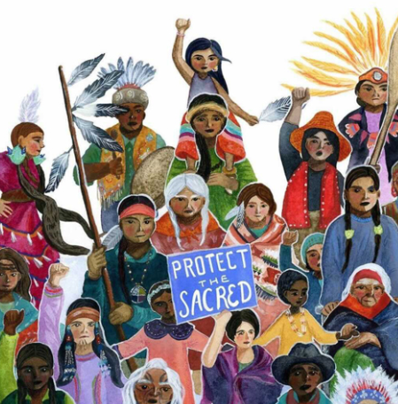
Part II
Featured Books, Lessons, and Activities

Slide 17
We Are Water Protectors
Told from the perspective of a Native American child, this bold and lyrical picture book is a powerful call to action to defend Earth's natural resources--inspired by the Dakota Access Pipeline protests and similar movements led by Indigenous tribes all across North America.
Publisher: Roaring Book Press
Copyright Date: 2020
Reading Level: 1.9
Interest Level: P-2
https://www.youtube.com/watch?v=1btJgUXzmw0

Slide 18
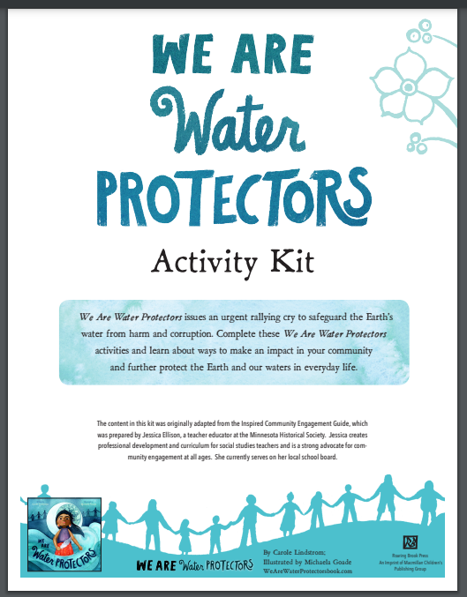
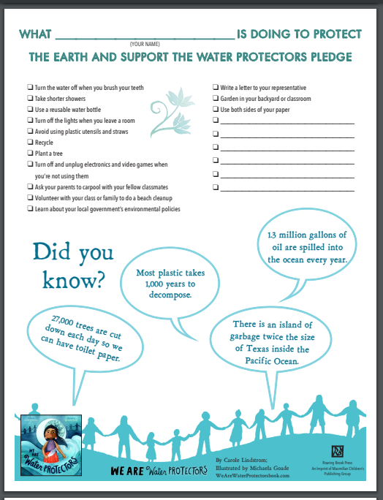
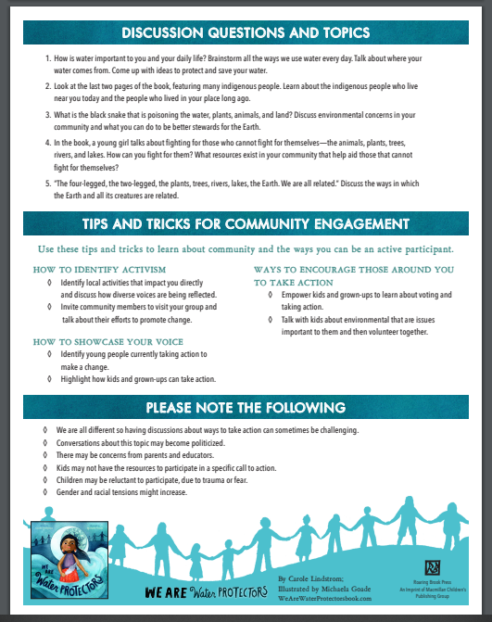
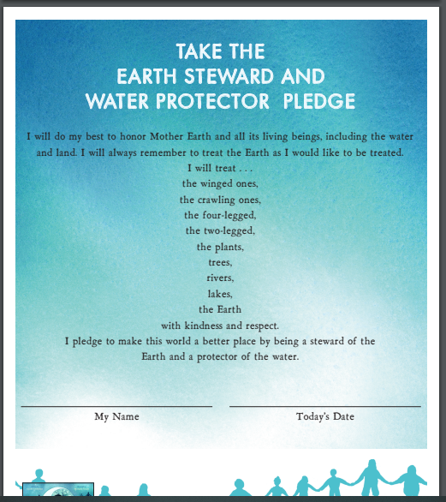
https://static.macmillan.com/static/macmillan/2020-online-resources/downloads/we-are-water-protectors-activity-kit.pdf

Slide 19
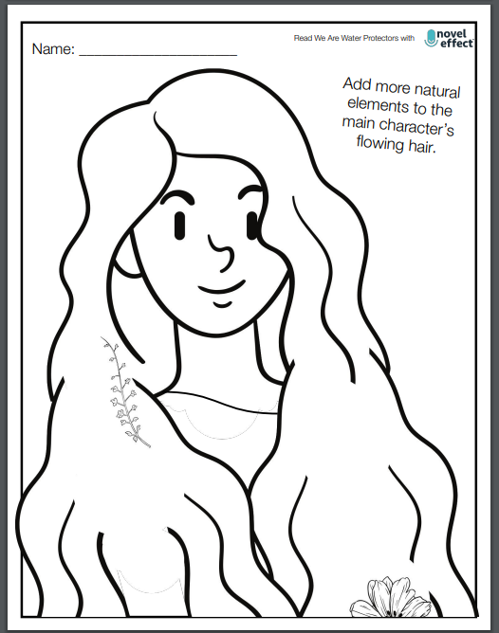
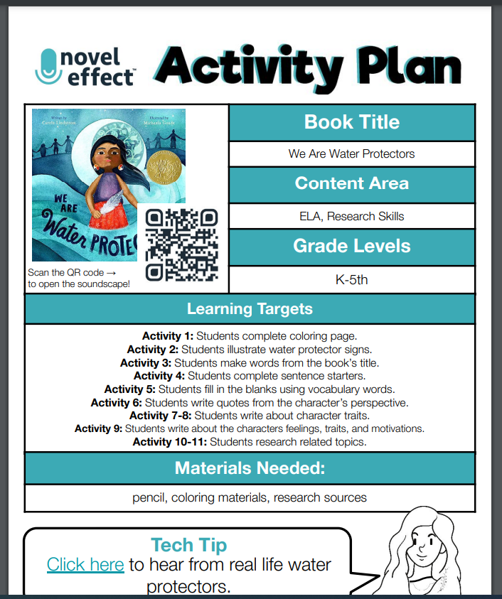
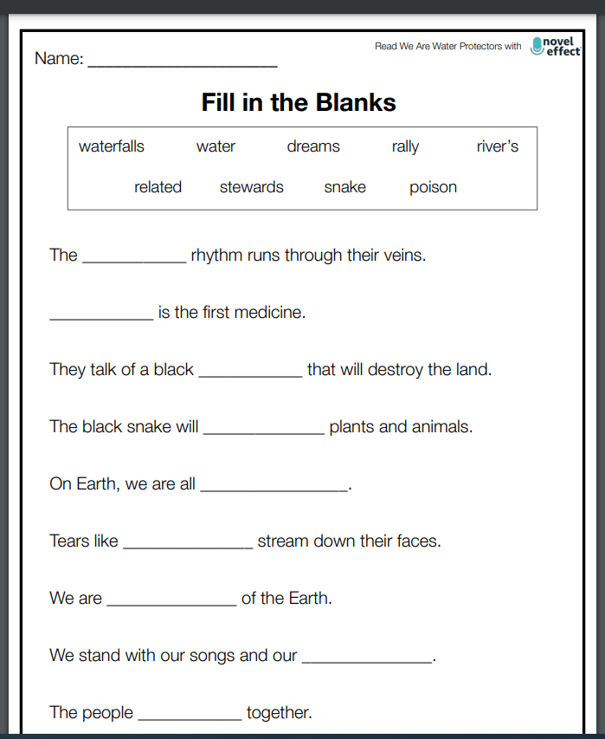
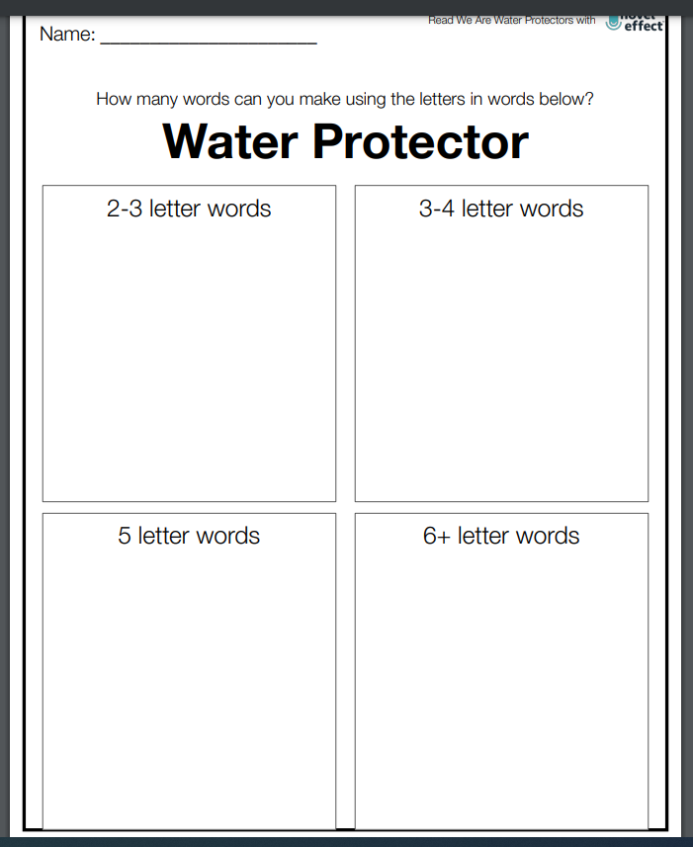
18-page Activity Guide
https://noveleffect.com/wp-content/uploads/2022/10/We-Are-Water-Protectors-Activity.pdf

Slide 20
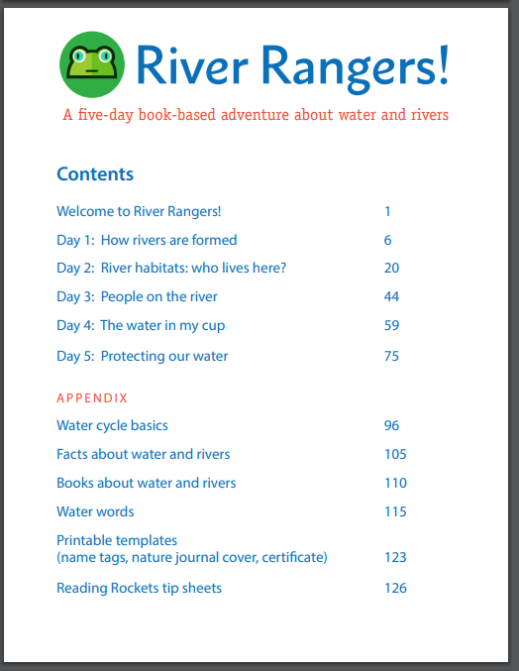
https://www.startwithabook.org/sites/default/files/river-rangers-toolkit-dc-metro.pdf

Slide 21
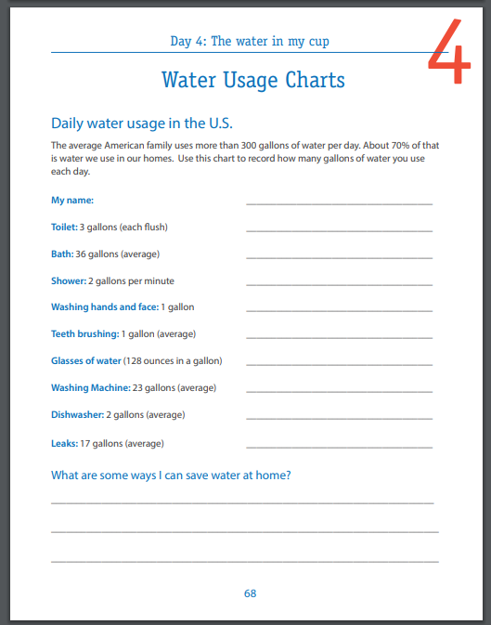
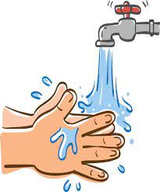
https://www.startwithabook.org/sites/default/files/river-rangers-toolkit-day4.pdf

Slide 22
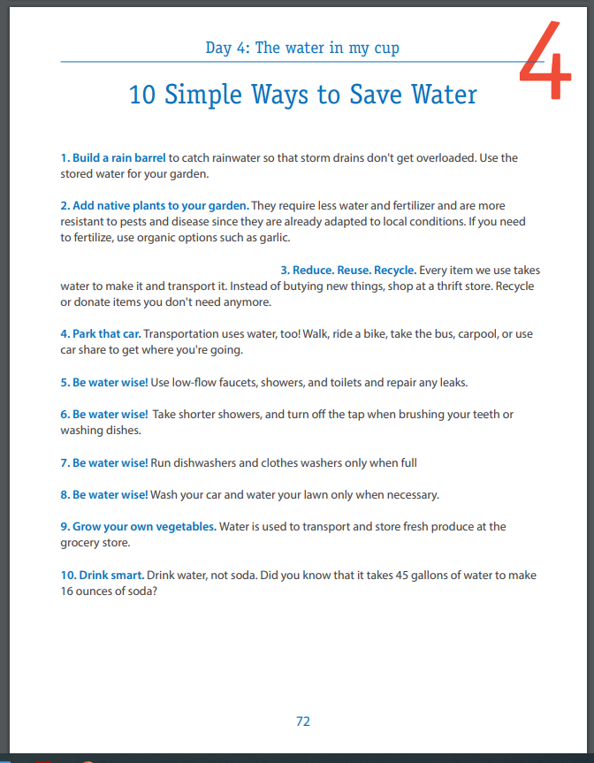

Slide 23
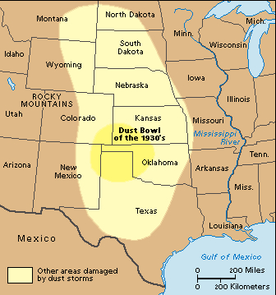
Out of the Dust
In a series of poems, fifteen-year-old Billie Jo relates the hardships of living on her family's wheat farm in Oklahoma during the dust bowl years of the Depression.
Publisher: Scholastic
Copyright Date: 1997
Reading Level: 5.3
Interest Level: 5-9

Slide 24
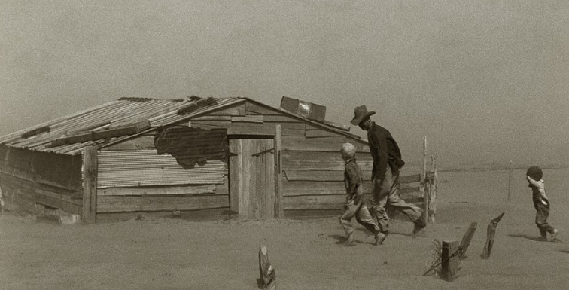
The Dust Bowl and Droughts
The Dust Bowl was a period of severe dust storms that greatly damaged the ecology and agriculture of the American and Canadian prairies during the 1930s. It was caused by a combination of both natural factors and manmade factors.
Droughts take place when an area has less precipitation, which includes rain, snow, sleet or hail, than it normally has over a period of time - long enough to cause a decrease in the water supply. Some droughts are over relatively quickly, others have been known to last for years.
Effects of a Drought
Droughts can have an effect on the environment. Animals and plants need water to survive, so an extreme drought will cause them to die. Plants will stop growing, and entire crops can be destroyed. Droughts can cause other environmental disasters, such as wildfires and landslides.

Slide 25
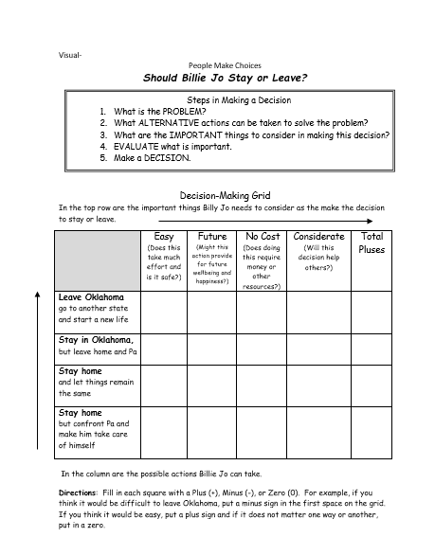
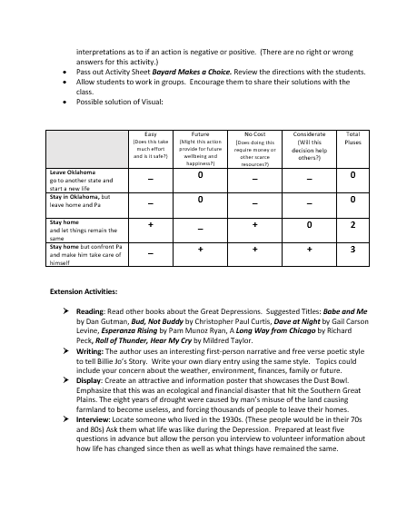
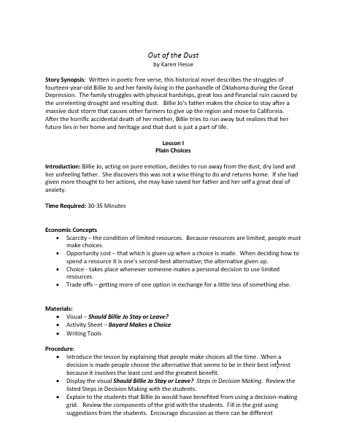

Slide 26
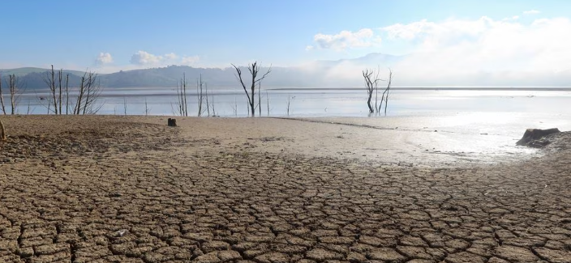
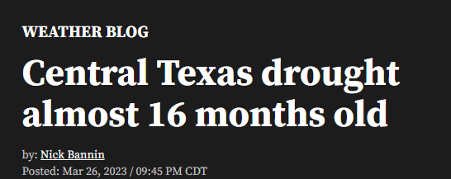

Slide 27
When the World Runs Dry
(Informational Text)
Book Synopsis: This informational text explores the various ways in which water around the world is in danger, why we must act now, and why you’re never too young to make a difference.
Publisher: Workman Pub. Co.
Copyright Date: 2022
Reading Level: 6.0
Interest Level: 7-12

Slide 28
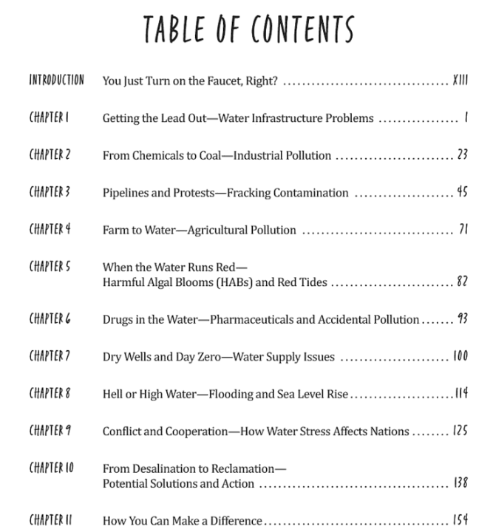
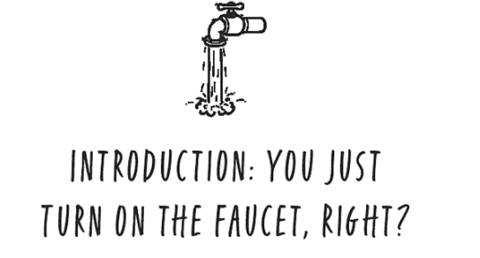
Topics Include:
Lead and water
Infrastructure problems
Pollution
Fracking contamination
Harmful algae blooms
Water supply issues
Rising sea levels
Potential Solutions

Slide 29
DRY
A severe drought in Southern California causes taps to run dry. The citizens quickly become desperate as government institutions break down. Alyssa, her brother Garrett, and their doomsday-prepper neighbor Kelton embark on a hazardous journey of survival.
Publisher: Simon & Schuster, Inc.
Copyright Date: 2018
Reading Level: 5.5
Interest Level: 7-12

Slide 30
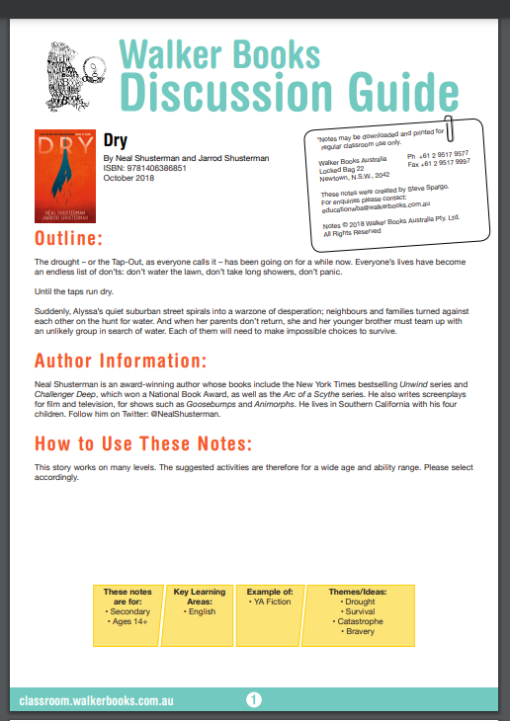
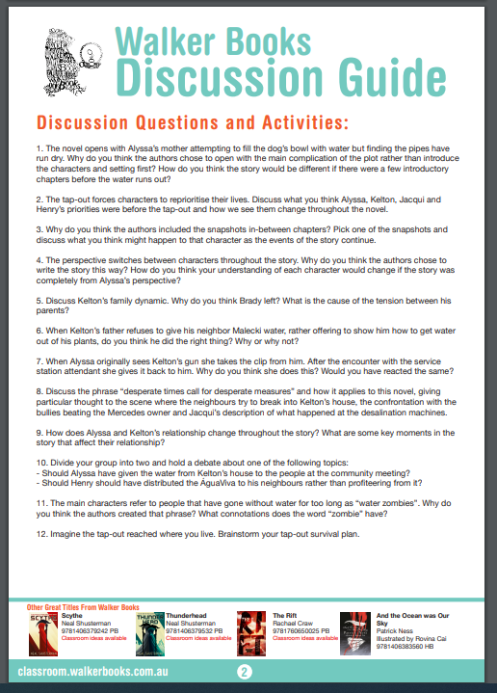
https://classroom.walkerbooks.com.au/home/wp-content/uploads/2018/09/Dry-Classroom-Ideas.pdf

Slide 31
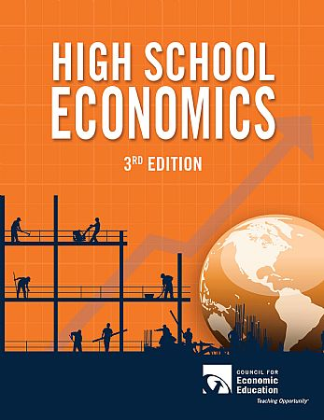

Slide 32
PART III
Eco-Anxiety
Eco-anxiety refers to a chronic fear of environmental doom.
Causes include:
Reading or watching too many books or programs concerning environmental events
Being involved in an traumatic ecological incident
Living in an area affected by climate change
Belonging to a vulnerable population

Slide 33
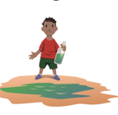
Eco-anxiety Teaching Tips Use language children will understand.
Keep your explanations developmentally appropriate.
Young children need simple information they can understand and need to be reminded that they are safe.
Older students will have questions and will need an opportunity to express their range of emotions.

Slide 34
Eco-anxiety Teaching Tips Take the time to talk.
Let students talk about their feelings and assure them what they are feeling is normal.
Remember that some children may not want to talk about their feelings.
Encourage these students to express themselves through writing, art, and other projects.

Slide 35
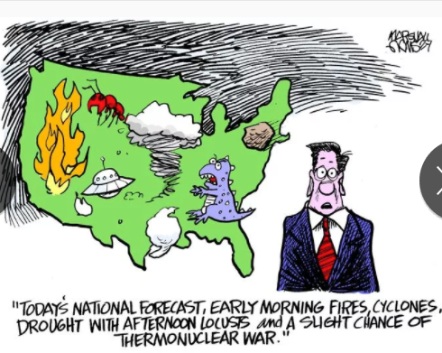
Eco-anxiety Teaching Tips Monitor and limit television and news.
Developmentally inappropriate information and overexposure to news of the event can cause more anxiety or fear, particularly in young children.
Adults also need to be careful of the content of conversations that they have with each other in front of children.

Slide 36
Assessment Questions
Why do you think, throughout history, civilizations and cities have developed around major rivers?
Is it possible to allocate water fairly on a global scale?
How can we prepare for dire situations such as droughts, natural disasters, and man-made contaminations?

Slide 37
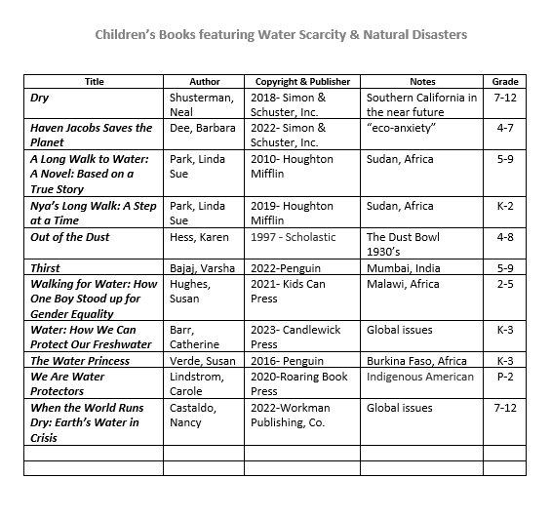

Slide 38
Invest In Girls

Slide 39
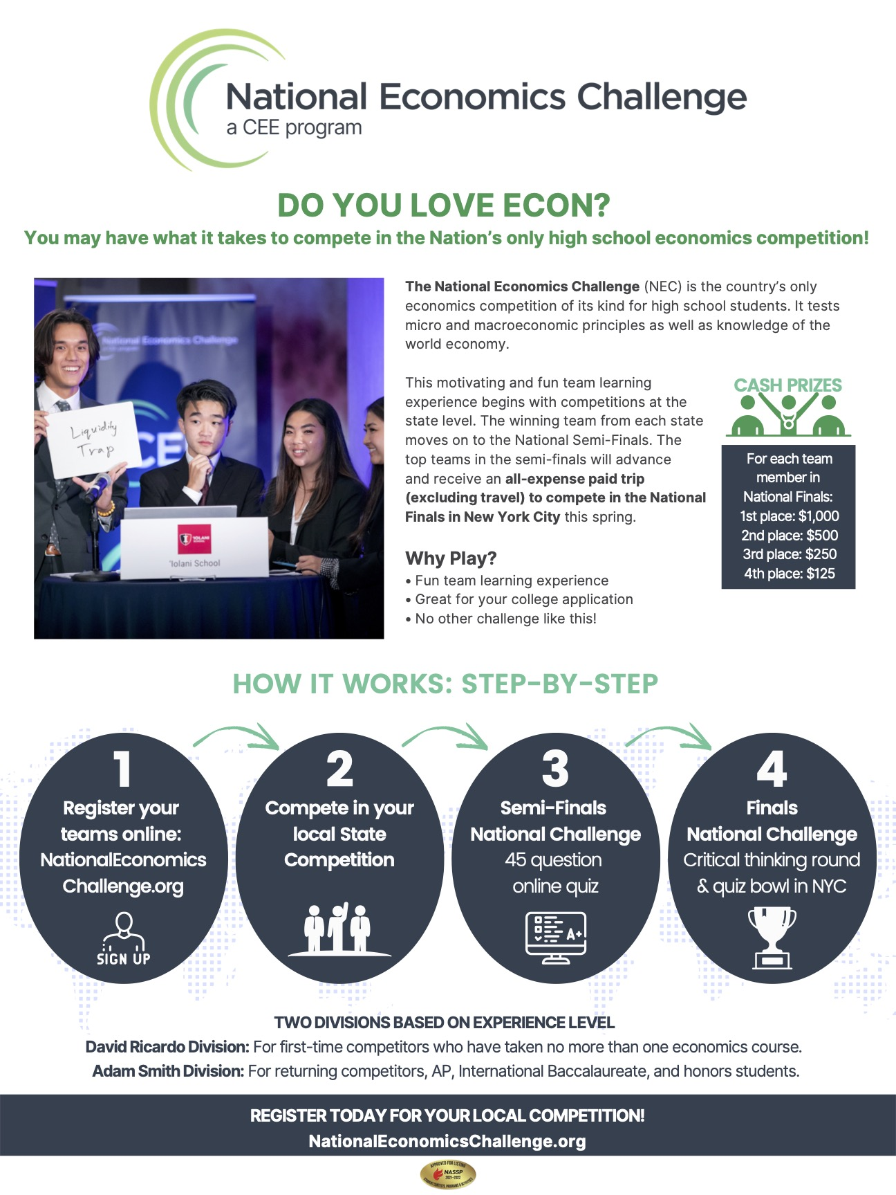
NEC

Slide 40
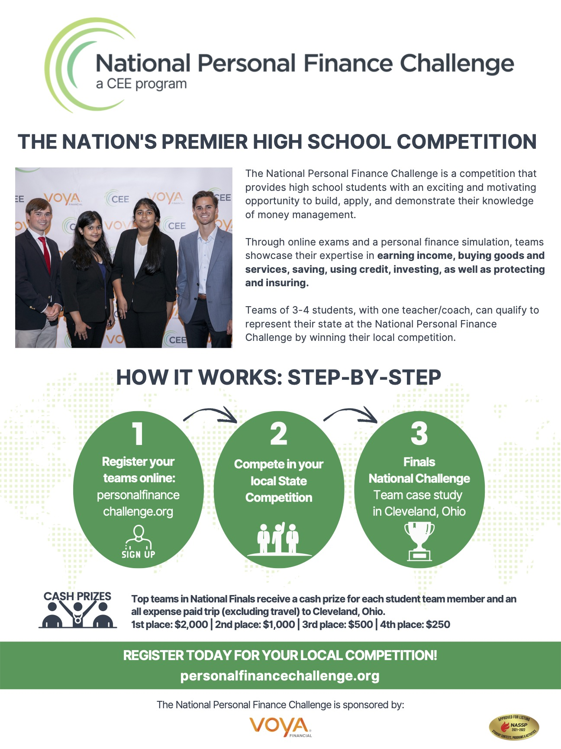
NPFC

Slide 41
Advocacy

Slide 42
Suggested Presentation Deck
CEE Affiliates
https://www.councilforeconed.org/resources/local-affiliates/
Include your local affiliate page

Slide 43
Thank You to Our Sponsors!

Slide 44
Contact information
Thank You
Lauren H Shifflett shiffllh@jmu.edu Lynne F Stover stoverlf@jmu.edu

