Slide 1

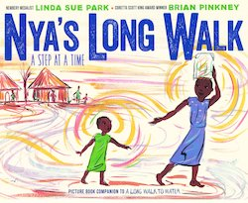
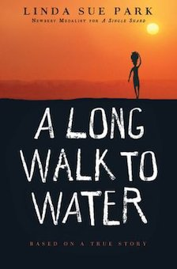
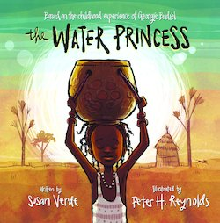
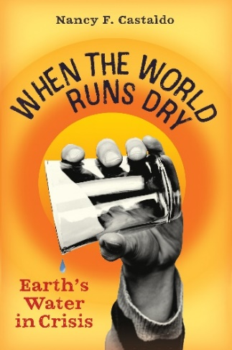
Lauren Shifflett shiffllh@jmu.edu
Lynne Stover stoverlf@jmu.edu
March 21, 2023
International Thirst:
Scarcity Across the Sea

Slide 2
EconEdLink Membership
You can now access CEE’s professional development webinars directly on EconEdLink.org! To receive these new professional development benefits, become an EconEdLink member. As a member, you will now be able to:
Automatically receive a professional development certificate via e-mail within 24 hours after viewing any webinar for a minimum of 45 minutes
Register for upcoming webinars with a simple one-click process
Easily download presentations, lesson plan materials and activities for each webinar
Search and view all webinars at your convenience
Save webinars to your EconEdLink dashboard for easy access to the event
Access our new Professional Development page here

Slide 3
Professional Development Opportunities
To earn professional development credit for CEE webinars found on EconEdLink, you must:
Watch a minimum of 45-minutes and you will automatically receive a professional development certificate via e-mail within 24 hours.
Attendees can learn how much credit they will earn per workshop.
Accessing resources:
You can now easily download presentations, lesson plan materials, and activities for each webinar from EconEdLink.org/professional-development/
Local resources:
Insert your local professional development opportunities (if applicable)

Slide 4
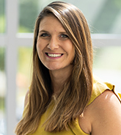
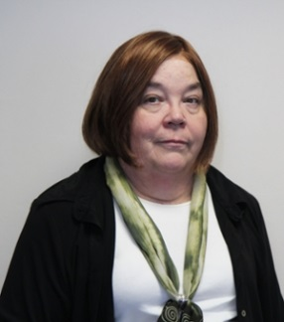
Presenters
Lauren Hensley Shifflett is the new Associate Director at the James Madison University Center for Economic Education. Prior to joining the Center, she spent twelve years in early elementary education where she enjoyed prospering young minds as a classroom teacher. Lauren became nationally known as an elementary economic educator when she received the John Morton Award of the national Council for Economic Education in 2021. Her love for economics guides her lessons to prepare students for life.
shiffllh@jmu.edu
Lynne Farrell Stover is currently a Teacher Consultant at the James Madison University Center for Economic Education. Prior to this, she spent thirty-three years in public education where she enjoyed various teaching assignments including classroom teacher, gifted education specialist, and librarian. She is the author of over fifty educational articles and eight teacher resource books. She is the recipient of the 2022 NAEE Platinum Curriculum Award for her lessons developed for Virginia’s Reading Makes Cents Program.
stoverlf@jmu.edu

Slide 5
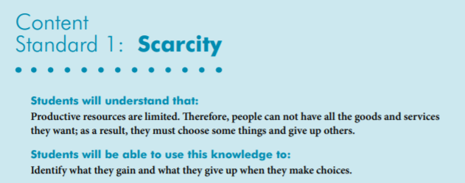

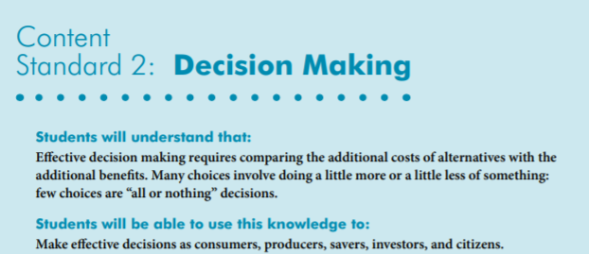
National Content Standards
https://www.councilforeconed.org/wp-content/uploads/2012/03/voluntary-national-content-standards-2010.pdf

Slide 6
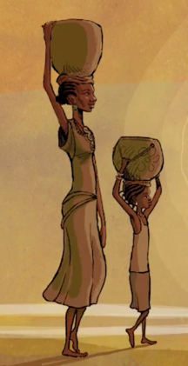
Agenda
Introduction [5 mins.]
Review information concerning the current water crisis. [5 mins.]
Examine related children’s books and review lessons and activities based on the featured titles. [35 mins.]
Discuss the costs and benefits of promoting environmentally themed books. [5 mins.]
Conclude with discussion questions, book list review, and webinar survey [5 mins.]

Slide 7
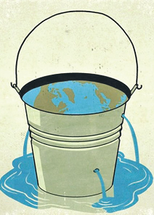
Objectives
In this webinar teachers will:
Review information concerning the current water crisis.
Relate the concepts of scarcity, allocation of limited resources, opportunity cost, and decision-making to the topic of water scarcity.
Learn how climate change will likely exacerbate a worldwide water crisis.
Consider the cross curricular possibilities of the topic as related to the social sciences and STEM lessons.
Discuss class and wealth differences in relation to clean water accessibility.
Examine the children’s books “Thirst” by Varsha Bajaj, “A Long Walk to Water” by Linda Sue Park and “The Water Princess” by Susan Verde.

Slide 8
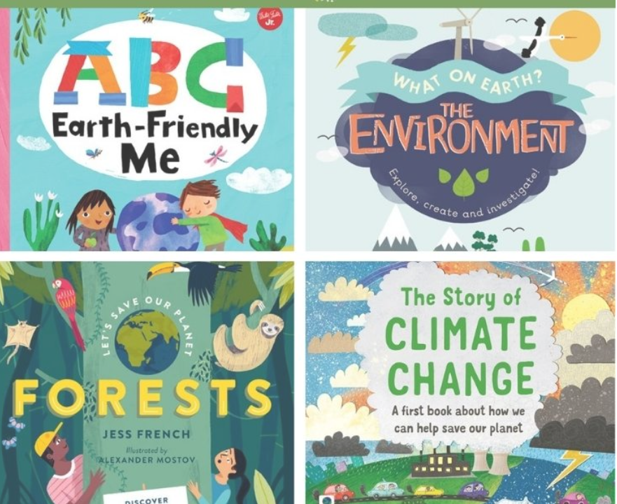
PART I
Introduction & Quick Overview
It’s common knowledge that the environment is in trouble.
We’ve already started to see the devastating effects of climate change.
Teaching our students about the environment is an important part of their education and prepares them for an uncertain future.

Slide 9
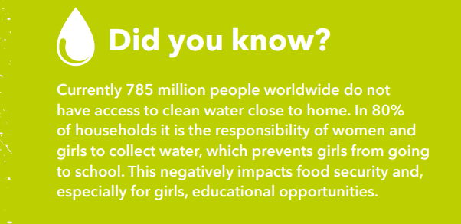

Slide 10
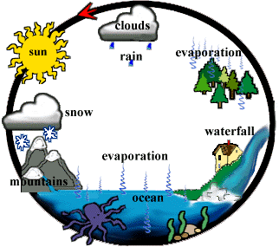
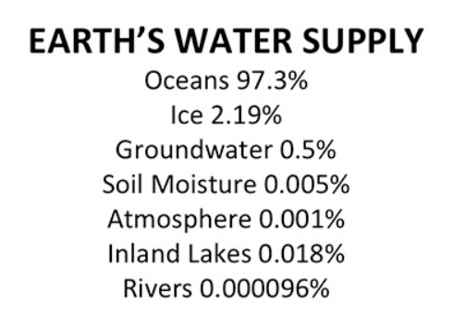
https://virginia.agclassroom.org/matrix/lesson/225/

Slide 11
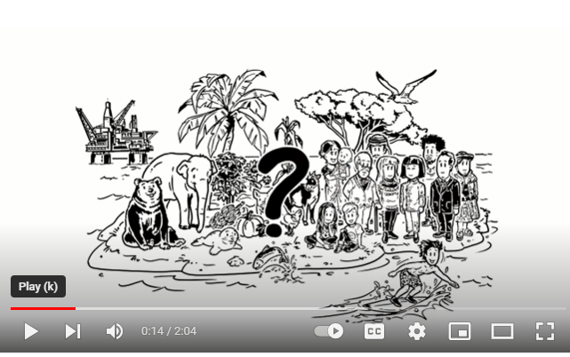
Water Scarcity - Explained in a Nutshell
https://www.youtube.com/watch?v=E6pjj2gVnWA

Slide 12
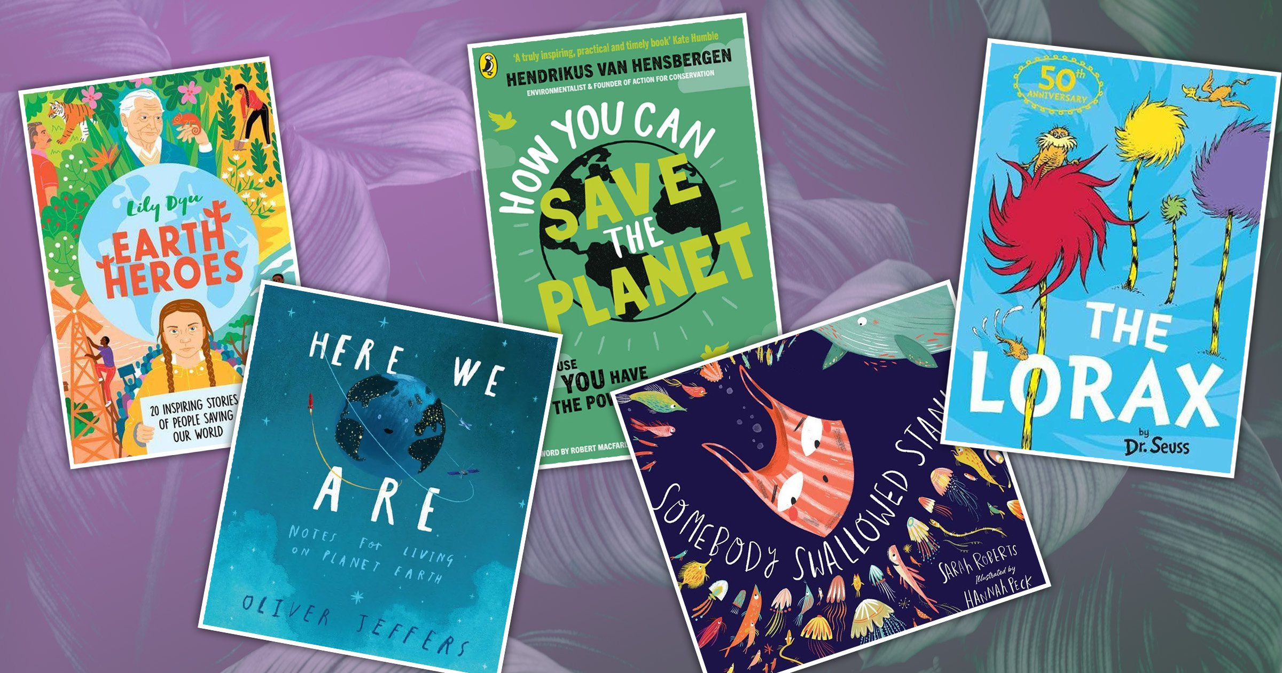
Part II
Featured Books and Lessons
Economic concepts become more interesting when students can make connections to a story. Students learn to recognize that economic decision-making is part of everyday life when reading or listening to a book.
Research shows that using children’s literature to teach in the content areas can enrich learning. It can help build an awareness of economic concepts through storytelling as well as help students develop problem solving skills, recognize ethical dilemmas and comprehend social commentary.

Slide 13
THE WATER PRINCESS
Book Synopsis: The story of a young girl who gets up every morning to make to long journey to bring water to her small African village. After returning home and boiling to water so it can be used to drink, she dreams of a day when her village will have cool, crystal-clear water of its own.
Publisher: Penguin Copyright Date: 2016
Reading Level: 2.2
Interest Level: K-3
https://www.youtube.com/watch?v=tIWAjQhClK0
6 minutes

Slide 14
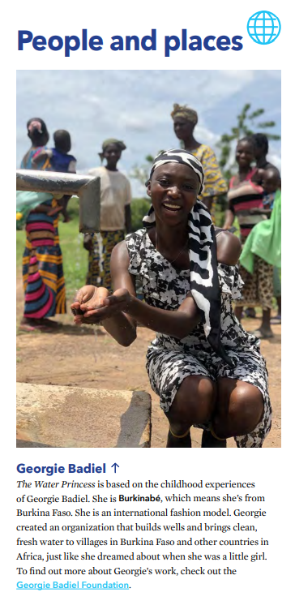
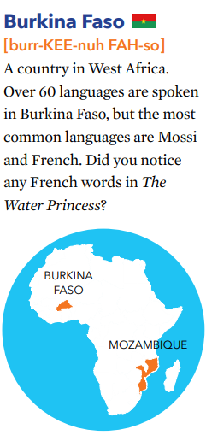


Emory University’s Carlos Museum
https://carlos.emory.edu/sites/default/files/2020-05/WP%20lesson%20plan.pdf

Slide 15
Nya’s Long Walk: A Step at a Time
Story Synopsis: Nya’s little sister becomes sick when they are returning home from their daily journey to the water hole. Nya must find the strength to her and the water back to their village, one step at a time.
Publisher: Houghton Mifflin
Copyright Date: 2019
Reading Level: 2.9
Interest Level: P-2
https://youtu.be/yZvgsh0TLhA
6 minutes

Slide 16

Nya has to fetch fresh water for her family.
What could be the reason?
To demonstrate how much of the Earth’s water supply is actually used, ask some students to help you with the next steps. (Make sure that the students understand this is just a demonstration and there is actually more water than this on earth.)
Pour water into a one-gallon container, such as a plastic ice cream bucket. This represents all the water on the earth.
Pour a half-cup of water out of the one-gallon container and into a clear bowl. The water in the bowl represents all of the fresh water on earth, which is less than three percent of the total water on earth. Fresh water is found in lakes, rivers, groundwater, ice, and living things. The 15 half-cups that are still in the one-gallon container represent salt water. We cannot use salt water without first removing the salt in a process known as desalination. Though research and technology are improving this process, it is still prohibitively expensive and often impractical.
With an eyedropper, drop one drop of water from the half-cup onto a small plate. This one drop represents the freshwater that is available for our use. This water is found in rivers and lakes. The rest of the water in the half-cup is deep groundwater, water bound up as soil moisture, biomass water, or water in the atmosphere.
https://virginia.agclassroom.org/matrix/lesson/225/

Slide 17
A Long Walk to Water: A Novel: Based on a True Story
Two eleven-year-olds in Sudan, a girl in 2008 and a boy in 1985, tell a stories of survival. The girl, Nya, is fetching water from a pond that is two hours' walk from her home. Salva, becomes one of the "lost boys" of Sudan,. Their stories intersect with hope for a better future.
Publisher: Houghton Mifflin Copyright Date: 2010
Reading Level: 5.0
Interest Level: 5-9

Slide 18
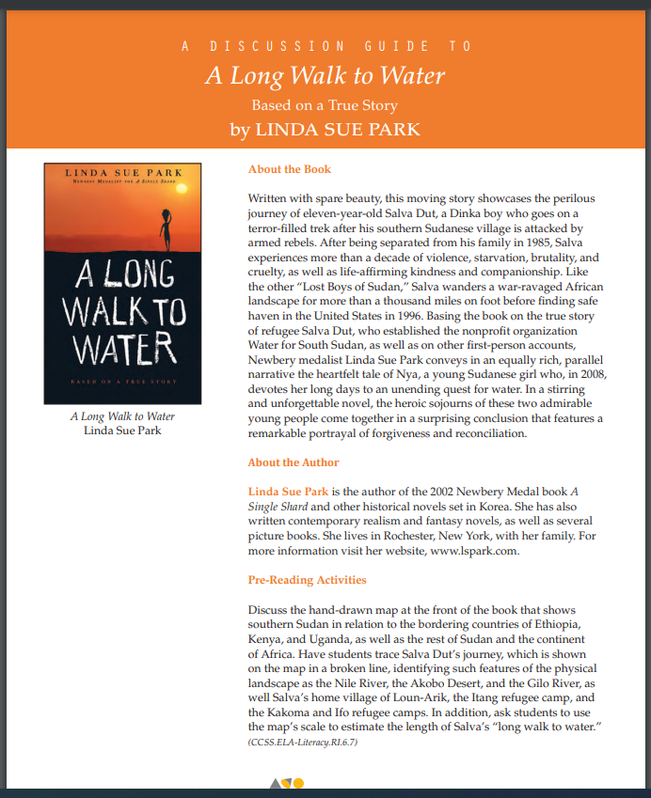
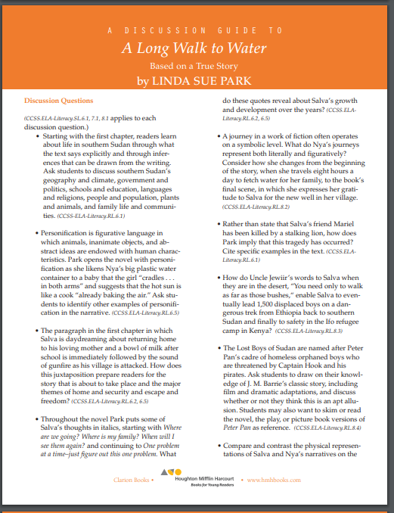
https://lindasuepark.com/wp-content/uploads/2020/03/dg_longwalktowater.pdf
Complex questions without any suggested answers.

Slide 19
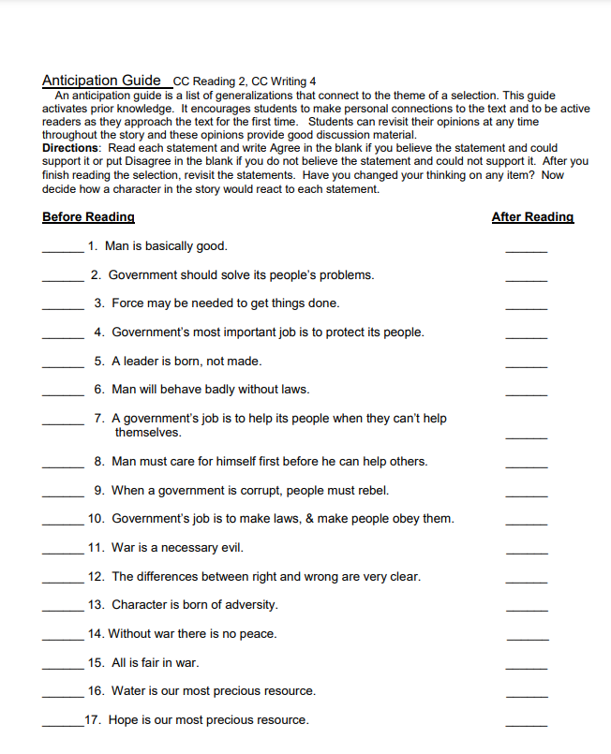
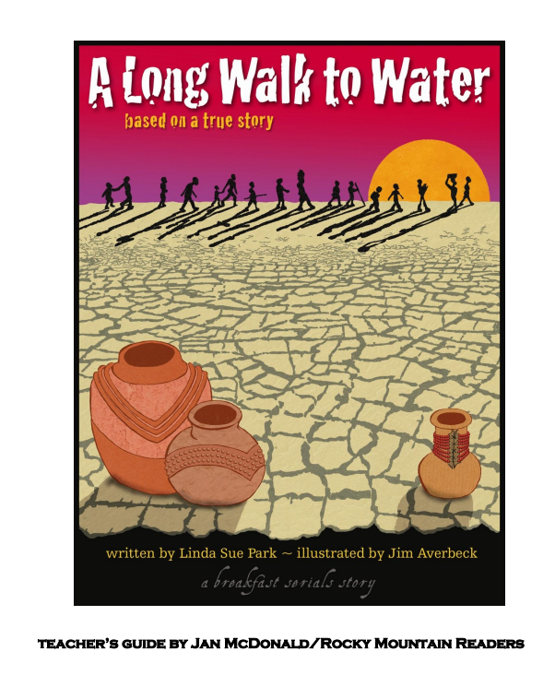
https://static1.squarespace.com/static/613e5d3ed1ee594ddbfd25cf/t/6344604e326a2c6fae1cbdbc/1665425487295/ALWTW+sample+teachers+guide.pdf
Teacher’s Guide – 33 pages

Slide 20
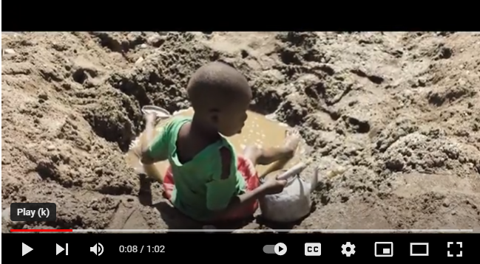
The Children Walking 6K for Water
https://www.youtube.com/watch?v=2X4gZWvxzrE

Slide 21
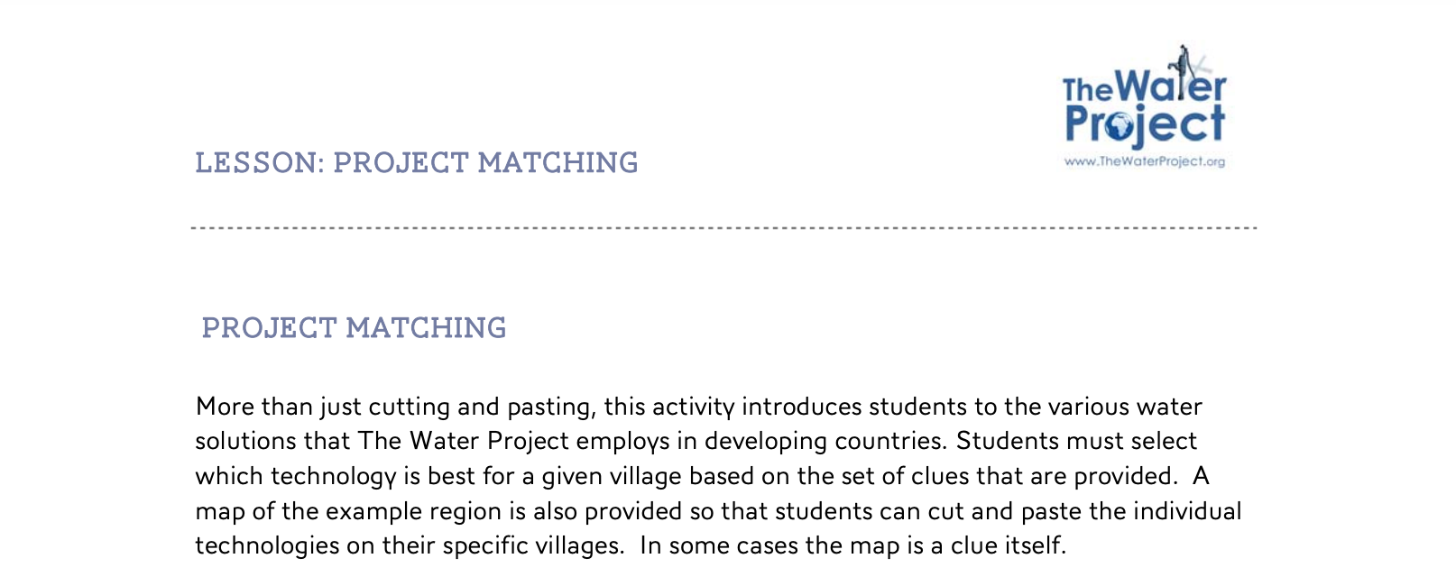
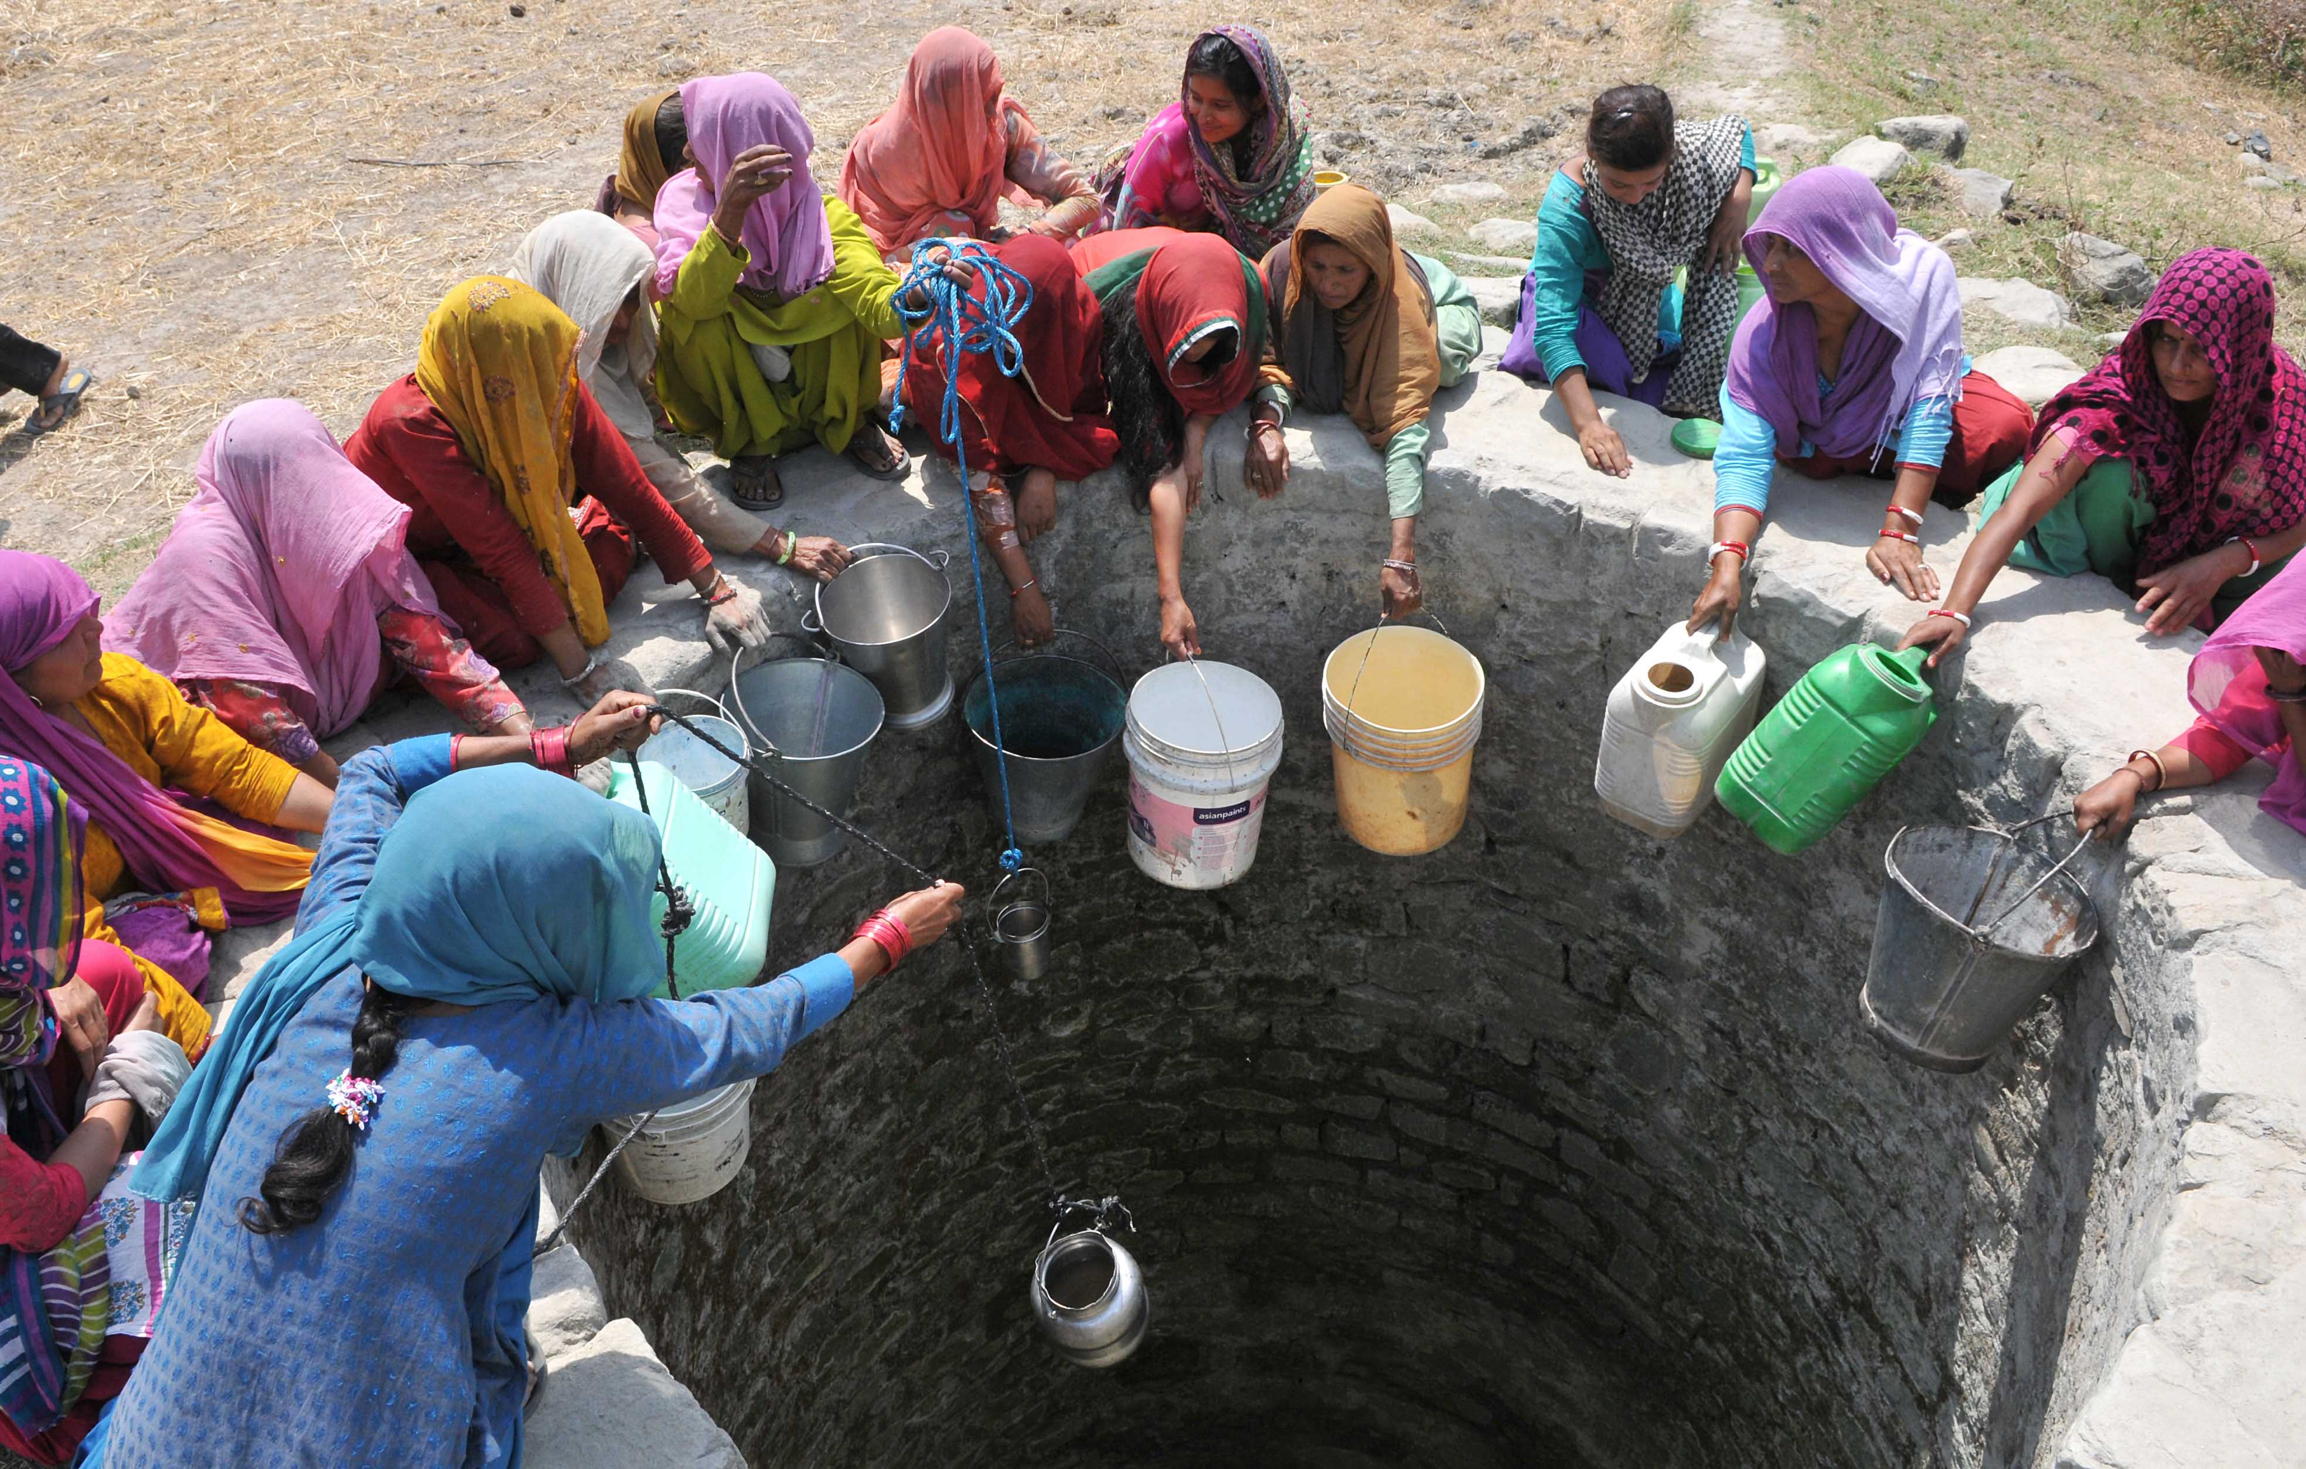
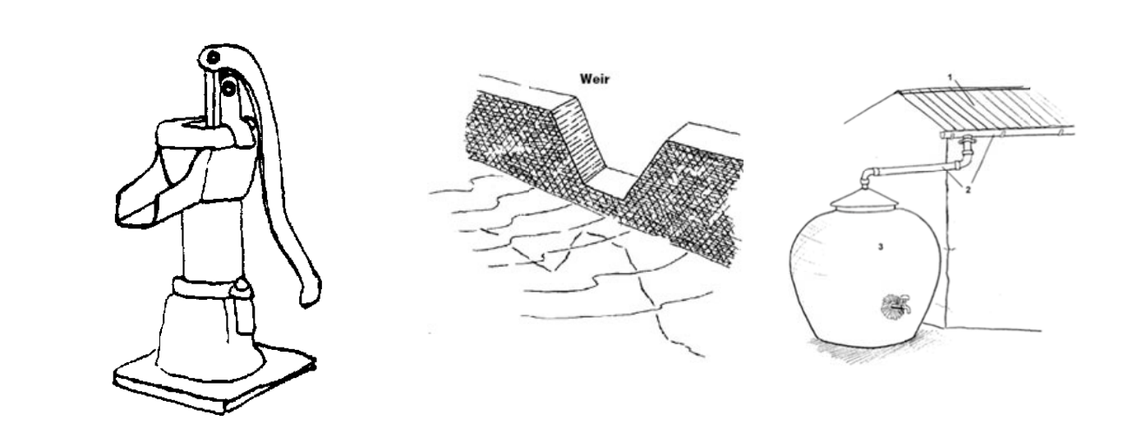

Slide 22
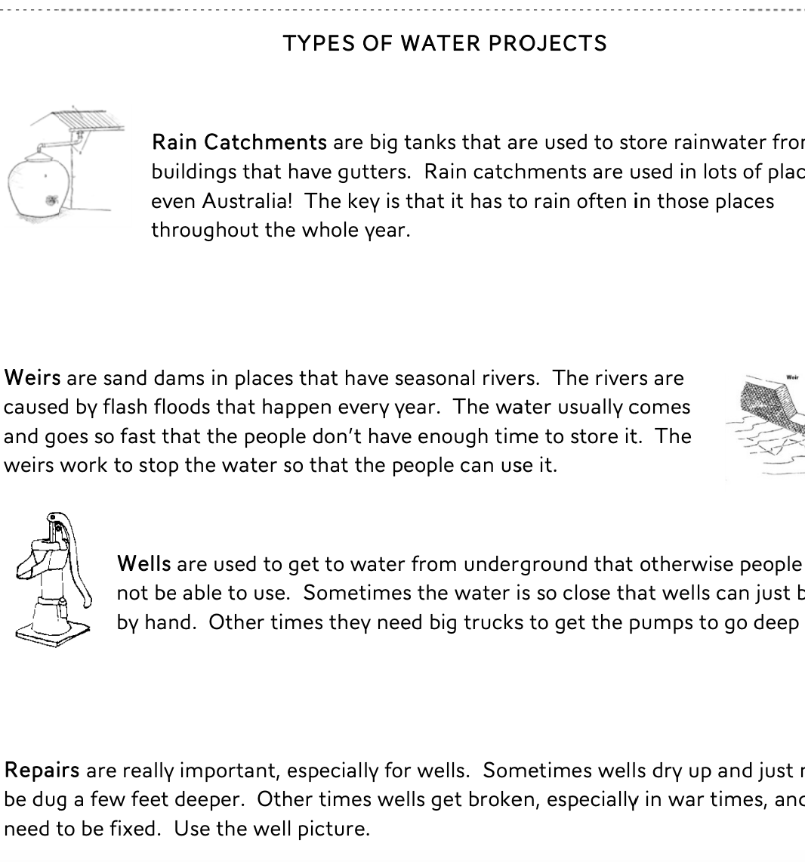
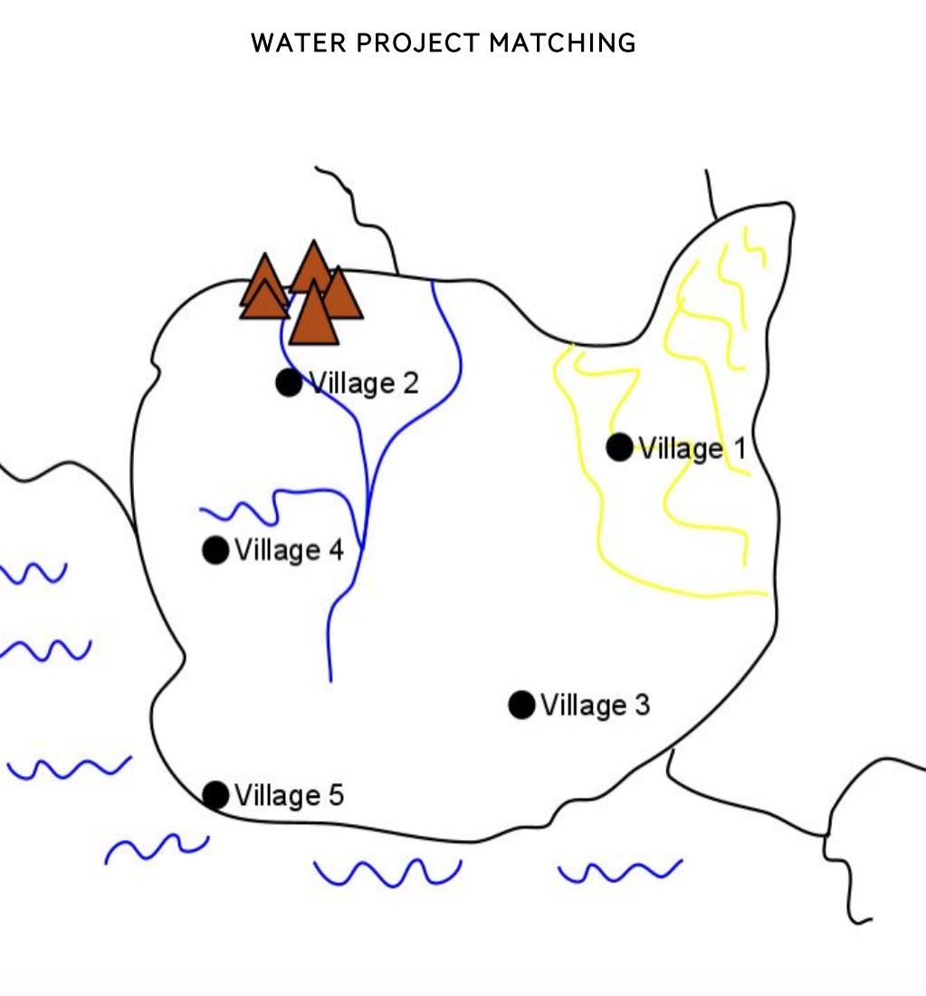
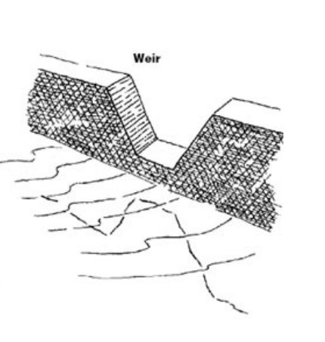
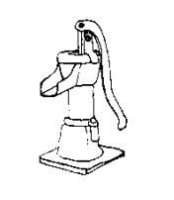
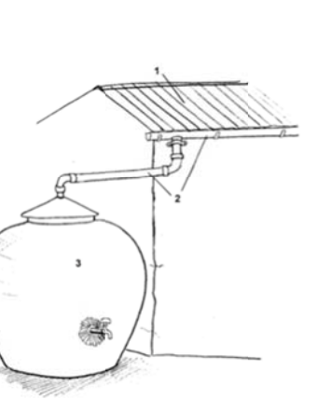
What type of Water Project is Needed?

Slide 23

Story Synopsis: Minni lives in the poorest part of Mumbai, where access to water is limited to a few hours a day and the communal taps have long lines. In the high-rise building where she just started to work, she discovers that water streams out of every faucet and there’s even a rooftop swimming pool. She resolves to fight for water equity.
Publisher: Penguin
Copyright Date: 2022
Reading Level: 4.4
Interest Level: 5-9

Slide 24
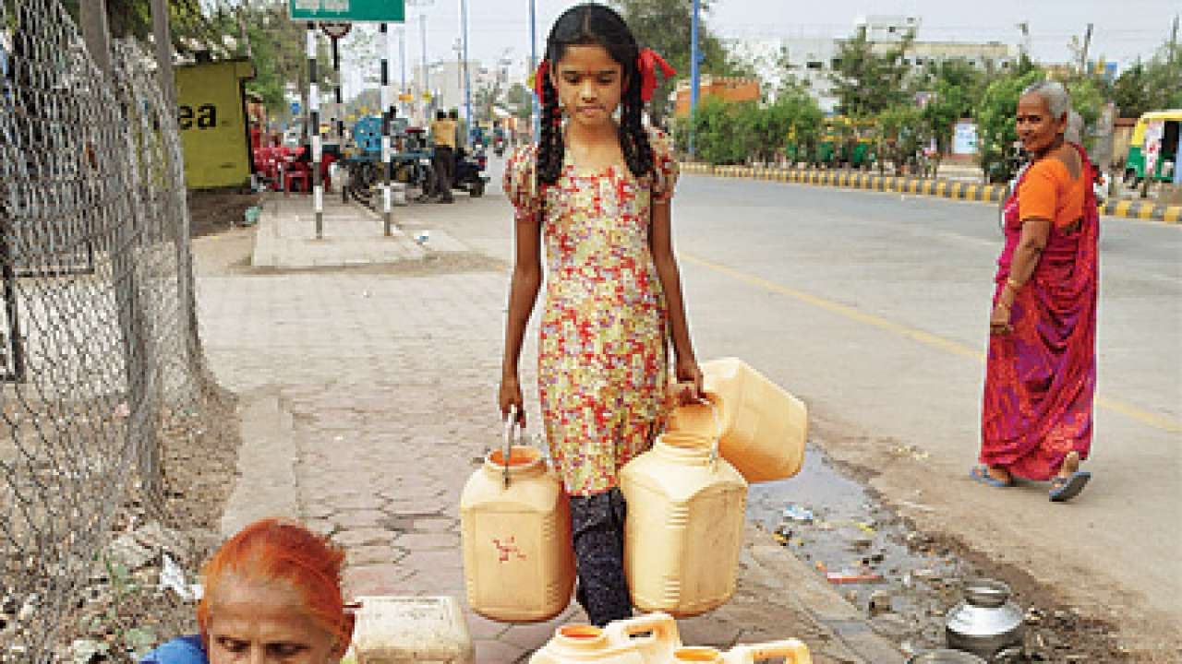
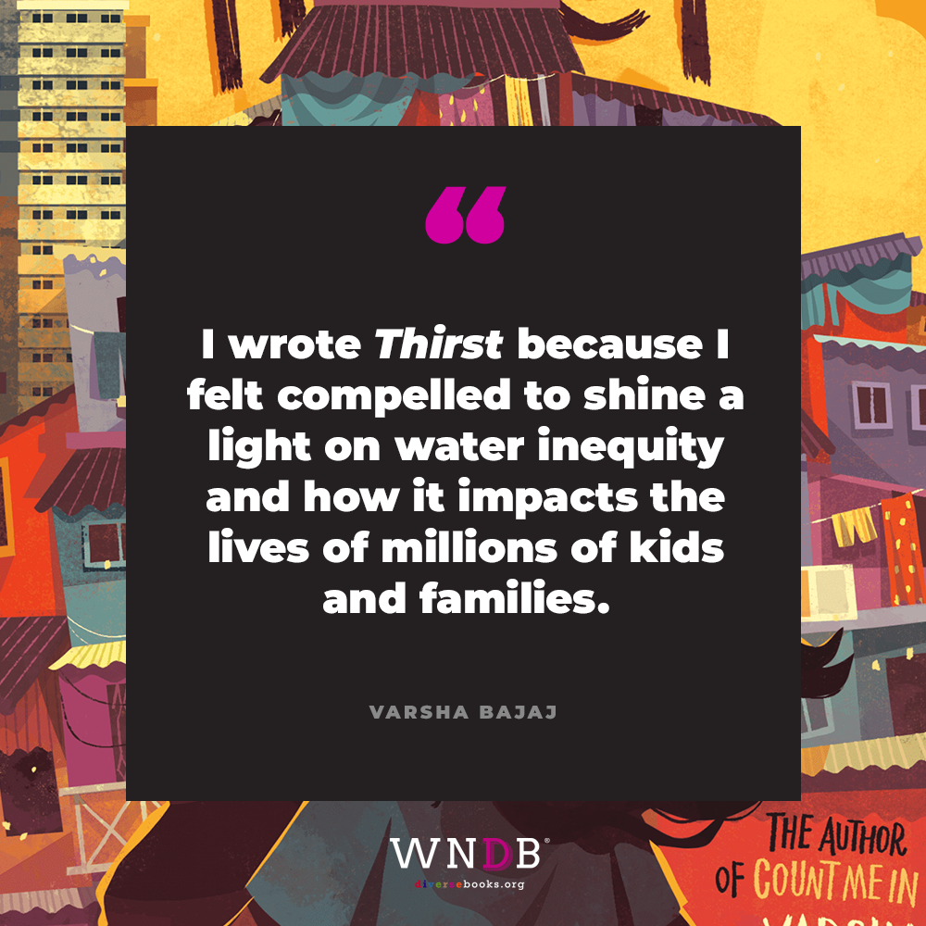
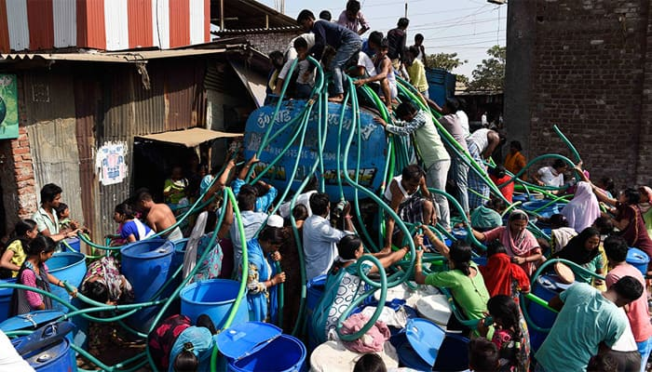
Thirst: Mumbai
https://diversebooks.org/blog-qa-with-varsha-bajaj-thirst/

Slide 25
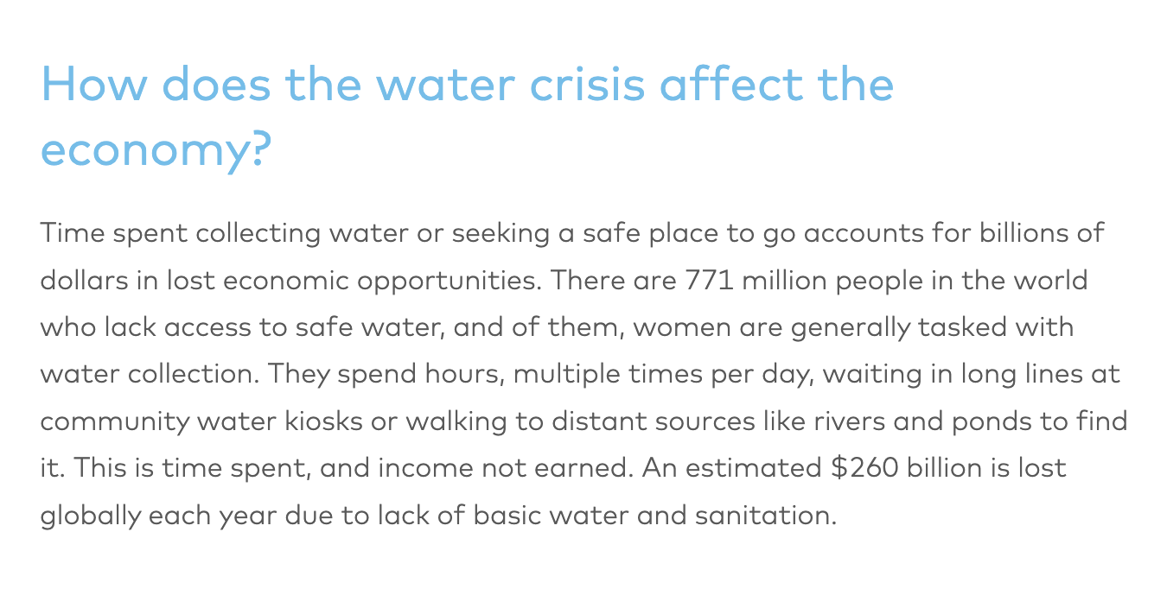
Thirst: How Water Effects the Economy?
https://water.org/our-impact/water-crisis/

Slide 26
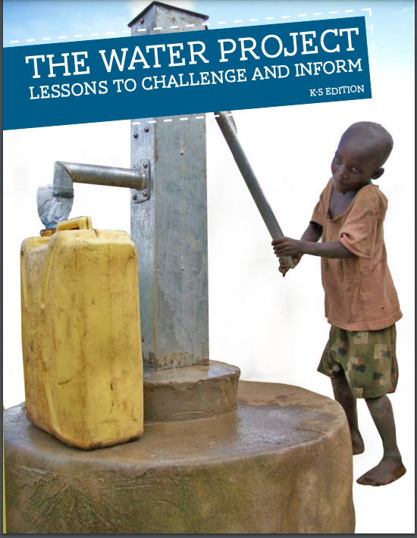
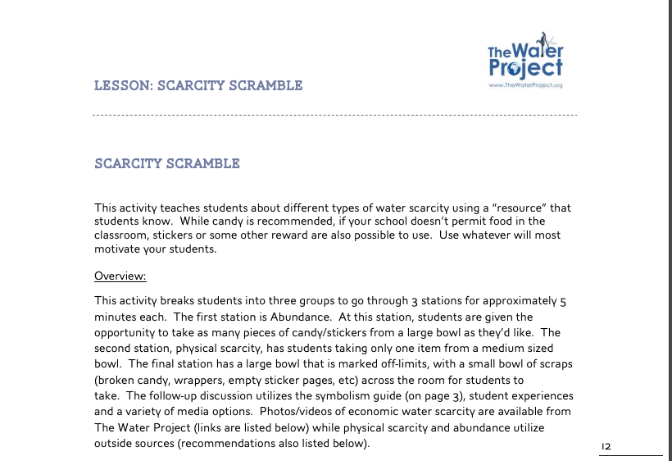
Scarcity Scramble
https://thewaterproject.org/resources/download/TheWaterProject-TeachingGuide-K5.pdf

Slide 27
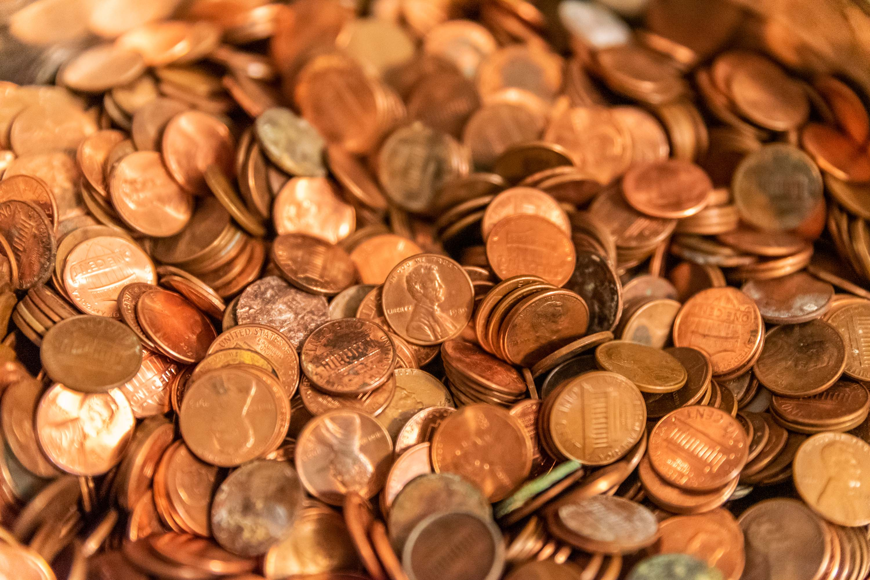

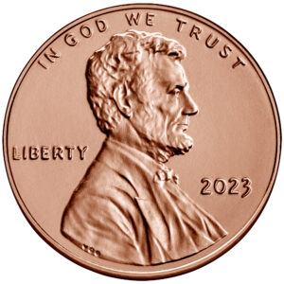
Abundance vs Scarcity Activity
Physical Scarcity
Economic
Scarcity
Abundance

Slide 28
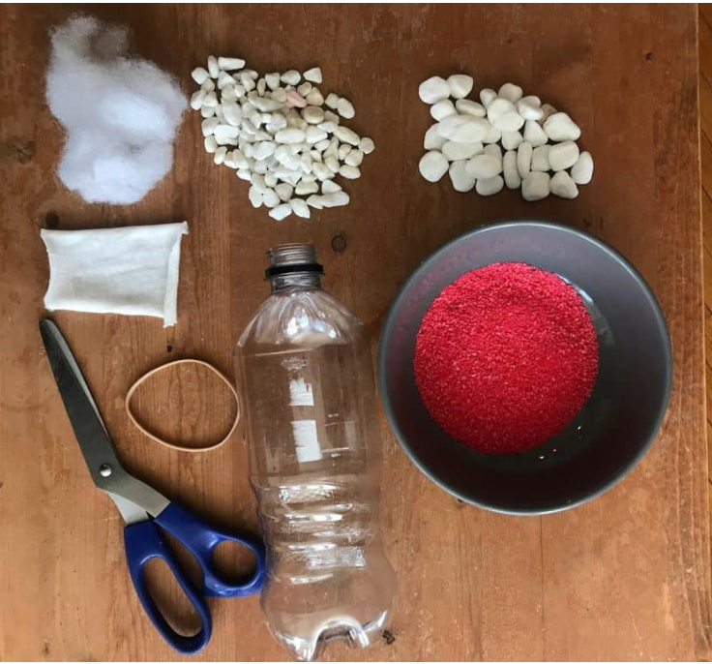
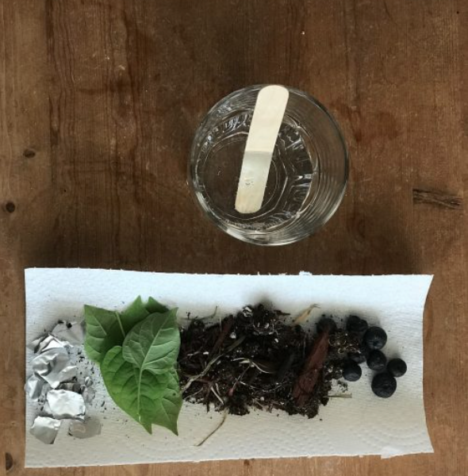
Make Your Own Water Filter
In this activity, learners will challenge themselves to create an effective water filter made from recycled materials and natural materials found outside. While this activity does not actually filter the water to the standards that allow for drinking, it will allow students to explore the first stage of water treatment, which is filtration.
Materials
https://pinnguaq.com/learn/create-a-water-filter-from-recycled-and-natural-materials/

Slide 29
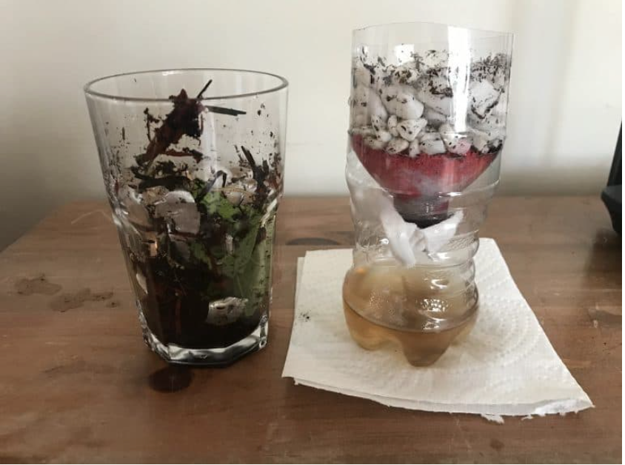
Creating a Water Filter
In this activity, learners will challenge themselves to create an effective water filter made from recycled materials and natural materials found outside. While this activity does not actually filter the water to the standards that allow for drinking, it will allow students to explore the first stage of water treatment, which is filtration.
https://pinnguaq.com/learn/create-a-water-filter-from-recycled-and-natural-materials/

Slide 30

When the World Runs Dry
(Informational Text)
Book Synopsis: This informational text explores the various ways in which water around the world is in danger, why we must act now, and why you’re never too young to make a difference.
Publisher: Workman Pub. Co.
Copyright Date: 2022
Reading Level: 6.0
Interest Level: 7-12

Slide 31

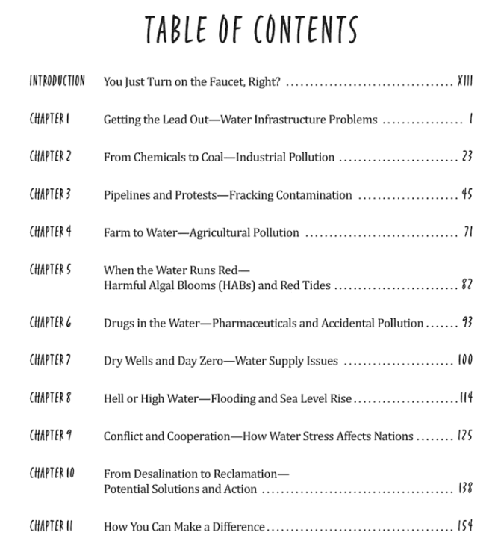
Topics Include:
Lead and water
Infrastructure problems
Pollution
Fracking contamination
Harmful algal blooms
Water supply issues
Rising sea levels
Potential solutions.

Slide 32

PART III
Eco-Anxiety
Eco-anxiety refers to a chronic fear of environmental doom.
Causes include:
Reading or watching too many books or programs concerning environmental events
Being involved in an traumatic ecological incident
Living in an area affected by climate change
Belonging to a vulnerable population

Slide 33
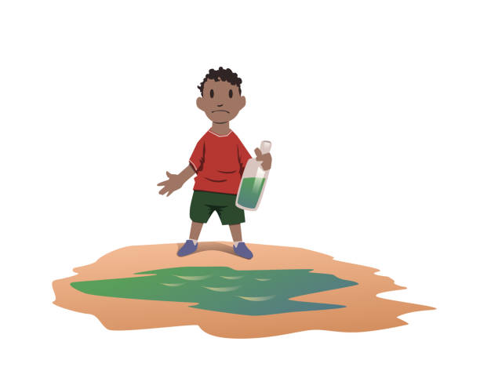
Eco-anxiety Teaching Tips
Use language children will understand.
Keep your explanations developmentally appropriate.
Young children need simple information they can understand and need to be reminded that they are safe.
Older students will have questions and will need an opportunity to express their range of emotions.

Slide 34

Eco-anxiety Teaching Tips
Take the time to talk.
Let students talk about their feelings and assure them what they are feeling is normal.
Remember that some children may not want to talk about their feelings.
Encourage these students to express themselves through writing, art, and other projects.

Slide 35
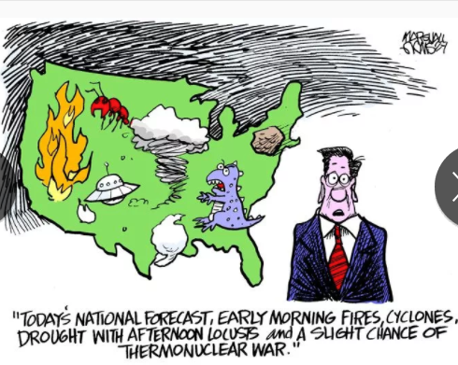
Eco-anxiety Teaching Tips
Monitor and limit television and news.
Developmentally inappropriate information and overexposure to news of the event can cause more anxiety or fear, particularly in young children.
Adults also need to be careful of the content of conversations that they have with each other in front of children.

Slide 36
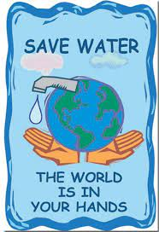
Assessment Questions
How might your water use habits change if you had to carry all the water you use into your home?
How might your water use habits change if you had to boil all the water you use in your home?
What does it mean to conserve water?

Slide 37
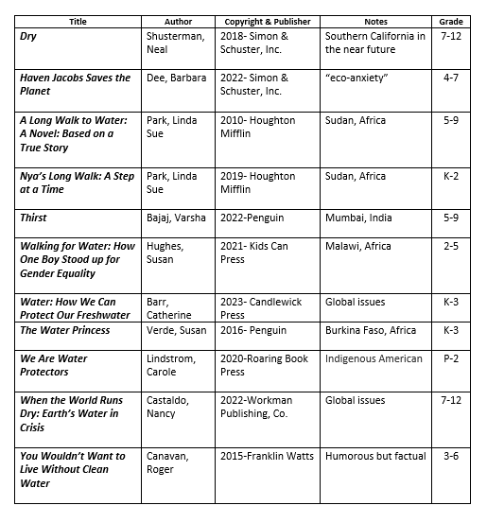
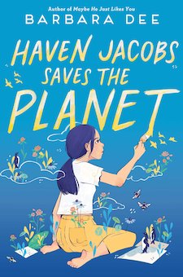
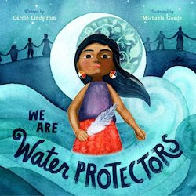
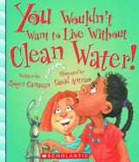


Children’s Books featuring Water Scarcity

Slide 38

Invest In Girls

Slide 39

NPFC

Slide 40

NEC

Slide 41

Suggested Presentation Deck
CEE Affiliates
https://www.councilforeconed.org/resources/local-affiliates/
Include your local affiliate page

Slide 42

Advocacy

Slide 43











Thank You to Our Sponsors!
43

Slide 44
Contact information
Thank You
Lauren Shifflett
shiffllh@jmu.edu
Lynne Stover
stoverlf@jmu.edu

