Slide 1
AP Macro Unit 5.3:
MONEY GROWTH & INFLATION

Slide 2
Presenter
Dr. Chris Cannon
Associate Director
Georgia Council on Economic Education
ccannon11@gsu.edu

Slide 3
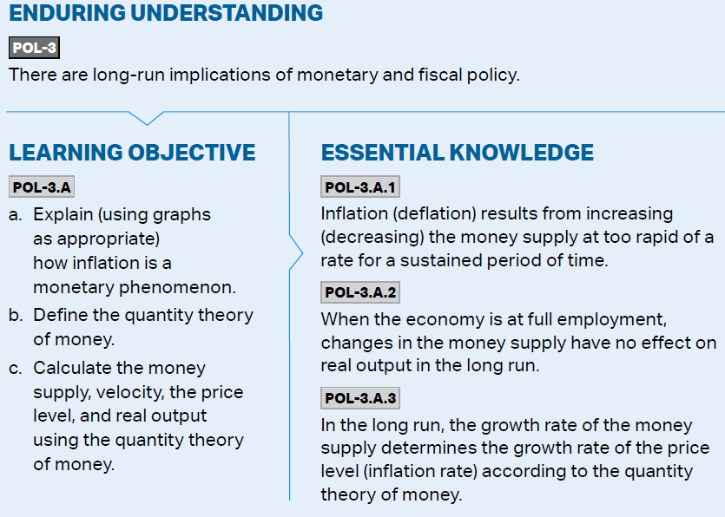
What is expected (from AP CED)

Slide 4
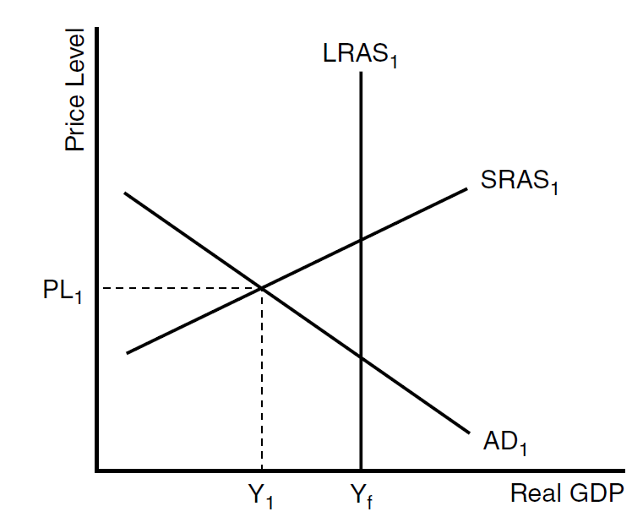
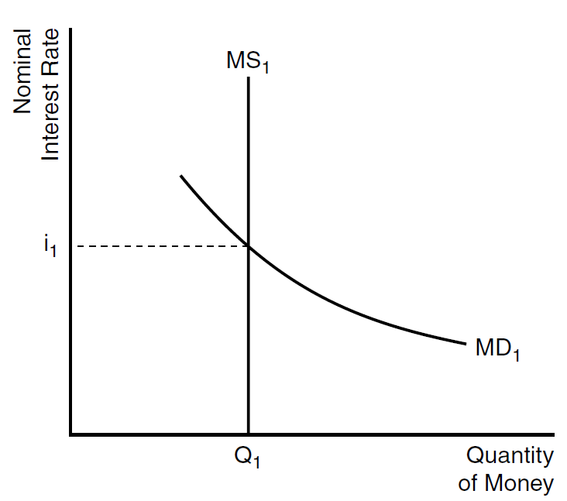
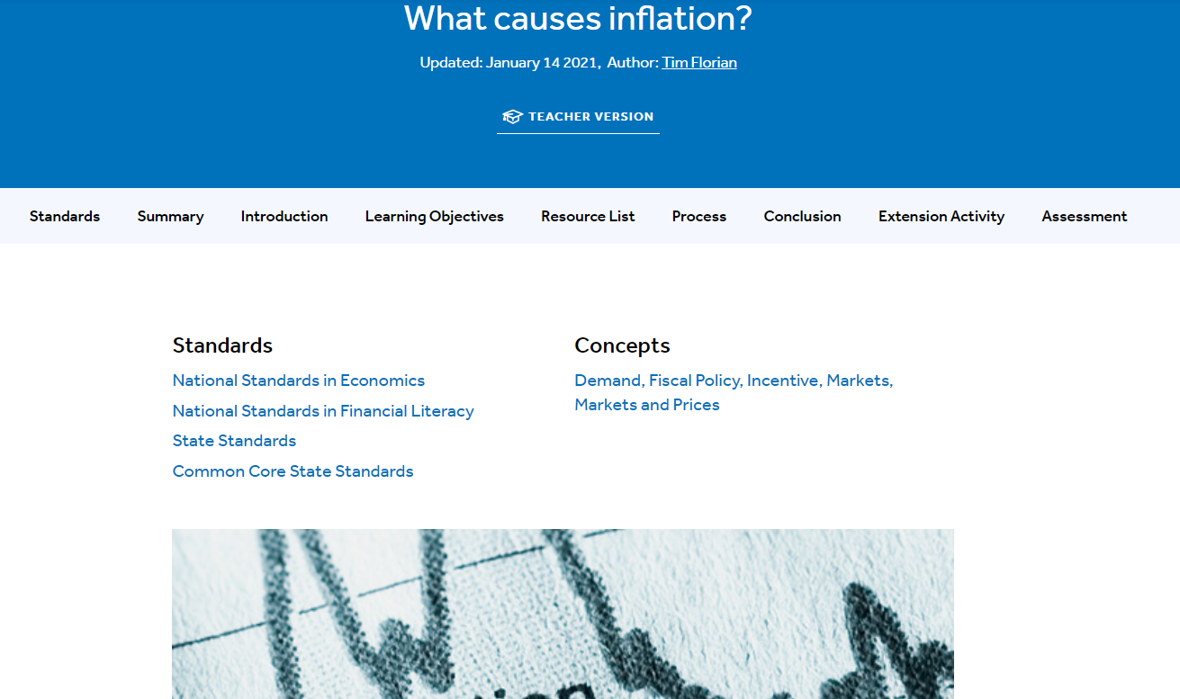
Foundational Content
Inflation
Causes over calculation
AD/AS Model
Money Market

Slide 5
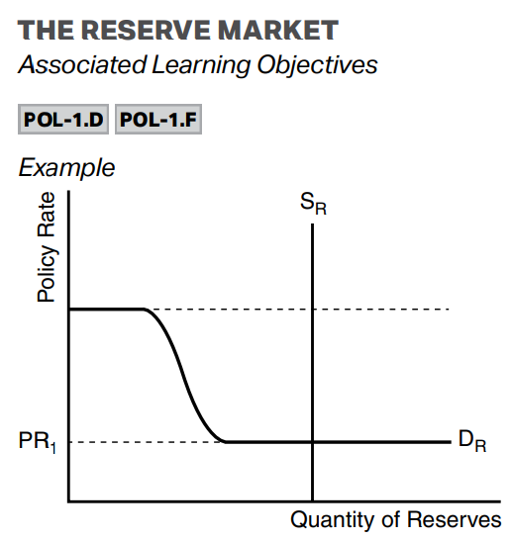
NEW NEW NEW NEW NEW NEW NEW NEW NEW NEW NEW
Reserve Market

Slide 6
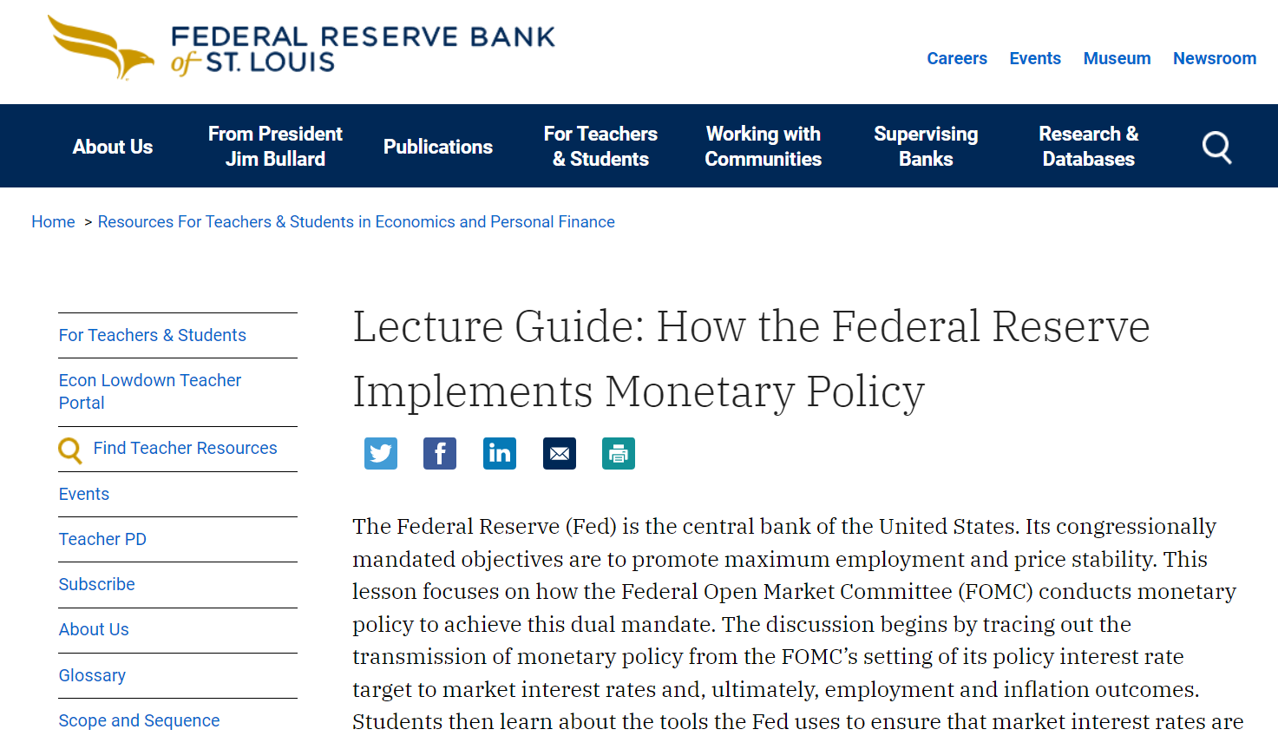
St. Louis Fed Material on new Monetary Policy
https://www.stlouisfed.org/education/monetary-policy-lecture-guide

Slide 7
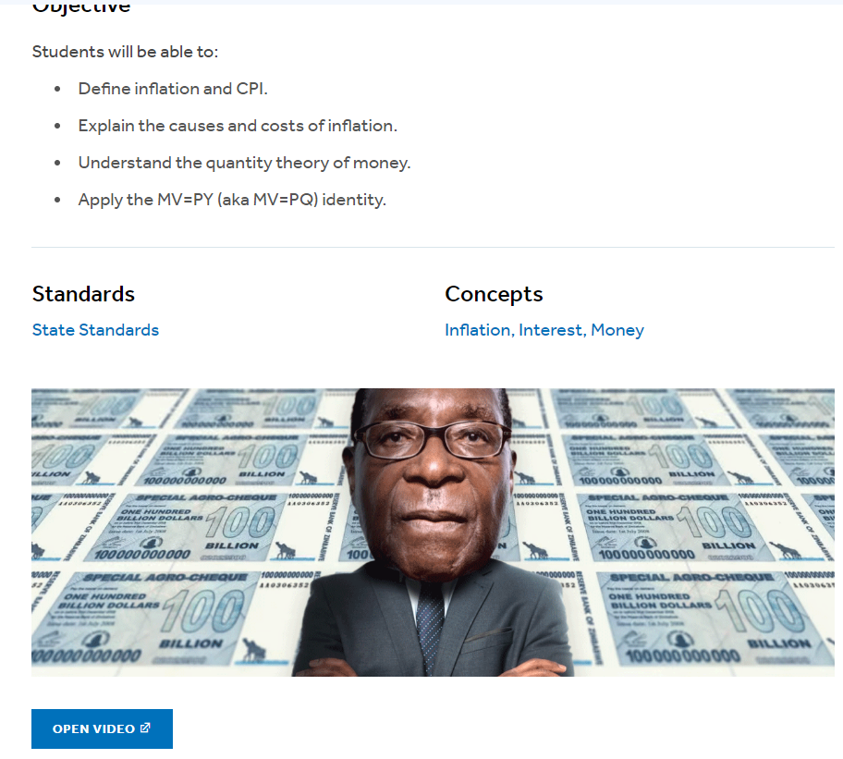
Inflation is a monetary phenomenon
This lesson/video from MRU can be found on EconEd link:
https://econedlink.org/resources/inflation-and-the-quantity-theory-of-money-video-series-and-quiz/

Slide 8
Student simulation…Inflation in real time
Pass out beans or toy dollars or paper clips as currency
Count the total
Auction off a candy bar or two and record the price
Pass out more beans/dollars/paper clips
Repeat the auction (it’s important to auction of the exact same item in the same quantity) and record the price
Repeat steps 4 and 5 as many times as desired
RESULT: more money w/ the same goods = higher prices!
(Lesson may be in Capstone materials or Greatest Hits?)

Slide 9
Inflation is a monetary phenomenon…on graphs
Link “printing money” to money market graph
MS2
i2
Q2

Slide 10
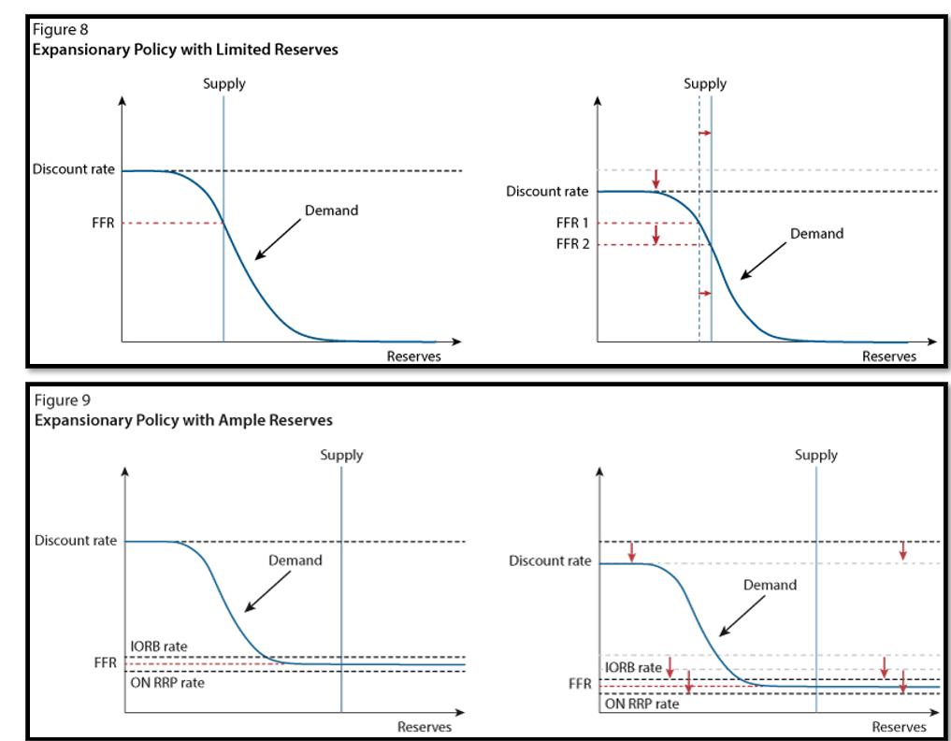

Slide 11
Inflation is a monetary phenomenon…on graphs
Increased money supply = lower interest rates = increases in C&I
PL2
AD2
Q2

Slide 12
The Quantity Theory of Money
https://econedlink.org/resources/inflation-and-the-quantity-theory-of-money-video-series-and-quiz/

Slide 13
Quantity Theory of Money - explaining inflation
Money Supply
Velocity
Price LEVEL
REAL GDP
(can also be Q)

Slide 14
NEW NEW NEW NEW NEW NEW NEW NEW NEW NEW NEW
M1 as of 2020
Coins and currency in circulation
Checkable (demand) deposits
Savings accounts
M2 as of 2020
Everything in M1
Money market funds
Certificates of Deposit
Other “time” deposits

Slide 15
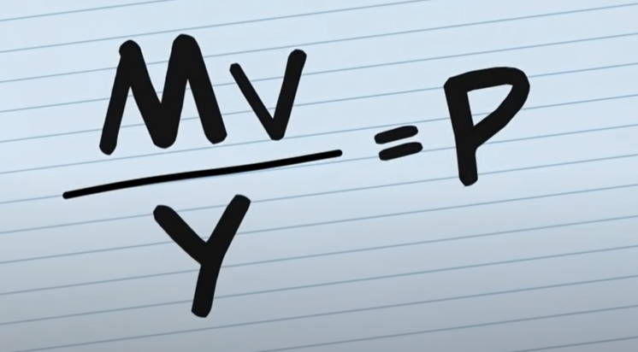
Quantity Theory of Money - explaining inflation
Re-written, this is the same as:

Slide 16
Quantity Theory of Money - explaining inflation
Real GDP (Y) does not vary wildly from year to year
Velocity (v) is relatively predictable for most people and the M2 velocity in the US has hovered between 1.2 and 1.9 for more than a decade
M is the variable with the MOST ability to influence price changes

Slide 17
Forbes article on Money Velocity in real life
https://www.forbes.com/sites/forbesfinancecouncil/2022/04/25/money-velocity-is-at-an-all-time-low-why-does-it-matter/?sh=764b958f3dfa

Slide 18
Suggestions for practice problems
Know the terminology
M x V = Nominal GDP
P x Q (or Y) = Nominal GDP
“In the quantity theory of money, nominal GDP is represented by which side of the equation?”
MV
PQ
Both (correct answer)
Neither…

Slide 19
Suggestions for practice problems
Do the algebra
“Assume the money supply is $100 and nominal GDP in an economy is $500. Calculate the velocity of money”
MV = PQ
100v = 500
v = 5

Slide 20
Suggestions for practice problems
Do the algebra
“If the average price level in the economy is 500 and Nominal GDP is 1000, according to the quantity theory of money, which MUST be true?”
M must equal 500
V must equal 500
Q must equal 1000
MV must equal 1000 (correct) or Q must equal 2 (correct)

Slide 21
Suggestions for practice problems
Theoretical questions
“Assume the Central Bank greatly increases the money supply and there is no change to the velocity of money. According to the quantity theory of money, which result is MOST likely?
Answer: Nominal GDP will increase
MV = PQ

Slide 22
Questions?
Thank you!

