Slide 1
WELCOME!
Housekeeping Items:
Please use the chat and/or Q & A function to ask questions or to notify moderator of issues
The session will be recorded and emailed to participants in the next few days
Thank you for joining us.
The webinar will begin shortly.

Slide 2
Unit 4: Financial Sector
Live Webinar: May 9th, 2022

Slide 3
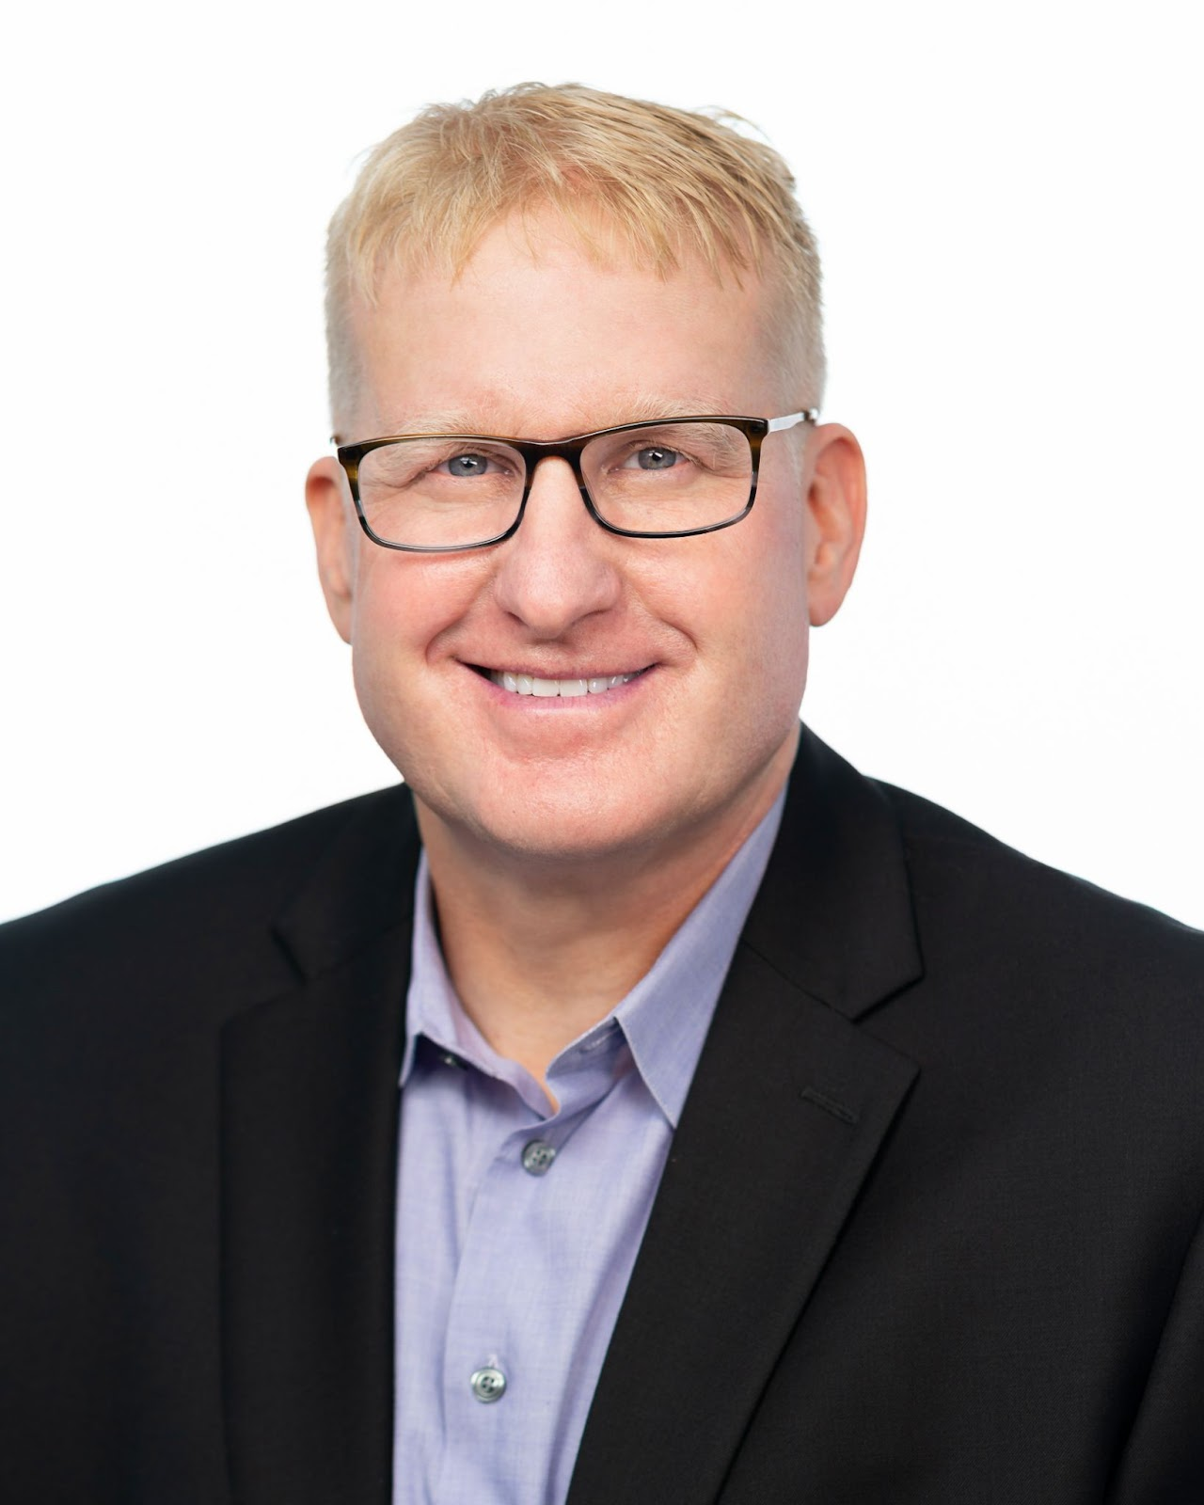
Instructor Bio
James Redelsheimer has been an AP and Regular Economics teacher at Robbinsdale Armstrong High School in Plymouth, Minnesota since 2003. James is a graduate of St. Olaf and received his Master's degree at the University of St. Thomas. He received the 3M Economics Educator Excellence Award from the Minnesota Council on Economic Education and was named Visa's Practical Money Skills Innovative Educator of the Month.
James enjoys traveling and has been a guest lecturer in the economics department at the Batumi State University in The Republic of Georgia and has received travel grants and fellowships for study travel to learn about the economies of Japan, China, Turkey, Germany, Korea, among others, and studied economics of the environment in Costa Rica. He currently serves as an AP Economics reader, grading AP Economics exams. He enjoys teaching Economics because it relates to students' everyday lives.

Slide 4
Webinar Objectives
In this webinar teachers will be able to:
Describe the key characteristics and risk tolerance of holding bonds, stocks, and cash.
Explain how bond prices and interest are inversely related

Slide 5
The Financial Sector
Individuals, businesses, and governments borrow and save so they need institutions to help.
Financial Sector- Network of institutions that link borrowers and lenders. Includes banks, mutual funds, pension funds, and other financial intermediaries.
Assets- Anything tangible or intangible that has value.
Interest Rate- The amount a lender charges borrowers for borrowing money. It’s the “price” of a loan.
Interest-bearing Assets – Assets that earn interest over time. e.g. bonds.
5

Slide 6
Personal Finance and Investment
Personal finance refers to the way individuals and families budget, save, and spend.
In a personal finance class, you learn about checking and savings accounts, credit cards, loans, the stock market, retirement plans, and how to manage your assets, but…
The word “INVESTMENT” in econ will always refer to business spending on tools and machinery.
A low interest rate will increase investment.
Copyright
ACDC Leadership 2019
6

Slide 7
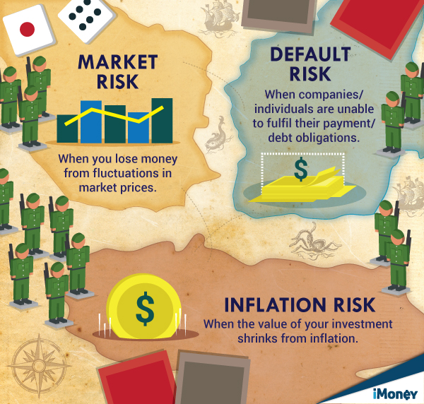
Risks of Buying Assets
7

Slide 8
Liquidity- the ease with which an asset can be converted to a medium of exchange. In general, the higher the liquidity the lower the rate of return

Slide 9
Bonds v. Stocks
Bonds (securities) are loans, or IOUs, that represent debt that the government, business, or individual must repay to the lender.
The bond holder has NO OWNERSHIP of the company and is paid interest.
To get more money, you could sell half of your company and issue shares of stock.
Stocks (equities) represent ownership of a corporation and the stockholder is often entitled to a portion of the profit paid out as dividends.
9

Slide 10
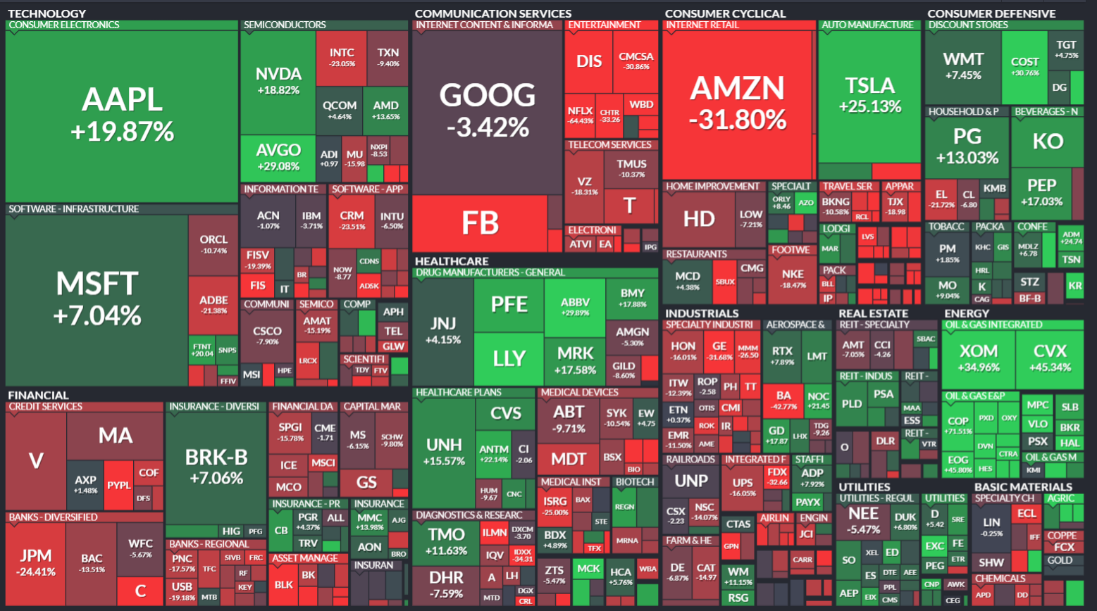

Slide 12
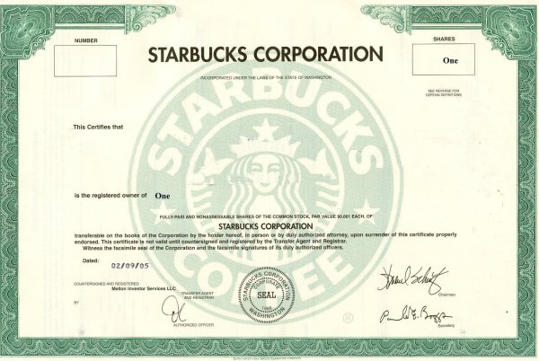
Buying a Stock
You buy 1 share of 1.5 billion shares
Value of Your Shares
(Current stock price) X (# of shares you buy)
How You Make Money
Receive dividends of ~ $1.00 per share per year
Sell your share at a higher price than you bought it
Risk
Volatility of market
Price could plummet & not recover
Impossible to know when to sell to maximize earnings

Slide 13
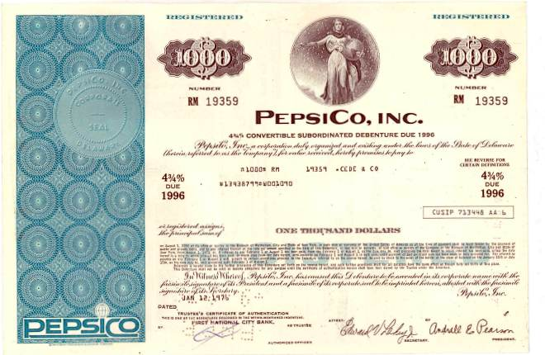
Buying a Bond
You lend $1,000 to PepsiCo when they issue a bond
Terms of the Agreement
4.75% interest per year on the amount you lent to them
Repay your $1,000 at the end of the term (10 years)
How You Make Money
$47.50 per year for 10 years
$1,000 at end of term (this was your money in the first place)
Risk
Company/govt cannot repay you due to bankruptcy

Slide 14
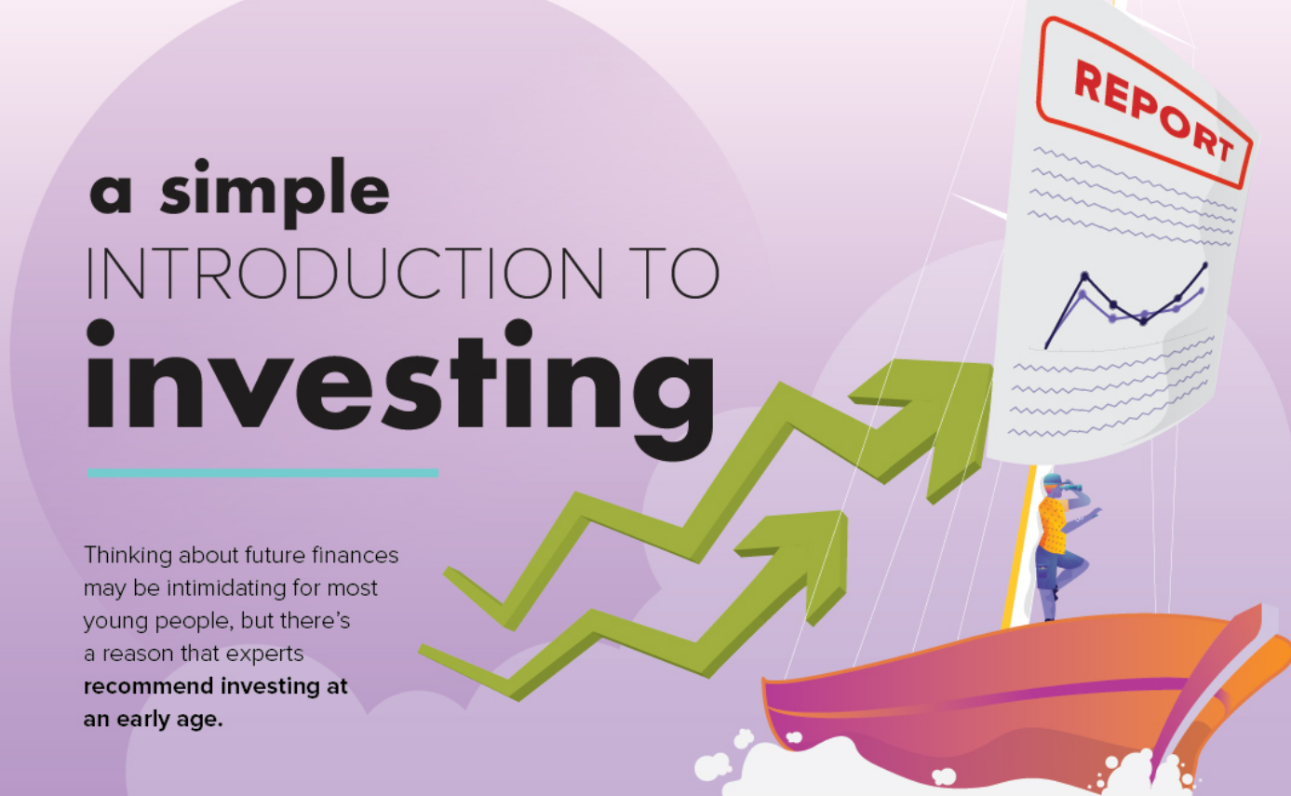

Slide 15
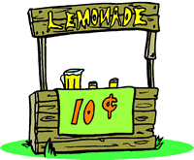
Bonds vs. Stocks
Pretend you are going to start a lemonade stand. You need some money to get your stand started. What do you do?
You ask your grandmother to lend you $100 and write this down on a piece of paper: "I owe you (IOU) $100, and I will pay you back in a year plus 5% interest."
Your grandmother just bought a bond.
Bonds are loans, or IOUs, that represent debt that the government or a corporation must repay to an investor. The bond holder has NO OWNERSHIP of the company.
Ex: War Bonds During World War II
But, now you need more money…

Slide 16
Bonds vs. Stocks
To get more money, you sell half of your company for $50 to your brother Tom.
You put this transaction in writing: "Lemo will issue 100 shares of stock. Tom will buy 50 shares for $50."
Tom has just bought 50% of the business.
A stock owner is part owner of a company. He is allowed to make decisions and is entitled to a percent of the profits.

Slide 17
Which of the following is true for bonds but not for stocks?
A. Bonds are the least liquid form of assets.
B. Bonds represent partial ownership in a company.
C. Bonds earn variable rates of return.
D. Bonds are interest-bearing assets.
E. Bonds have zero opportunity cost.

Slide 18
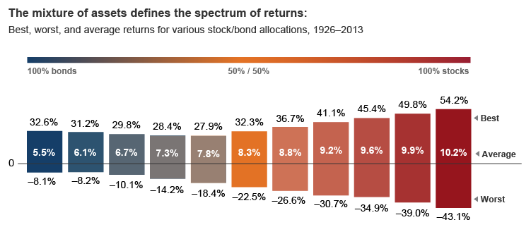

Slide 19
Bonds Prices and Interest Rates
A bond is issued at a specific interest rate that doesn’t change throughout the life of the bond.
Example: Assume a 30 year U.S. Treasury bond has a face value of $1000 and the interest rate is 5%. Each year, for 30 years, you will get $50.
If the interest rate falls and new bonds are being issued at 3% then people would rather have the old 5% bonds.
If you like, you can sell bonds before they mature.
If you sold the original 5% bond, buyers would bid up the price since they would rather have 5%.
The Point: Bond price and interest rates are inversely related.
19

Slide 20
Assume you bought a bond one year ago with an interest rate of 5%, but today interest rates are 3%. Explain:
What will happen to the price of the bond you hold, and why?
The price of your bond increases, due to higher demand for your bond.

Slide 22
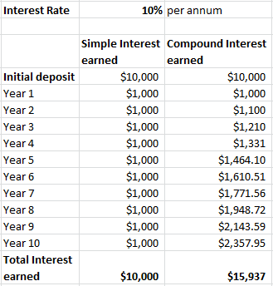
Compounding interest is the interest earnedon both the principal and the interest an account has already earned.

Slide 23
If you double a penny every day,
how much $ will you have in 30 days?
Day 1: $.01
Day 2: $.02 Day 3: $.04 Day 4: $.08 Day 5: $.16 Day 6: $.32 Day 7: $.64 Day 8: $1.28 Day 9: $2.56 Day 10: $5.12 Day 11: $10.24 Day 12: $20.48 Day 13: $40.96 Day 14: $81.92 Day 15: $163.84
Day 16: $327.68 Day 17: $655.36 Day 18: $1,310.72 Day 19: $2,621.44 Day 20: $5,242.88 Day 21: $10,485.76 Day 22: $20,971.52 Day 23: $41,943.04 Day 24: $83,886.08 Day 25: $167,772.16 Day 26: $335,544.32 Day 27: $671,088.64 Day 28: $1,342,177.28 Day 29: $2,684,354.56 Day 30: $5,368,709.12!!!

Slide 25
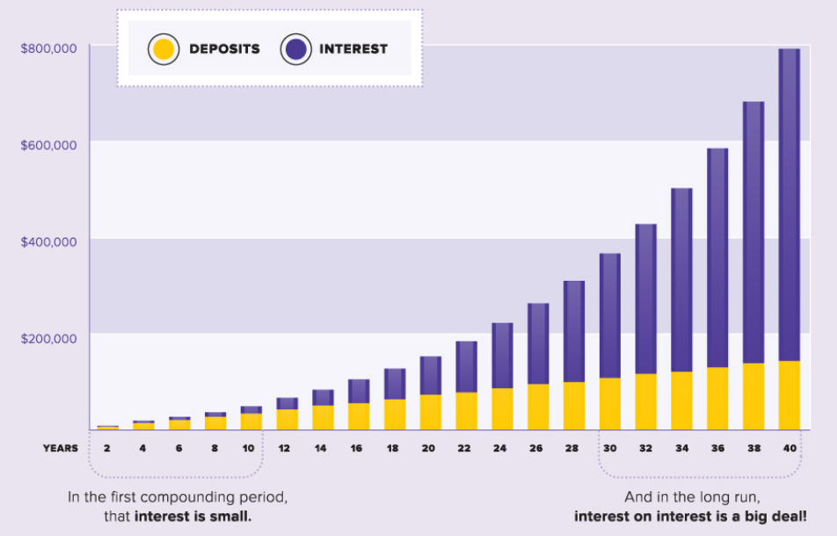

Slide 26
checking account/cash
savings account
real estate bitcoin
For each individual, suggest one financial asset from the list provided appropriate for his/her circumstance and explain your reasoning.
Luke has $700 that he doesn’t need to spend at the moment. However, when he has $1,500 he would like to buy a car. He’s planning to have all the money within the next six months.
Savings account; gain more interest than cash/checking, more liquid than CD, balance too low for money market
certificates of deposit bonds stocks (equities)

Slide 27
checking account/cash
savings account
real estate bitcoin
For each individual, suggest one financial asset from the list provided appropriate for his/her circumstance and explain your reasoning.
2. Han is 25 years old and has $10,000 and his goal is to double the value of his money. He isn’t worried if his money declines in value in the short term.
Stocks; not afraid of risk, young, long-time horizon
certificates of deposit bonds stocks (equities)

Slide 28
checking account/cash
savings account
real estate bitcoin
certificates of deposit bonds stocks (equities)
For each individual, suggest one financial asset from the list provided appropriate for his/her circumstance and explain your reasoning.
3. Rey has $5,000 that she can save. She would like her money to increase in value but she’s very risk averse. She won’t expect to need this money for at least two years.
Certificate of deposit; very low risk, she doesn’t need liquidity, so get the higher interest of a CD

Slide 29
checking account/cash
savings account
real estate bitcoin
certificates of deposit bonds stocks (equities)
For each individual, suggest one financial asset from the list provided appropriate for his/her circumstance and explain your reasoning.
4. Lando has $10,000. He earns income by buying cars, fixing them up and selling them, so he needs access to his money because he always needs to be ready to buy a car when he finds a deal.
Checking/cash; he needs liquidity above all else

Slide 30
checking account/cash
savings account
real estate bitcoin
certificates of deposit bonds stocks (equities)
For each individual, suggest one financial asset from the list provided appropriate for his/her circumstance and explain your reasoning.
5. Leia received a $250,000 inheritance from her uncle. She wants an asset that will continue to generate passive income for her for several decades, but she is worried that there is a bubble in the stock market.
Real estate. Investment property generates passive income. She is ok with little liquidity.

Slide 31
checking account/cash
savings account
real estate bitcoin
certificates of deposit bonds stocks (equities)
For each individual, suggest one financial asset from the list provided appropriate for his/her circumstance and explain your reasoning.
6. Steve is 66 years old and has been retired for the past two years. He has saved well for retirement and is now is happy to accept lower returns in favor of more security at this point in his life.
Bonds; needs low risk, doesn’t need liquidity at the expense of higher returns

Slide 33
When consumers hold money rather than bonds because they expect the interest rate to increase in the future, they are holding money for which of the following purposes?
A. Transactions
B. Unforeseen expenditures
C. Speculation
D. Illiquidity
E. Exchange

Slide 34
Which of the following measures the opportunity cost of holding currency?
A. The nominal wage rate
B. The increase in the demand for money
C. The forgone interest on alternative assets
D. The ability to access currency to meet unexpected expenses
E. The average income tax rates

Slide 35
Which of the following describes a major difference between stocks and bonds?
A. Stocks represent ownership in a corporation, and bonds represent a loan to a corporation.
B. Bonds represent ownership in a corporation, and stocks represent a loan to a corporation.
C. Stocks are counted in gross domestic product, and bonds are not counted.
D. Bonds are counted in gross domestic product, and stocks are not counted.
E. Bonds pay dividends, and stocks earn interest.

Slide 36
Assume that a country’s government increases borrowing. What will most likely happen to the prices of previously issued bonds and the price level in the short run?
 | Bond Prices | Price Level
A | Increase | Increase
B | Increase | Decrease
C | Increase | No Change
D | Decrease | Increase
E | Decrease | Decrease

Slide 37
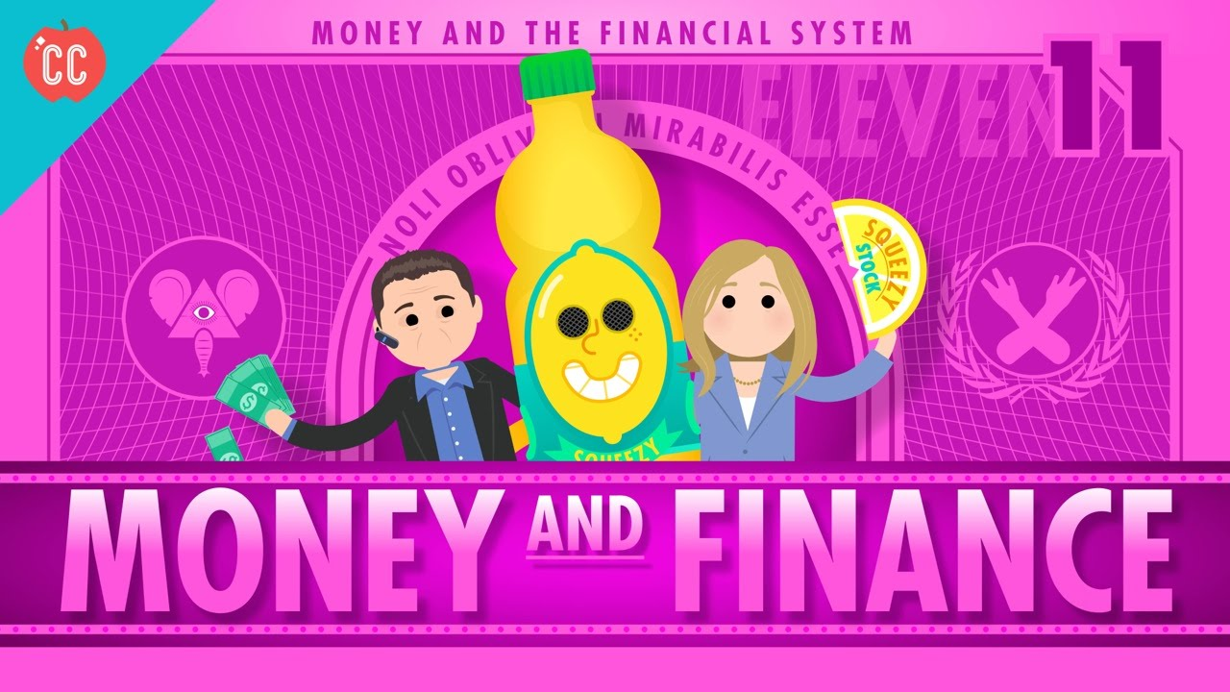
Notes:
https://www.youtube.com/watch?v=Dugn51K_6WA

Slide 38
Additional Resources
Curriculum:
Additional MCEE K-12 Resources: z.umn.edu/TeacherResources
Council for Economic Education (National):
EconEdLink
ReadyAssessments

Slide 39
Thank You
James Redelsheimer | jred40@gmail.com
mcee.umn.edu | mcee@umn.edu | 612.625.3727

