Slide 1
College and Career Readiness: The Economics of College: Inflation, Interest Rates & Higher Education Presented by Matthew Gherman Edward R. Murrow High School 10/11/21 mgherman@schools.gov

Slide 2
EconEdLink Membership
You can now access CEE’s professional development webinars directly on EconEdLink.org! To receive these new professional development benefits, become an EconEdLink member. As a member, you will now be able to:
Automatically receive a professional development certificate via e-mail within 24 hours after viewing any webinar for a minimum of 45 minutes
Register for upcoming webinars with a simple one-click process
Easily download presentations, lesson plan materials and activities for each webinar
Search and view all webinars at your convenience
Save webinars to your EconEdLink dashboard for easy access to the event
You may access our new Professional Development page here

Slide 3
Professional Development Certificate
To earn your professional development certificate for this webinar, you must:
Watch a minimum of 45-minutes and you will automatically receive a professional development certificate via e-mail within 24 hours.
Accessing resources:
You can now easily download presentations, lesson plan materials, and activities for each webinar from EconEdLink.org/professional-development/

Slide 4
Agenda
How to motivate and build a better understanding of inflation with an application to college loans, understanding debt and personal finance.
To examine how we are affected by developments in the macro economy.

Slide 5
Objectives
Motivations to introduce inflation
Activities to build on inflation
Connecting inflation to the loan process
Understanding the causes of inflation

Slide 6
National Standards
11.3 The consumer price index (CPI) is the most commonly used measure of price-level changes. It can be used to compare the price level in one year with price levels in earlier or later periods.
12.The real interest rate is the nominal or current market interest rate minus the rate of inflation.

Slide 7
State Standards
12.E1a In making economic decisions in any role, individuals should consider the set of opportunities that they have, their resources (e.g., income and wealth), their preferences, and their ethics.
12.E1b Sound personal financial (money management) practices take into account wealth and income, the present and the future, and risk factors when setting goals and budgeting for anticipated saving and spending. Cost-benefit analysis is an important tool for sound decision making. All financial investments carry with them varying risks and rewards that must be fully understood in order to make informed decisions. Greater rewards generally come with higher risks.
12.E1c Managing personal finance effectively requires an understanding of the forms and purposes of financial credit, the effects of personal debt, the role and impact of interest, and the distinction between nominal and real returns. Predatory lending practices target and affect those who are least informed and can least afford such practices. Interest rates reflect perceived risk, so maintaining a healthy credit rating lowers the cost of borrowing.

Slide 8
Part 1: College Motivation

Slide 9
Cartoon Analysis

Slide 10
Inflation Definition
Inflation is the decrease in the purchasing power of our dollar. How much money it takes to buy one good from one year to the next. Essentially it is paying more for the same/less goods/services from one year to the next.
Symptom: Higher Prices

Slide 11
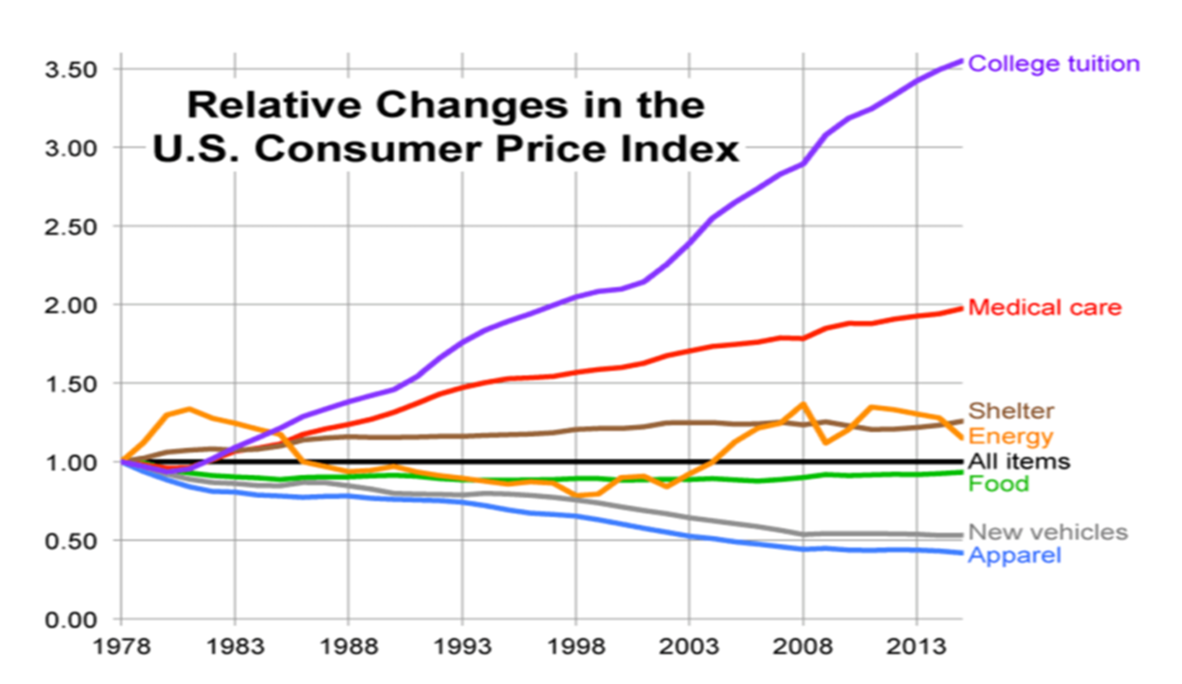
Class question: Why do you think is the cause for this situation?

Slide 12
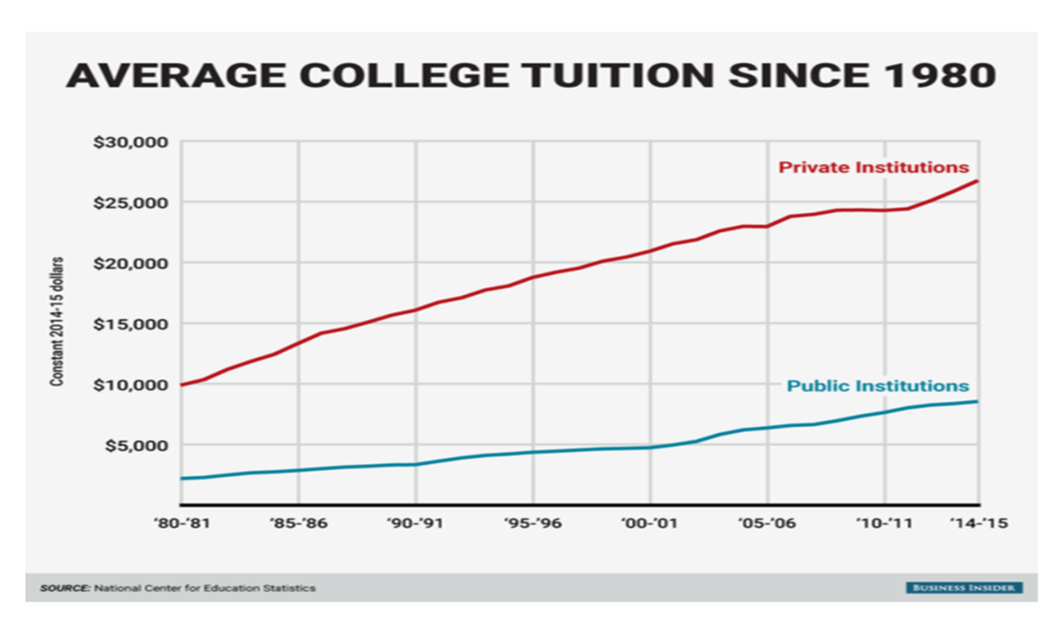

Slide 13
College Inflation Stats
“…If the cost of college tuition was $10,000 in 1986, it would now cost the same student over $21,500. If education had increased as much as the average inflation rate… but instead education is $59,800, or over 2 ½ times, the inflation rate.” – The College Trap
According to the College Board, tuition and fees at private universities have risen to an average of $34,740 per year. J.P. Morgan predicts four years at a private college could cost as much as $48,004 in 2035

Slide 14
College Inflation Stats
“A good rule of thumb is that tuition rates will increase at about twice the general inflation rate. On average, tuition tends to increase about 8% per year. An 8% college inflation rate means that the cost of college doubles every nine years.” – finaid.org
https://nces.ed.gov/fastfacts/display.asp?id=76

Slide 15
Part II: Calculation and Causes

Slide 16
How is inflation Calculated?
Price stability measures the change in the price level.
The price level measures the average change over time in the prices paid by urban consumers for a market basket (collection of goods) of consumer goods and services (how much it would cost today, for last year’s goods). This is also known as the Consumer Price Index.
300 goods and services broken into different categories and weighted.

Slide 17
Inflation Rate
The rate of change of one period to another period is known as the inflation rate.
When inflation increases or decreases this is referred to as a change in the price level.
This is percentage change in the market basket/price index.

Slide 18
What are the causes?
Demand Pull
Graph
Increase in total spending (AD) in the economy
Not necessarily bad at first
Increase in ability and willingness to spend = increase in production and rise in prices
Becomes bad when too much money starts to chase too few goods and services…Spending is greater than production

Slide 19
What are the causes?
Cost-Push Inflation
Graph
Bad
Increase in the cost of resources
Increase in expectation of prices
Decrease in businesses ability and willingness to produce
Decrease in production leads to higher prices and more unemployment
STAGFLATION! Worst economic condition

Slide 20
What are the causes?
The Inflation Spiral
Graph
Self-sustaining upward trend in general price levels due to interaction of demand pull and cost push inflation
“Wage-price spiral”
High cost of living prompts demands for higher wages
This pushes production costs up forcing firms to increases prices
This in turn triggers calls for fresh wage increases ... and so on

Slide 21
Part III: Effects

Slide 22
Inflation “Erosion” Formula
Real (true value/adjusted for inflation value)
Nominal (on paper/unadjusted value)
Real _____ = nominal ______ - inflation rate
0% rate of growth = 2% savings account – 2% inflation rate

Slide 23
Banks | Consumers | Businesses | Government
Inflation Tax | Real = nominal – inflation Erodes purchasing power Erodes Savings Erodes Fixed income Erodes wage gains Erodes Bond Values Expected vs. unexpected inflation | Unit of Account Effect Menu Costs Elastic Businesses lose money | Inflation Temptation Depreciation of currency Lack of foreign capital

Slide 24
Personal Finance: bonds
https://www.youtube.com/watch?v=IuyejHOGCro
For bonds, assume:
1) bonds’ interest rate is non-variable (does not change);
2) bonds are traded like stocks – they can increase and decrease in value.
Bonds are “IOU’s” from the government, corporations and the Federal Reserve. People give these entities loans and are paid back after a certain period of time (called a maturity date) with the principal (initial amount) plus a yearly compounded interest. For example, a $1,000 5% bond over the course of 5 years = year 1: 1,050; year 2: 5% interest of$1,050 = $1,152 and so forth up until year 5.
OR…
the bond rate (or coupon rate) creates a yearly income; so a $1,000 bond with a 5% coupon rate will give you an income of $50 per bond

Slide 25
Problems in Accounting for inflation
Does not account for changes in technology
Does not account for changes in improvements in quality
Only the urban consumer is calculated: not the entire economy

Slide 26
Part IV: rEturn to College

Slide 27
Composition of a Loan
Principal: Amount of loan
Interest: Extra percentage you must pay to the bank
Balance: Amount remaining on a loan

Slide 28
How do banks make their money?
Part I: Interest, a.k.a profit of the bank for loaning money
Part II: Amortization Schedule
https://www.bankrate.com/calculators/mortgages/loan-calculator.aspx
Amortization: Paying off debt over time with fixed regular installments
Amortization Schedule: Allocation of payments between interest and principal. Early payments have a higher percentage of interest and less principal.

Slide 29
Why is paying off loans so hard?
Answer: Inflation and Fisher’s hypothesis
Fisher’s Hypothesis: loans are paid over a long period of time, so over this time, inflation will set in and erode the real profit of the banks

Slide 30
Fisher’s Hypothesis
Nominal = real + expected inflation
So 6% = 4% + 2%
Then when inflation happens…
Real = nominal – inflation
4%= 6% - 2%
The bank maintains its % real profit from the outset of the loan.

Slide 31
What can we do to pay it off quicker?
Make sure loan is fixed!
fixed vs. variable
Pay more than minimum
reduces the length of your loan
Split (bi-weekly payments)
13 payments per year instead of 12!

Slide 32
Saving while in college
DON’T buy new textbooks
DON’T leave home without your student ID.
DO limit meals out
DO choose housing wisely.
DO explore campus amenities
DON’T own a car.
DO visit your local bank.
DO monitor cell phone usage
DON’T be careless with credit cards
DO stay focused on your studies!
Buy in bulk
Meet application deadlines.
Start paying off interest now

Slide 33
Saving While in College Activities
CEE Activity Calculators
https://econedlink.org/resources/student-budget-analysis-calculator/
https://econedlink.org/resources/college-savings-calculator/

Slide 34
Thinking ahead…
Savings Account
Mutual funds/stocks/private broker
529s
Education Savings Account
Uniform Transfer/Gift to Minors Act
“A dollar saved is a dollar not in debt”

Slide 35
Before you save for your kids…
Pay off any debt (this includes things like your credit card debt, your own student loan debt, etc.)
Set up an emergency fund of 3 to 6 months of expenses to cover any unexpected costs
Put 10-15% of your income toward retirement savings through your employer-sponsored retirement plan, like a 401(k) and/or a Roth IRA

Slide 36
529’s
“If your goal is to save for college, a 529 plan is where you should put your money." -- Marcus Cordero, CEO Gradvisor
“A 529 plan can be a smart way to save for college expenses, and has some clear advantages over using a standard brokerage account. With a 529, you can grow your savings tax-free, and may even get some nice state tax incentives for your contributions.” – The Motley Fool

Slide 37
529 Pros & Cons
Pros | Cons
Investments are allowed to grow on a tax-deferred basis Withdrawals will be 100% tax-free, as long as the proceeds are used for qualifying education expenses. Tax deduction if the 529 is run by the state you live in Age-based growth Unlimited/very high contribution Electronic Transfers/Gift Transfers Parental Control Can transfer to other children | Penalties for early withdrawal Penalties for non-education withdrawal Limited investment options Age-Based Growth

Slide 38
Other Options
Education Savings Account (ESA) or Education IRA | UTMA or UGMA (Uniform Transfer/Gift to Minors Act)
An ESA allows you to save $2,000 (after tax) per year, per child Pros: Tax free growth and withdrawal for education Variety of investment options Cons: Hard allowance limit ($2,000) Hard withdrawal age (30) Income limit to qualify | An UTMA/UGMA differs from ESAs and 529 Plans in how they aren’t designed just for education savings The account is in the child’s name but is controlled by a custodian (usually a parent or grandparent). This person manages the account until the child reaches age 21 At age 21 (age 18 for the UGMA), control of the account transfers to the child to use any way they choose Pros: Funds can be used for more than just college expense Tax advantages for the contributor Cons: Beneficiary can use money however they choose once of legal age (pay for college or a sports car) Beneficiary can’t be changed after selected

Slide 39
Stocks vs. Mutual Funds
Stocks | Mutual Funds
Pros: Most liquid No restrictions Cons: Low interest rates Tax penalty for interest rates No Parental control after 18 | Pros: Liquid No restrictions Growth Dividend/income potential Any investment option you want Parental control? Cons: Tax penalty for dividends Tax penalty for withdrawal Parental control?

Slide 40
Assessment #1: Inflation Activity
See handout

Slide 41
Assessment Question #2: How to Choose the Right College
Watch the following two videos:
https://www.youtube.com/watch?v=h6UeibGuIXc
https://www.youtube.com/watch?v=1u3BVR24ffE
What are 3 pieces of advice you found most helpful/useful? Explain why.

Slide 42
Assessment #3: Compare & Contrast Colleges
Examine two colleges you are thinking about applying to or attending
Research the courses offered to help you achieve your career goal. Which college offers the better courses/educational environment/interning opportunities? For this part, you may just simply spend some time navigating two websites and write a paragraph on your final thoughts between both. Consider the above questions in your comparison.
How do the two colleges compare in cost? Use a mortgage calculator to determine how much you would have to pay each month, and for how long, if you take out a loan at 5%? For this part simply enter the number for each college.

Slide 43
Assessment #4: 529 Comparison
What is the New York 529 5 year return?
What is the New York 529 10 year return?
How do these returns compare to other states’?
What are the tax benefits of using your states’ 529?
What is an age-based portfolio strategy? What are the benefits/drawbacks?
Choose two 529’s – how do they compare? Which might you consider investing in?

Slide 44
Assessment #5: Stock Application
“The Dividend Aristocrat”…
If you had a $100 to invest in, which dividend aristocrat would you invest in? Answer the following questions in your analysis:
What is the company’s dividend?
Why is it considered a dividend aristocrat?
Write 2-3 sentences about the company (its products, management and/or history) that explains why it is a good company to invest in.

Slide 45
References and Resources
https://www.collegedata.com/cs/content/content_payarticle_tmpl.jhtml?articleId=10064
https://www.usnews.com/education/best-colleges/paying-for-college/articles/what-you-need-to-know-about-college-tuition-costs
http://college.usatoday.com/2017/06/09/private-college-tuition-is-rising-faster-than-inflation-again/
https://www.forbes.com/sites/steveodland/2012/03/24/college-costs-are-soaring/#5c92fb891f86
https://moisandfitzgerald.com/pros-and-cons-of-529-college-savings-plans/
https://www.fool.com/retirement/2017/06/10/should-you-use-a-529-plan-to-save-for-college.aspx
https://studentloanhero.com/news/student-loan-interest-rates-rising-need-know/
https://www.amortization-calc.com/
https://www.investopedia.com/terms/a/amortization.asp
https://www.daveramsey.com/baby-steps?int_cmpgn=no_campaign&int_dept=dr_blog_bu&int_lctn=Blog-Text_Link&int_fmt=text&int_dscpn=saving_for_college_blog-inline_link_baby_step_5#baby_step_5
https://www.daveramsey.com/blog/saving-for-college-is-easier-than-you-think
http://time.com/money/collection-post/4161051/invest-for-college/
https://www.fool.com/retirement/2017/03/31/your-2017-guide-to-saving-for-college-with-a-cover.aspx

Slide 46
CEE Affiliates
https://www.councilforeconed.org/resources/local-affiliates/

Slide 47
Thank You to Our Sponsors!

