Slide 1
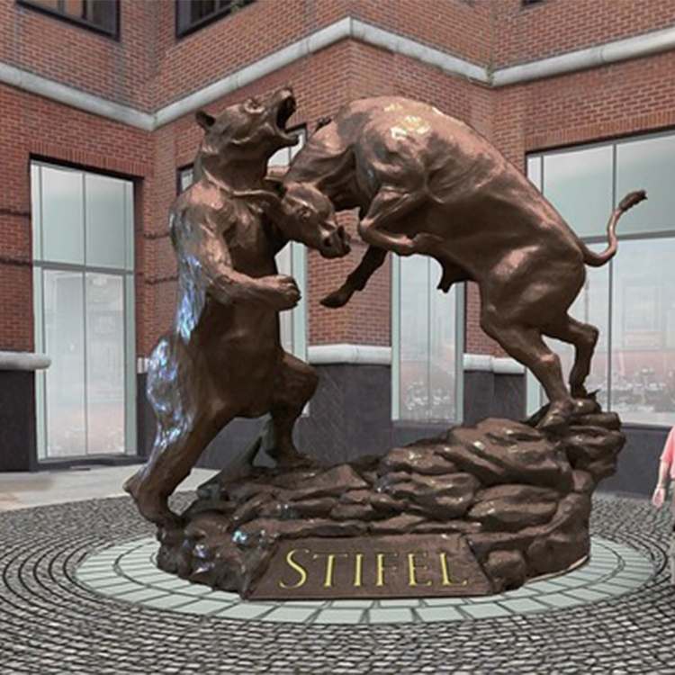
Wall Street Jeopardy: Games for Strategies Concepts, and Jargon Doug Young June 3rd, 2021 doug.n.young@gmail.com

Slide 2
EconEdLink Membership
You can now access CEE’s professional development webinars directly on EconEdLink.org! To receive these new professional development benefits, become an EconEdLink member. As a member, you will now be able to:
Automatically receive a professional development certificate via e-mail within 24 hours after viewing any webinar for a minimum of 45 minutes
Register for upcoming webinars with a simple one-click process
Easily download presentations, lesson plan materials and activities for each webinar
Search and view all webinars at your convenience
Save webinars to your EconEdLink dashboard for easy access to the event
You may access our new Professional Development page here

Slide 3
Professional Development Certificate
To earn your professional development certificate for this webinar, you must:
Watch a minimum of 45-minutes and you will automatically receive a professional development certificate via e-mail within 24 hours.
Accessing resources:
You can now easily download presentations, lesson plan materials, and activities for each webinar from EconEdLink.org/professional-development/

Slide 4
National Standard in Financial Literacy
Financial Investing
Students will understand that: Financial investment is the purchase of financial assets to increase income or wealth in the future. Investors must choose among investments that have different risks and expected rates of return. Investments with higher expected rates of return tend to have greater risk. Diversification of investment among a number of choices can lower investment risk.

Slide 5
New York State- Standard 4
Economics Students will use a variety of intellectual skills to demonstrate their understanding of how the United States and other societies develop economic systems and associated institutions to allocate scarce resources, how major decision-making units function in the United States and other national economies, and how an economy solves the scarcity problem through market and nonmarket mechanisms.

Slide 6
Objectives
Students will be able to:
Describe five types of investment risk.
Use the risk pyramid to describe the relationship between potential investment risk and potential investment reward.
Describe the characteristics of the following investments: insured savings accounts, certificates of deposit, U.S. government securities, corporate bonds, stocks and mutual funds.
Compare and contrast the risks and rewards of several common investment tools.
Analyze and make financial decisions based on risk and return.
Be aware of the scams and other types of fraud found when investing in the financial markets so one doesn’t get burnt.

Slide 7
Agenda
Lessons on Saving and Investing
Terms, Concepts and Jargon
Understanding Risks versus Returns, when investing
Formative Assessments
Kahoot Game
Playing “Wall Street Jeopardy”
Customizing Templates for Class and Hybrid Use
Summative Assessment

Slide 8
References
Financial Investing
https://www.econedlink.org/resources/there-is-no-free-lunch-in-investing/
There is No Free Lunch in Investing:
https://www.econedlink.org/resources/there-is-no-free-lunch -in-investing/
The Five Stages of Investing https://www.econedlink.org/resources/the-five-stages-of-investing/
Learning, Earning and Investing
What is a Stock? https://www.econedlink.org/resources/what-is-a-stock-lesson-demo/
What is a Bond? https://www.econedlink.org/resources/what-is-a-bond-lesson-demo/
What are Mutual Funds? https://www.econedlink.org/resources/what-are-mutual-funds-lesson-demo/

Slide 9
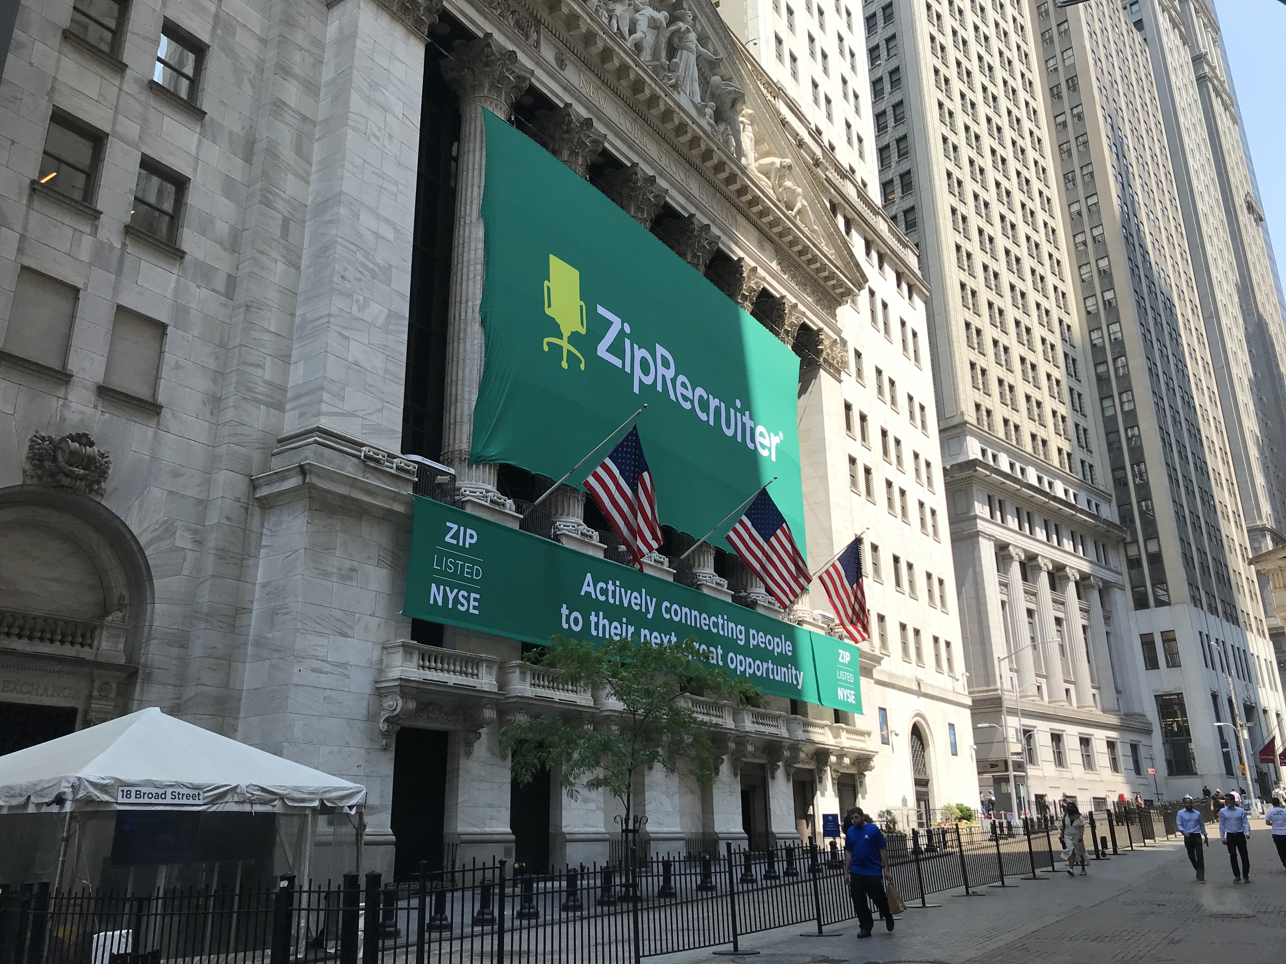
Wall Street versus Main Street

Slide 10
Concepts, Terms and Jargon
Cost/Benefit
Decision Making
Stock Market (s)
Stocks (types)
Bonds (types)
Mutual Funds (types)
Exchange Traded Funds (ETF)
C.D., Money Markets Fund
Diversification
Asset Allocation
I.P.O.’s
Capital Gains and Dividends
Insider Trading
Hedge and Equity Funds
Securities Fraud
Ponzi Schemes
Boiler Room Schemes
Wire Fraud
Risk versus Return
Rule of 72 and Compounding
Bull, Bear, Pigs, etc.
Options and Futures
S.P.A.C.S.

Slide 11
More Concepts, Terms and Jargon
Asset Allocation
Boiler Room Schemes
Bonds (types)
Bull, Bear, Pigs, etc.
Capital Gains and Dividends
C.D., Money Markets Fund
Cost/Benefit
Decision Making
Diversification
Exchange Traded Funds (ETF)
Financial v. Physical Assets
Insider Trading
I.P.O.’s
Hedge and Equity Funds
Mutual Funds (types)
Options and Futures
Ponzi Schemes
Risk versus Return
Rule of 72 and Compounding
Securities Fraud
S.P.A.C.S.
Stock Market (s)
Stocks (types)
Wire Fraud

Slide 14
Kahoot Lesson
1. This Wall Street animal refers to a descending/falling stock market? A. Bull C. Pig
B. Lamb D. Bear
C. Chicken
2. This Wall Street animal refers to an ascending/rising stock market.
A. Bull C. Pig
B. Lamb D. Bear
C. Chicken
3. This Wall Street animal refers to a greedy investor.
A. Bull C. Pig
B. Lamb D. Bear
C. Chicken
4. This Wall Street animal refers to a person with funds but is too afraid to invest.
A. Bull C. Pig
B. Lamb D. Bear
C. Chicken
5. This Wall Street animal refers to people who invest and get slaughtered in bad economic times.
A. Bull C. Pig
B. Lamb D. Bear
C. Chicken

Slide 15
Kahoot Answers
1. This Wall Street animal refers to a descending/falling stock market? A. Bull C. Pig
B. Lamb D. Bear
C. Chicken
2. This Wall Street animal refers to an ascending/rising stock market.
A. Bull C. Pig
B. Lamb D. Bear
C. Chicken
3. This Wall Street animal refers to a greedy investor.
A. Bull C. Pig
B. Lamb D. Bear
C. Chicken
4. This Wall Street animal refers to a person with funds but is too afraid to invest.
A. Bull C. Pig
B. Lamb D. Bear
C. Chicken
5. This Wall Street animal refers to people who invest and get slaughtered in bad economic times.
A. Bull C. Pig
B. Lamb D. Bear
C. Chicken

Slide 16
Category Change
1. The risk when a business you have invested in won’t return your money—much less pay a rate of return.
A. Market Risk D. Inflation
B. Liquidity E. Financial
C. Fraud
2. The risk when the price of an investment drops. This doesn’t usually happen to money saved at a bank.
A. Market Risk D. Inflation
B. Liquidity E. Financial
C. Fraud
3. Liquidity is the ability to turn your money into cash or spendable funds.
A. Market Risk D. Inflation
B. Liquidity E. Financial
C. Fraud
4. In this risk people invest money today to have that money, and more, available in the future.
A. Market Risk D. Inflation
B. Liquidity E. Financial
C. Fraud
5. Risk of some investments which are misrepresented by dishonest individuals after your money.
A. Market Risk D. Inflation
B. Liquidity E. Financial
C. Fraud

Slide 17
Category Change Answers
1. The risk when a business you have invested in won’t return your money—much less pay a rate of return.
A. Market Risk D. Inflation
B. Liquidity E. Financial
C. Fraud
2. The risk when the price of an investment drops. This doesn’t usually happen to money saved at a bank.
A. Market Risk D. Inflation
B. Liquidity E. Financial
C. Fraud
3. Liquidity is the ability to turn your money into cash or spendable funds.
A. Market Risk D. Inflation
B. Liquidity E. Financial
C. Fraud
4. In this risk people invest money today to have that money, and more, available in the future.
A. Market Risk D. Inflation
B. Liquidity E. Financial
C. Fraud
5. Risk of some investments which are misrepresented by dishonest individuals after your money.
A. Market Risk D. Inflation
B. Liquidity E. Financial
C. Fraud

Slide 18
Summative Assessment
Give each student a copy of the Financial Risk Pyramid (above slide)and have each student choose one topic from each of the three investment tools (Saving, Investment and Speculative Investment). Have them write a brief paragraph explaining two reasons why it is important to understand the tool they choose from a risk/reward relationship.
They should conclude by choosing one way in which they, or others, could have been scammed (victims of committed fraud) through an unscrupulous trader. Explain how they could either lose money or be involved in an illegal action which might be prosecuted by the law.
Source: FFFL, Lesson 20, Activity 20.3, page 279.

Slide 19
https://store.councilforeconed.org/

Slide 20
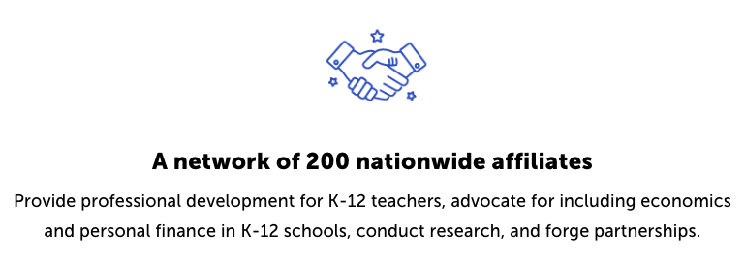
CEE Affiliates
https://www.councilforeconed.org/resources/local-affiliates/

Slide 21
Thank You to Our Sponsors!

