Slide 1

The Role of State Government During the COVID-19 Pandemic
Presented by: Amanda Stiglbauer
Blythewood High School
astiglbauer@richland2.org

Slide 2
EconEdLink Membership
You can now access CEE’s professional development webinars directly on EconEdLink.org! To receive these new professional development benefits, become an EconEdLink member. As a member, you will now be able to:
Automatically receive a professional development certificate via e-mail within 24 hours after viewing any webinar for a minimum of 45 minutes
Register for upcoming webinars with a simple one-click process
Easily download presentations, lesson plan materials and activities for each webinar
Search and view all webinars at your convenience
Save webinars to your EconEdLink dashboard for easy access to the event
You may access our new Professional Development page here

Slide 3
Professional Development Certificate
To earn your professional development certificate for this webinar, you must:
Watch a minimum of 45-minutes and you will automatically receive a professional development certificate via e-mail within 24 hours.
Accessing resources:
You can now easily download presentations, lesson plan materials, and activities for each webinar from EconEdLink.org/professional-development/

Slide 4
Agenda
Introduction
Poll - Do you approve of your state’s response to the pandemic?
Collaboration Board
Political Cartoons
Content Delivery and Economic Indicators
Activity/Padlet - States’ Responses and Emojis
Notices and Wonders

Slide 5
Objectives
Analyze economic data and policy actions by state governments during the COVID-19 pandemic.
Evaluate the extent to which state governments’ policies related to the COVID-19 pandemic prioritized the health and safety of citizens, while also focusing on economic recovery.

Slide 6
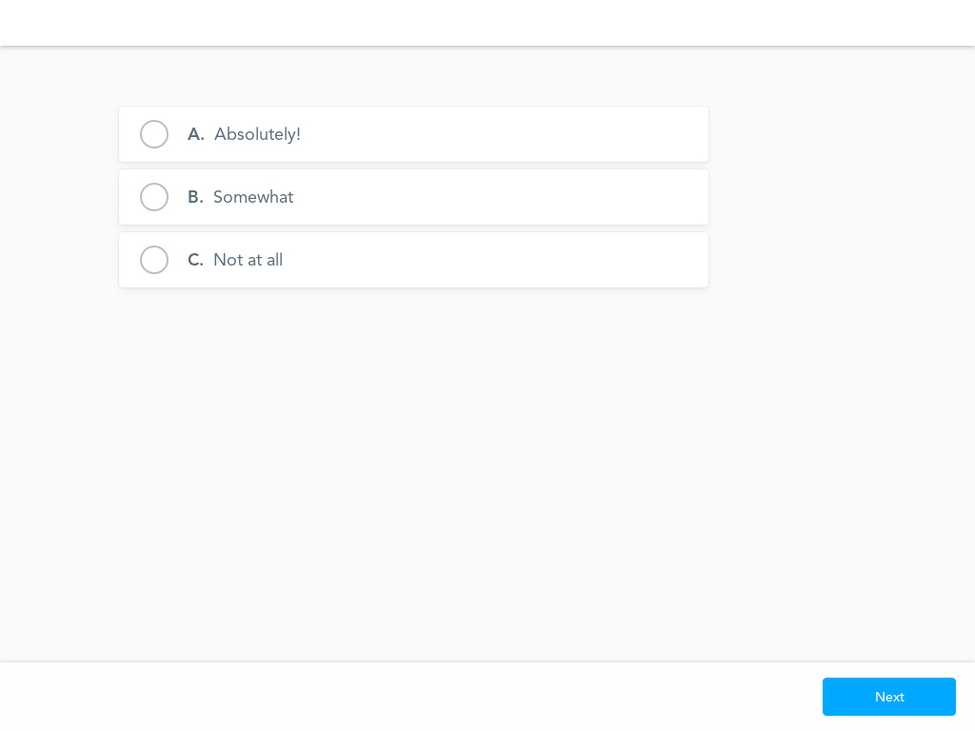
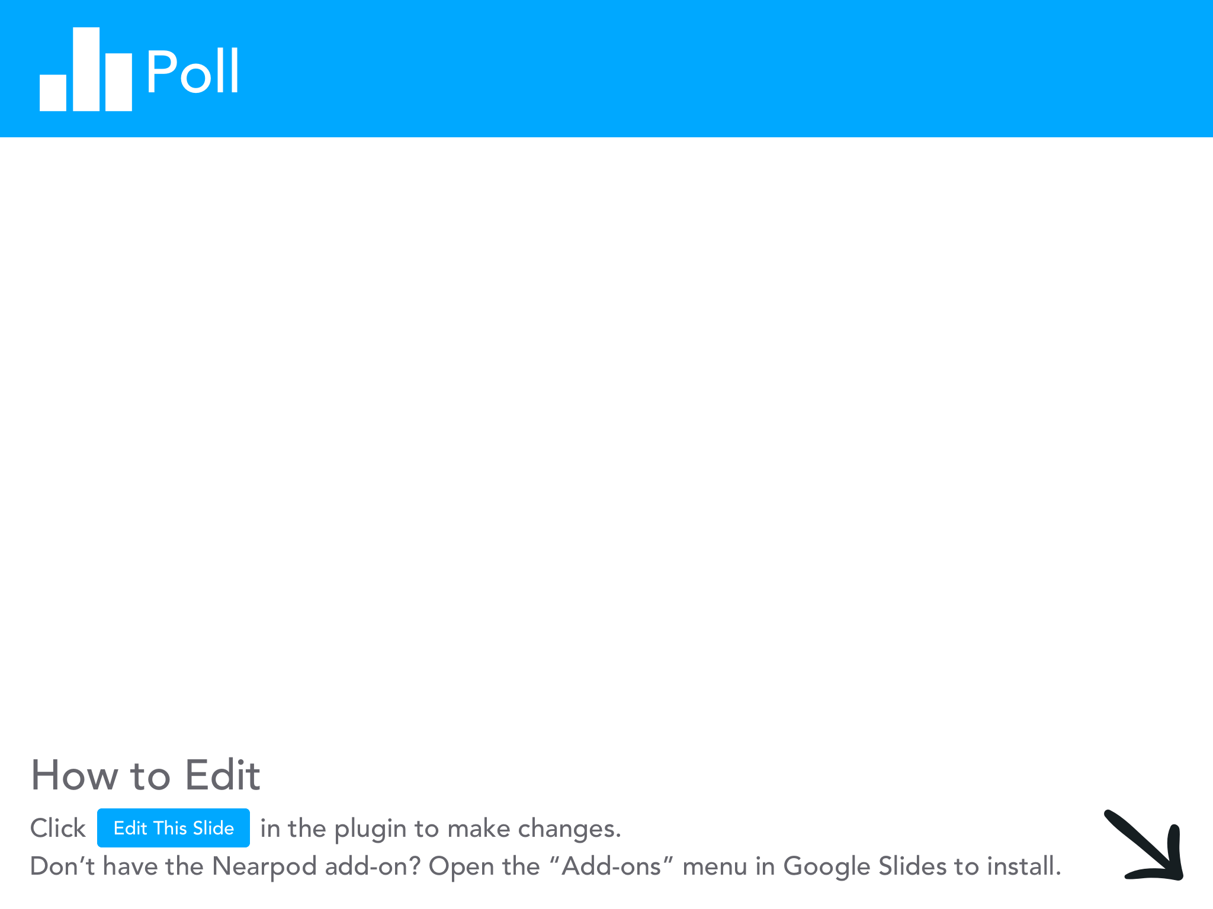

Slide 7
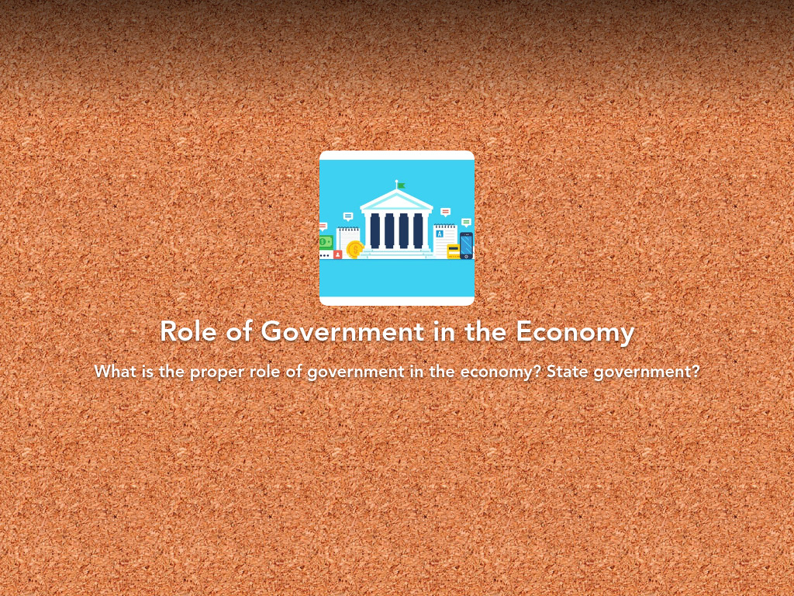
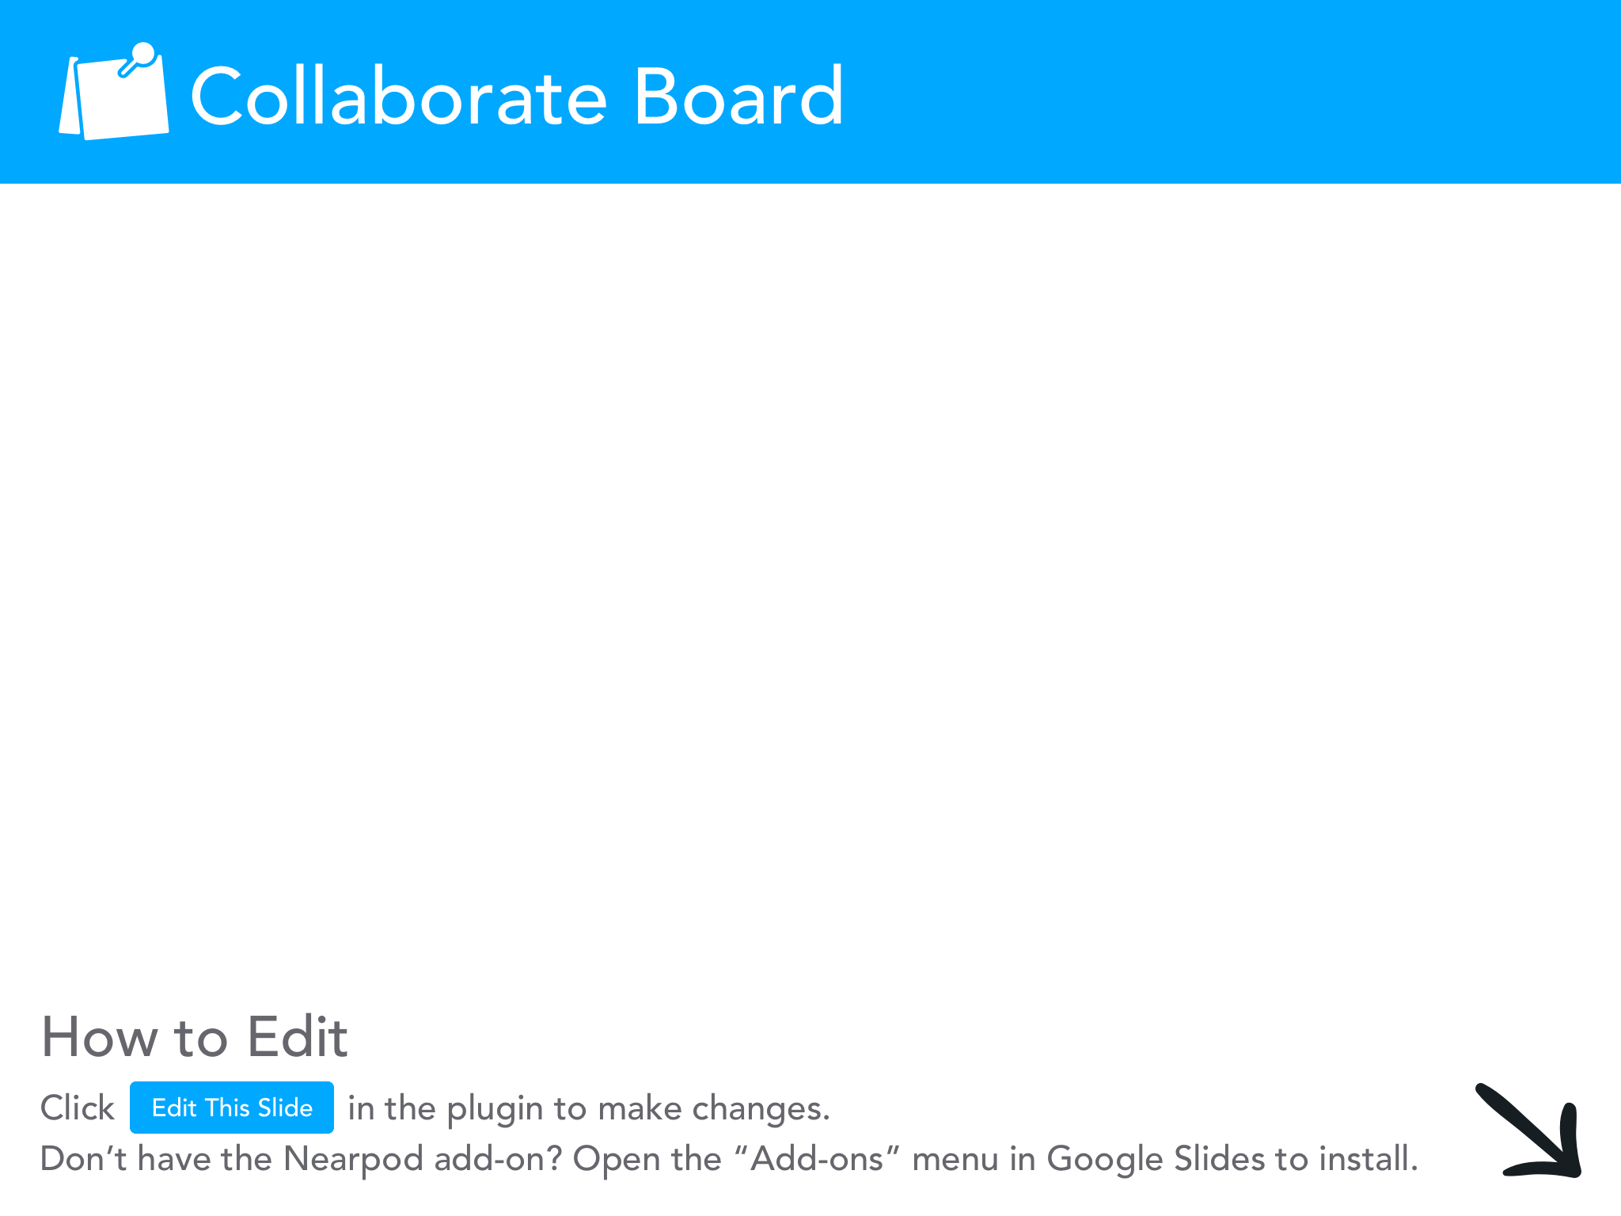

Slide 8
What is the role of state governments in emergency situations, like a pandemic?

Slide 9
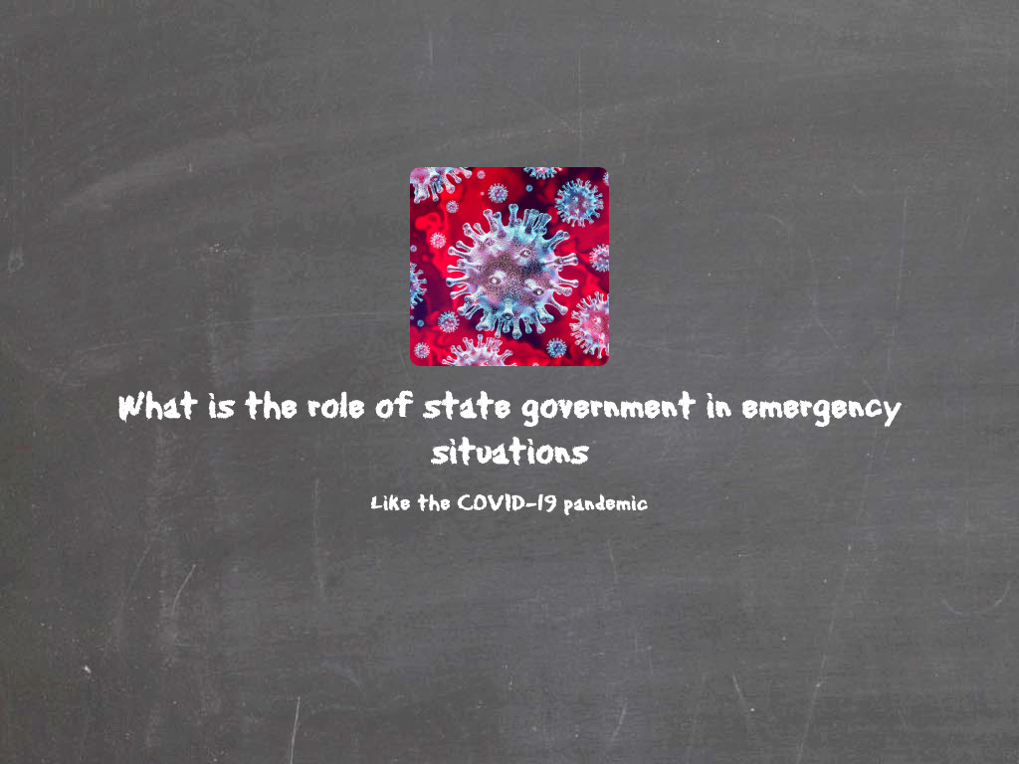

Slide 10
Essential Dilemma
Can state governments’ responses to the COVID-19 pandemic prioritize the health and safety of citizens while also focusing on economic stability?

Slide 11
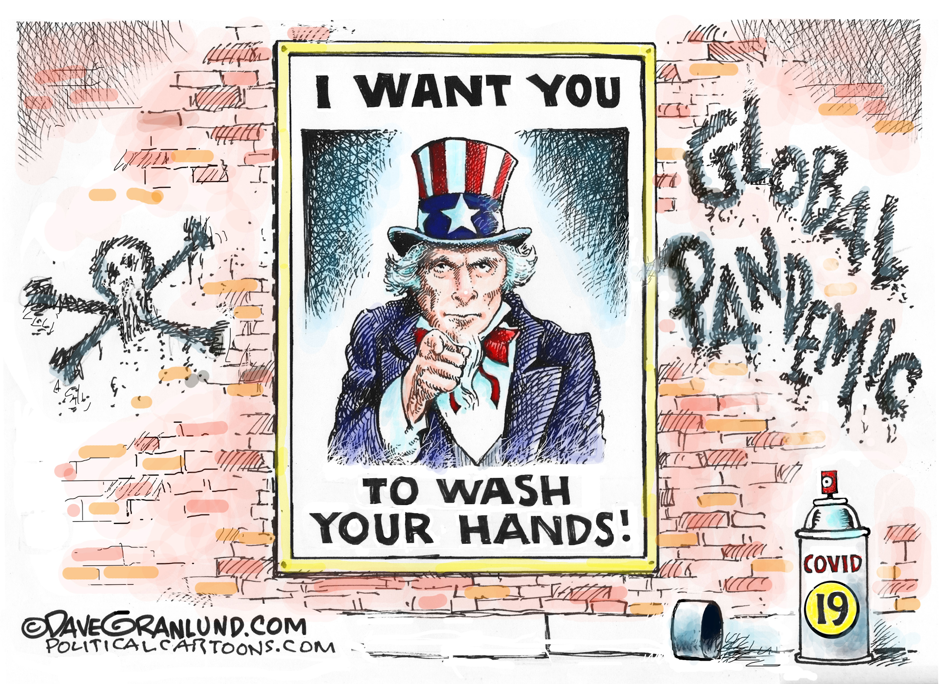
What is the main idea the illustrator is seeking to convey?
What actions do you believe the illustrator of this cartoon is in favor of?

Slide 12
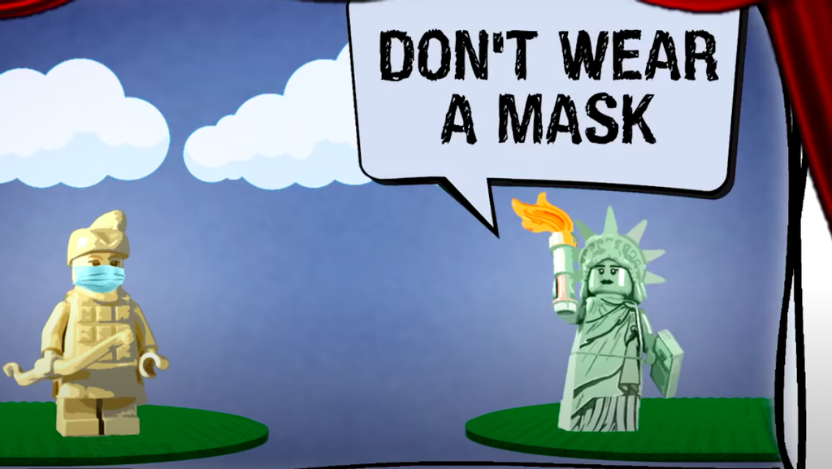

Slide 13
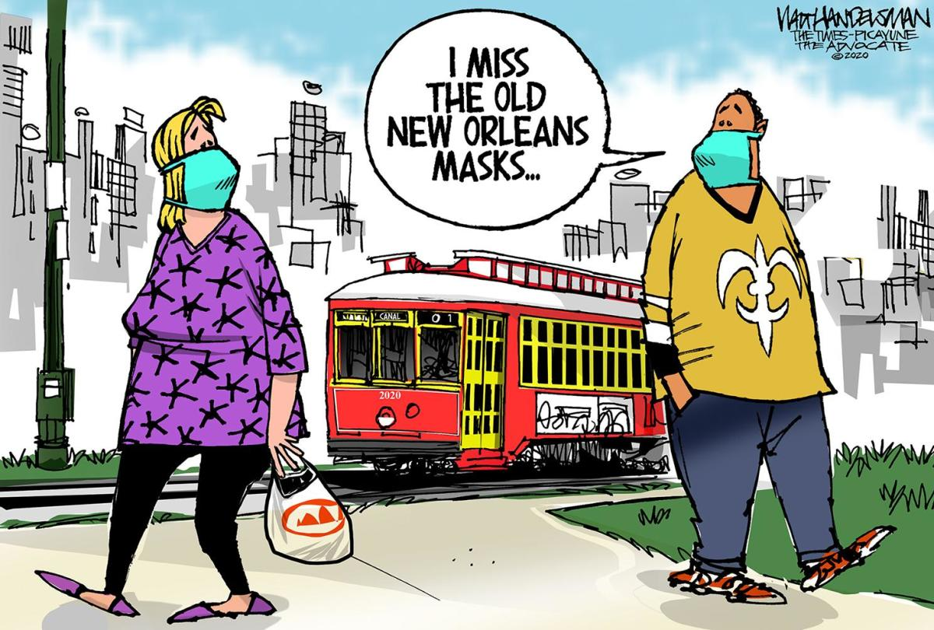

Slide 14
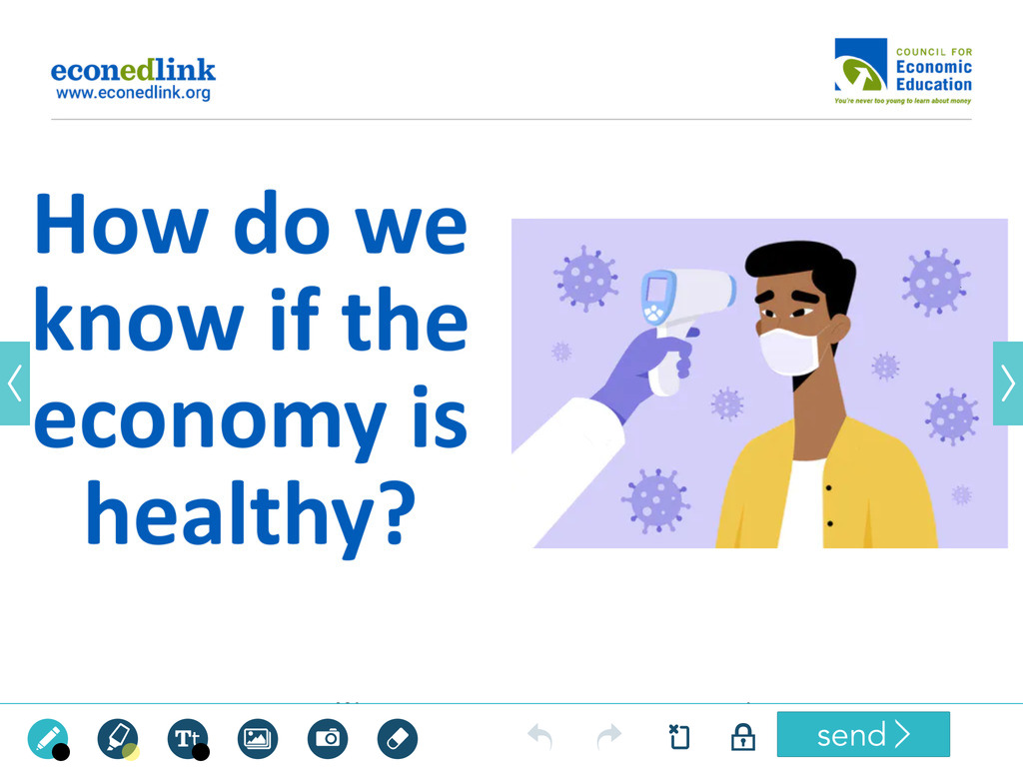
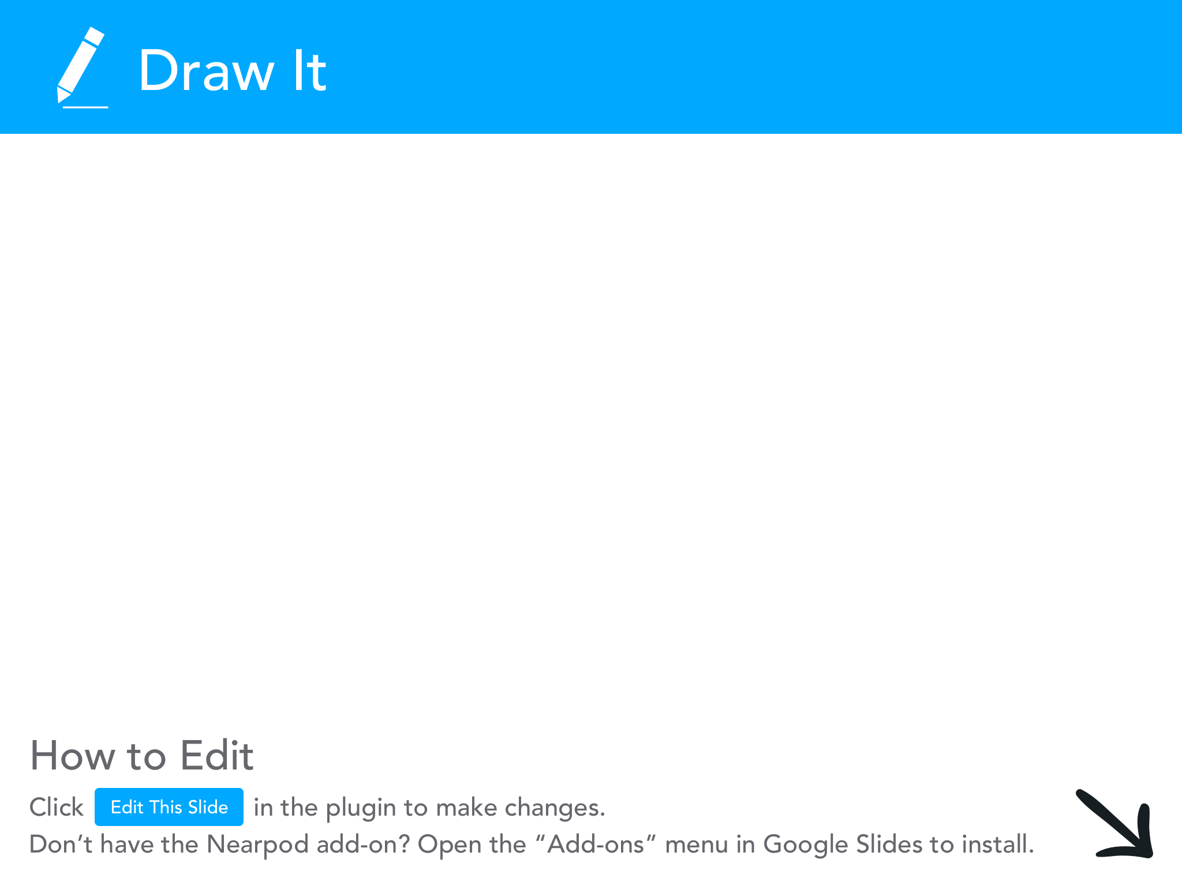

Slide 15
State Governments’ Responses to COVID-19 Pandemic
State open status score
Mask requirements
School reopening status
Unemployment rates from March 2020, April 2020, and present
Decline in state revenues 2021
Percent Change in Real GDP by State
Trend in COVID-19 Cases & Deaths

Slide 16
Cost-Benefit Analysis of Reopening States
What is it? Weighing pros and cons (of seen and unseen factors) when making a decision...
Costs of Reopening
additional deaths and hospitalizations
loss of potential income
risk of repeated outbreaks and closures
return to heavy traffic
political implications
Benefits of Reopening
reduction in unemployment
increase in tax revenue when people return to work
reduced need for future stimulus?
save small businesses

Slide 17
Handout 1: Instructions for Completing States’COVID-19 Responses

Slide 18
Information for South Carolina
State | State Open Status Score | Mask Requirements | School Reopening Status | Unemployment Rates March 2020, April 2020, Current | Percent Change in Real GDP by State,Q1 2020 - Q 2 2020 | Projected Decline in State Revenues 2021 | Trend in COVID-19 Cases and Deaths | Emoji Ratings and Cost-Benefit Analysis
South Carolina | 7 | yes* executive order for state govt offices; encouraged local govts to adopt Many local governments have allowed mask mandates to expire. | Yes; District plans submitted to State Department of Education; CARES Act funding allocated to DOE to distribute to districts to combat spread of COVID-19 in schools. | March 2020 3.2% April 2020 12.8% December 2020 5.6% | -32.6% | 6-10% | decreasing | 💹 - Initial dip in economic activity (unemployment and % change in real GDP met by recovery) ↘️- downward trend in COVID-19 cases 💣 - Decline in state revenues, lack of local government mask ordinance renewals, and rise in cases may be a ticking time bomb 🙈-States are going into this blind. SC may value the benefit of economic recovery over the potential health costs, but results remain to be seen.

Slide 19
Activity - Emoji Ratings

Slide 20
Padlet
Look at your state’s openness score and indicators. Then, select 2 emojis that best describe your state’s status, followed by a brief description.
Example:
- 🔋 Downward trend in COVID-19 cases and unemployment figures declining = recovery on the horizon
💣 - Decline in state revenues, lack of local government mask ordinance renewals, and rise in cases may be a ticking time bomb

Slide 21
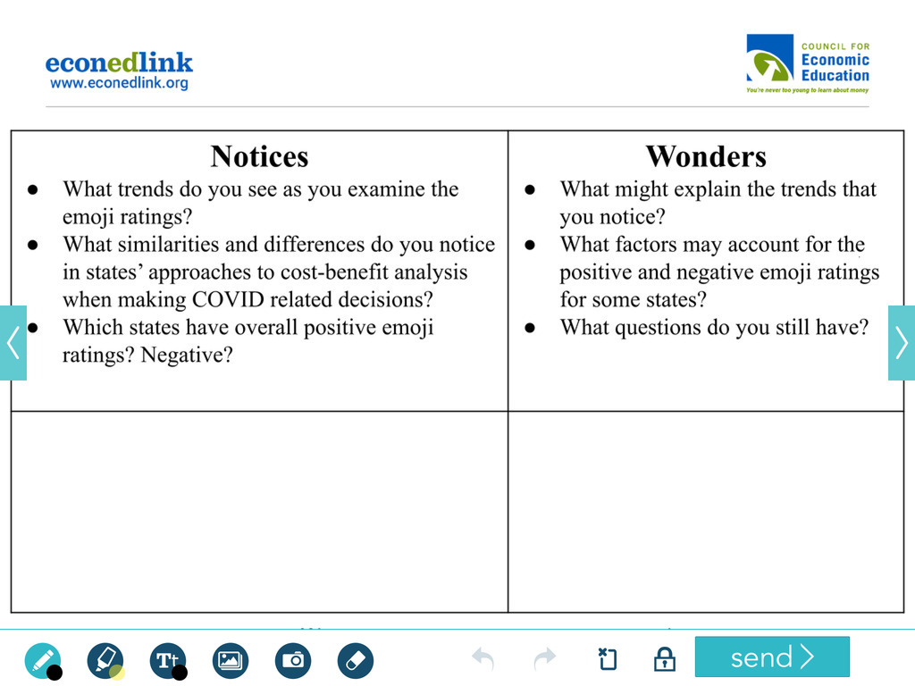

Slide 22
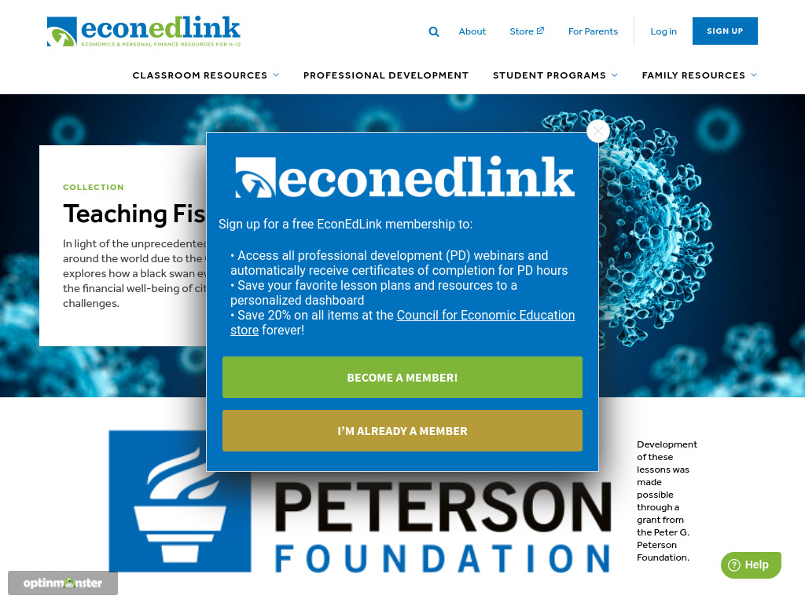
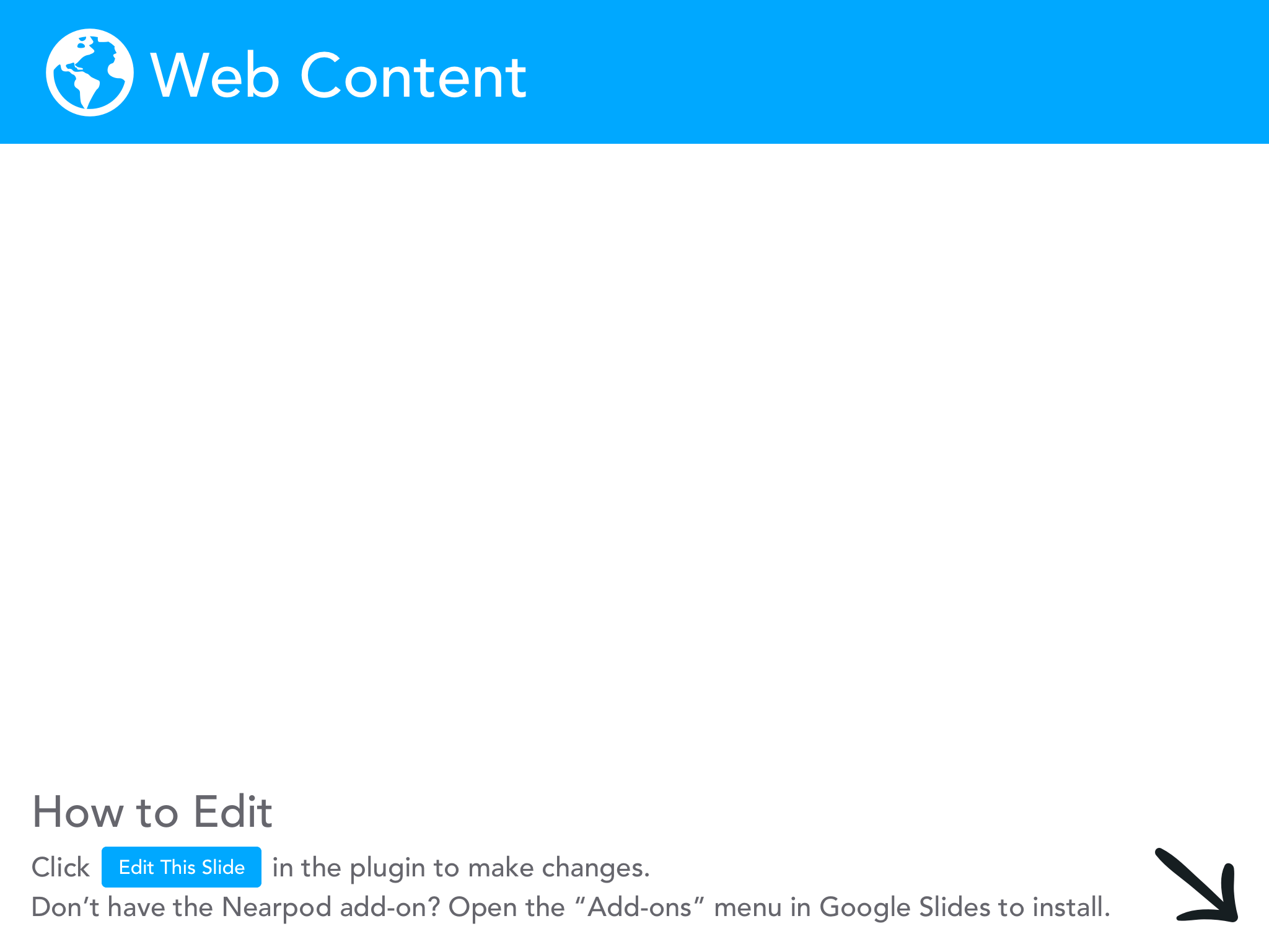

Slide 23
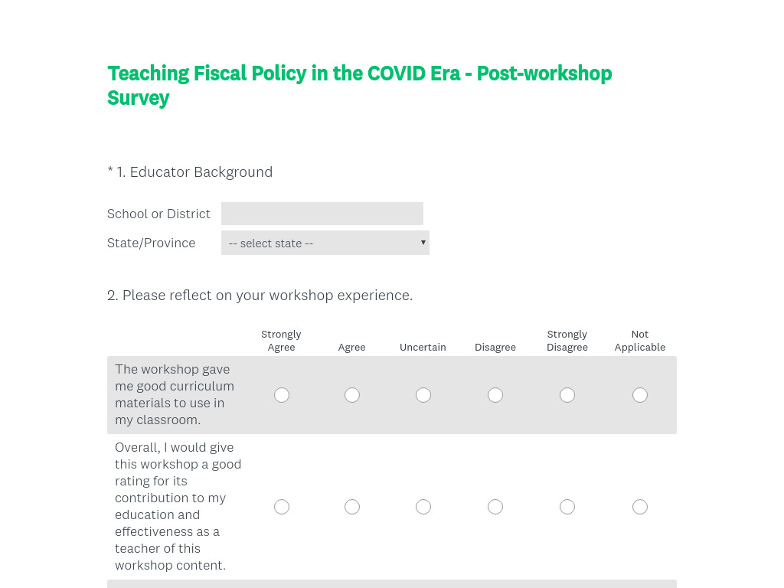

Slide 24
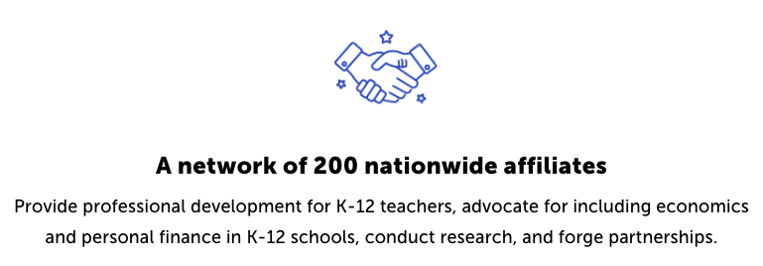
CEE Affiliates
https://www.councilforeconed.org/resources/local-affiliates/

Slide 25




Thank You to Our Sponsors!

