Slide 1
Financial Fitness For Life, Chapter 15: Shopping For A Credit Card Presented by Andrew Menfi April 8th, 2020 amenfi3@gmail.com

Slide 2
EconEdLink Membership
You can now access CEE’s professional development webinars directly on EconEdLink.org! To receive these new professional development benefits, become an EconEdLink member. As a member, you will now be able to:
Automatically receive a professional development certificate via e-mail within 24 hours after viewing any webinar for a minimum of 45 minutes
Register for upcoming webinars with a simple one-click process
Easily download presentations, lesson plan materials, and activities for each webinar
Search and view all webinars at your convenience
Save webinars to your EconEdLink dashboard for easy access to the event
You may access our new Professional Development page here

Slide 3
Professional Development Certificate
To earn your professional development certificate for this webinar, you must:
Watch a minimum of 45-minutes and you will automatically receive a professional development certificate via e-mail within 24 hours.
Accessing resources:
You can now easily download presentations, lesson plan materials, and activities for each webinar from EconEdLink.org/professional-development/

Slide 4
https://www.econedlink.org/resources/collection/fffl-9-12/

Slide 5
Objectives
Engaging and usable Lessons & Activities on the topic of Choosing A Credit Card & Managing Credit Card Debt
Review best practices and key points about credit usage.
See independent learning activities for students about choosing credit cards.

Slide 6
Agenda
Key Web Resources
Key Points For Student Notes
Activity #1: Personal Stories
Activity #2: Debt
Activity #3: Credit Card Comparison
Activity #4: Credit Card Research
Activity #5: Credit Score

Slide 7
National Standards
STANDARD 11: MONEY & INFLATION
STANDARD 12: INTEREST RATES

Slide 8
State Standards
New York:
12.E1 INDIVIDUAL RESPONSIBILITY AND THE ECONOMY
12.E3 THE IMPACT OF AMERICAN CAPITALISM IN A GLOBAL ECONOMY:

Slide 9
Key Web Resources

Slide 10
Notes/Mini Lecture
What is credit?
APR [Annual Percentage Rate]
Credit Score
Credit Card Debt
Credit Card Rewards

Slide 11
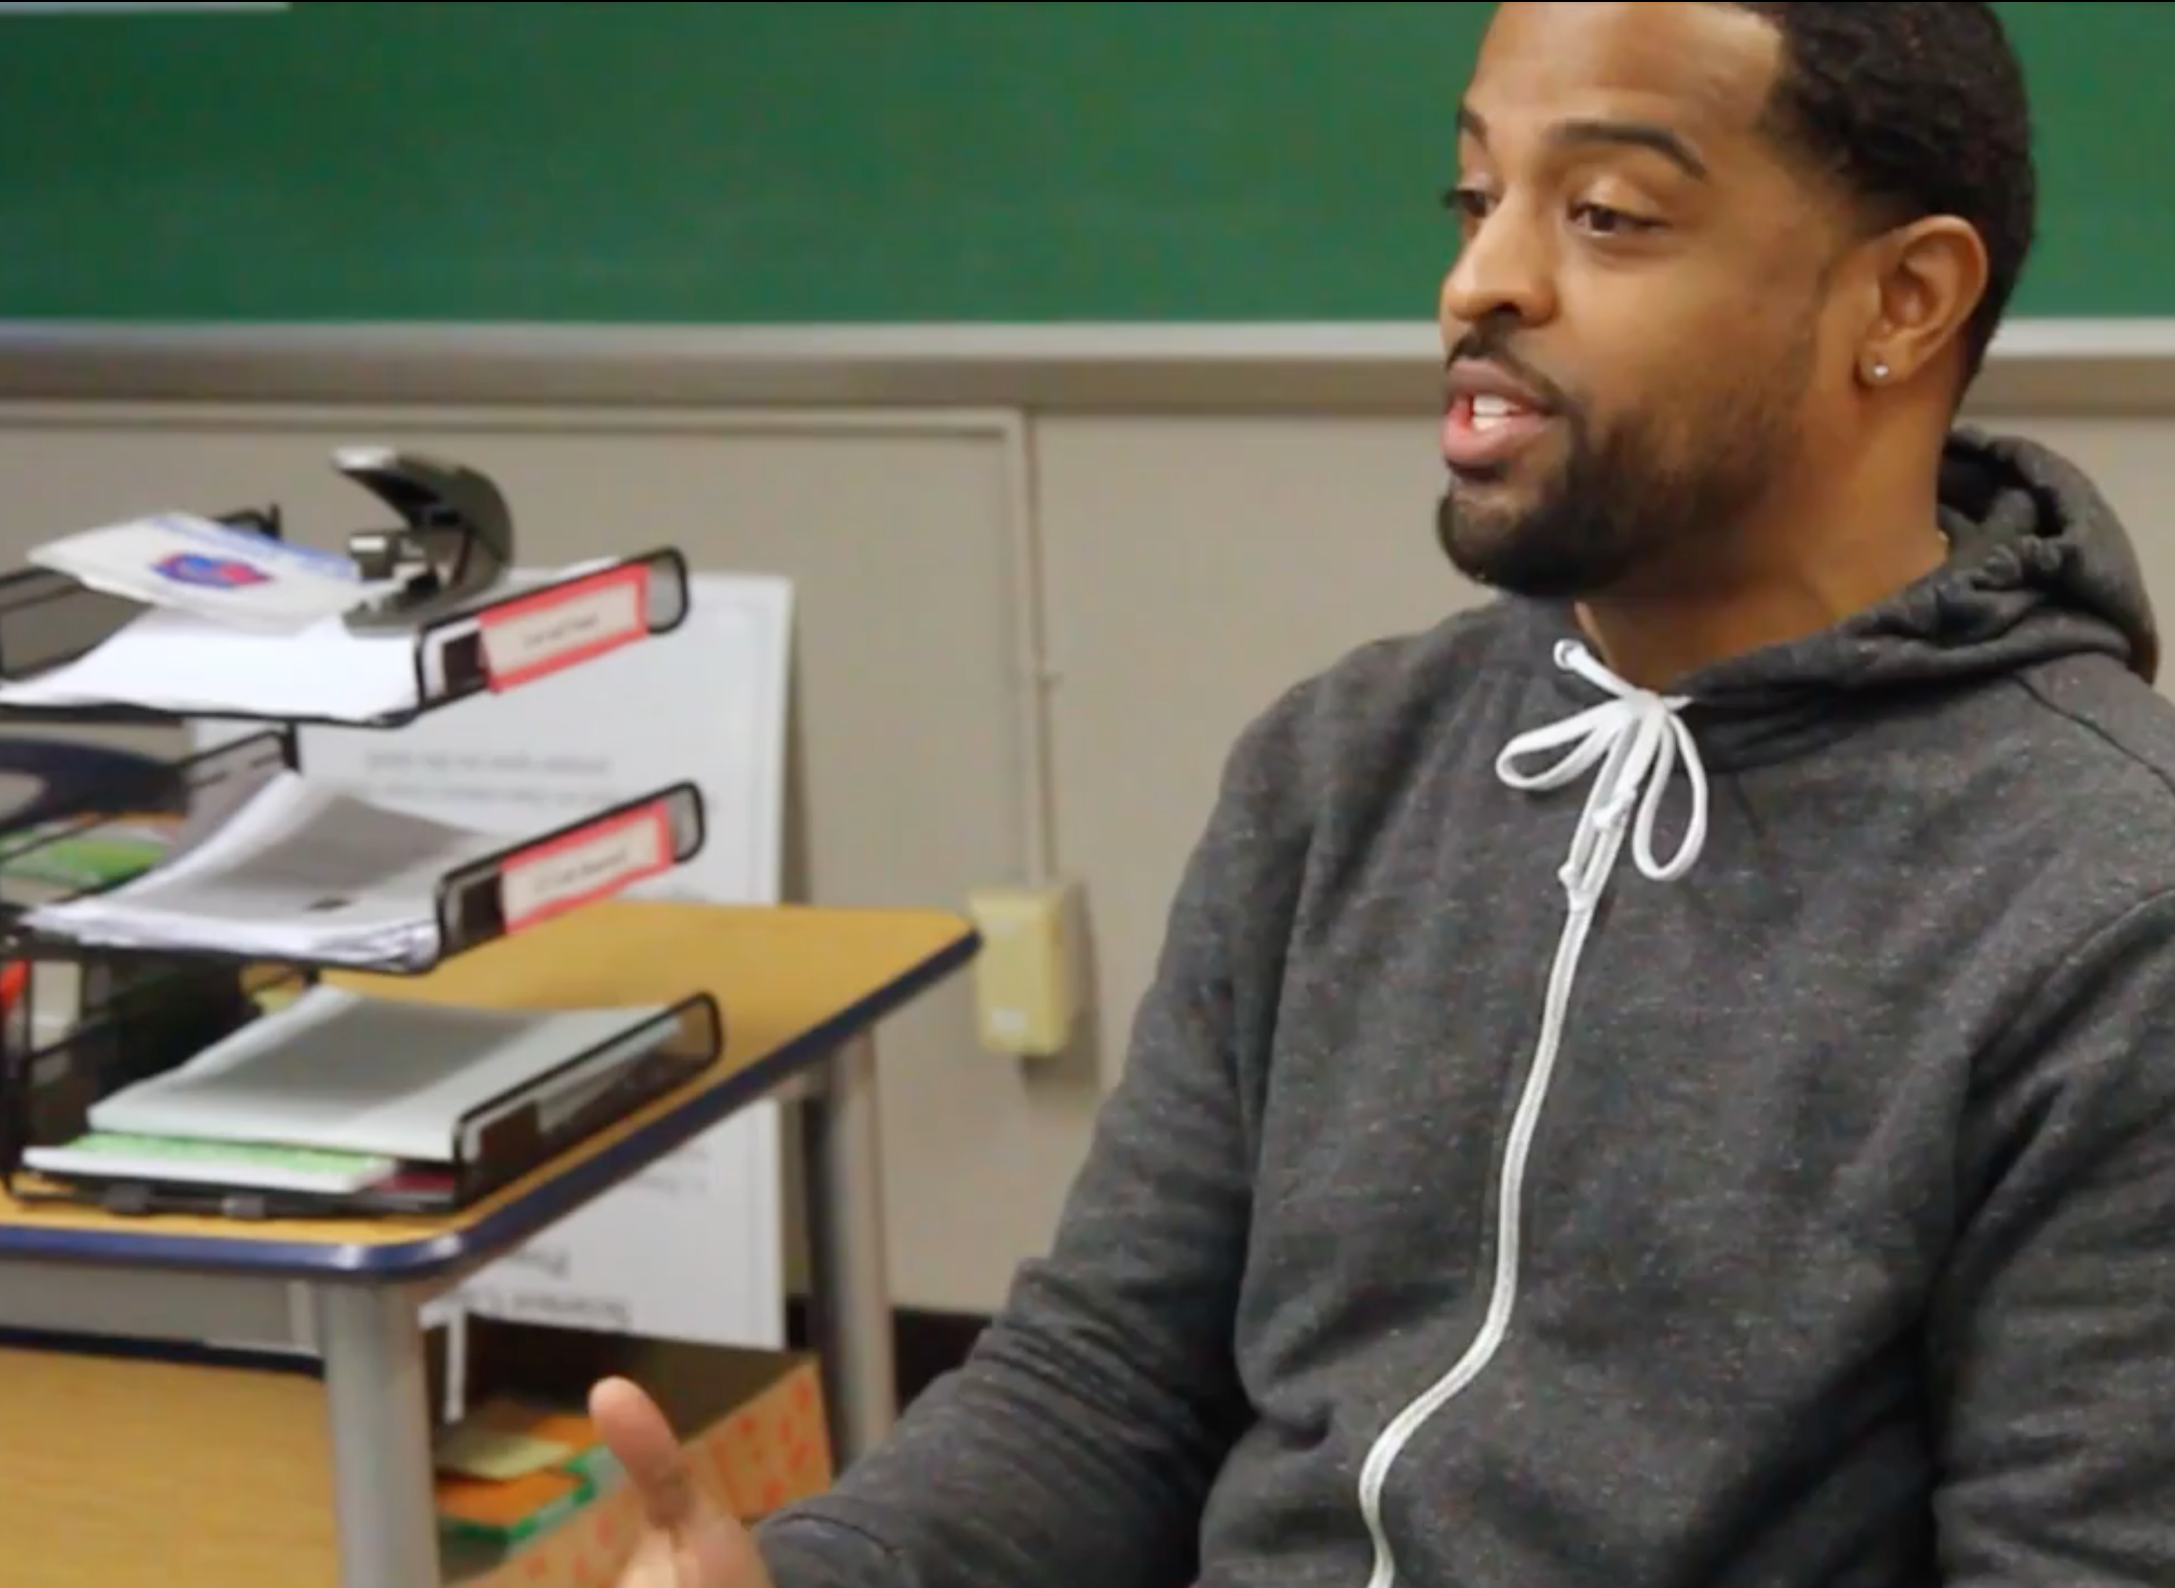
Activity #1: Personal Stories
Interview
Video

Slide 12
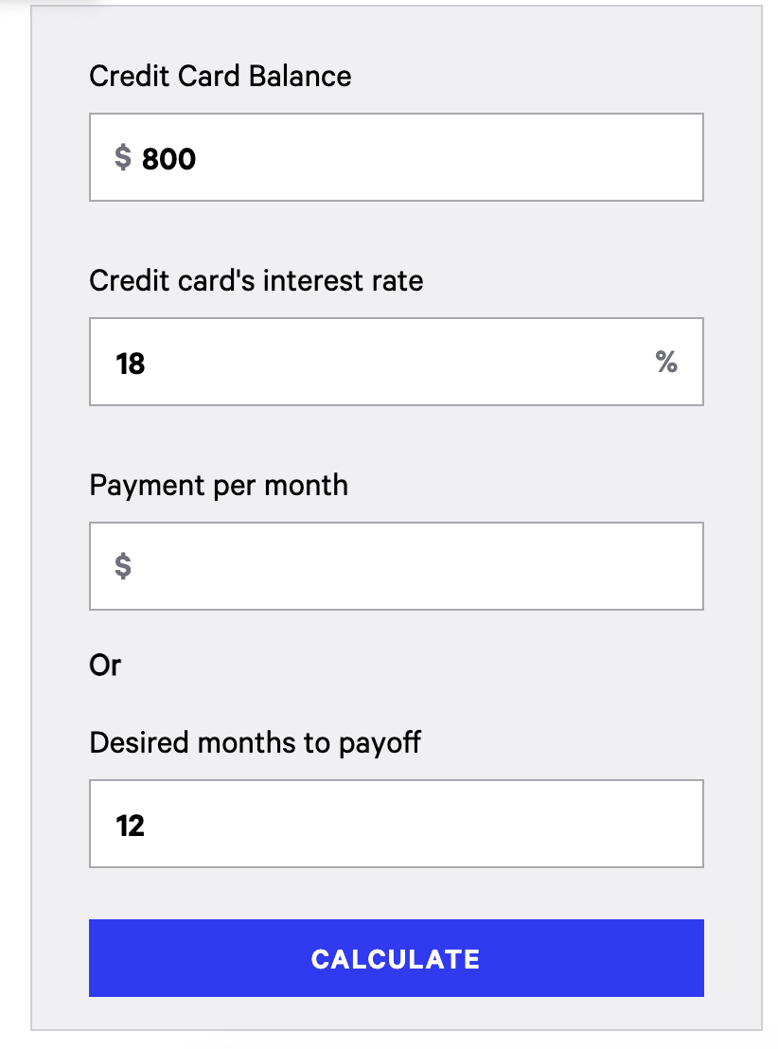
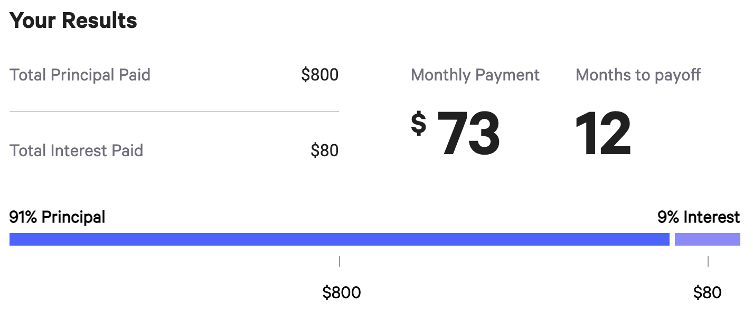
Activity #2: Debt
Bankrate.com

Slide 13
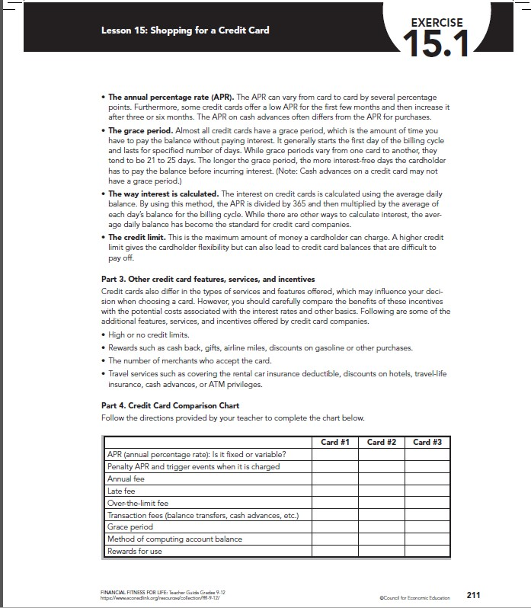
Activity #3: Credit Card Comparison
Nerdwallet.com & FFFL
Documents OR No Documents

Slide 14
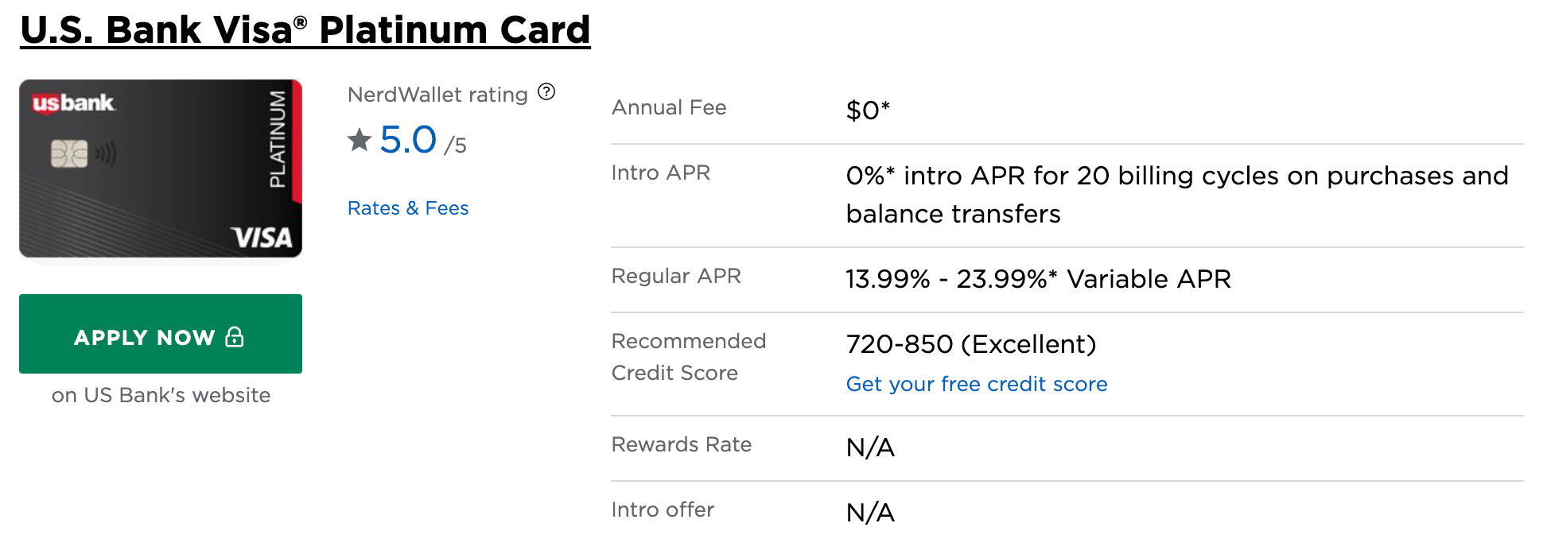
Activity #4: Credit Card Research
Nerdwallet.com
Debate/ Written Assignment

Slide 15
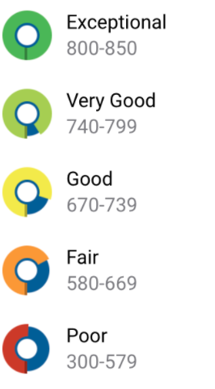
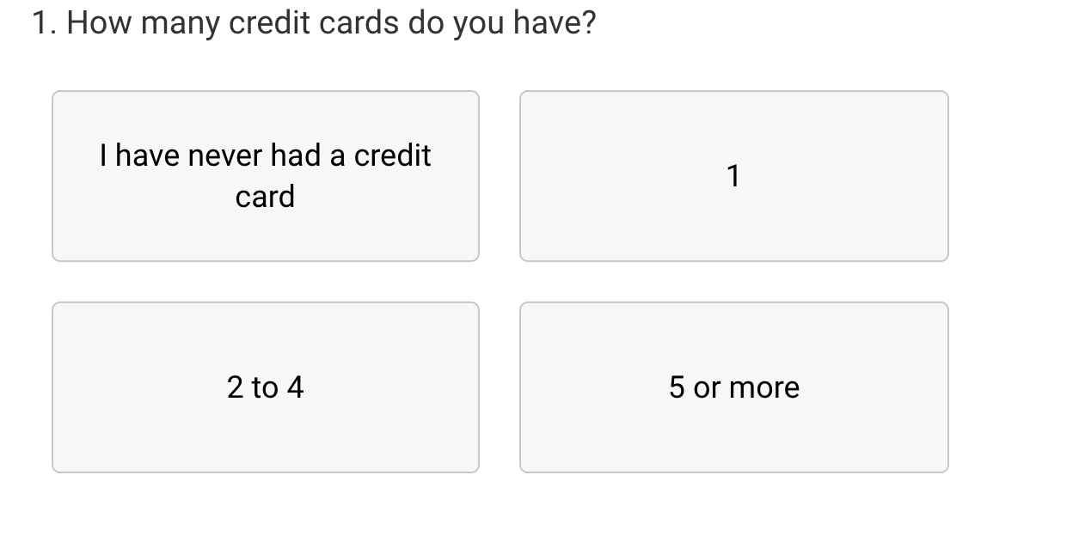
Activity #5: Credit Scores
Myfico.com

Slide 16
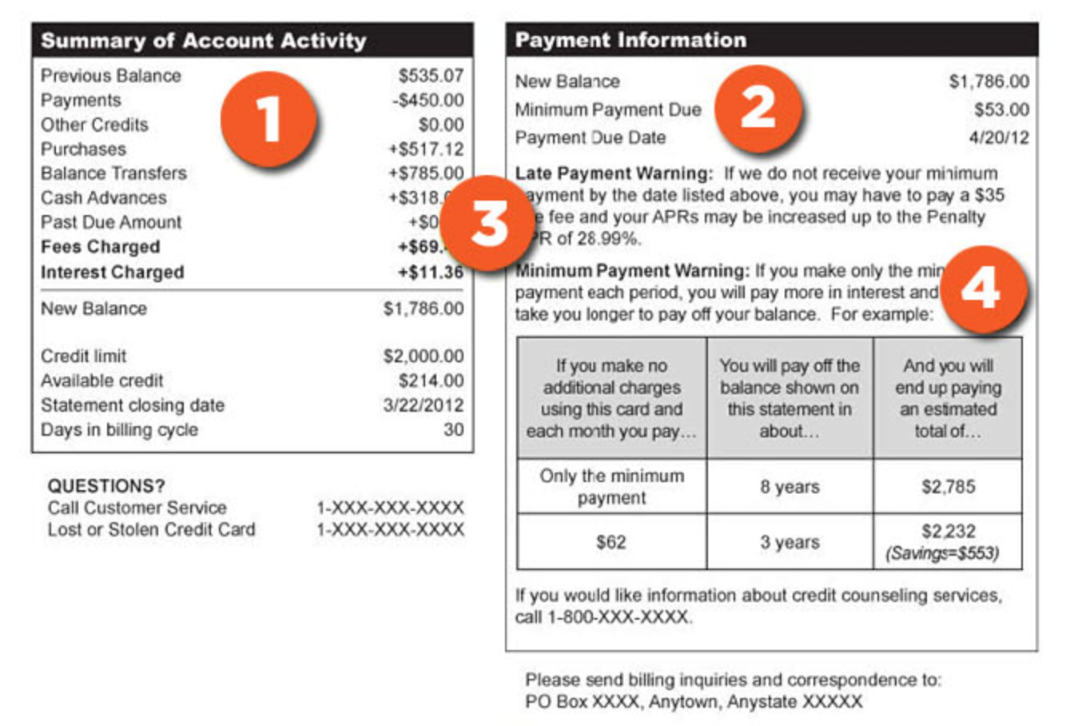
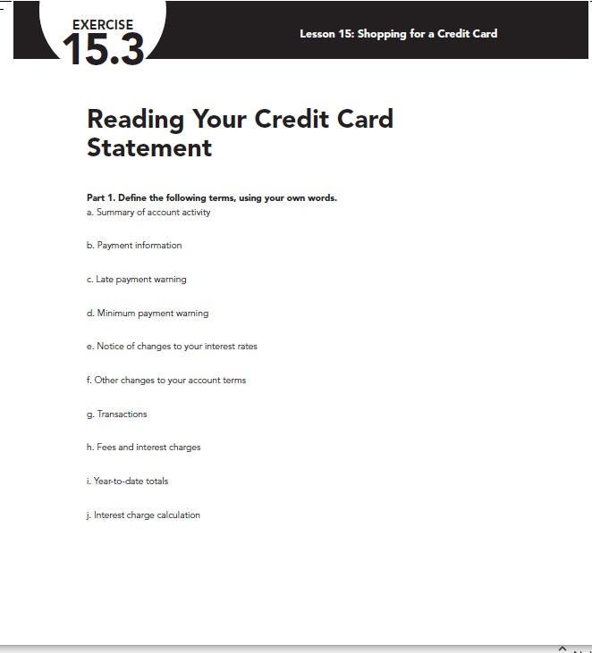
Activity #6: Credit Statement
mycreditunion.gov & FFFL

Slide 17
Questions?
Andrew Menfi
Social Studies Teacher
New Visions Charter High School
for Advanced Math & Science
amenfi3@gmail.com
Thanks For Your Time!

Slide 18
CEE Affiliates
https://www.councilforeconed.org/resources/local-affiliates/

Slide 19
Thank You to Our Sponsors!

Slide 20
We’ve gone Virtual!
Teach Economics?
Your students may have what it takes to compete in the nation’s only high school economics competition!
Why Play?
• Fun team learning experience
• Great for college applications
• No other challenge like this
• Online participation makes access easy
• Chance for cash prizes
How it Works
Teams register
Teachers enroll team(s) of 3- 4 high school students from the same school. Multiple teams allowed.
Teams compete within their state
Compete to win your state competition for a chance to advance to the National Semi-Finals.
National Semi-Finals: May 3-20, 2021
Teams answer multiple-choice questions on macroeconomics, microeconomics, and international & current events.
National Finals: May 22-24, 2021
Teams analyze an economic issue and present their solution. Top teams engage in the Finals Quiz Bowl where they face-off answering questions to claim the National Title.
Two divisions based on experience level
David Ricardo for first-time competitors who have taken no more than one economics course.
Adam Smith for returning competitors, AP, International Baccalaureate, and honors students.
Register Today at NationalEconomicsChallenge.org

Slide 21
FIND YOUR LOCAL COMPETITION AND REGISTER TODAY!
The National Personal Finance Challenge is a competition that provides high school students with an exciting and motivating opportunity to build, apply, and demonstrate their knowledge of money management.
Through online exams and a personal finance simulation, teams showcase their expertise in earning income, buying goods and services, saving, using credit, investing, as well as protecting and insuring.
Teams of up to four students, with one teacher/coach, can qualify to represent their state at the National Personal Finance Challenge by winning their local competition.
NATIONALS
Semi-Finals: First round elimination via online multiple-choice questions.
Finals: Case study round virtually co-hosted by the Cleveland Fed on June 3.
personalfinancechallenge.org

Slide 22
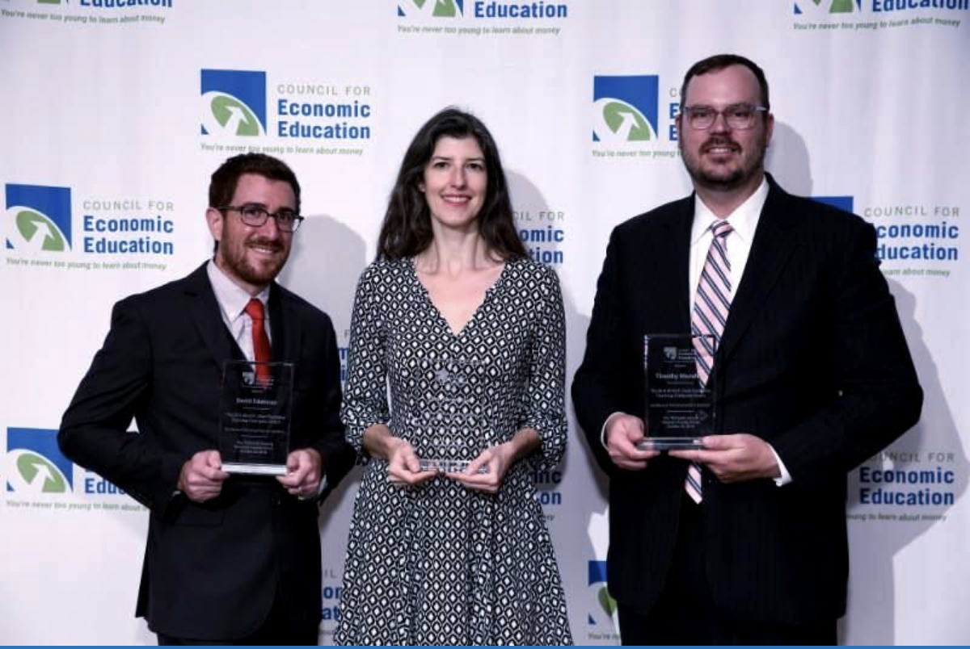
The 2021 Sloan Teaching Champion Award
Winners receive:
A cash award of $5,000
A cash award of $2,500 for their school to support economic education
Recognition at our annual Visionary Awards convening.
This award promotes economic education by honoring three outstanding teachers who incorporate exemplary teaching techniques that improve their students’ economic understanding in and out of the classroom.
This award is open to New York metropolitan area high school teachers of all subjects, not just teachers of economics. Applicants must demonstrate how they integrate economics into their teaching.
Sound like you or someone you know?
Applicants must teach in one of the
Twelve New York state counties (New York, Kings, Bronx, Richmond, Queens, Nassau, Suffolk, Westchester, Putnam, Rockland, Orange and Dutchess)
Eight New Jersey counties (Bergen, Passaic, Essex, Hudson, Middlesex, Union, Morris, Monmouth), or the
Two Connecticut counties (Fairfield and New Haven)
Application will be launched on Friday February 19th 2021
You can access the application here.
CONTACT
Please feel free to e-mail us at rrivera@councilforeconed.org
with any questions you have.

