Slide 1
The Price of Excluding the Black Vernacular in Schools
William Anderson
2/16/2021
Love1stedcon@gmail.com

Slide 2
EconEdLink Membership
You can now access CEE’s professional development webinars directly on EconEdLink.org! To receive these new professional development benefits, become an EconEdLink member. As a member, you will now be able to:
Automatically receive a professional development certificate via e-mail within 24 hours after viewing any webinar for a minimum of 45 minutes
Register for upcoming webinars with a simple one-click process
Easily download presentations, lesson plan materials and activities for each webinar
Search and view all webinars at your convenience
Save webinars to your EconEdLink dashboard for easy access to the event
You may access our new Professional Development page here

Slide 3
Professional Development Certificate
To earn your professional development certificate for this webinar, you must:
Watch a minimum of 45-minutes and you will automatically receive a professional development certificate via e-mail within 24 hours.
Accessing resources:
You can now easily download presentations, lesson plan materials, and activities for each webinar from EconEdLink.org/professional-development/

Slide 4
Agenda
• Intro/Norms
• Zen PowerPoint
• History of Black English Vernacular (BEV)
• Current State of BEV
• The Cost and Moving Forward

Slide 5
Norms
• It’s all LOVE
• Things may get uncomfortable…That’s okay.
• Just consider it.
• Chances are we will not solve all the problems here today.
• DO NOT let the work stop here.

Slide 6
Objectives
EWBAT: Discuss and critically think about aspects of the history and impact of the varieties of the Black English Vernacular
EWBAT: Analyze the potential impacts of Standard Language practices on students who use BEV as their home language
EWBAT: Consider the impact of how fiscal support of students using BEV could impact the educational outcomes of the students using the language.

Slide 7
National Standards
CCSS.ELA-LITERACY.RH.11-12.3
Evaluate various explanations for actions or events and determine which explanation best accords with textual evidence, acknowledging where the text leaves matters uncertain.
CCSS.ELA-LITERACY.RH.11-12.7
Integrate and evaluate multiple sources of information presented in diverse formats and media (e.g., visually, quantitatively, as well as in words) in order to address a question or solve a problem.
CCSS.ELA-LITERACY.RH.11-12.9
Integrate information from diverse sources, both primary and secondary, into a coherent understanding of an idea or event, noting discrepancies among sources.

Slide 8
Assessment Questions
What contributed to the creation of the BEV language varieties?
How have schools in the past looked to integrate BEV language practices? What have been some of the outcomes of said efforts?
What are some of the potential messages that Standard Language practices give BEV speaking students?
What are viable actions that can be taken by educators to elevate the status of the BEV?
How has your understanding of BEV grown, and what action can you individually take to elevate the vernacular?

Slide 9
“Zen PowerPoint/Slides Presentations”
• A PowerPoint or slide presentation that has no words following the opening slide
• Pushes the presenter to find an image(s) that can convey entire ideas
• Challenges the presenter to know their content well enough that they can not use the words on a slide as support to their presentation
• Gives the audience a visual to connect with the learning
• Fun

Slide 10


History/The How
Alim and Smitherman describe the development of Black English as “a linguistic system born out of a Creolization process that merged African and European languages and ways of using them. As the linguistic legacy of the African slave trade” (Alim & Smitherman, 2012, p.169).
Notes:
From its inception, Black English has been the product of oppressive practices enacted by a ruling class interested in othering, dividing, and subjugating a targeted population.
This language, born out of bondage, is oftentimes more complex grammatically and functionally than any other form of American English (Alim & Smitherman, 2012.) However, due to its circumstance and its societal position within the hierarchy of power, it is viewed as anything but complex and functional (Alim & Smitherman, 2012).

Slide 11
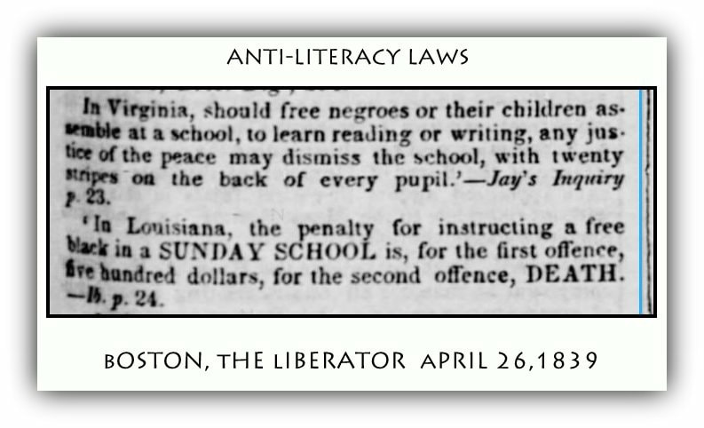
History/The How
Baldwin (1979) indicates that “a language comes into existence by means of brutal necessity, and the rules of the language are dictated by what the language must convey” (p. 1).
Rickford & Rickford (2000) refer to Black English as “Spoken Soul”
Notes:
Enslaved peoples, stripped of their native tongue by the threat of the “lash”, were not given reading materials, other than the Bible. Laws were enacted and enforced forbidding them to learn to read or write anything beyond the “Good Book”. They were to shed their native tongues and were forced to develop their own version of a foreign language (Rickford & Rickford, 2000). Under these circumstances, a variety of English had to be developed by Black people to articulate their communal experience.
... is a symbol of a culture and a life-style that have had to continue to have a profound impact on American popular life; it retains the association of warmth and closeness for the many blacks who first learned it from their mothers and fathers and other family members; it expresses camaraderie and solidarity among friends; it establishes rapport among blacks; and it serves as a creative and expressive instrument in the present and as a vibrant link with this nation’s past. (p. 10)

Slide 12





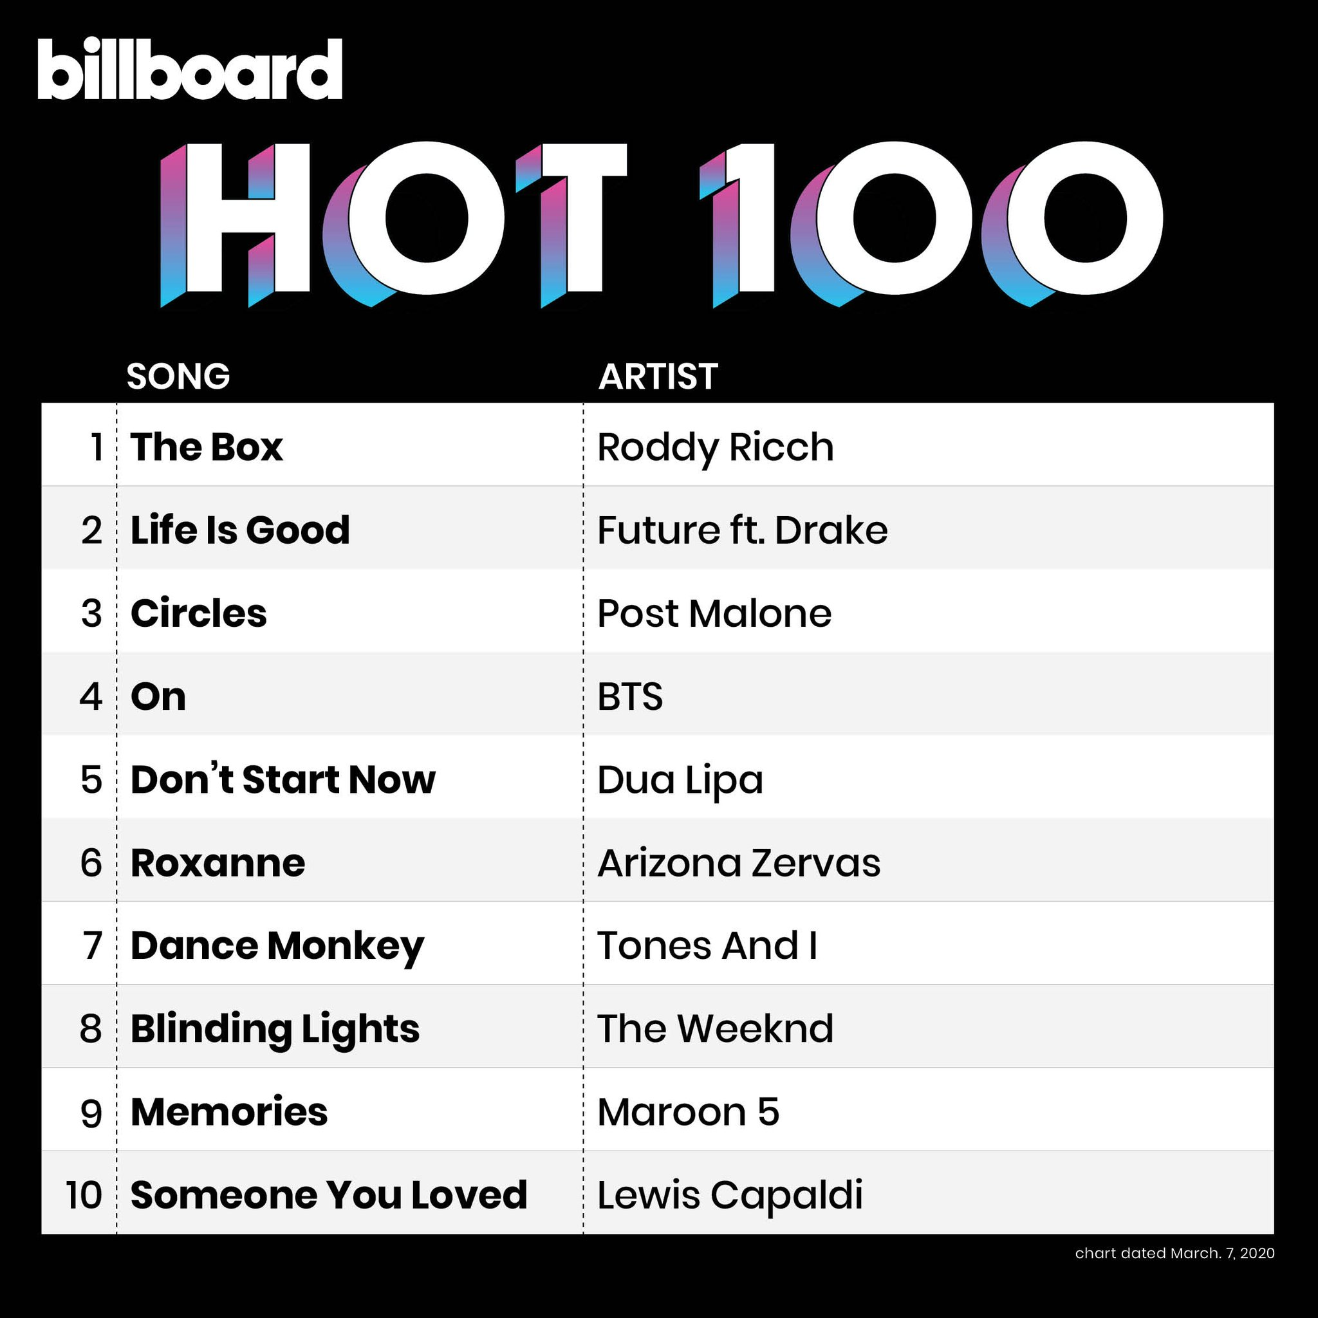
Currently (Relatively)/The What
Notes:
This distortion Bloomquist speaks of does not rest in the realm of entertainment and popular culture; Black student’s use of Black language often suffers the collateral damage of this linguistic legacy, as they navigate educational and cultural spaces.

Slide 13

Currently/The What
Schools’ role in language subjugation…
“to instill linguistic insecurity, to discriminate linguistically, to channel children in ways that have an integral linguistic component, while appearing open and fair to all” (Hymes, 1983, p. 207).
Baker-Bell (2020) ... “When Black students experience Anti-Black Linguistic Racism, it is not only an attempt to eradicate their group’s language, it is also an attempt to eradicate their identity, community intelligence, theories of reality and centuries of Black survival philosophy” (p. 25).
Notes:
Raciolinguistics, scholarship seeking to demonstrate the languaging of race, i.e. “using race theory to better understand the social and political process of sociolinguistic variation” (Alim, 2016, p. 12). It is scholarship that is interested in the way in which language plays a crucial role in the development of race and ethnicity (Alim & Smitherman, 2012).
Flores and Rosa (2015) discuss “raciolinguistic ideologies,” specifically they indicate that, “...the ideological construction and value of standardized language practices are anchored in what we term raciolinguistic ideologies that conflate certain racialized bodies with linguistic deficiency unrelated to any objective linguistic practice” (p. 150)

Slide 14
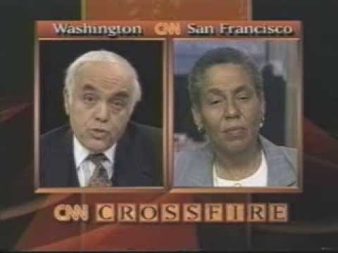
Currently/The What
Lippi-Green... “A standard language ideology, which proposes that an idealized nation-state has one perfect, homogenous language, becomes the means by which discourse is seized, and provides rationalization for limiting access to discourse” (p. 65).
“...Black students are taught to hate their language which indirectly teaches them to hate themselves” (Baker-Bell, p. 25, 2020).
Notes:
The nation, or at least those with a platform to share their thoughts, believed that OUSD had made a decision to teach Black students using slang and federal dollars. Though the decision made by the Task Force was one made with the intent of leveraging students home language the same way bilingual instruction is created and developed for a student who may speak Spanish, outsiders “heard” that OUSD wants to teach Black students ghetto talk (Rickford & Rickford, 2000).

Slide 15

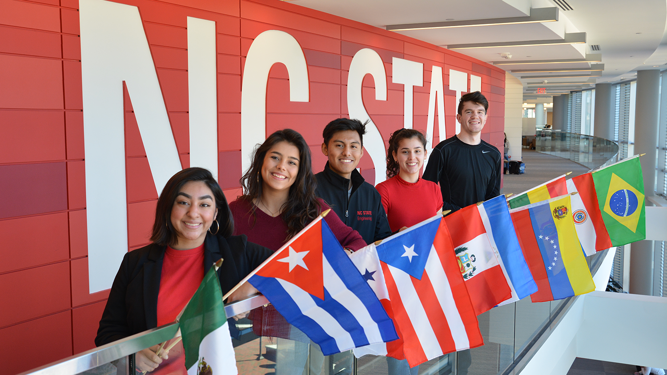

Moving Forward/The Why
Notes:
Denver public school is one example of how home language usage can become mandated. Years ago, DPS add a consent decree that created a legal standing that Spanish speaking students must have the opportunity to speak, be taught in and learn their home language. Because of this consent decree, money is allocated by the state and ultimately the district, along with training and instructors to ensure that Spanish speaking students receive this level of language support.

Slide 16

Questions/Comments/Concerns

Slide 17
References
Alim, S., & Smitherman, G. (2012). Articulate while Black. Oxford.
Baker-Bell, A. (2020). Linguistic justice Black language, literacy, and pedagogy. Routledge.
Lippi-Green, R. (1997). English with an accent: Language, ideology, and discrimination in the United States. Routledge.
Rickford, J. R., & Rickford, R. J. (2000). Spoken soul the story of Black English. Wiley.

Slide 18
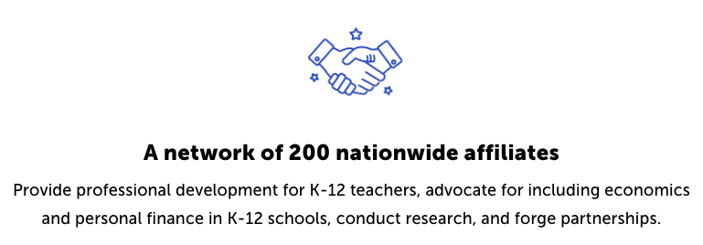
CEE Affiliates
https://www.councilforeconed.org/resources/local-affiliates/

Slide 19




Thank You to Our Sponsors!

Slide 20





We’ve gone Virtual!
Teach Economics?
Your students may have what it takes to compete in the nation’s only high school economics competition!
Why Play?
• Fun team learning experience
• Great for college applications
• No other challenge like this
• Online participation makes access easy
• Chance for cash prizes
How it Works
Teams register
Teachers enroll team(s) of 3- 4 high school students from the same school. Multiple teams allowed.
Teams compete within their state
Compete to win your state competition for a
chance to advance to the National Semi-Finals.
National Semi-Finals: May 3-20, 2021
Teams answer multiple-choice questions on macroeconomics, microeconomics, and international & current events.
National Finals: May 22-24, 2021
Teams analyze an economic issue and present their solution. Top teams engage in the Finals Quiz Bowl where they face-off answering questions to claim the National Title.
Two divisions based on experience level
David Ricardo for first-time competitors who have taken no more than one economics course.
Adam Smith for returning competitors, AP, International Baccalaureate, and honors students.
Register Today at NationalEconomicsChallenge.org

Slide 21





FIND YOUR LOCAL COMPETITION
AND REGISTER TODAY!
The National Personal Finance Challenge is a competition that provides high school students with an exciting and motivating opportunity to build, apply, and demonstrate their knowledge of money management.
Through online exams and a personal finance simulation, teams showcase their expertise in earning income, buying goods and services, saving, using credit, investing, as well as protecting and insuring.
Teams of up to four students, with one teacher/coach, can qualify to represent their state at the National Personal Finance Challenge by winning their local competition.
NATIONALS
Semi-Finals: First round elimination via online multiple-choice questions.
Finals: Case study round virtually co-hosted by the Cleveland Fed on June 3.
personalfinancechallenge.org

