Slide 1
TurboTax In Virtual Classrooms by Intuit, Pt.2:
W2’s and More W2’s
Presented by:
Jared Davidove
Sr. Manager, Strategic Education Partnerships
Ruben Rivera, Phd.
Director of Professional Development, Council for Economic Education

Slide 2
Ruben Rivera, PhD
Director of Professional Development
Council for Economic Education
Jared Davidove
Sr. Manager, Strategic Education Partnerships
Intuit
Notes:
Ryan Slide
Jared bio -
Jared leads Intuit’s Financial Readiness program aiming to empowering students to make smart money decisions and own their financial futures. As an Innovation Catalyst with deep expertise in Personal Finance Jared serves as a Board Member for the Jump$tart Coalition, a committee member for the NY State Comptroller on Personal Finance, and has been tasked with designing the Congressional Award’s first ever Personal Finance Program.”
Elaine bio -

Slide 3
Agenda
Brief overview from our previous webinars (10 minutes)
TurboTax Curriculum and Simulation for virtual Learning Overview (5 minutes)
Virtual Case Study #3 + Activity: Using multiple W2’s (35 minutes)
Virtual Case Study #1 + Activity: Using a single W2 (optional or take home)
Q&A ( 5 minutes)

Slide 4
POLL ON TURBOTAX
Notes:
Ryan Slide
Jared bio -
Jared leads Intuit’s Financial Readiness program aiming to empowering students to make smart money decisions and own their financial futures. As an Innovation Catalyst with deep expertise in Personal Finance Jared serves as a Board Member for the Jump$tart Coalition, a committee member for the NY State Comptroller on Personal Finance, and has been tasked with designing the Congressional Award’s first ever Personal Finance Program.”
Elaine bio -

Slide 5
Financial Fitness For Life
Financial Fitness for Life (3rd edition) helps you prepare students for life beyond the classroom by presenting lessons and activities based on real-world economics and personal finance concepts.
Updated lesson plans with slides
1 new lesson plan for Paying Post-Secondary Education
17 ready-to-use EdTech tools
6 new activities using real-world tools in partnership with Intuit
Purchase at https://store.councilforeconed.org/

Slide 6
EconEdLink.org Resource
Webinar on FFFL Ch:7 Uncle Sam Takes a Bite
W

Slide 7
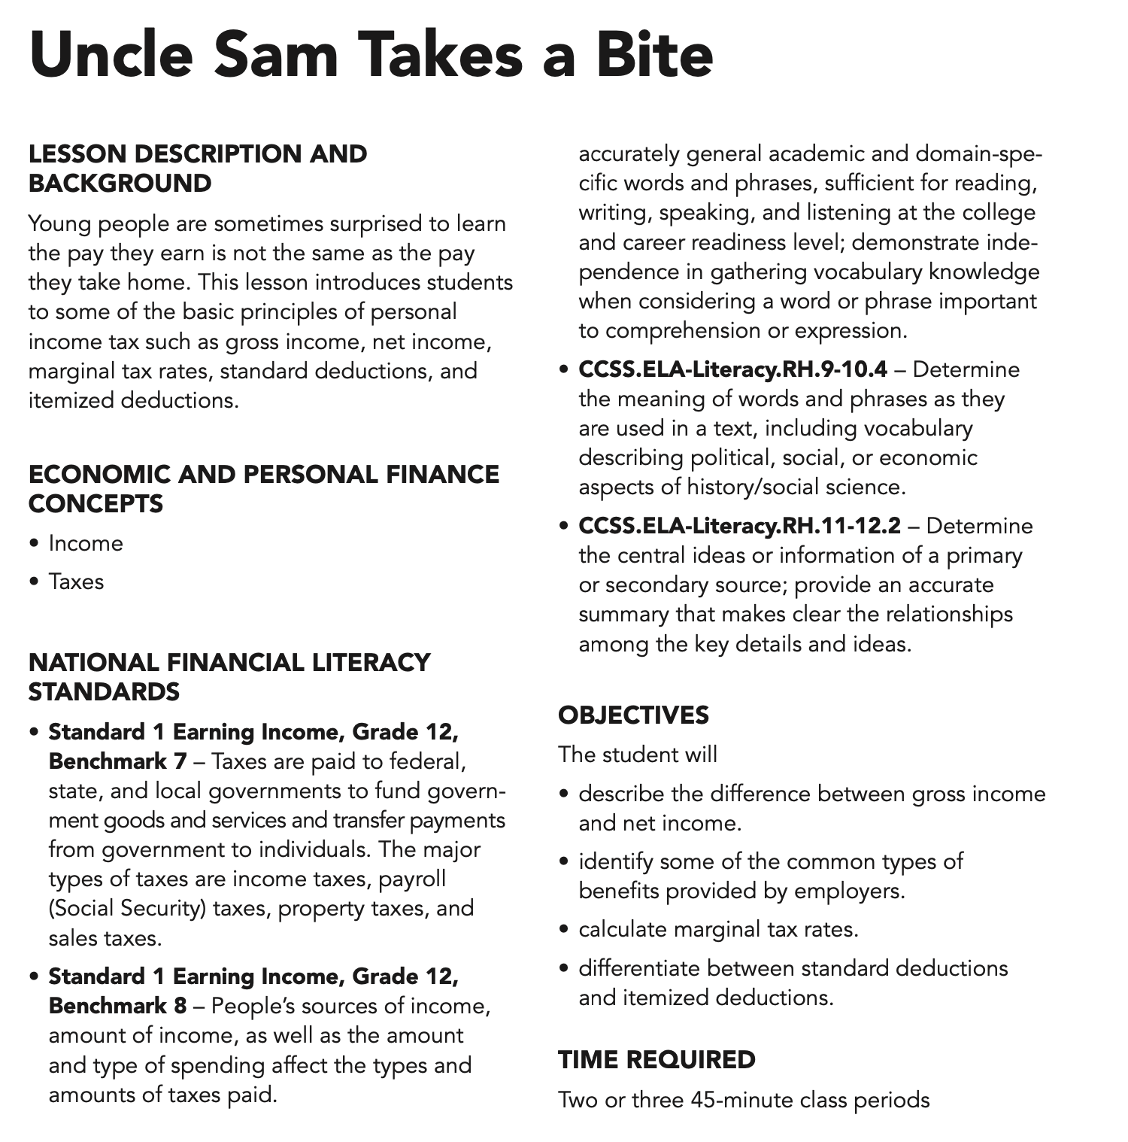
Lesson 7: Uncle Sam Takes a Bite Includes: 3 lessons + activities using TurboTax

Slide 8
Powering Prosperity
Around the World
$ 7.7B
650+
46M
5.1M
37M
600k⁺
95M⁺
FY20 Revenue
Active QBO Apps
TurboTax
Global Customers
QuickBooks Global Customers
MINT + Turbo Users
Tax Pros and Experts
Credit Karma
Customers

Slide 9
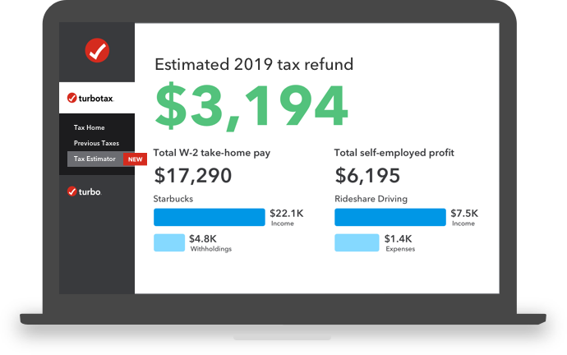
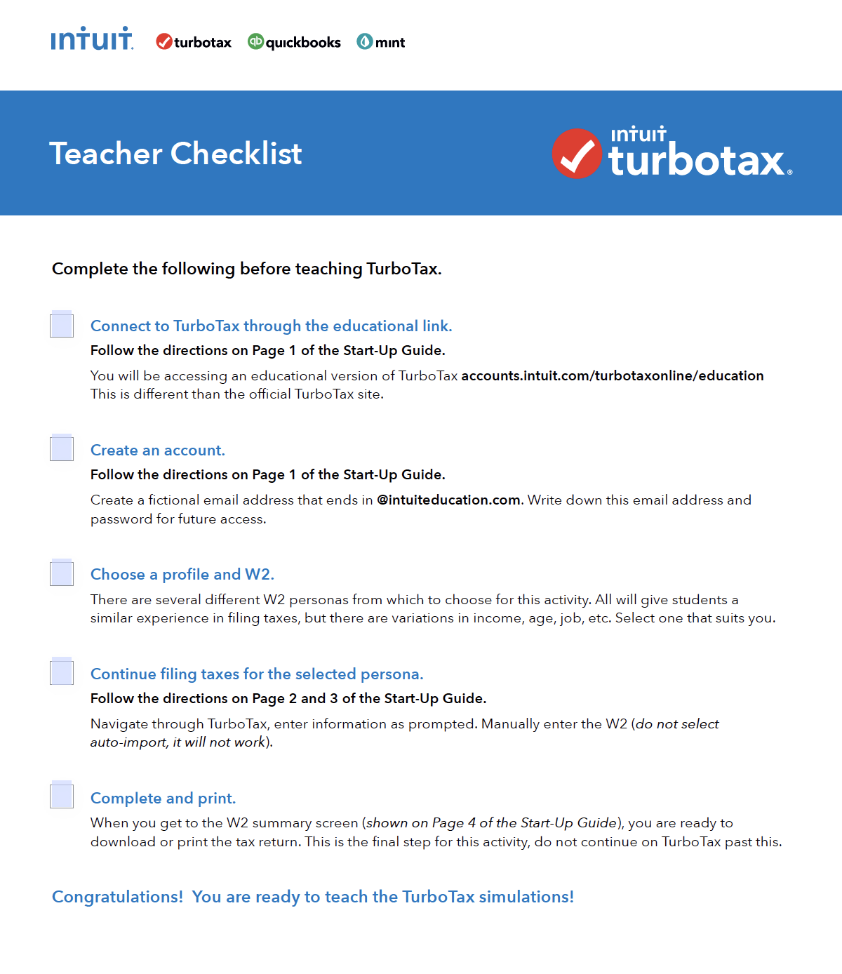
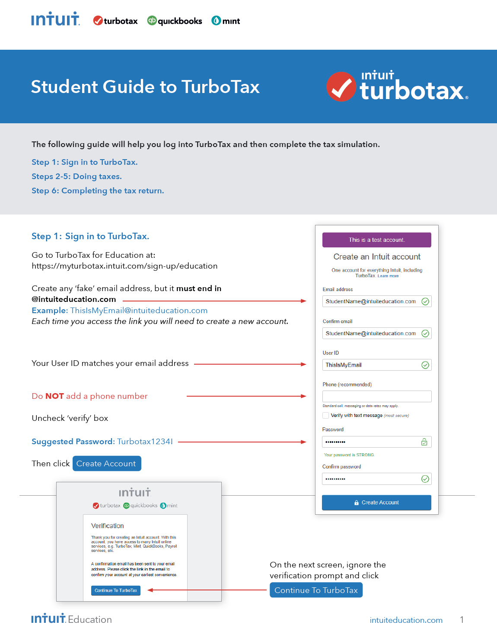
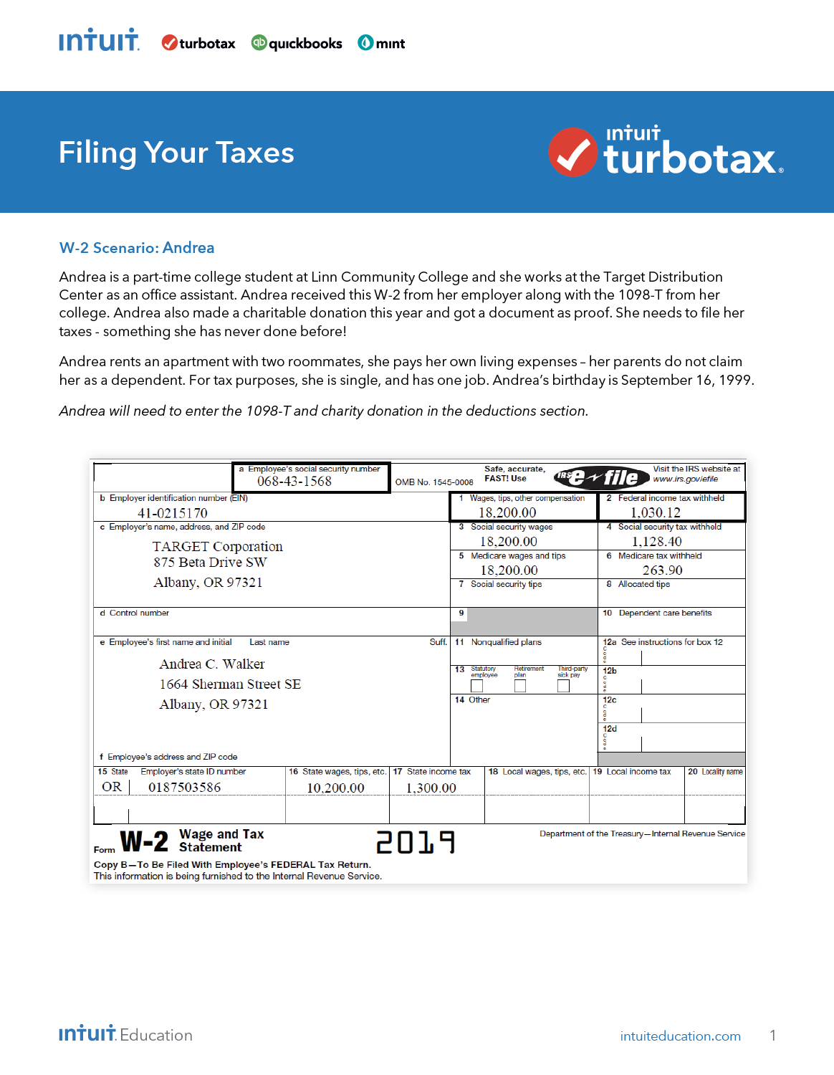
What is TurboTax?
Practice filing fictional taxes, in easy and relevant ways
Demystify Tax Day Anxiety
Uses IRS Free File Program through Freedom File Alliance
Fictional W2 Scenarios
Federal and State Returns
Complete Resource Activity on TurboTax
Notes:
Use this divider when using Title Option 2

Slide 10
Intro to Taxes
There are FOUR case studies in the Turbotax curriculum.
Today we will explore the following:
Case study 1 - Ezra Daniels.
(Using a single W2)
✓ Ezra Daniels
The simplest of all the W2s, in this scenario the filer is a dependent high school student with a part-time job earning less than $10,000 per year.
Case study 3 - Dirk Lohani
(Using multiple W2’s )
✓ Dirk Lohani
The filer in this scenario is an independent young adult working for two different employers and has two W2s. Dirk earns almost $30,000 per year from full-time employment.
Notes:
Use this divider when using Title Option 2

Slide 11
Intro to Taxes
Guiding Questions:
What Is Form W-2?
A W-2 form, also known as the Wage and Tax Statement, is the document an employer is required to send to each employee and to the Internal Revenue Service (IRS) at the end of the year. A W-2 reports the employee's annual wages and the amount of taxes withheld from their paychecks. A W-2 employee is someone whose employer deducts taxes from their paychecks and submits this information to the government.
What Information Does a W-2 Include?
Every W-2 has the same fields, no matter the employer. W-2 forms are divided into state and federal sections since employees must file taxes on both levels. There are fields that provide the employer's information, including the company's Employer Identification Number (EIN) (federal) and the employer's state ID number. The remaining fields mostly focus on the details of the employee's income from the previous year.
Source: Investopedia
Notes:
Use this divider when using Title Option 2

Slide 12
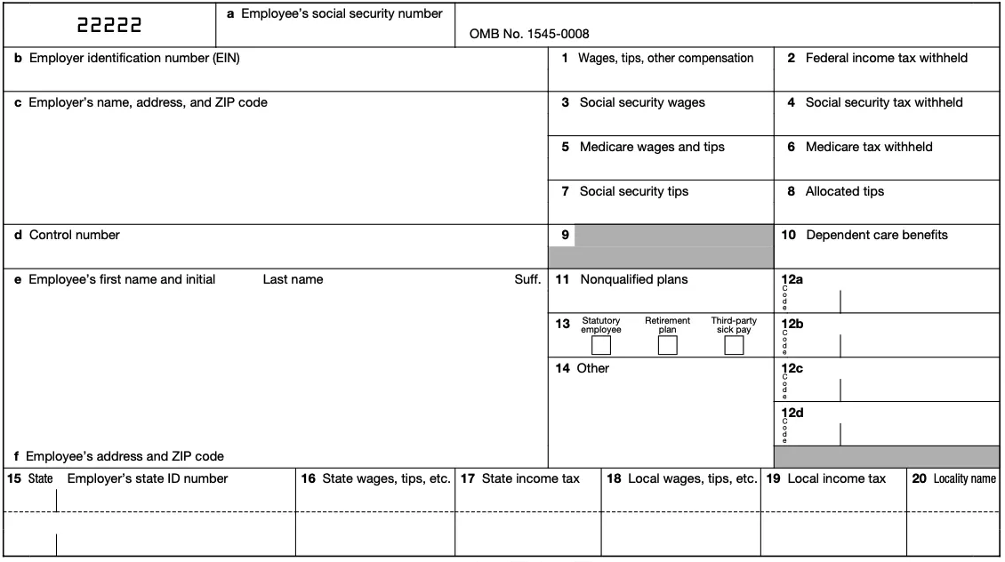
Intro to Taxes
Sample
W2
For a full breakdown of W2’s, see our introduction to Turbotax webinar.
Notes:
Use this divider when using Title Option 2

Slide 13
Intro to Taxes
Case study 3 - Dirk Lohani
(Using Multiple W2’s)
NOTE:
Dirk DID NOT receive a stimulus payment.
For the NY State: He lives in ORANGE COUNTY, Marlboro.
Complete Resource Activity on TurboTax
Notes:
Use this divider when using Title Option 2

Slide 14
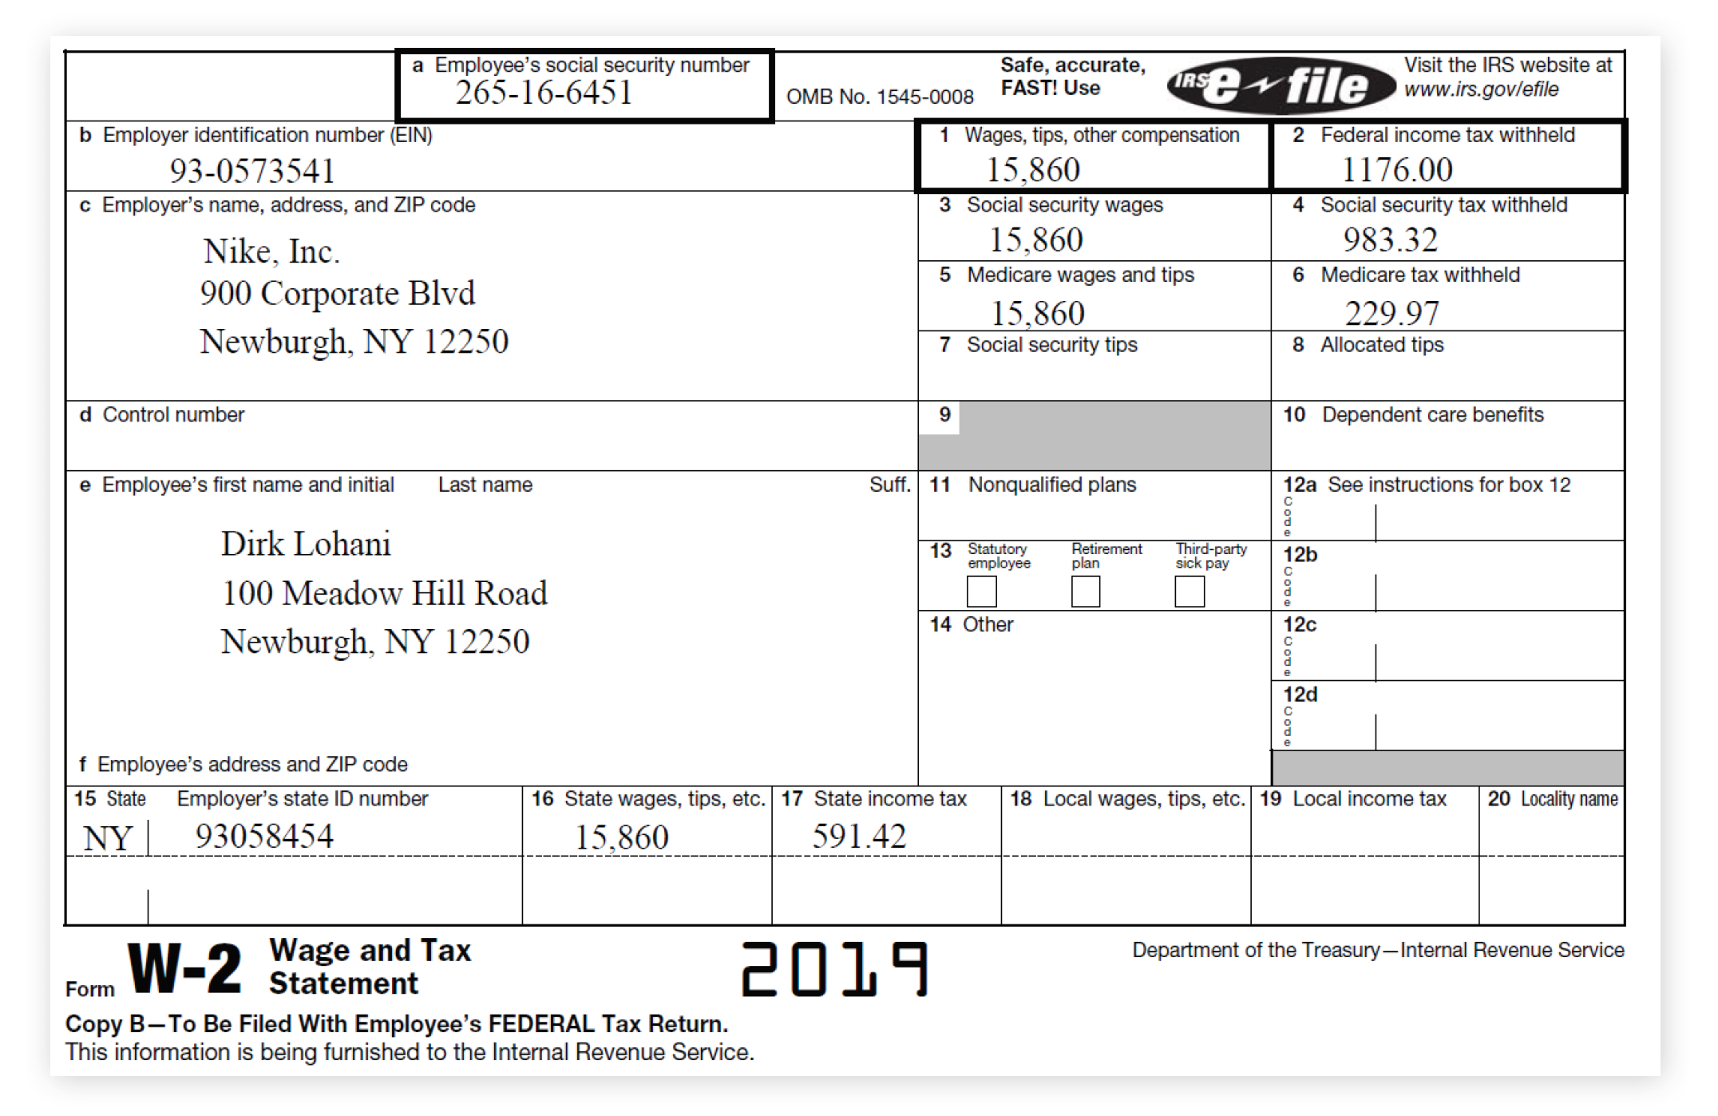
Intro to Taxes
Case study 3 - Dirk Lohani
(Using Multiple W2’s)
ACTIVITY - (15 minutes)
Complete the following W2’s
using the Turbotax student guide.
Answer the following questions:
Does Dirk owe taxes or
will he receive a refund?
Identify the amounts
(taxes owed or refunds) for both the state and federal government.
Define Standard Deduction.
What is Dirk’s standard deduction?
What is Dirk’s annual Income?
How much did he pay in Federal and State taxes?
Notes:
Use this divider when using Title Option 2

Slide 15
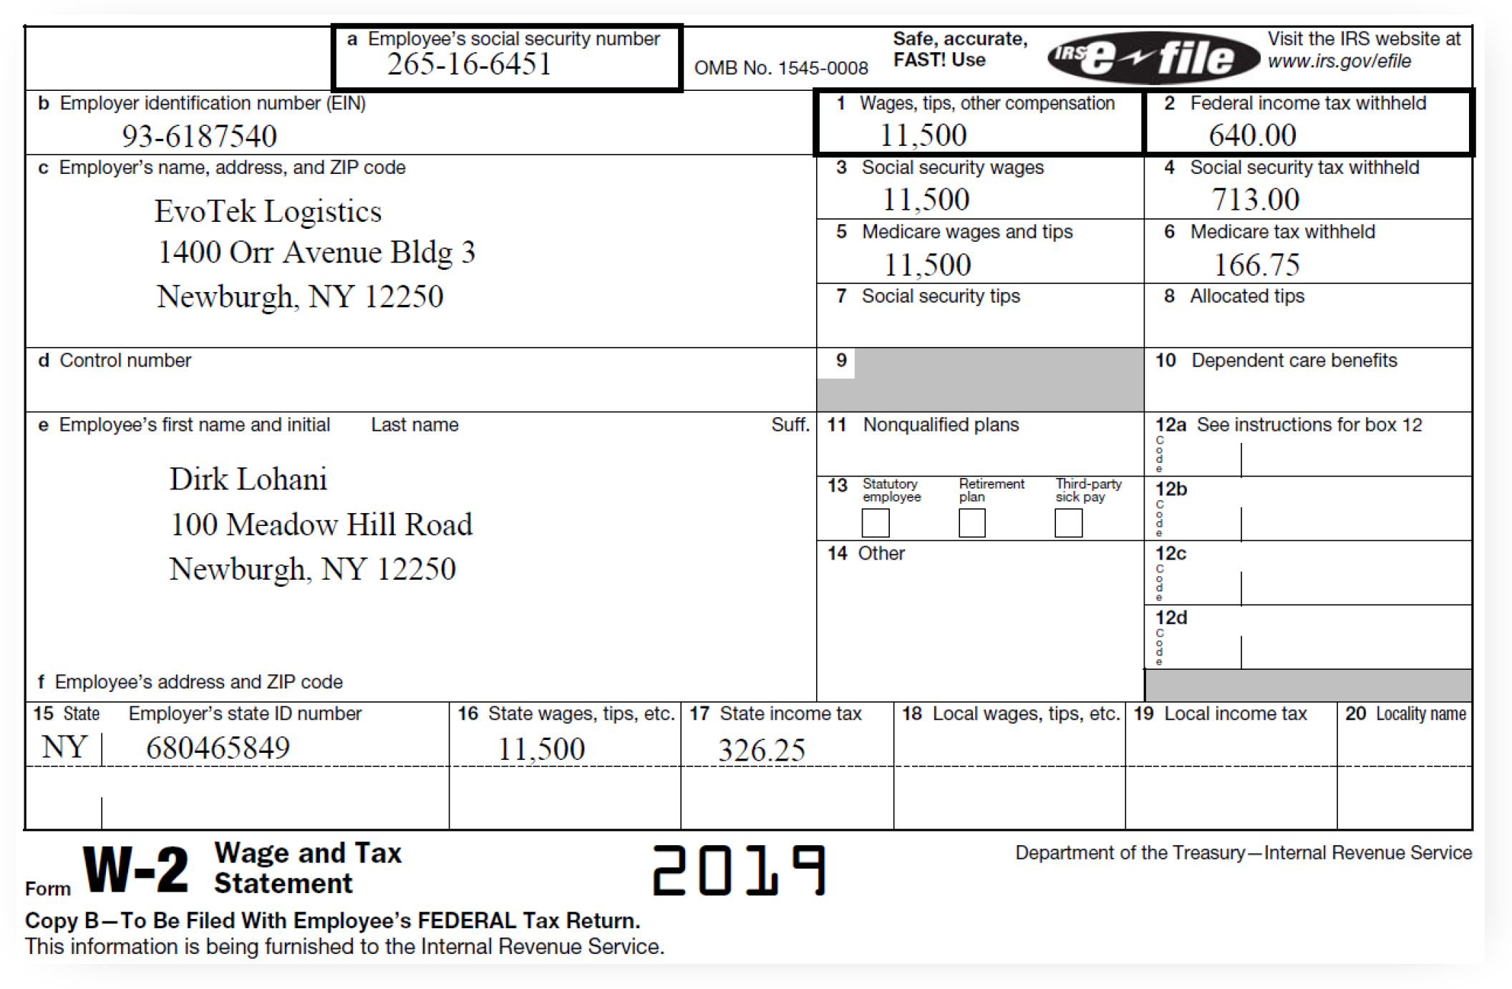
Intro to Taxes
ACTIVITY - (15 minutes)
Complete the following W2’s
using the Turbotax student guide.
Answer the following questions:
Does Dirk owe taxes or
will he receive a refund?
Identify the amounts
(taxes owed or refunds) for both the state and federal government.
Define Standard Deduction.
What is Dirk’s standard deduction?
What is Dirk’s annual Income?
How much did he pay in Federal and State taxes?
Notes:
Use this divider when using Title Option 2

Slide 16
TurboTax Simulation Demo

Slide 17
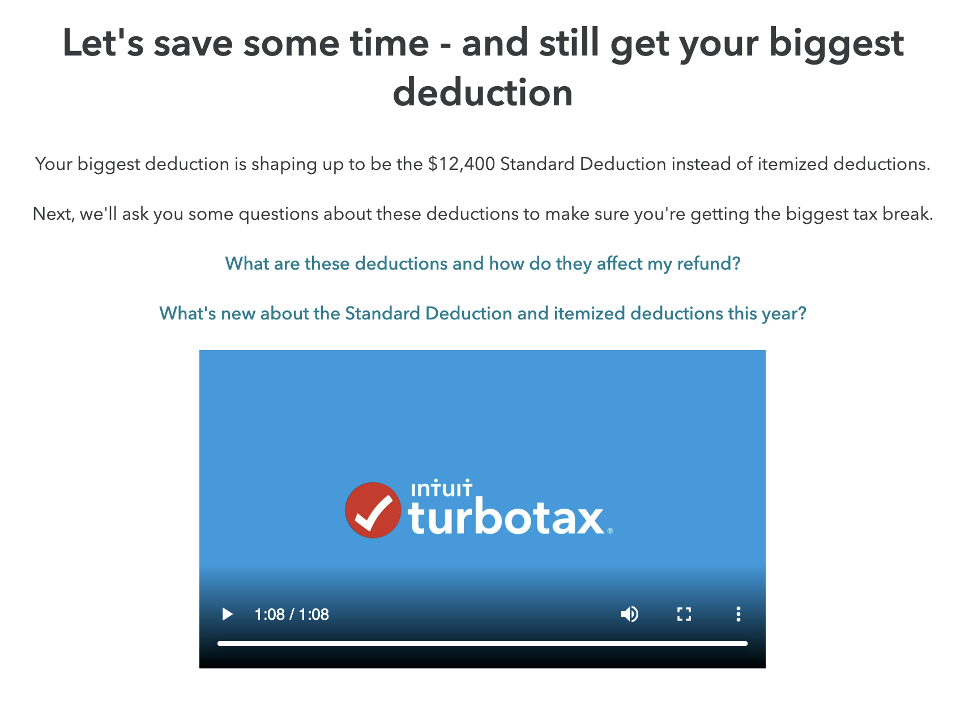
Intro to Taxes
Case study 3 - Dirk Lohani
(Using multiple W2’s)
ACTIVITY - (15 minutes)
Complete the following W2’s
using the Turbotax student guide.
ANSWERS:
Dirk will Receive a REFUND.
Federal Refund: $1416
State Refund: $14
Standard deduction: The Standard Deduction is a fixed dollar amount set by the government that is based on things like your filing status and age.
What is Dirk’s standard deduction is $12,400.
Total Income: $27,360
Total Federal Taxes paid: $1,816
Notes:
Use this divider when using Title Option 2

Slide 18
Intro to Taxes
Case study 1 - Ezra Daniels.
(Using W2’s)
Complete Resource Activity on TurboTax
Notes:
Use this divider when using Title Option 2

Slide 19
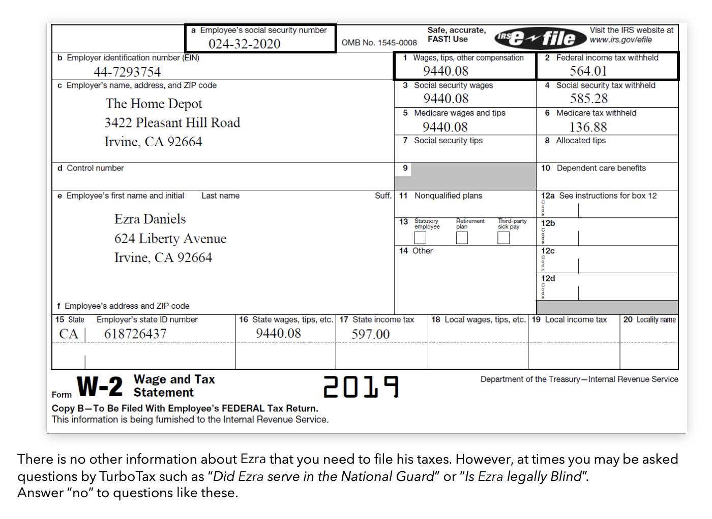
Intro to Taxes
Case study 1 - Ezra Daniels.
(Using W2’s)
ACTIVITY - (10 minutes)
Complete the following W2 using the Turbotax student guide.
Answer the following questions:
Does Ezra owe taxes or will he receive a refund?
Identify the amounts (taxes owed or refunds) for both the state and federal government.
Define Standard Deduction.
What is Ezra’s standard deduction?
Notes:
Use this divider when using Title Option 2

Slide 20
Intro to Taxes
Case study 1 - Ezra Daniels.
(Using W2’s)
ACTIVITY - (10 minutes)
Complete the following W2 using the Turbotax student guide.
Answers:
Ezra will receive a REFUND for both the state and federal government.
State Refund: $564
Federal Refund: $757
Standard deduction: The Standard Deduction is a fixed dollar amount set by the government that is based on things like your filing status and age.
Ezra’s standard deduction is $12,400.
Notes:
Use this divider when using Title Option 2

Slide 21
Intro to Taxes
Time Frame: One to two class periods (depending on the number of W2s)
Purpose: Demystify Tax Day anxiety and help students understand the withholding of income taxes from pay using TurboTax.
Objectives: Students will be able to learn and practice filing taxes using the IRS Free File Program for synchronous and asynchronous learning.
Students will be able to:
Identify payroll taxes
Explain how federal income taxes are used
Describe how employers withhold and remit taxes
Explain the purpose of form W4 and W2
Use the following EconEdLink activity:
https://www.econedlink.org/resources/intro-to-turbotax-simulation/
Notes:
Use this divider when using Title Option 2

Slide 22
Thank You | Q&A
Next Webinar:
January 13th 2021, 7-8 p.m. ET
College Expenses and Charitable Donations
NEW QUICKBOOKS WEBINARS Coming Soon.

