Slide 1
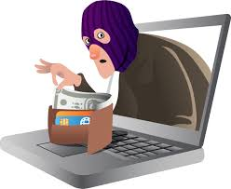
Financial Fitness for Life, Chapter 19: Don’t Be Scammed
Doug Young April22, 2021 doug.n.young@gmail.com

Slide 2
EconEdLink Membership
You can now access CEE’s professional development webinars directly on EconEdLink.org! To receive these new professional development benefits, become an EconEdLink member. As a member, you will now be able to:
Automatically receive a professional development certificate via e-mail within 24 hours after viewing any webinar for a minimum of 45 minutes
Register for upcoming webinars with a simple one-click process
Easily download presentations, lesson plan materials and activities for each webinar
Search and view all webinars at your convenience
Save webinars to your EconEdLink dashboard for easy access to the event
You may access our new Professional Development page here

Slide 3
Professional Development Certificate
To earn your professional development certificate for this webinar, you must:
Watch a minimum of 45-minutes and you will automatically receive a professional development certificate via e-mail within 24 hours.
Accessing resources:
You can now easily download presentations, lesson plan materials, and activities for each webinar from EconEdLink.org/professional-development/

Slide 4
https://www.econedlink.org/resources/collection/fffl-9-12/

Slide 5
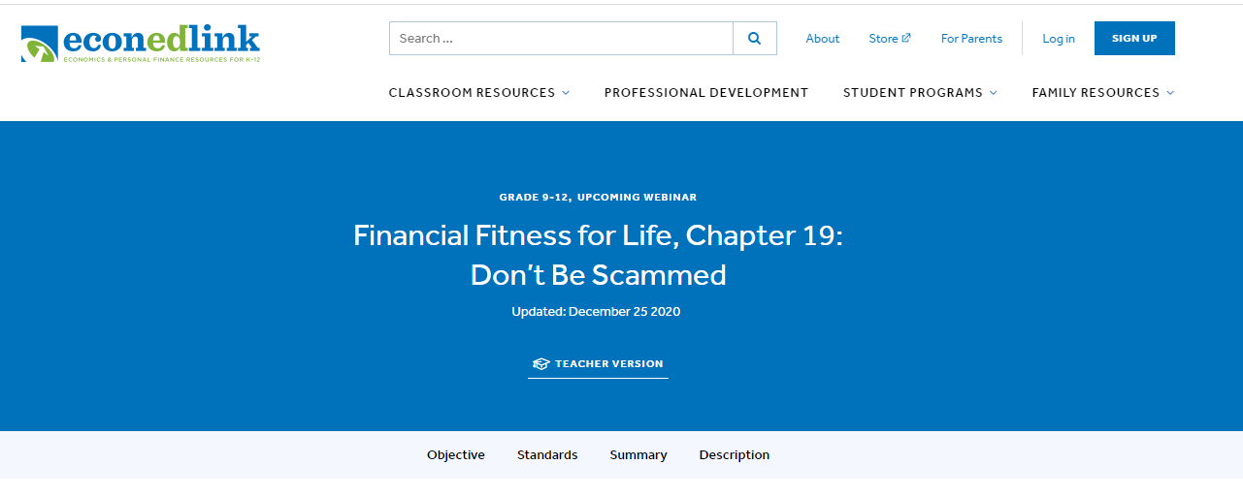
https://www.econedlink.org/resources/financial-fitness-for-life-chapter19-dont-be-scammed/

Slide 6
National Standards
• Standard 6 Protecting and Insuring, Grade 12, Benchmark 13
Loss of assets, wealth, and future opportunities can occur if an individual’s personal information is obtained by others through identity theft and then used fraudulently. By managing their personal information and choosing the environment in which it is revealed, individuals can accept, reduce, and insure against the risk of loss due to identity theft.
• Standard 6 Protecting and Insuring, Grade 12, Benchmark 14
Federal and state regulations provide some remedies and assistance for victims of identity theft.

Slide 7
Florida State Standards
Understand the fundamental concepts relevant to the development of a market economy.
Standard: SS.912.E.1.15
Content area: Economics
Correlation strength:
Grades: Grade: 912
Updated: 2008

Slide 8
Objectives
The student will:
List ways individuals and companies attempt to gain money and personal information from others for fraudulent uses.
Explain how individuals can protect themselves from identity theft and other scams.
Provide suggestions on where to obtain information on scams.
Give information on where to report scams.

Slide 9
Agenda
What is a scam?
“Scam Speak” have you even been a victim of any of these?
Exercise 19.1 – “Scam or No Scam”
Scam Speak – Kahoot exercise
Exercise 19.2 & 19.3 – Looking in depth at various scams
Tips to avoid getting taken – Exercises 19.4 &19.5
Questions

Slide 10
What makes a scam a “Scam”?
As you watch this video, what makes this a scam?
https://www.youtube.com/watch?v=i4nCy6Xs6R8
How are the scammers attempting to obtain information and money?
When and how do scams occur?
How will you know if you have been a victim of a scam?
Exercise 19.1: “Scam or No Scam” Read each of the scenarios below and decide which are examples of a scam and which are not. Then list the clues that made you think that a scenario was a scam.

Slide 11
Warning Signs of a Scam
It’s a phone call and not a letter from an agency, bank or government office.
High pressure sales techniques.
Promise of high return on your money or value on your buy.
No-risk investment.
No printed material on item for sale (brochure, prospectus, etc).
Promise of an opportunity of a life-time.
Lies and false promises.
Limited time offers (“opportunity gone tomorrow”).
Caller needs an expression of “good faith,” which means money.

Slide 12
Auto Yo-Yo Scam
At a car dealership, you’re told that you have good credit and can get a good APR, probably around 3.9%, on the loan you need.
You sign papers and are told the car will be prepped, loan processed with registration and plates available tomorrow.
You come in the next day for your car and the salesperson says everything is ready but there is a problem.
They did another credit report on you and your score is lower than originally stated and the cost of the loan will go from 3.9% to 13.9%.
You now have a decision to make, what do you do?
Scam or No Scam?
https://askthemanager.com/2018/08/car-dealer-slang-every-salesperson-should-know/

Slide 13
Scenario 1: Hawaii
Alethia received an unexpected phone call. She was informed she had won an all-expenses paid trip for two to Hawaii. What a great surprise! She didn’t remember entering any contests. However, Hawaii was a place she has wanted to visit, but it is an expensive vacation and one she can’t afford right now. All she has to do is give the caller her credit card number to pay a small fee of $100 and the vacation is hers.
“Scam or No Scam?”
Clues validating your choice.

Slide 14
Scenario 2: Healthcare
Jack is on Medicaid. He received an email stating that due to a record-keeping mistake he was entitled to a one-time payment of $200. The email directed him to a website where Jack was to enter details such as his social security number and mailing address. Jack could use $200 and it was money he was entitled to, right? He quickly filled out the online form.
“Scam or No Scam?”
Clues validating your choice.

Slide 15
Scenario 3: Banking
Carlos has a credit card with ABC Bank. He receives a call from a bank representative stating a $1,050 charge for a purchase made outside the United States using his credit card. Because this was larger than the normal amounts Carlos put on his credit card, the bank representative wanted to know if Carlos had made this purchase. Carlos said no he had not. The bank representative said they would remove the charge and investigate further.
“Scam or No Scam?”
Clues validating your choice.

Slide 16
Scenario 4: Grandparents
It is late and Sam receives a phone call from his grandson, Sean. The connection is bad so Sam has a hard time understanding Sean. Finally, he realizes Sean has been arrested, is in jail and needs money for bail. Of course, Sam wants to help is grandson. Sean tells him to go to the drugstore and buy two gift cards, $500 each and tells him where to mail the cards.
“Scam or No Scam?”
Clues validating your choice.

Slide 17
Scenario 5: Fundraiser
Matt receives a call from the local volunteer fire department. The caller informs him that he won the fishing rod that he bid on at the silent auction fundraiser last week. Matt remembers bidding on it, but didn’t think he would be the highest bidder. The caller tells him to stop by the local fire hall to collect the item.
“Scam or No Scam?”
Clues validating your choice.

Slide 18
Scenario 6: Taxes
Robert received a letter from Next Step Recovery Co. stating that the communication served as formal notice that his delinquent tax debt had been placed with Next Step, who is a contractor to the Internal Revenue Service for the collection of the balance. The letter also included information from the IRS on Taxpayer Rights. To verify the name and address of Next Step, Robert can visit www.irs.gov. The letter stated that Robert can send the balance due by check or money order made out to the United Stated Treasury and mailed directly to the IRS at Department of the Treasury, Internal Revenue Service, Kansas City, MO 64999 or contact Next Step to discuss a payment plan. It warned not to send cash.
“Scam or No Scam?”
Clues validating your choice.

Slide 19
Scenario 7: Job Offer
Jackson receives a call from a company offering him a job as a professional shopper. He has been looking for work and expresses interest. The caller says they will send him a cashier’s check. He should deposit it in his bank account and then wire a portion back to the company to cover expenses. The remainder he gets to keep as payment for his services. Jackson likes to shop, needs the money and agrees to the offer.
“Scam or No Scam?”
Clues validating your choice.

Slide 20
Scenario 8: Sports
Shaquilla’s favorite hockey team has made it to the Stanley Cup finals. She would love to go but tickets are more than she can afford and difficult to get. She receives a call from a ticket broker saying he has two tickets for sale because the original ticket holder is ill and is unable to attend. Plus, at this price she can buy two tickets and take her dad. But she must act fast. These tickets are in demand. Shaquilla is thrilled and immediately agrees to give the broker her credit card number and address so he can mail her the tickets.
“Scam or No Scam?”
Clues validating your choice.

Slide 21
Kahoot Exercise
1. The top method for scammers to target consumers is:
A. Direct mail C. phone calls and text messaging
B. E-mails D. None
2. The Top Fraud of 2020 Goes to:
A. Imposter scams C. Ghosting Scams
B. Keylogger scams D. Phishing scams
3. Imposter scams includes scammers who:
A. Act as government officials stealing stimulus payments.
B. Pretend to be healthcare workers in COVID-19 testing and vaccine scams,
C. Fake charity scams
D. All of the above
4. Which of these organizations would NOT be an agency you can go to for help, if scammed?
A. FTC - Federal Trade Commission (www.ftc.gov)
B. Identity Theft Resource Center (https://www.idtheftcenter.org/)
C. U.S. Department of Justice, Office of Victims of Crime (https://ovc.ojp.gov/)
D. HugeDomains.Com (www.iwishgoods.com)
5. Scammers pretending to be interested in you, asking for your e-mail and later ask for financial help to come visit you. This is a:
A. Dating scam C. Phishing scam
B. Ghosting scam D. Skimming scam

Slide 22
Kahoot Answers
The top method for scammers to target consumers is:
A. Direct mail C. phone calls and text messaging
B. E-mails D. None
2. The Top Fraud of 2020 Goes to:
A. Imposter scams C. Ghosting Scams
B. Keylogger scams D. Phishing scams
3. Imposter scams includes scammers who:
A. Act as government officials stealing stimulus payments.
B. Pretend to be healthcare workers in COVID-19 testing and vaccine scams,
C. Fake charity scams
D. All of the above
4. Which of these organizations would NOT be an agency you can go to for help, if scammed?
A. FTC - Federal Trade Commission (www.ftc.gov)
B. Identity Theft Resource Center (https://www.idtheftcenter.org/)
C. U.S. Department of Justice, Office of Victims of Crime (https://ovc.ojp.gov/)
D. HugeDomains.Com (www.iwishgoods.com)
5. Scammers pretending to be interested in you, asking for your e-mail and later ask for inancial help to come visit you. This is a:
A. Dating scam C. Phishing scam
B. Ghosting scam D. Skimming scam

Slide 23
What does it mean to be “Scammed’?
https://www.comparitech.com/vpn/avoiding-common-scams-schemes/

Slide 24
Scam Speak
Brute Force
Catfish
Charity Fraud
Dating
Drive-by Download
Ghosting
Grandkid
Hash Busters
Home Repair
Immigration Help
IRS Imposter
Keylogger
Malvertising
Man-in-the-middle attack
Moneymule
Pharming
Phishing
Ransomware
Romance (Online Dating)
Scareware
Skimming
Smishing
Spear-phishing
Spoofing
Spyware
Tech Support
Vishing
You’ve Won
Whaling

Slide 25
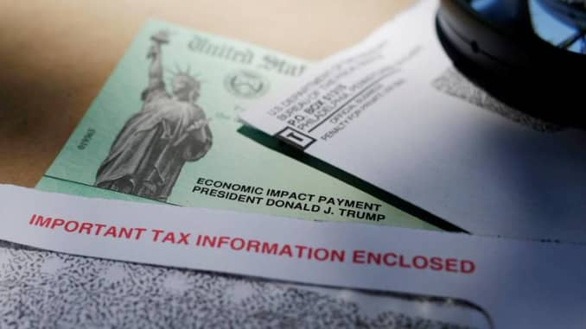
Five Common Stimulus Check Scams
https://www.cnbc.com/2020/12/29/stimulus-check-scams-here-are-red-flags-to-watch-for.html

Slide 26
Scams
Exercise 19.2 - Divide the class into nine groups and assign each group one of the nine scams listed. You could have each student chose a scam from the handout entitled “Scam Speak.” There is a Teacher’s Answer Key. Websites below and Google searches will provide information needed for their research.
Exercise 19.3 - Use this worksheet or newsprint for reporting put findings.
Scams: Internet, Government Grant, Lottery & Sweepstakes, Ticket, Identity Theft, Telephone, Charity, Banking, and Dating
Websites:
U.S. Government - https://www.usa.gov/common-scams-frauds#item-37147
F.T.C. - https://www.consumer.ftc.gov/features/scam-alerts
C.F.P.B. - https://www.consumerfinance.gov/consumer-tools/fraud/

Slide 27
Common Scams Reporting Sheet
Exercise 19.2
Type of Scam:
Description of Scam:
How to Report the Scam:
Ways to Protect from Being Scammed:
Source:

Slide 28
Exercise 19.3 Scam Recording Sheet
Type of Sam | Description | Where to Report | Ways to Avoid Being a Victim

Slide 29
Exercise 19.4 - Tips
1. Don’t send money using a wire transfer, prepaid debit card, or a gift card to someone you have not met.
2. Be distrustful of links or attachments in unsolicited emails. Scammers are good at making websites and emails look official.
3. Don’t be pressured to make a decision or take action.
4. Do not use a wire transfer, prepaid money card, gift card or any method to pay for goods, services, taxes or debts. These can’t be traced and are like paying with cash.
5. Use secure websites. Make sure the website has “https” in the URL.
6. Be careful when using dating websites. Scammers reach potential targets using a variety of online sites.
7. Guard your personal information, such as Social Security Number, birthdate, and credit card information. Never give this information to anyone who contacts you unsolicited. Scammers attempt to obtain this information over the phone, by email, on social media, or by knocking on your door.
8. If you win a prize, a contest or the lottery, you will not be asked to send money to cover the cost of shipping or expenses.
9. Do not accept and deposit a check at your bank and then agree to wire money to a caller.
10. Be sure to use privacy settings on social media and online accounts. Be careful of what you share on social media. Scammers gain and use information about you from these accounts.

Slide 30
Protecting One’s Self
Exercise 19.5
1. Secure your SSN. Don’t carry it or write your number on your checks..
2. Don’t respond to unsolicited requests for personal information
3. Collect mail promptly or place a hold on your mail when you are away from home.
4. Pay attention to your billing cycles. If bills are late, contact the sender.
5. Enable on mobile devices (banking websites, etc.)
6. Update sharing and fithe security features rewall settings when on a public wi-fi network (Use VPN’s).
7. Review your credit and bank account statements. Watch for unauthorized debts.
8. Shred receipts, credit offers, account statements, and expired credit cards, to prevent “dumpster divers” from getting your personal information.
9. Store personal information in a safe place.
10. Install firewalls and virus-detection software on your home computer.
11. Create complex passwords. Change passwords if a company breach occurs
12. Review your credit report once a year checking all open accounts using free website: www.annualcreditreport.com
13. Freeze your credit files with Equifax, Experian, Innovis, TransUnion, and the National Consumer Telecommunications and Utilities Exchange, for free.

Slide 31
Closure
What is a scam?
What are some characteristics of a scam?
How can you protect yourself from scams?
Where can you get information on U.S. scams?
Where can you report scams?
What is identity theft?
What are two things you can do to protect yourself from identify theft?

Slide 32
Assessment
A local senior citizen center director contacts you. She is concerned that some of its members are not knowledgeable about scams and
may be taken advantage of. She asks you to make a presentation at a local senior center about scams and identity theft.
Prepare a 5-to-10-minute visual and written presentation that includes at least two examples of ways senior citizens could be scammed, lists suggestions learned in the lesson about how they can protect themselves from scams, gives websites where one can find information on a particular scam, and lists whom a senior citizen should contact if they think they have been scammed.

Slide 33
Cybercrimes in 2020
1. 46% of businesses have experienced a cyber threat since the Covid-19 lockdown.
2. Google reported 18 million daily malware and phishing mails in the space of a week.
3. Cyber attacks to healthcare organizations has doubled.
4. Hackers attack every 39 seconds.
5. The global average cost of a data breach is $3.9 million, according to IBM.
6. Cyber Incident response teams reduce data breach costs by $360,000.
7. On average, it takes 279 days to identify and contain a breach.
8. Only 5% out of 4.3 billion of companies’ folders were protected.
9. 53% of companies were found to have 1,000 sensitive files open to every employee.
10. 64% of Americans don't know how to handle a data breach.

Slide 34
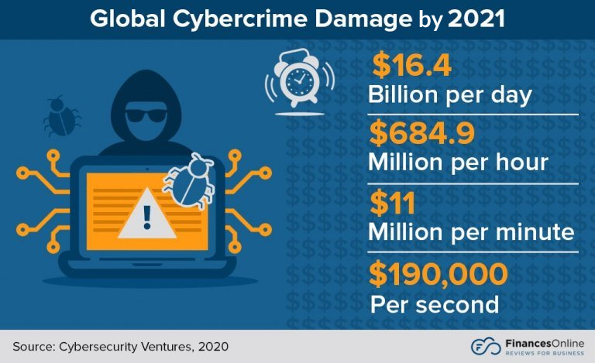

Slide 35
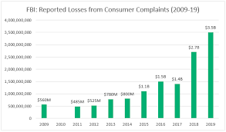

Slide 37
References
70+ common online scams used by cyber criminals and fraudsters
https://www.comparitech.com/vpn/avoiding-common-scams-schemes/
Common scams and schemes used by cyber criminals.
Identity Theft Resource Center https://www.idtheftcenter.org/
A non-profit organization established to empower and guide victims, business and government to minimize risk and mitigate consumers, he impact of identity compromise and crime.
Netflix: Spycraft - https://decider.com/show/spycraft/
Spycraft is an 8-part docuseries that examines the different ways countries have spied on each other and gathered intelligence over the decades. Different methods are examined in each episode.
ProPublica: What Facebook Knows About You.
https://www.propublica.org/article/breaking-the-black-box-what-facebook-knows-about-you
How companies are profiling (monetizing) you.

Slide 38
CEE Affiliates
https://www.councilforeconed.org/resources/local-affiliates/

Slide 39
Thank You to Our Sponsors!

Slide 40
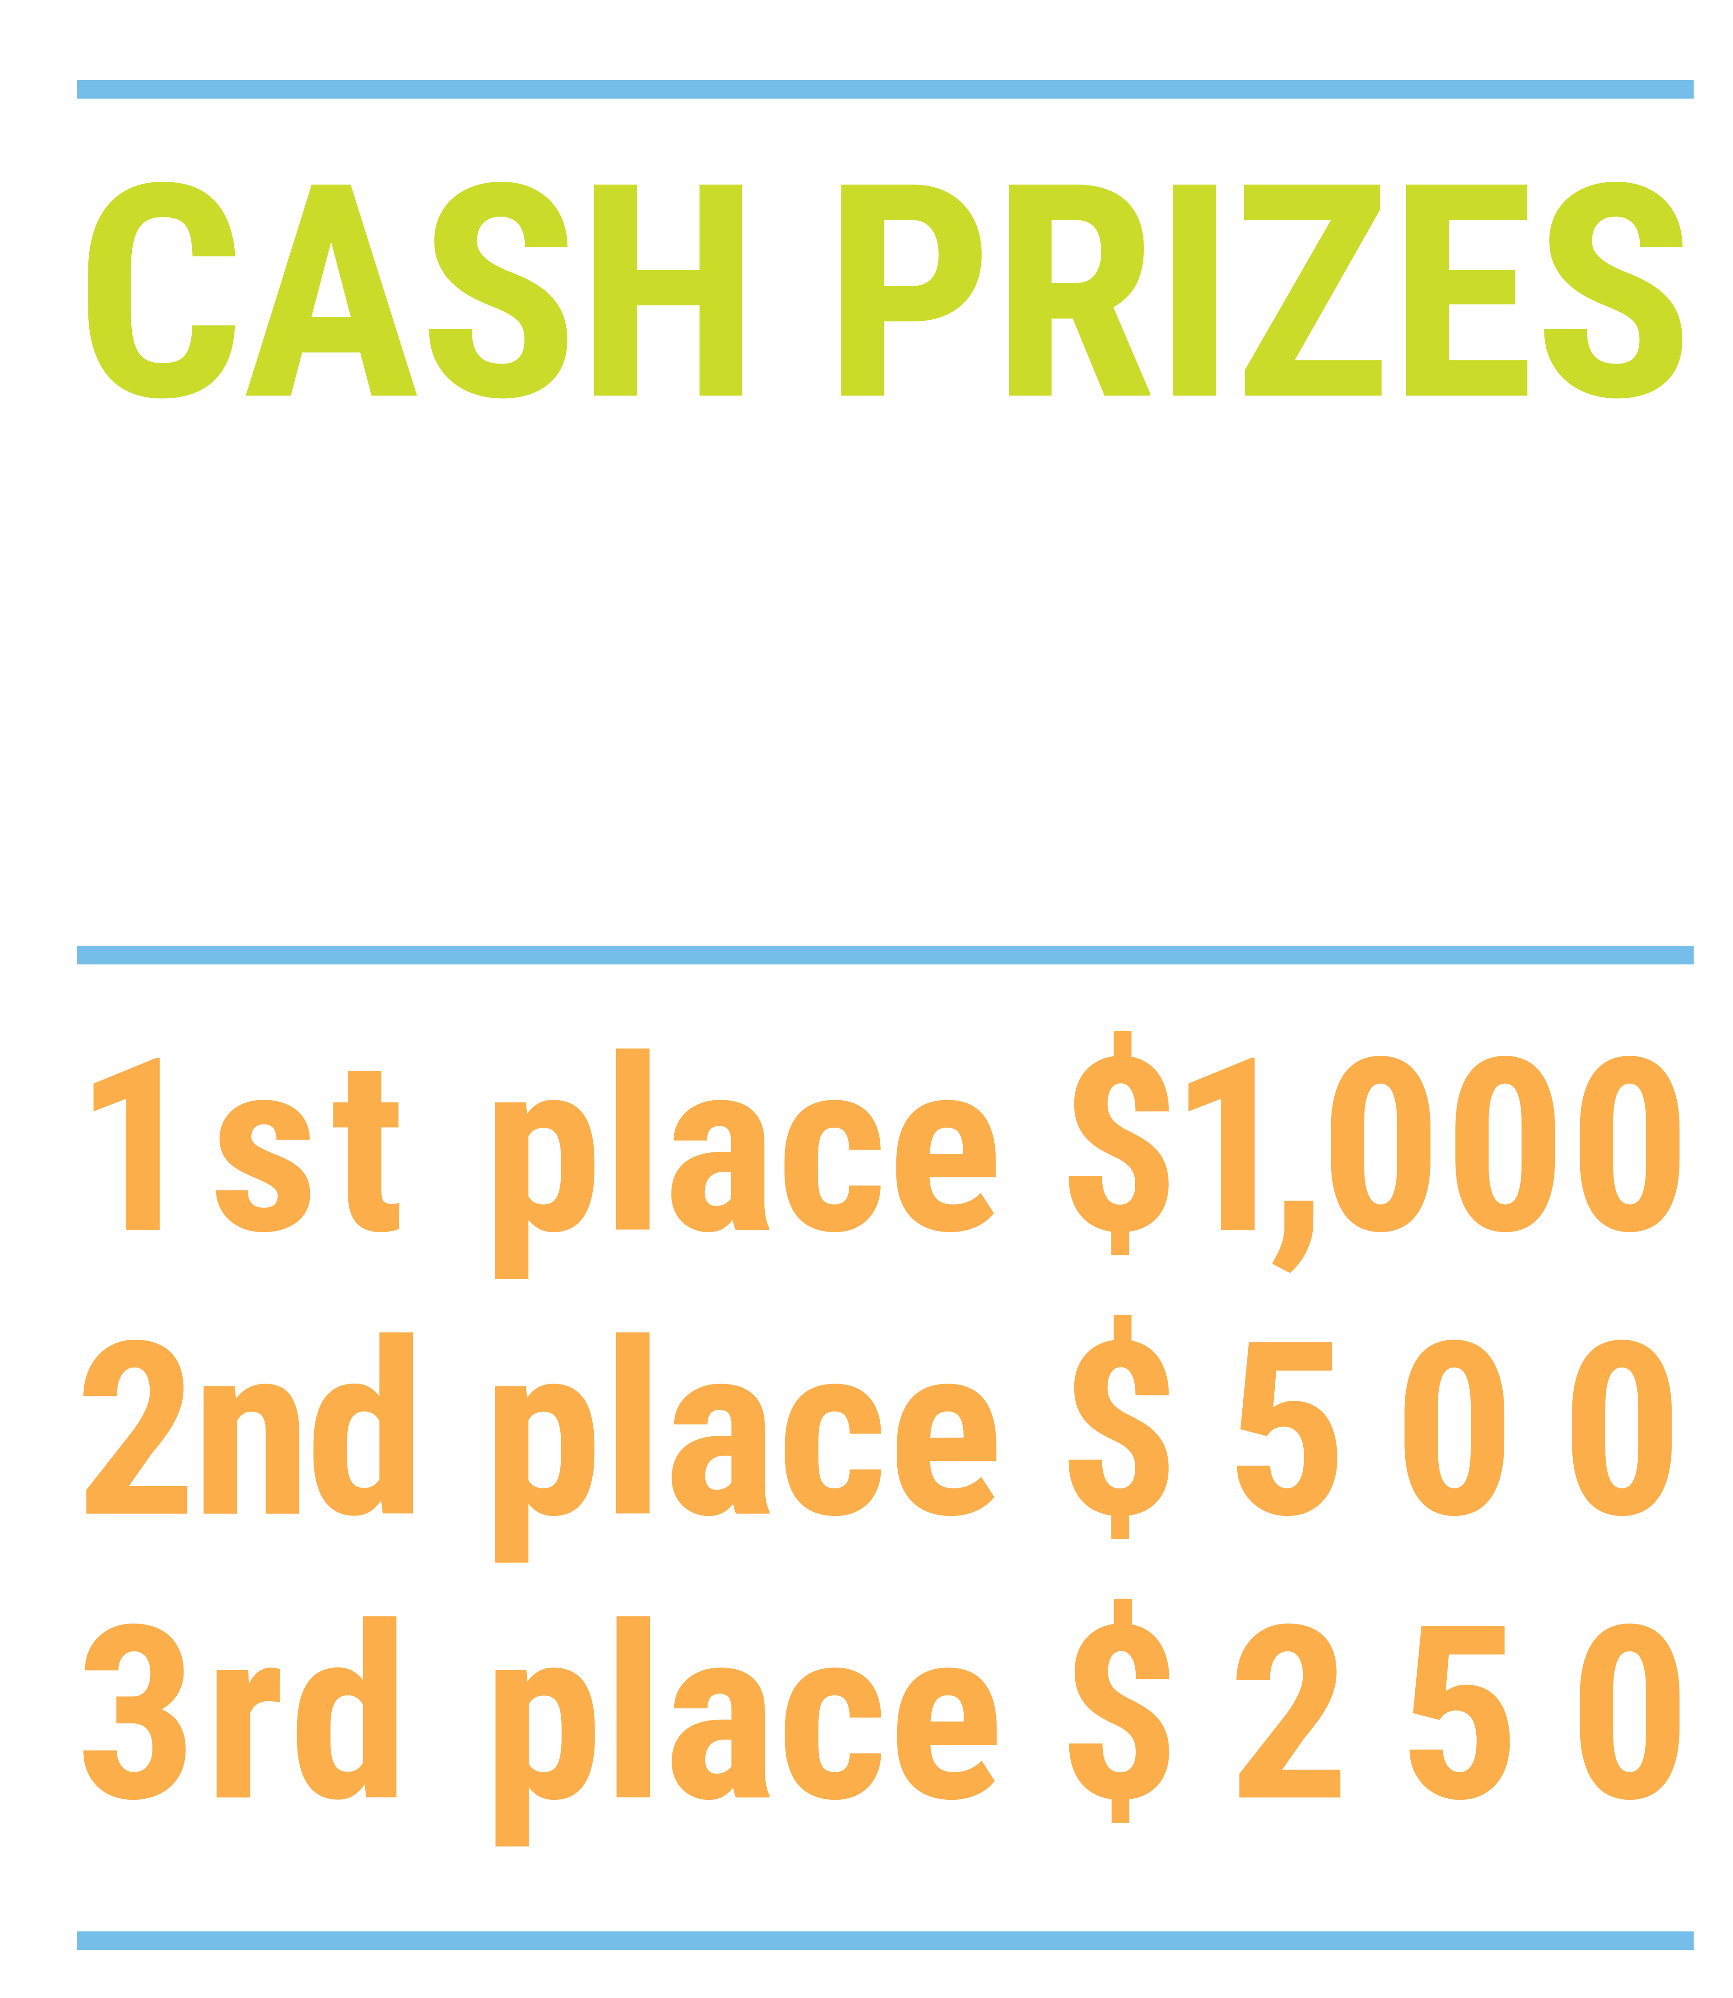
We’ve gone Virtual!
Teach Economics?
Your students may have what it takes to compete in the nation’s only high school economics competition!
Why Play?
• Fun team learning experience
• Great for college applications
• No other challenge like this
• Online participation makes access easy
• Chance for cash prizes
How it Works
Teams register
Teachers enroll team(s) of 3- 4 high school students from the same school. Multiple teams allowed.
Teams compete within their state
Compete to win your state competition for a chance to advance to the National Semi-Finals.
National Semi-Finals: May 3-20, 2021
Teams answer multiple-choice questions on macroeconomics, microeconomics, and international & current events.
National Finals: May 22-24, 2021
Teams analyze an economic issue and present their solution. Top teams engage in the Finals Quiz Bowl where they face-off answering questions to claim the National Title.
Two divisions based on experience level
David Ricardo for first-time competitors who have taken no more than one economics course.
Adam Smith for returning competitors, AP, International Baccalaureate, and honors students.
Register Today at NationalEconomicsChallenge.org

Slide 41
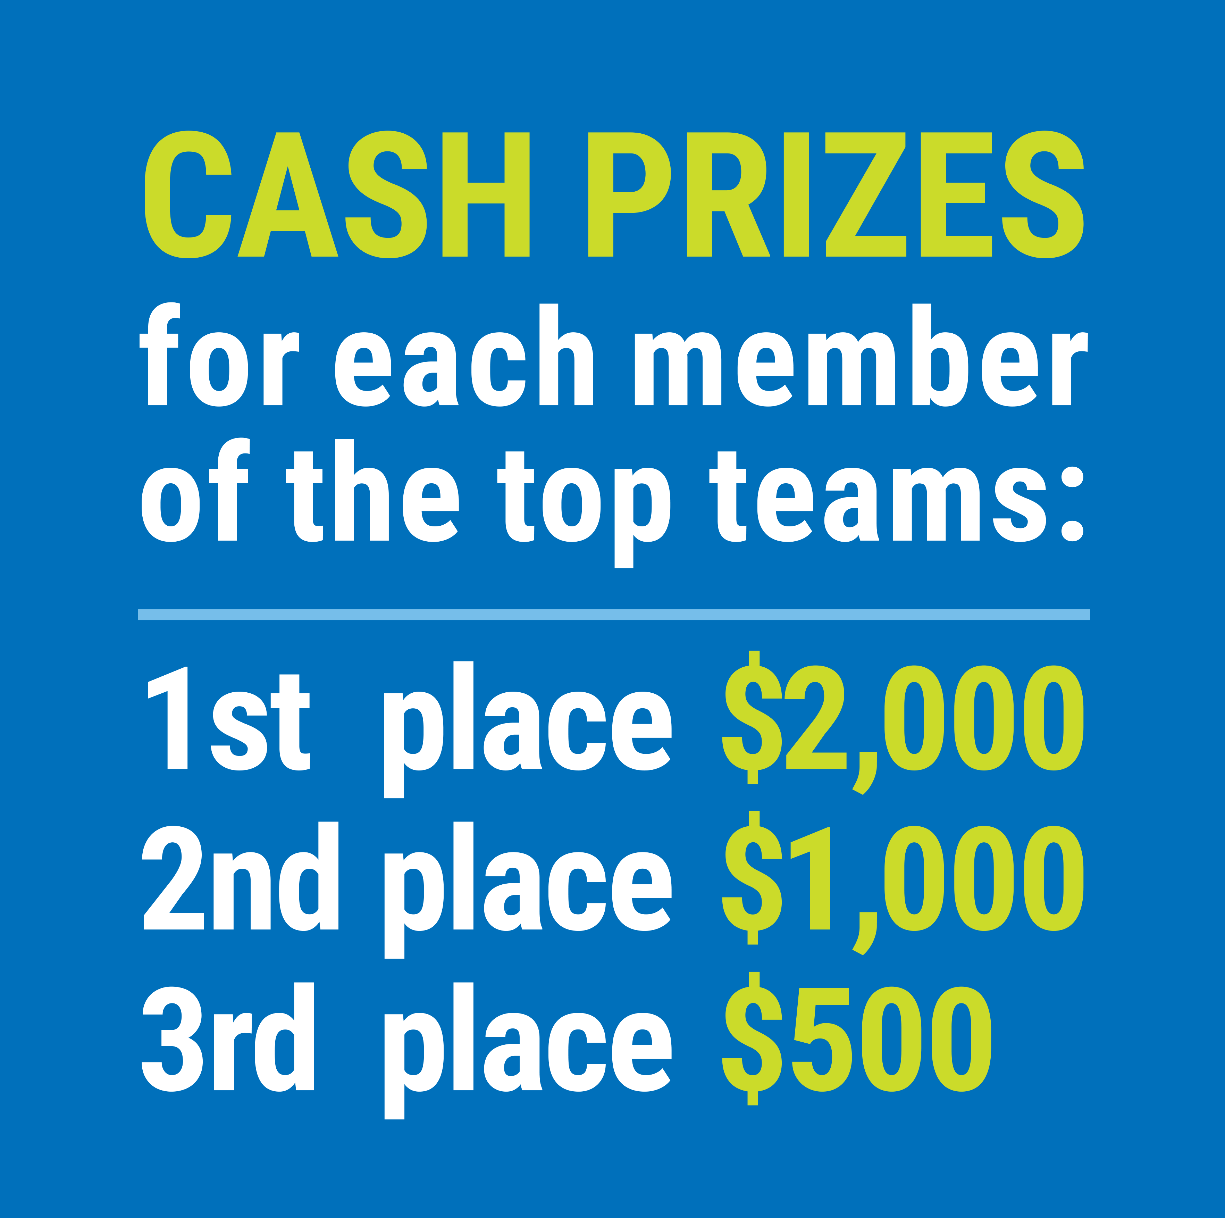
FIND YOUR LOCAL COMPETITION AND REGISTER TODAY!
The National Personal Finance Challenge is a competition that provides high school students with an exciting and motivating opportunity to build, apply, and demonstrate their knowledge of money management.
Through online exams and a personal finance simulation, teams showcase their expertise in earning income, buying goods and services, saving, using credit, investing, as well as protecting and insuring.
Teams of up to four students, with one teacher/coach, can qualify to represent their state at the National Personal Finance Challenge by winning their local competition.
NATIONALS
Semi-Finals: First round elimination via online multiple-choice questions.
Finals: Case study round virtually co-hosted by the Cleveland Fed on June 3.
personalfinancechallenge.org

Slide 42
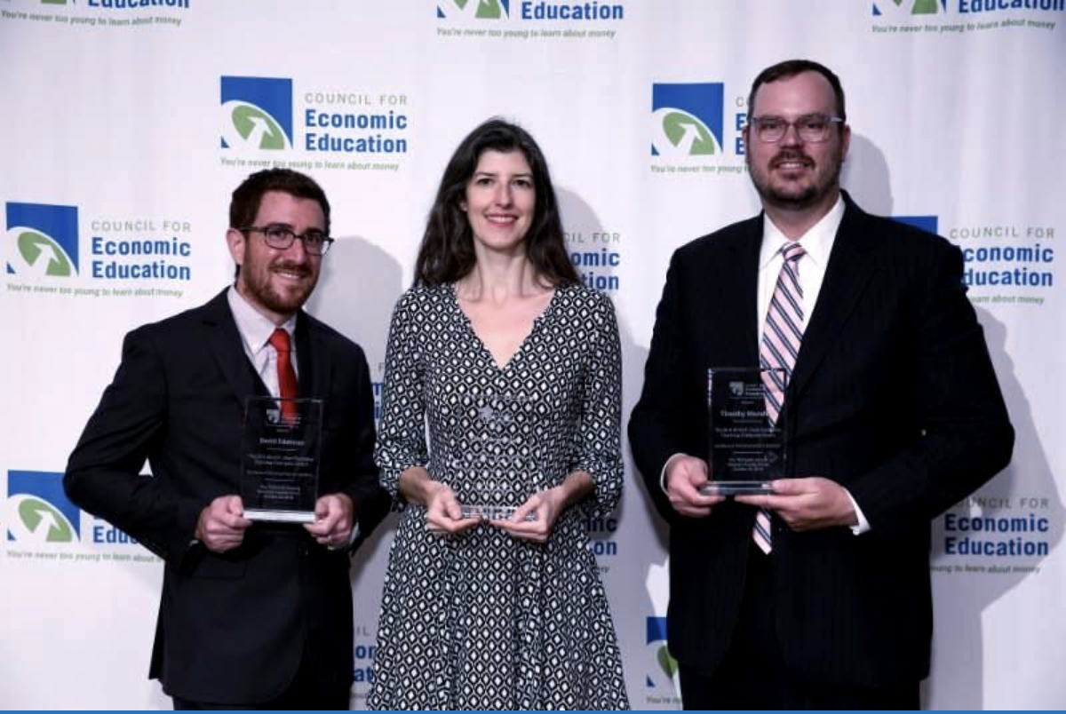
The 2021 Sloan Teaching Champion Award
Winners receive:
A cash award of $5,000
A cash award of $2,500 for their school to support economic education
Recognition at our annual Visionary Awards convening.
This award promotes economic education by honoring three outstanding teachers who incorporate exemplary teaching techniques that improve their students’ economic understanding in and out of the classroom.
This award is open to New York metropolitan area high school teachers of all subjects, not just teachers of economics. Applicants must demonstrate how they integrate economics into their teaching.
Sound like you or someone you know?
Applicants must teach in one of the
Twelve New York state counties (New York, Kings, Bronx, Richmond, Queens, Nassau, Suffolk, Westchester, Putnam, Rockland, Orange and Dutchess)
Eight New Jersey counties (Bergen, Passaic, Essex, Hudson, Middlesex, Union, Morris, Monmouth), or the
Two Connecticut counties (Fairfield and New Haven)
Application will be launched on Friday February 19th 2021
You can access the application here.
CONTACT
Please feel free to e-mail us at rrivera@councilforeconed.org
with any questions you have.

