Slide 1


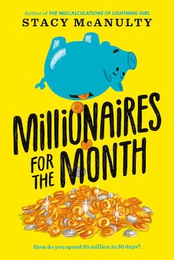


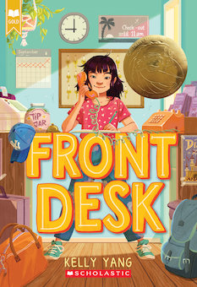
New Chapter Books
featuring
Economic Concepts and Social Commentary
February 9, 2021
Lynne Farrell Stover
stoverlf@jmu.edu

Slide 2
Professional Development Certificate
To earn your professional development certificate for this webinar, you must:
Watch a minimum of 45-minutes and you will automatically receive a professional development certificate via e-mail within 24 hours.
Accessing resources:
You can now easily download presentations, lesson plan materials, and activities for each webinar from EconEdLink.org/professional-development/

Slide 3
Session Agenda
In this session we will:
Examine National and State Standards
Review basic economic concepts
Discuss the relevance of interdisciplinary education
Explore featured titles and the lessons and activities based on their content
Share a related bibliography & additional resources

Slide 4
Objectives
Teachers will be able to:
Review related concepts.
Explore children’s chapter books and identify the economic concepts found in them.
Learn how to use book content to teach age- appropriate lessons and activities based on the featured concepts.
Discuss the new titles’ social commentary and how to implement this in the classroom.

Slide 5
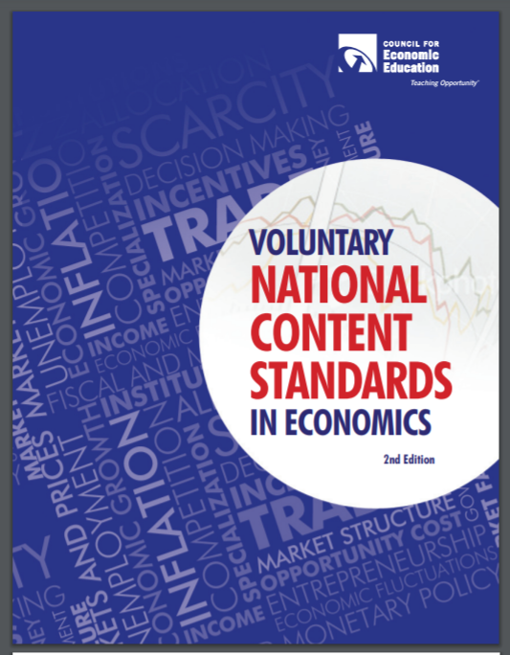
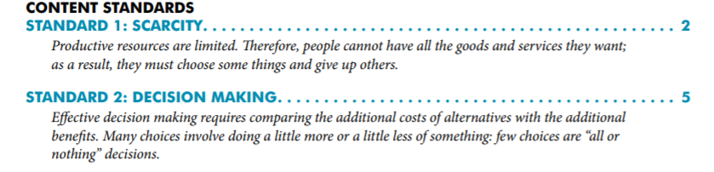
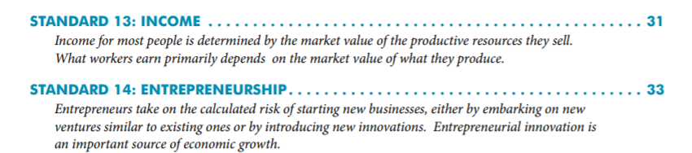
National Standards
https://www.councilforeconed.org/wp-content/uploads/2012/03/voluntary-national-content-standards-2010.pdf

Slide 6

Virginia State Standards
Virginia History and Social Science Standards of Learning
CE.11 The student will apply social science skills to understand how economic decisions are made in the marketplace by
a) explaining that because of scarcity, consumers, producers, and governments must make choices, understanding that everyone’s choice has an opportunity cost
CE.14 The student will apply social science skills to understand personal finance and career opportunities by
b) identifying human capital such as attitudes and behaviors that strengthen the individual work ethic and promote career success
EPF.9 The student will demonstrate knowledge of the global economy by
b) distinguishing between absolute and comparative advantage
EPF.13 The student will demonstrate knowledge of credit and loan functions by
a) evaluating the various methods of financing a purchase
b) analyzing credit card features and their impact on personal financial planning;
c) identifying qualifications needed to obtain credit

Slide 7

Why Use Children’s Literature to Teach Economics?
Personal finance and economic concepts become more interesting when students can make connections to a story. Students learn to recognize that economic decision-making is part of everyday life when reading or listening to a book.
Research shows that using children’s literature to teach in the content areas can enrich learning. It can help build an awareness of economic concepts through storytelling as well as help students develop problem solving skills, recognize ethical dilemmas and comprehend social commentary.

Slide 8
ECONOMICS 101

Slide 9
ECONOMICS 101
Economics is the study of _________
(as they pertain to _________, _________, and the _________).
choices
consumers
producers
government
Every nation has productive resources
__________________
Resources from the earth, unaltered by man
__________________
People’s effort, skills, and knowledge
__________________
Man-made resources
used over and over
natural
human
capital
__________________
Goods used in production to become part of a product
intermediate
which are used to produce
goods
and
services
to be __________________ or __________________ with money (savings).
bartered
purchased

Slide 10
however
Productive resources, and therefore, goods and services, are limited
Human wants (needs)
are basically unlimited
resulting in
SCARCITY
Consequently, buyers (consumers) and sellers (producers) have to make
economic __________________ (resulting in
__________________ __________________)
choices
opportunity
cost
when answering
three basic economic questions
__________ ___________
Buyers and sellers answer ?’s
___________ goods and
services will be produced?
___________ will the goods and services be produced?
___ _______ will the goods and services be distributed?
___________ ___________
Government answers ?’s
What
How
To whom
command economy
market economy
Answering these questions most efficiently creates the need for
___________________ and ___________________ resulting in trade.
specialization
interdependence
decision
making
scarcity
Economics: ___________ - __________ under ___________.

Slide 11
Full of Beans
by Jennifer L. Holm
Publisher: Random House
Copyright Date: 2018
Reading Level: 3.8
Interest Level: 3-6

Slide 12
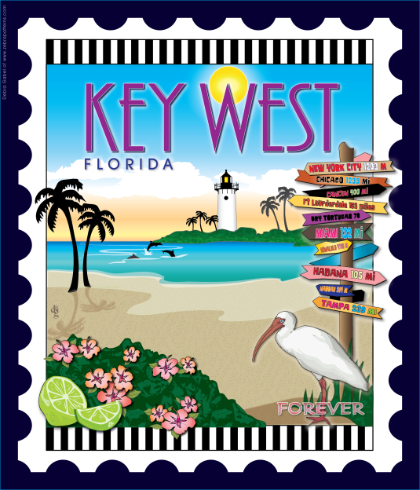
Story Synopsis: It’s 1934 in poverty-stricken Key West, Florida and ten-year-old Beans Curry and his family are doing their best to survive the Great Depression. When his father leaves to look for work in the North, Beans makes both good and bad decisions in an effort to help his mother support the family.
His decision to set off fire alarms to create diversions for a rum smuggler is a bad one. His remarkable head for business leading to the creation of the Diaper Gang is a good one.
Bean’s life really gets interesting, and profitable, when a team of New Dealers from Washington D.C. arrives with an ambitious plan to turn Key West into a vacation hot spot.

Slide 13
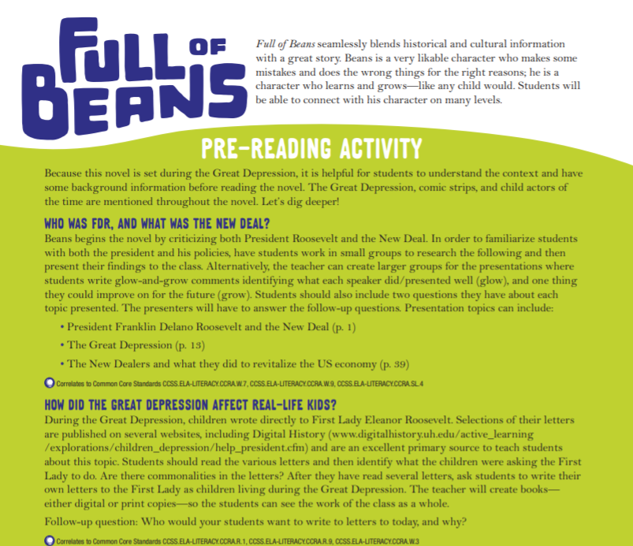

Publisher’s
16 page Educator’s Guide
https://images.randomhouse.com/promo_image/9780553510362_3414.pdf

Slide 14

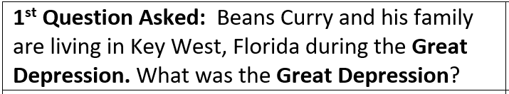
Economic Round Table
Answer: The Great Depression, 1929-1939, was the worst economic downturn in the industrialized world.

Slide 15
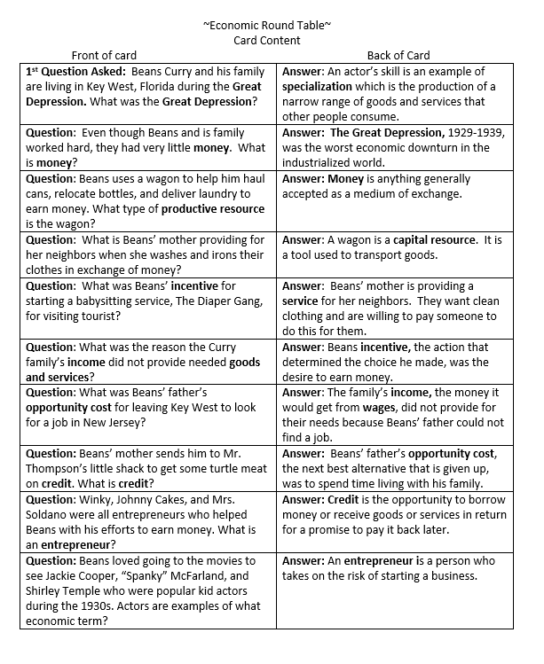
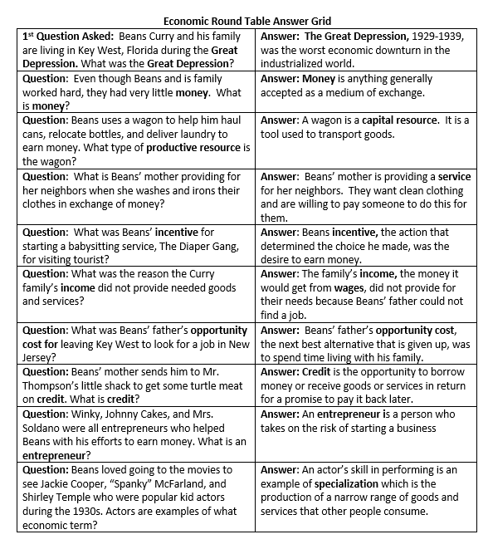

Slide 16
Merci Suarez Changes Gears
by Meg Medina
Publisher: Candlewick Press
Copyright Date: 2020
Reading Level: 4.6
Interest Level: 4-7

Slide 17
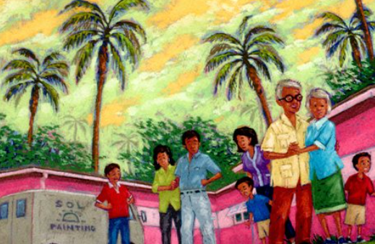
Story Synopsis: Eleven-year-old Merci navigates the ordeals of being a “scholarship kid” at an upscale South Florida private school, as well as the expectations of and responsibilities to her intergenerational family.
Instead of a stately mansion, Merci lives with her parents and brilliant older brother in one of three identical homes next to her Cuban-American extended family. Although she wants to
earn money so that she can afford a new
bike, she's stuck volunteering.
When her beloved grandfather starts
to act unpredictably, Merci realizes
something serious is happening
and no one is telling her anything.

Slide 18

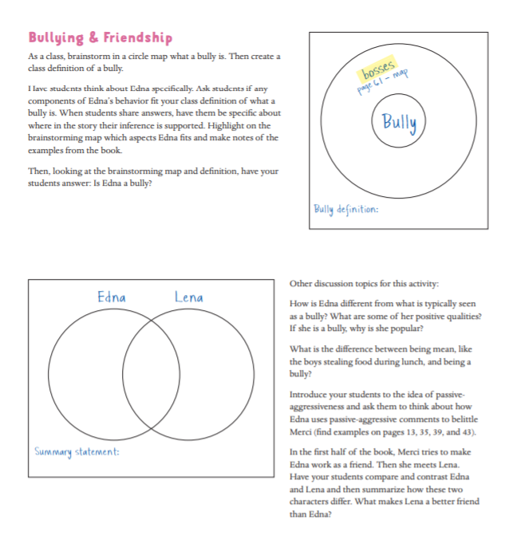
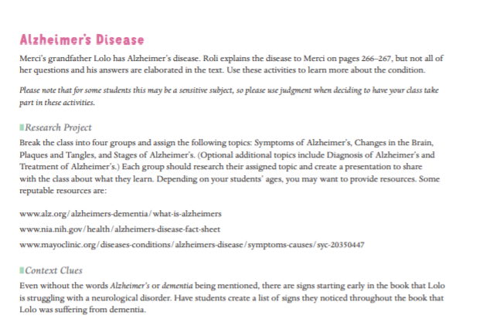
Publisher’s 8 page Educator’s Guide
https://candlewick.com/book_files/076369049X.btg.1.pdf

Slide 19
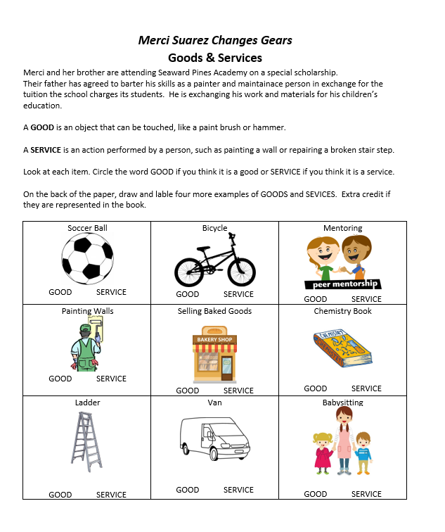

Goods & Services
Bartering

Slide 20
Front Desk
by Kelly Yang
Publisher: Scholastic
Copyright Date: 2019
Reading Level: 4.5
Interest Level: 4-7

Slide 21
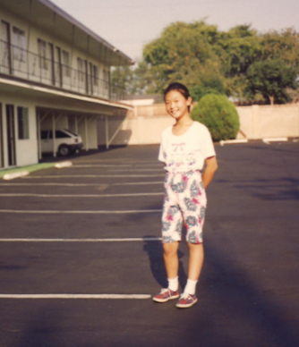
Story Synopsis: It is the early 1990s in Anaheim, California and ten-year-old Mia Tang and her parents are desperate for work and money.
Mia’s parents take a job managing a rundown motel. Exploited by the motel’s owner, the family struggles physically and financially. As her mother -- who was an engineer in China -- does the cleaning, Mia works the front desk and tries to cope with demanding customers and other recent immigrants, not to mention being only one of two Chinese students in her class, the other being Mr. Yao's son, Jason.

Slide 22

Author Kelly Yang immigrated to America when she was 6 years old and grew up in Southern California, where she and her parents worked in three different motels. She eventually left the motels and went to college at the age of 13 and law school at the age of 17. She is a graduate of UC Berkeley, where she majored in Political Science, and Harvard Law School. After law school, she gave up law to pursue her passion of writing and teaching children writing. She is the founder of The Kelly Yang Project (kellyyang.edu.hk), a leading writing and debating program for kids in Asia. Before turning to fiction, she was also a columnist for the South China Morning Post for many years. Her writing has been published in The New York Times, The Washington Post, and The Atlantic. She has three children and splits her time between Hong Kong and San Francisco, California.

Slide 23
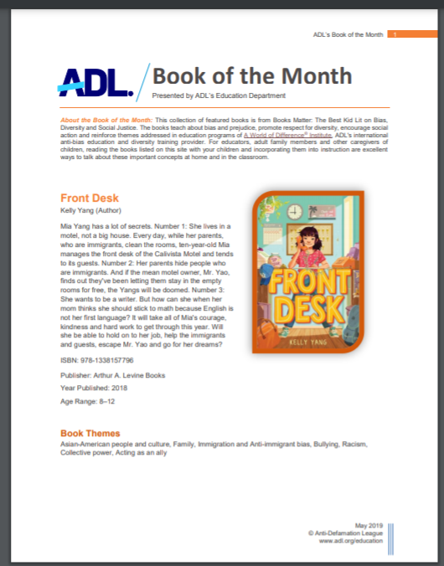
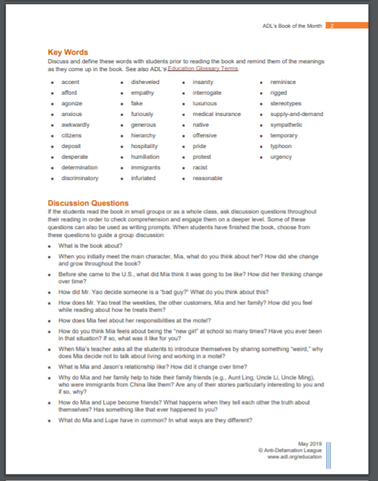
Anti-Defamation League’s 4 page Educator’s Guide
https://www.adl.org/media/12859/download

Slide 24


https://frontdeskthebook.com/for-teachers/

Slide 25
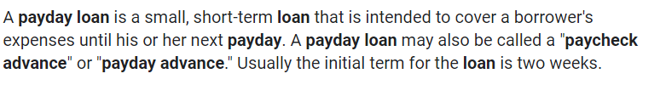
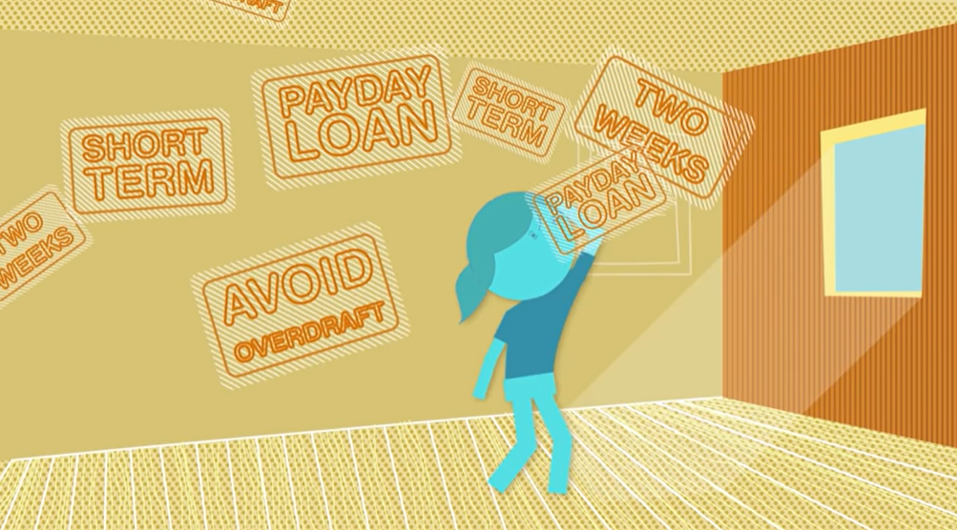

Introduction to Pay Day Loans
What is a payday loan and why is it getting so many of the Tangs’ friends in trouble?
https://www.youtube.com/watch?v=vyFlz0XpbTc

Slide 26

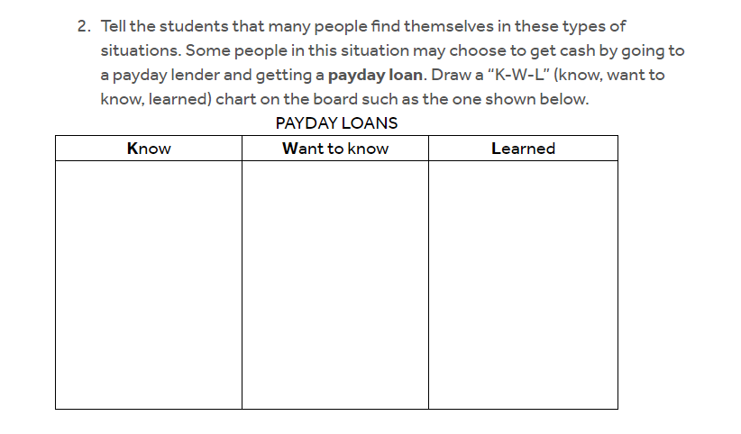
https://www.econedlink.org/resources/how-expensive-are-payday-loans/?view=teacher

Slide 27
Three Keys
by Kelly Yang
Publisher: Scholastic
Copyright Date: 2020
Reading Level: 4.8
Interest Level: 4-7

Slide 28
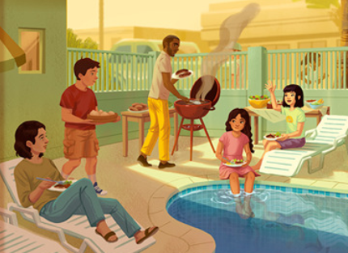
Story Synopsis: In this sequel to Front Desk, sixth grade Chinese- American Mia Tang continues to help run their motel in Anaheim, California. While business is good, negative political ads during the impending 1994 gubernatorial election proposing to kick undocumented children out of California schools are making life difficult for Mia and other marginalized classmates. When Mia's best friend Lupe reveals she and her family are undocumented, matters intensify. Lupe’s mother is stranded in Mexico and her father is arrested and threatened with deportation. Mia and her friends work hard to find a way to sway public opinion, and keep Lupe’s family from being separated.

Slide 29

The year is 1994 and Mrs. Tang, Mia’s mother, would like to have her own credit card. She discovers applying for a credit card is not going to be as easy as she thought…
Vocabulary
Credit
The ability of a customer to obtain goods or services before payment, based on an agreement to pay later.
Credit Application
A request for a loan, submitted to a lender (for example, a bank or a credit union) by a prospective borrower. The credit application provides background information which the lender uses to assess the prospective borrower’s creditworthiness — his or her ability to repay the loan.
Credit Card
A small, specially coded plastic card issued by a bank, business, etc., authorizing the cardholder to purchase goods or services on credit.

Slide 30
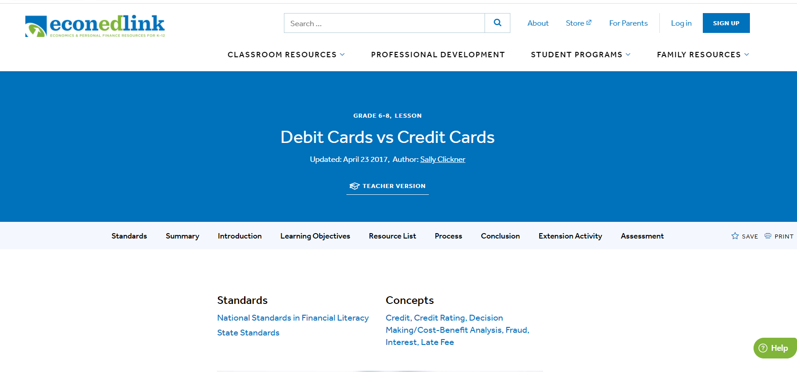
https://www.econedlink.org/resources/debit-cards-vs-credit-cards/

Slide 31
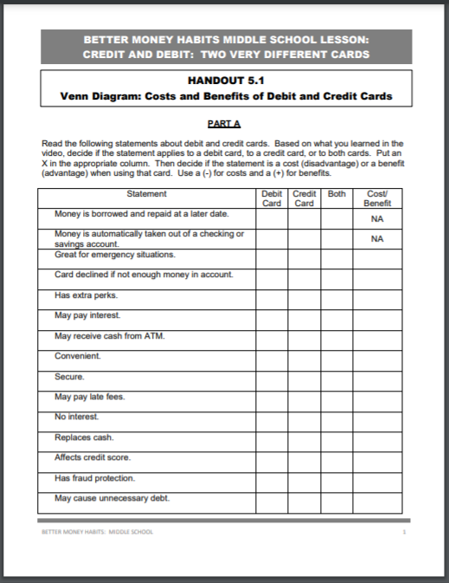
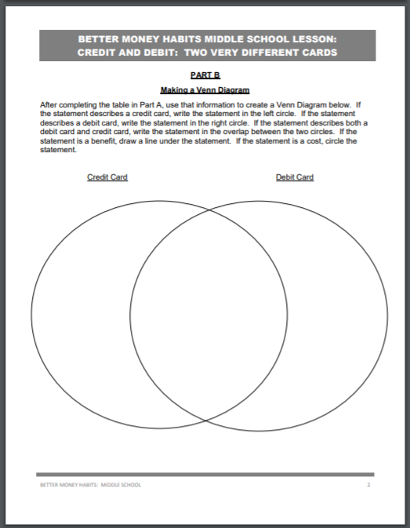
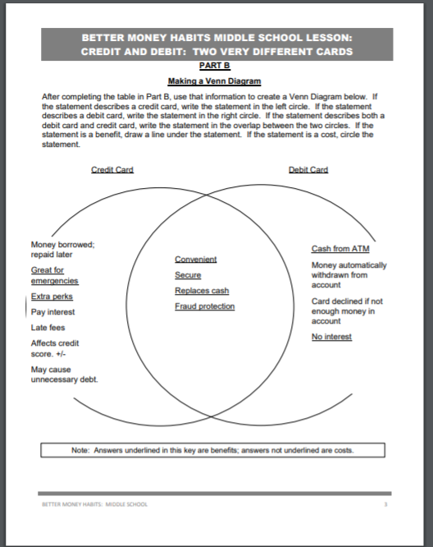
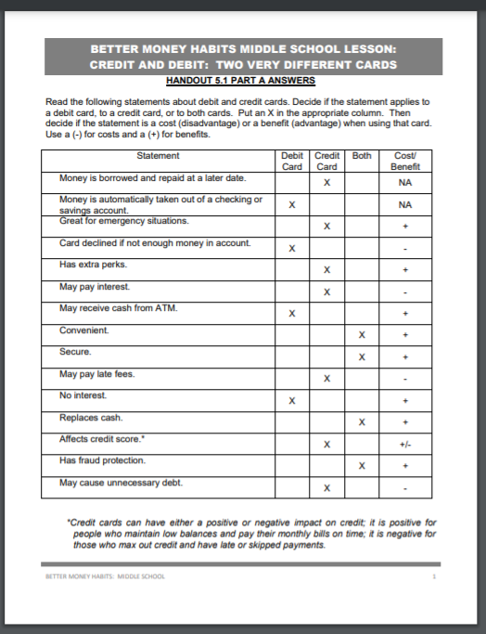

Slide 32
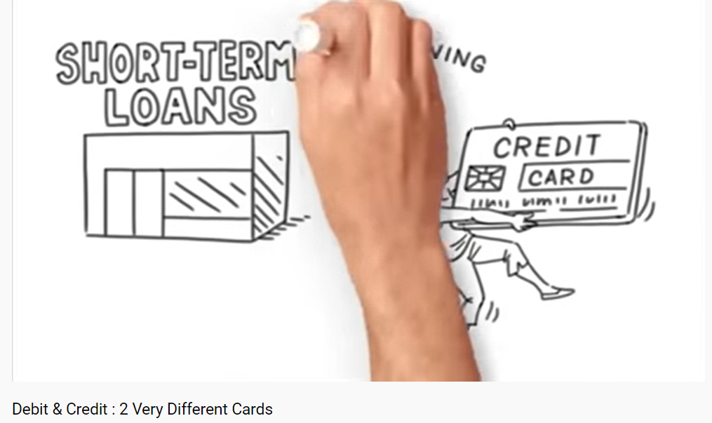
https://www.youtube.com/watch?v=XbtSftL6dbY

Slide 33
Millionaires for the Month
by Stacy McAnulty
Publisher: Random House
Copyright Date: 2020
Reading Level: 4.1
Interest Level: 4-7

Slide 34
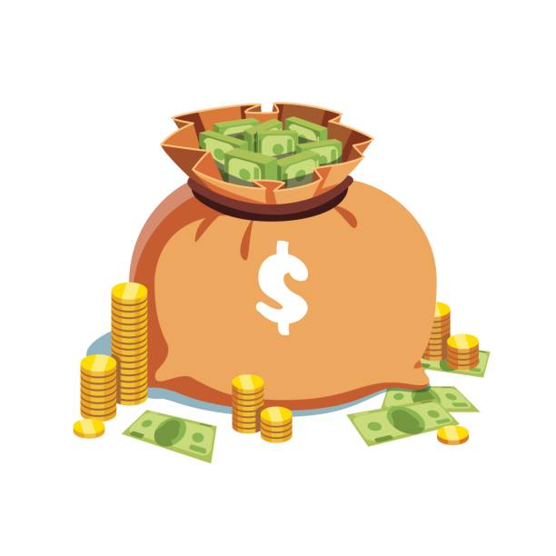
Story Synopsis: When sixth- graders Felix Rannells and Benji Porter find themselves unlikely partners on a field trip to New York City, they have no idea that they are starting the adventure of a lifetime.
After returning a lost wallet belonging to tech. billionaire Laura Friendly, (after “borrowing” twenty dollars for lunch), they are challenged to spend $5,368,709.12 in 30 days. Why that specific amount? Because a penny doubled every day for thirty days is $5,368,709.12! However, there are lots of lots of rules. The most difficult one to keep is that they can’t tell anyone.
But if they succeed, they each get ten million dollars to spend however they want. They accept the challenge and soon discover money can't buy everything, fix major problems or always be as exciting as they’d thought.

Slide 35
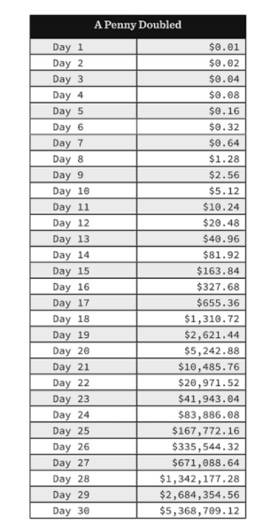
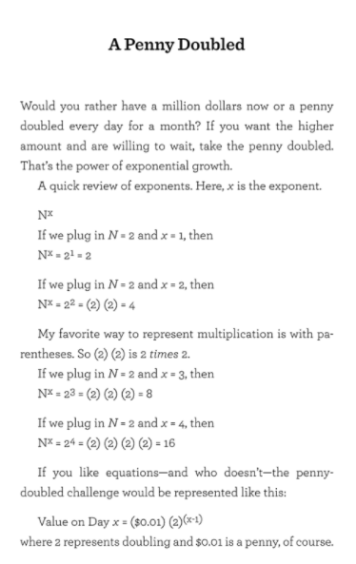
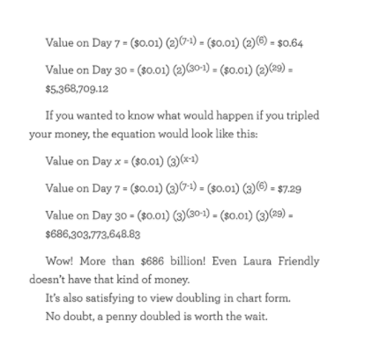
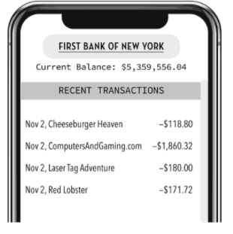
Book Resources

Slide 36
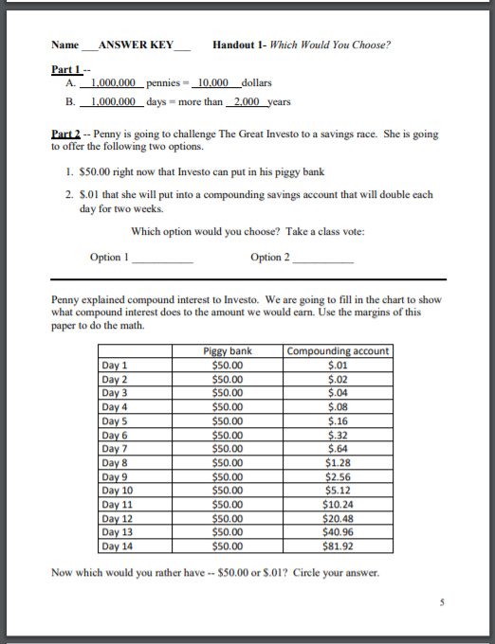
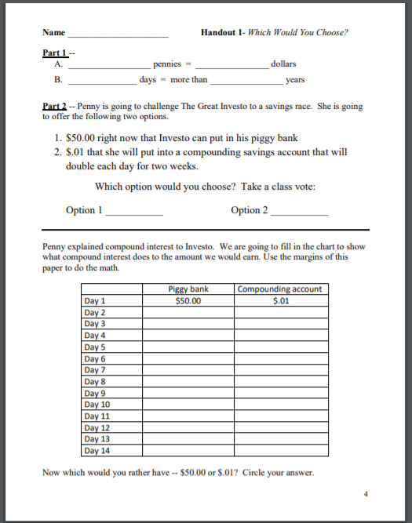
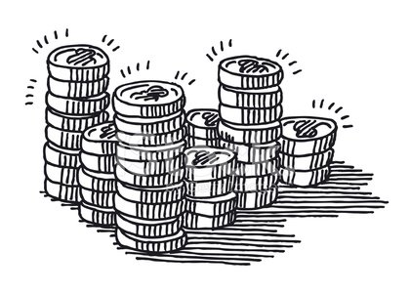
http://debankers.com/Assets/2017_TCTSD_Lesson_Investo_Million_Pennies.pdf

Slide 37
CHIRP
by Kate Messer
Publisher: Bloomsburg
Copyright Date: 2020
Reading Level: 4.6
Interest Level: 5-9

Slide 38
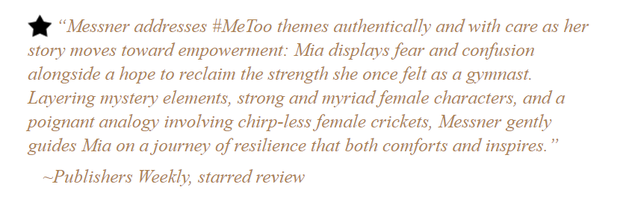
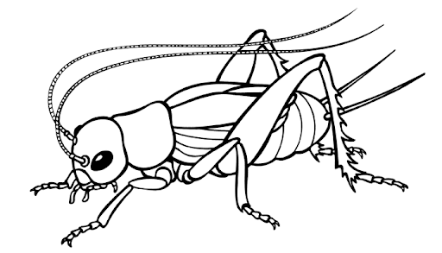
Story Synopsis: Seventh- grader Mia’s grandmother, a former entomology professor, owns a cricket farm in Vermont. Recovering from a stroke, she welcomes Mia and her family, who are there for the Summer to help with her quest to get more people to include protein-rich crickets in their diets. Soon, Mia finds that she and the new friends she meets at Launch Camp for Young Entrepreneurs are spending their free time trying to solve the mystery of who is trying to sabotage Gram’s farm. Mia, a fearless gymnast until an injury and painful secret leave her conflicted, overcomes her fears while creating an amazing business plan for Gram’s struggling cricket farm.

Slide 39
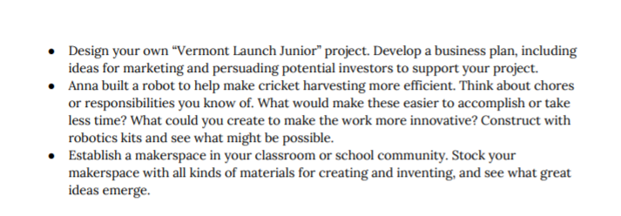
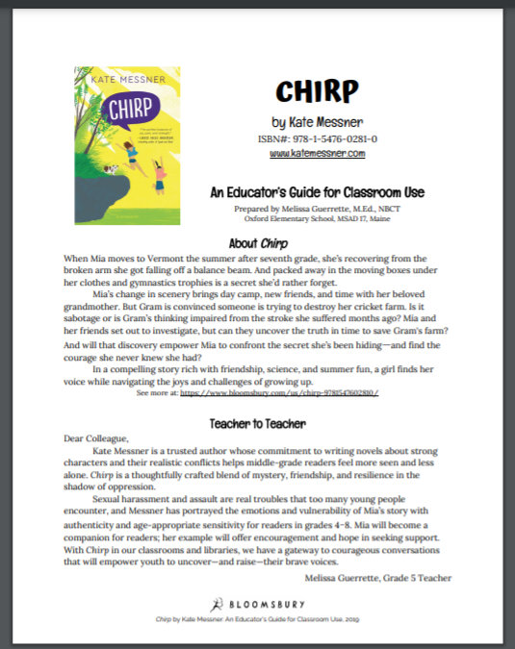
Publisher’s 11 page Educator’s Guide
Comparative Advantage - The ability to produce a good or service at a lower opportunity cost than some other producer. This is the economic basis for specialization and trade.
https://media.bloomsbury.com/rep/files/teachers-guide-for-chirp.pdf

Slide 40
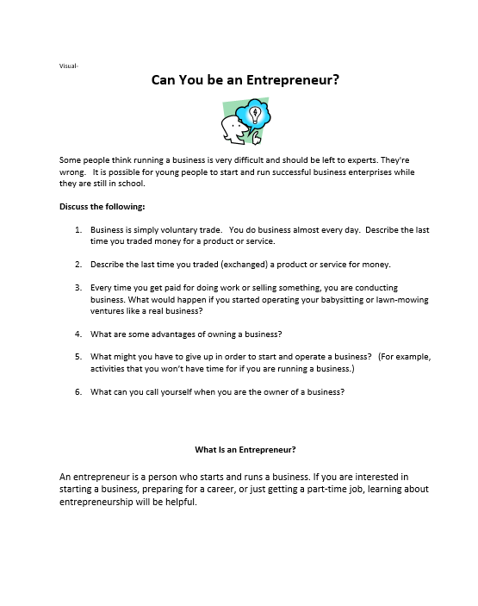
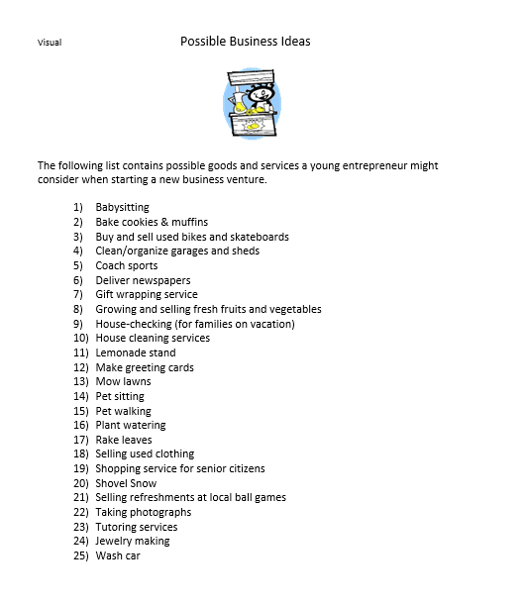
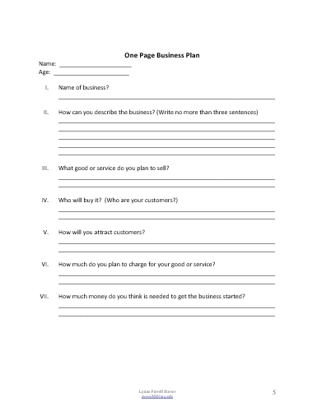
One Page Business Plan

Slide 41
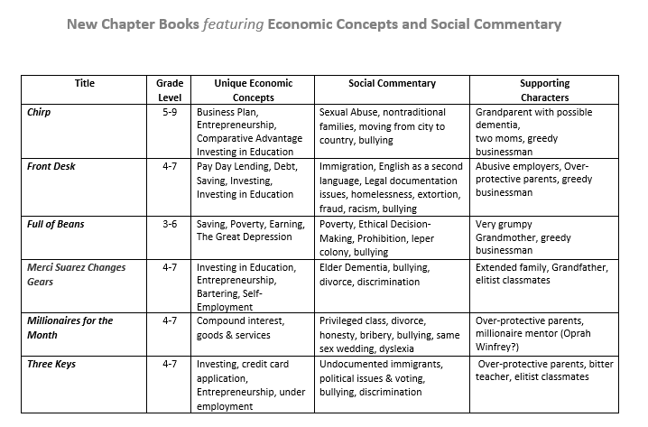
Content Review

Slide 42
Assessment Framing Questions
For your consideration:
Why do you think situations dealing with economics and personal finance are so often addressed in children’s literature?
Is it helpful for students to learn about how fictional characters deal with ethical situations? Are they able to apply “lessons learned” to their own lives?
Which do you think is more challenging: adapting a secondary lesson for an elementary classroom, or advancing an elementary lesson for high school students?
It seems that many new children’s books are addressing controversial social issues. Why do you think this is so?

Slide 43
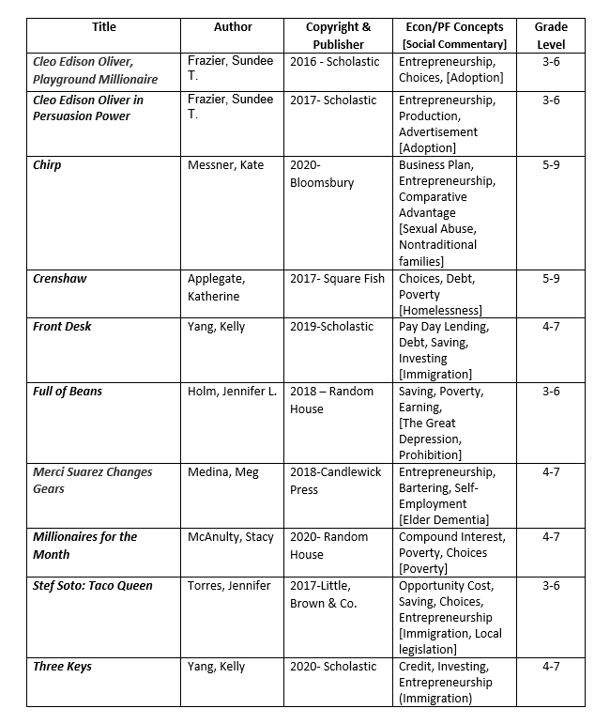

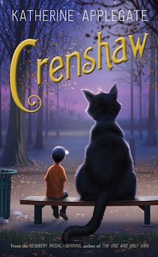

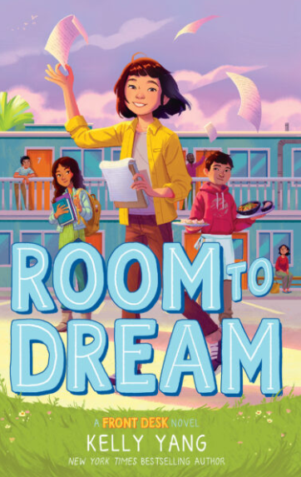

Slide 44
References
Title | Internet links Lesson Plans, Teacher Guides, and Videos
Chirp | https://media.bloomsbury.com/rep/files/teachers-guide-for-chirp.pdf
Front Desk | https://www.econedlink.org/resources/how-expensive-are-payday-loans/?view=teacher https://www.adl.org/media/12859/download
Full of Beans | https://images.randomhouse.com/promo_image/9780553510362_3414.pdf
Merci Suarez Changes Gears | https://candlewick.com/book_files/076369049X.btg.1.pdf
Millionaires for the Month | http://debankers.com/Assets/2017_TCTSD_Lesson_Investo_Million_Pennies.pdf
Three Keys | https://www.econedlink.org/resources/debit-cards-vs-credit-cards/ https://www.youtube.com/watch?v=XbtSftL6dbY

Slide 45

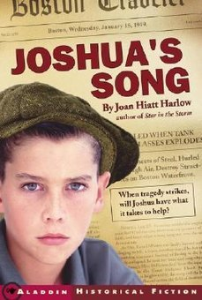





Pandemics Past, Present & Future:
Young Adult Literature featuring Scarcity, Decision-Making and Economic Systems
Lynne Farrell Stover
February 23, 2021
stoverlf@jmu.edu

Slide 46





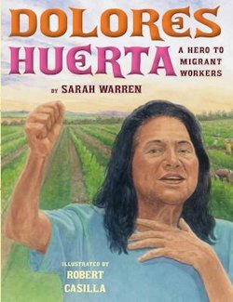
Enterprising Women:
Using Children’s Literature to Teach Economics
Lynne Farrell Stover
March 16, 2021
stoverlf@jmu.edu

Slide 47
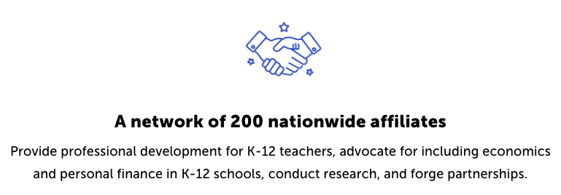
CEE Affiliates
https://www.councilforeconed.org/resources/local-affiliates/

Slide 48




Thank You to Our Sponsors!

