Slide 1
Fundamentals of AP Economics: Demand
Presented by Amanda Stiglbauer Blythewood High School Blythewood, SC March 15, 2021 astiglbauer@richland2.org

Slide 2
EconEdLink Membership
You can now access CEE’s professional development webinars directly on EconEdLink.org! To receive these new professional development benefits, become an EconEdLink member. As a member, you will now be able to:
Automatically receive a professional development certificate via e-mail within 24 hours after viewing any webinar for a minimum of 45 minutes
Register for upcoming webinars with a simple one-click process
Easily download presentations, lesson plan materials and activities for each webinar
Search and view all webinars at your convenience
Save webinars to your EconEdLink dashboard for easy access to the event
You may access our new Professional Development page here

Slide 3
Professional Development Certificate
To earn your professional development certificate for this webinar, you must:
Watch a minimum of 45-minutes and you will automatically receive a professional development certificate via e-mail within 24 hours.
Accessing resources:
You can now easily download presentations, lesson plan materials, and activities for each webinar from EconEdLink.org/professional-development/

Slide 4
National Standards
National Standards for Economics
STANDARD 7: MARKETS AND PRICES
A market exists when buyers and sellers interact. This interaction determines market prices and thereby allocates scarce goods and services.

Slide 5
Objectives
I can:
Explain the difference between a change in demand and change in quantity demanded.
Describe factors that cause changes in demand.
Explain why the demand curve is downward sloping.

Slide 6
Agenda
Word Cloud Activity
Time to Climb
Coronavirus Related Demand Spikes
Content: “What is demand, and what affects it?”
Demand Cartoons Activity
Debrief Activity

Slide 7
DEMAND
DEMAND: The WILLINGNESS
and ABILITY to buy a product at a given price.
THE LAW OF DEMAND: The quantity demanded of a product varies INVERSELY with its price.
_
_
_
_
_ _ _ _ _
$2.00
$1.75
$1.50
$1.25
$1.00
$ .75
$ .50
$ .25
$ .00
D
P
+ + + + + + + + + +
1 2 3 4 5 6 7 8 9
Q

Slide 8
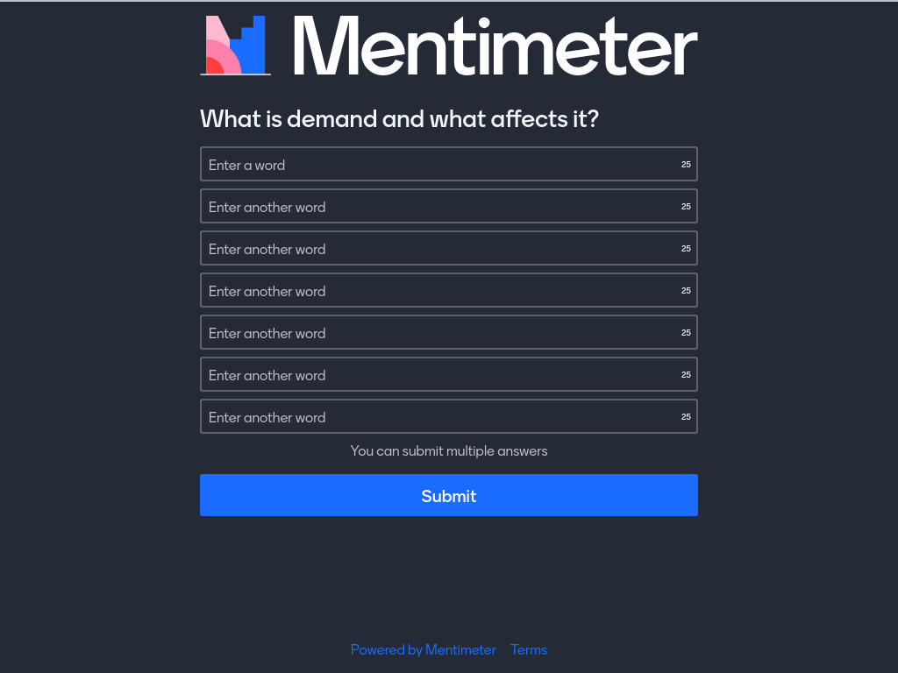
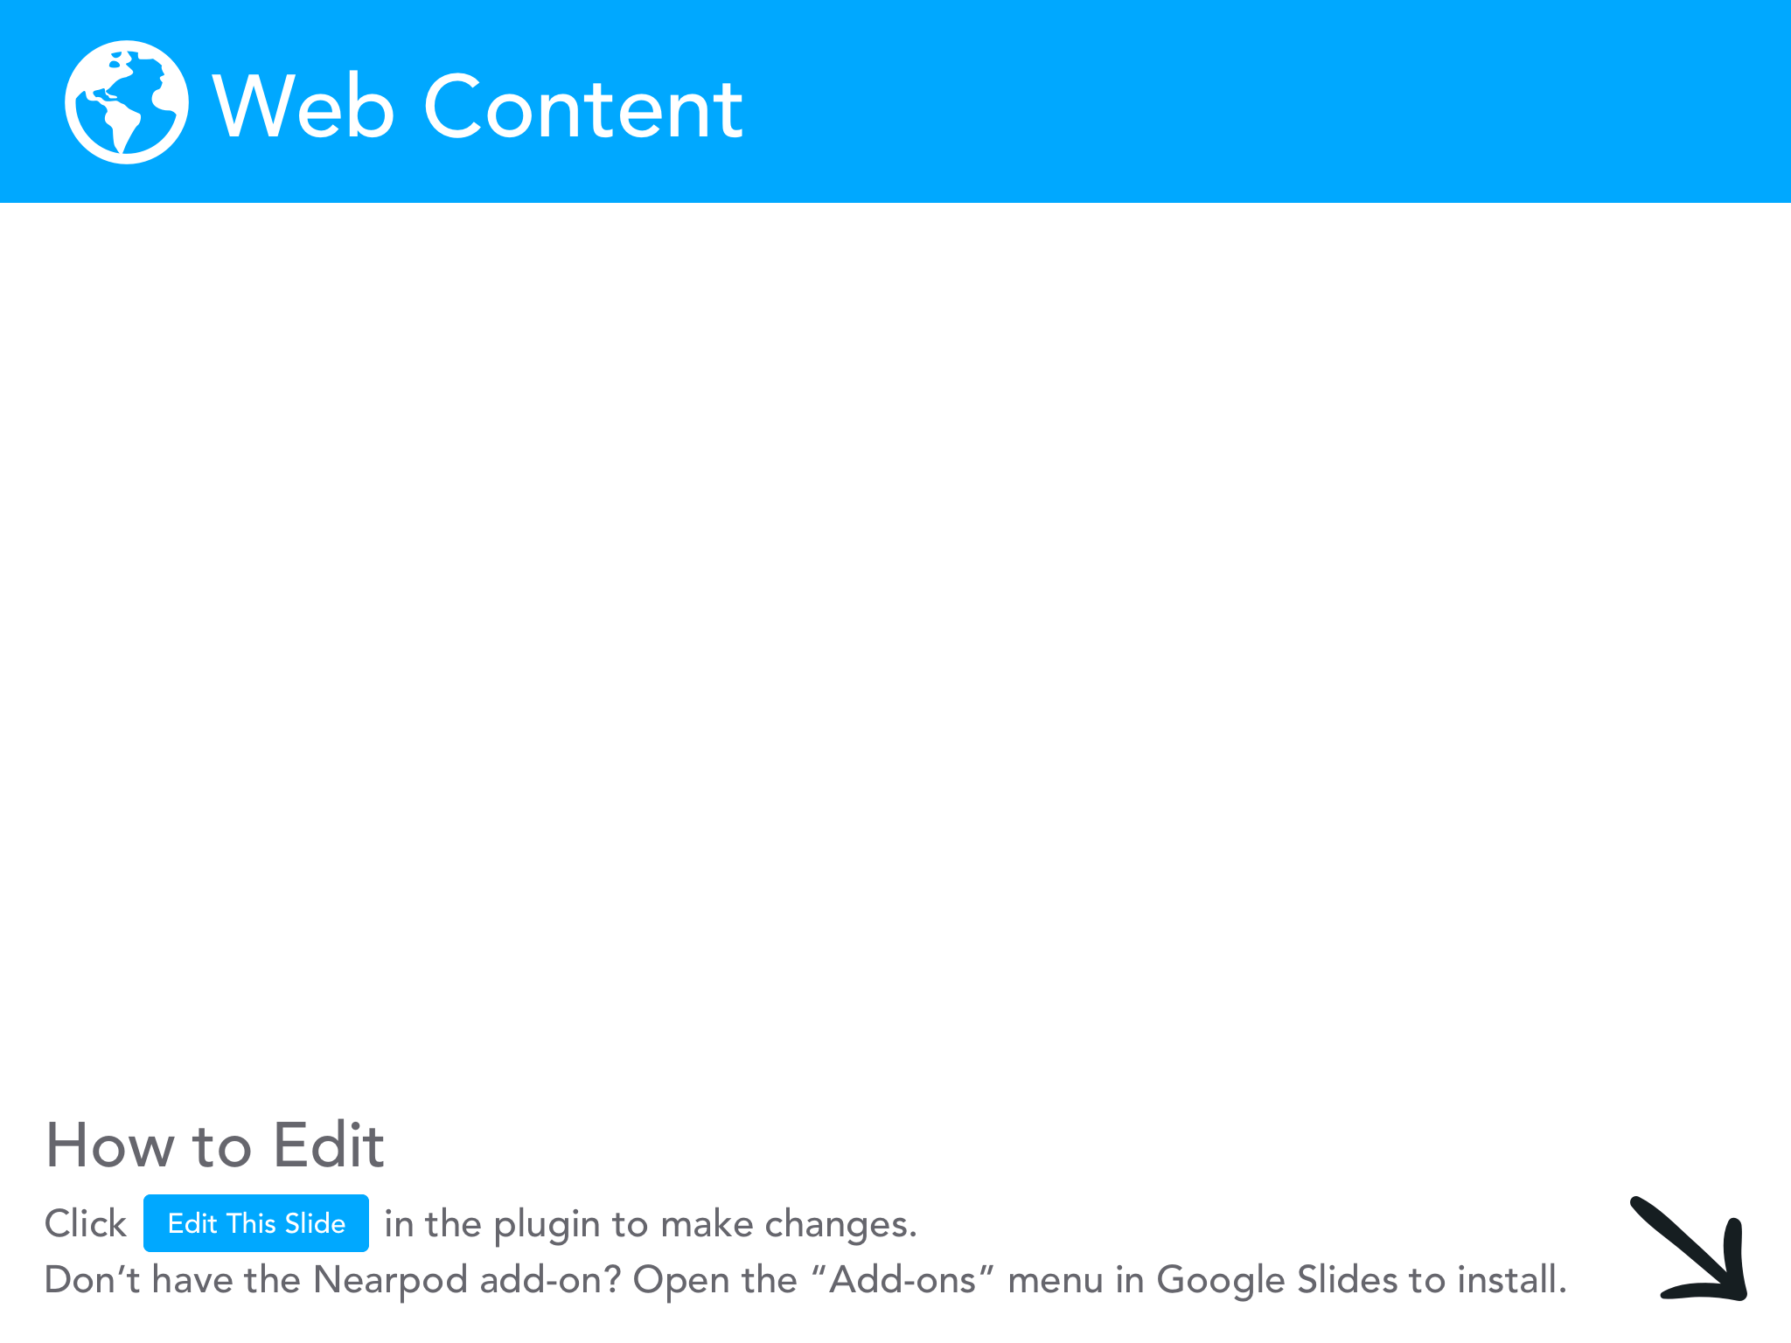

Slide 9
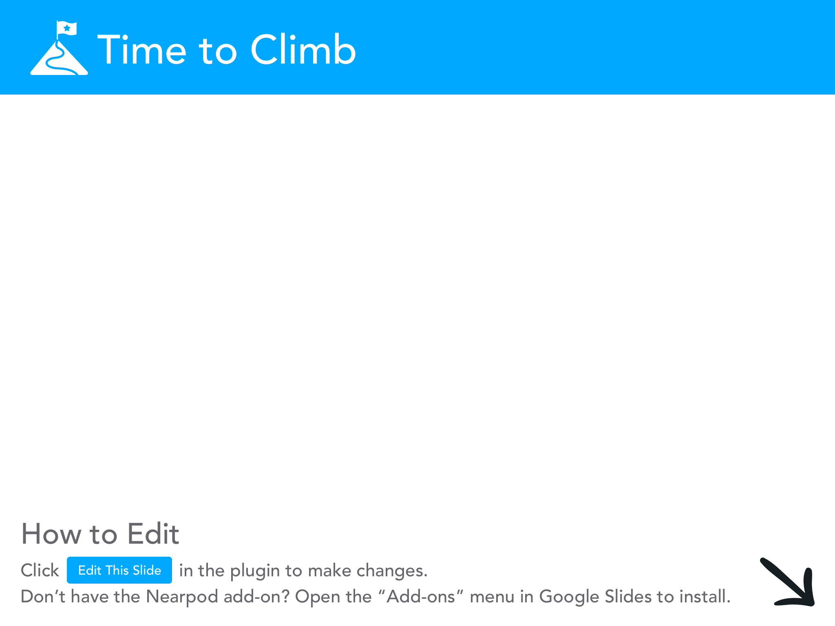

Slide 11
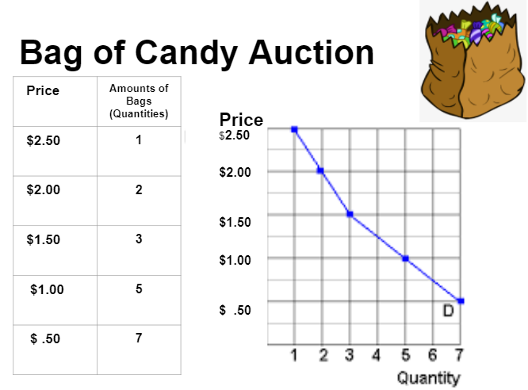

Slide 13
DEMAND
DEMAND: The WILLINGNESS
and ABILITY to buy a product at a given price.
THE LAW OF DEMAND: The quantity demanded of a product varies INVERSELY with its price.
_
_
_
_
_ _ _ _ _
$2.00
$1.75
$1.50
$1.25
$1.00
$ .75
$ .50
$ .25
$ .00
D
P
+ + + + + + + + + +
1 2 3 4 5 6 7 8 9
Q

Slide 14
Price of Chocolate
Demand Schedule
Price | Quantity Demanded
$5 | 10
$4 | 20
$3 | 30
$2 | 50
$1 | 80
$5
4
3
2
1
Demand
10 20 30 40 50 60 70 80
Quantity of Chocolate
Q

Slide 15
Change in Demand
Price of Chocolate
Demand Schedule
$5
4
3
2
1
Price | Quantity Demanded
$5 | 10 0
$4 | 20 5
$3 | 30 20
$2 | 50 30
$1 | 80 60
Demand
10 20 30 40 50 60 70 80
Quantity of Chocolate
Q

Slide 16
Why is the demand curve downward sloping?
Income Effect
-P of a good falls, consumers can buy more of product with current income.
2. Substitution Effect
-P of good falls, it becomes more attractive than other more expensive goods. Qd increases.
Diminishing Marginal Utility
-the more of a good a consumer has, less marginal utility for an additional unit.
D
P
Q

Slide 17
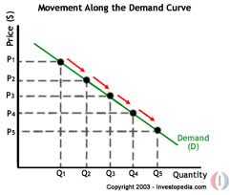
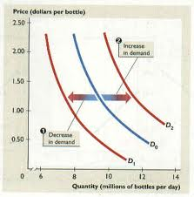
Difference between a change in demand and quantity demanded
Quantity Demanded
Only a change in PRICE can alter
Movement along the SAME demand curve
Demand
-Outside factor, such as consumer tastes, changes in population, price of other goods
-Shifts to a NEW demand curve (to the left or right)

Slide 19
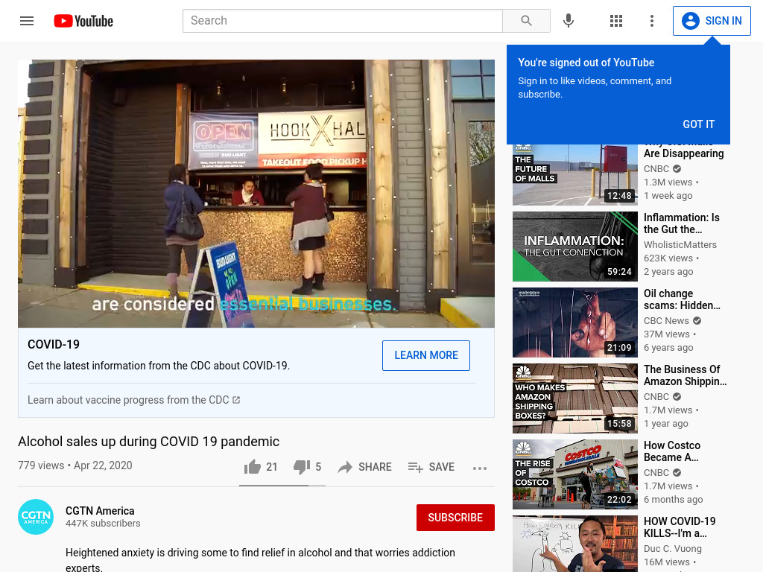

Slide 20
DETERMINANTS OF DEMAND
Tastes (preferences)
D
P
Q

Slide 21
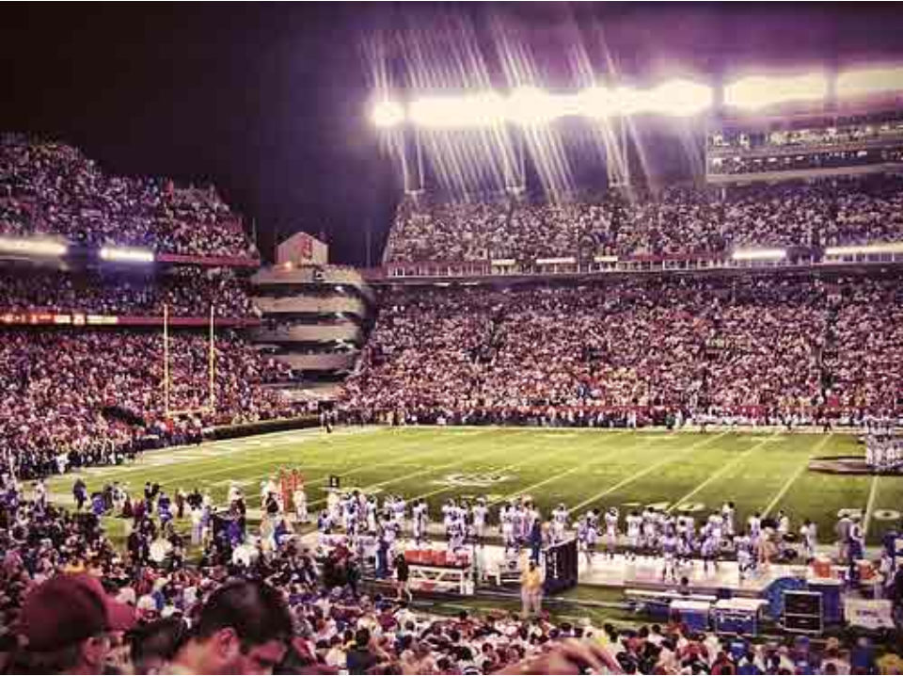

Slide 22
DETERMINANTS OF DEMAND
Tastes (preferences)
Income
D
P
Q

Slide 25
DETERMINANTS OF DEMAND
Tastes (preferences)
Income
Market Size
(Number of buyers)
D
P
Q

Slide 26
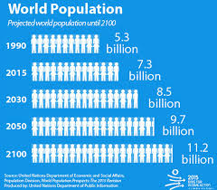

Slide 27
DETERMINANTS OF DEMAND
Tastes (preferences)
Income
Market Size
(Number of buyers)
Expectations (of
Future price)
D
P
Q

Slide 28
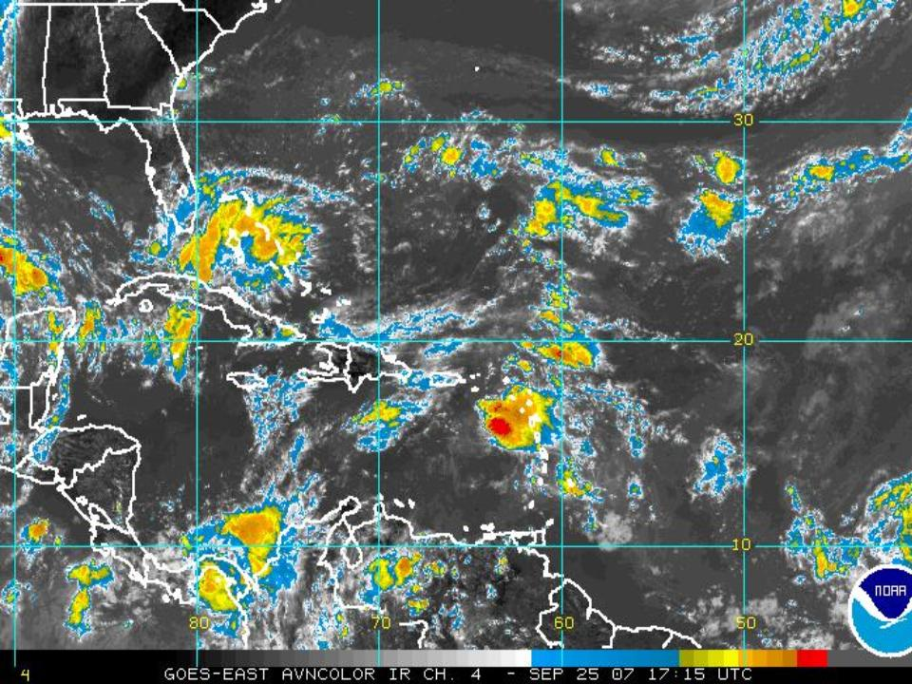

Slide 29
DETERMINANTS OF DEMAND
Tastes (preferences)
Income
Market Size
(Number of buyers)
Expectations (of
Future price)
Related Goods
(Price of other goods)
D
P
Q

Slide 30
T.I.M.E.R.

Slide 31
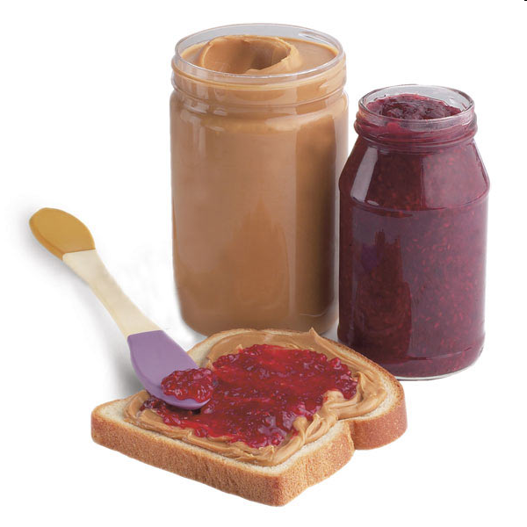
Price of Related Goods
Substitute Goods: Competitors
Price of one good goes up, demand for the other goes up.
Ex: Price of Pepsi goes up, demand for Coke goes up.
Complementary Goods: Go together
Price of one good goes up, demand for the other goes down.
Ex: Price of peanut butter goes up, demand for jelly goes down.

Slide 32
Income
As a person’s income rises, their demand for NORMAL goods also rises
What about inferior goods?
As income rises, demand for INFERIOR goods DECREASES

Slide 33
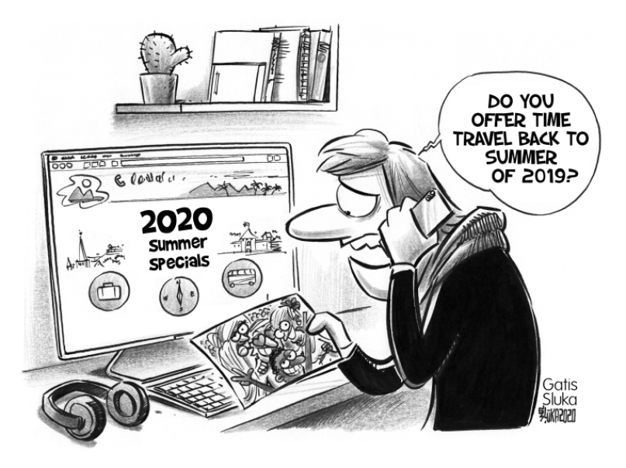
Determinant: Income
Product: Summer Travel
P
D₂
D₁
Q

Slide 34
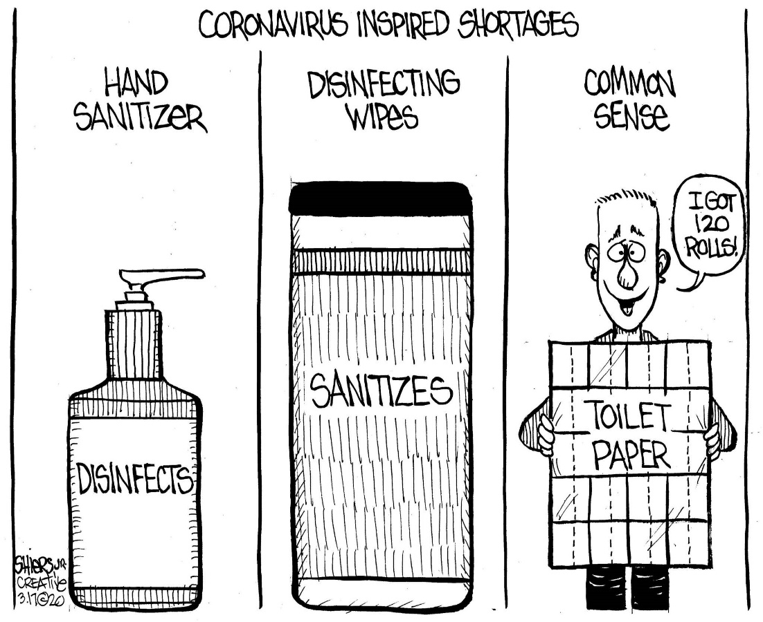
Products: Disinfectants & TP
Determinant: Expectations
P
D₁
D₂
Q

Slide 35
Demand Cartoons
Go to cartoonstock.com or any other political cartoon site
Find cartoons that illustrate THREE (different) determinants of demand (you should have a total of three cartoons, one for each determinant)
Copy and paste the cartoon to a Google Slides presentation (one slide per cartoon)
Show which determinant shifts the demand curve and tell what the product is
Draw graph to show how the demand curve shifts
Presentation should be three slides total (one slide for each cartoon, graph, explanation)
Here are some examples… (your product should look very similar to this)

Slide 36
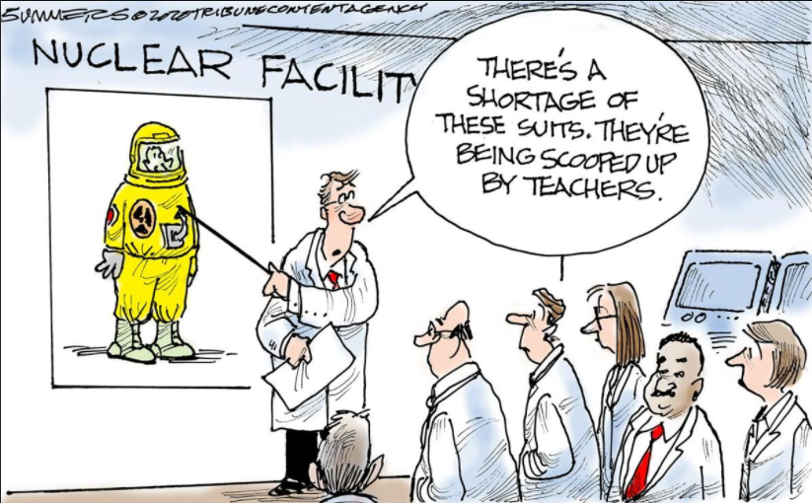
Got Yours?

Slide 37
Thank You to Our Sponsors!

Slide 38
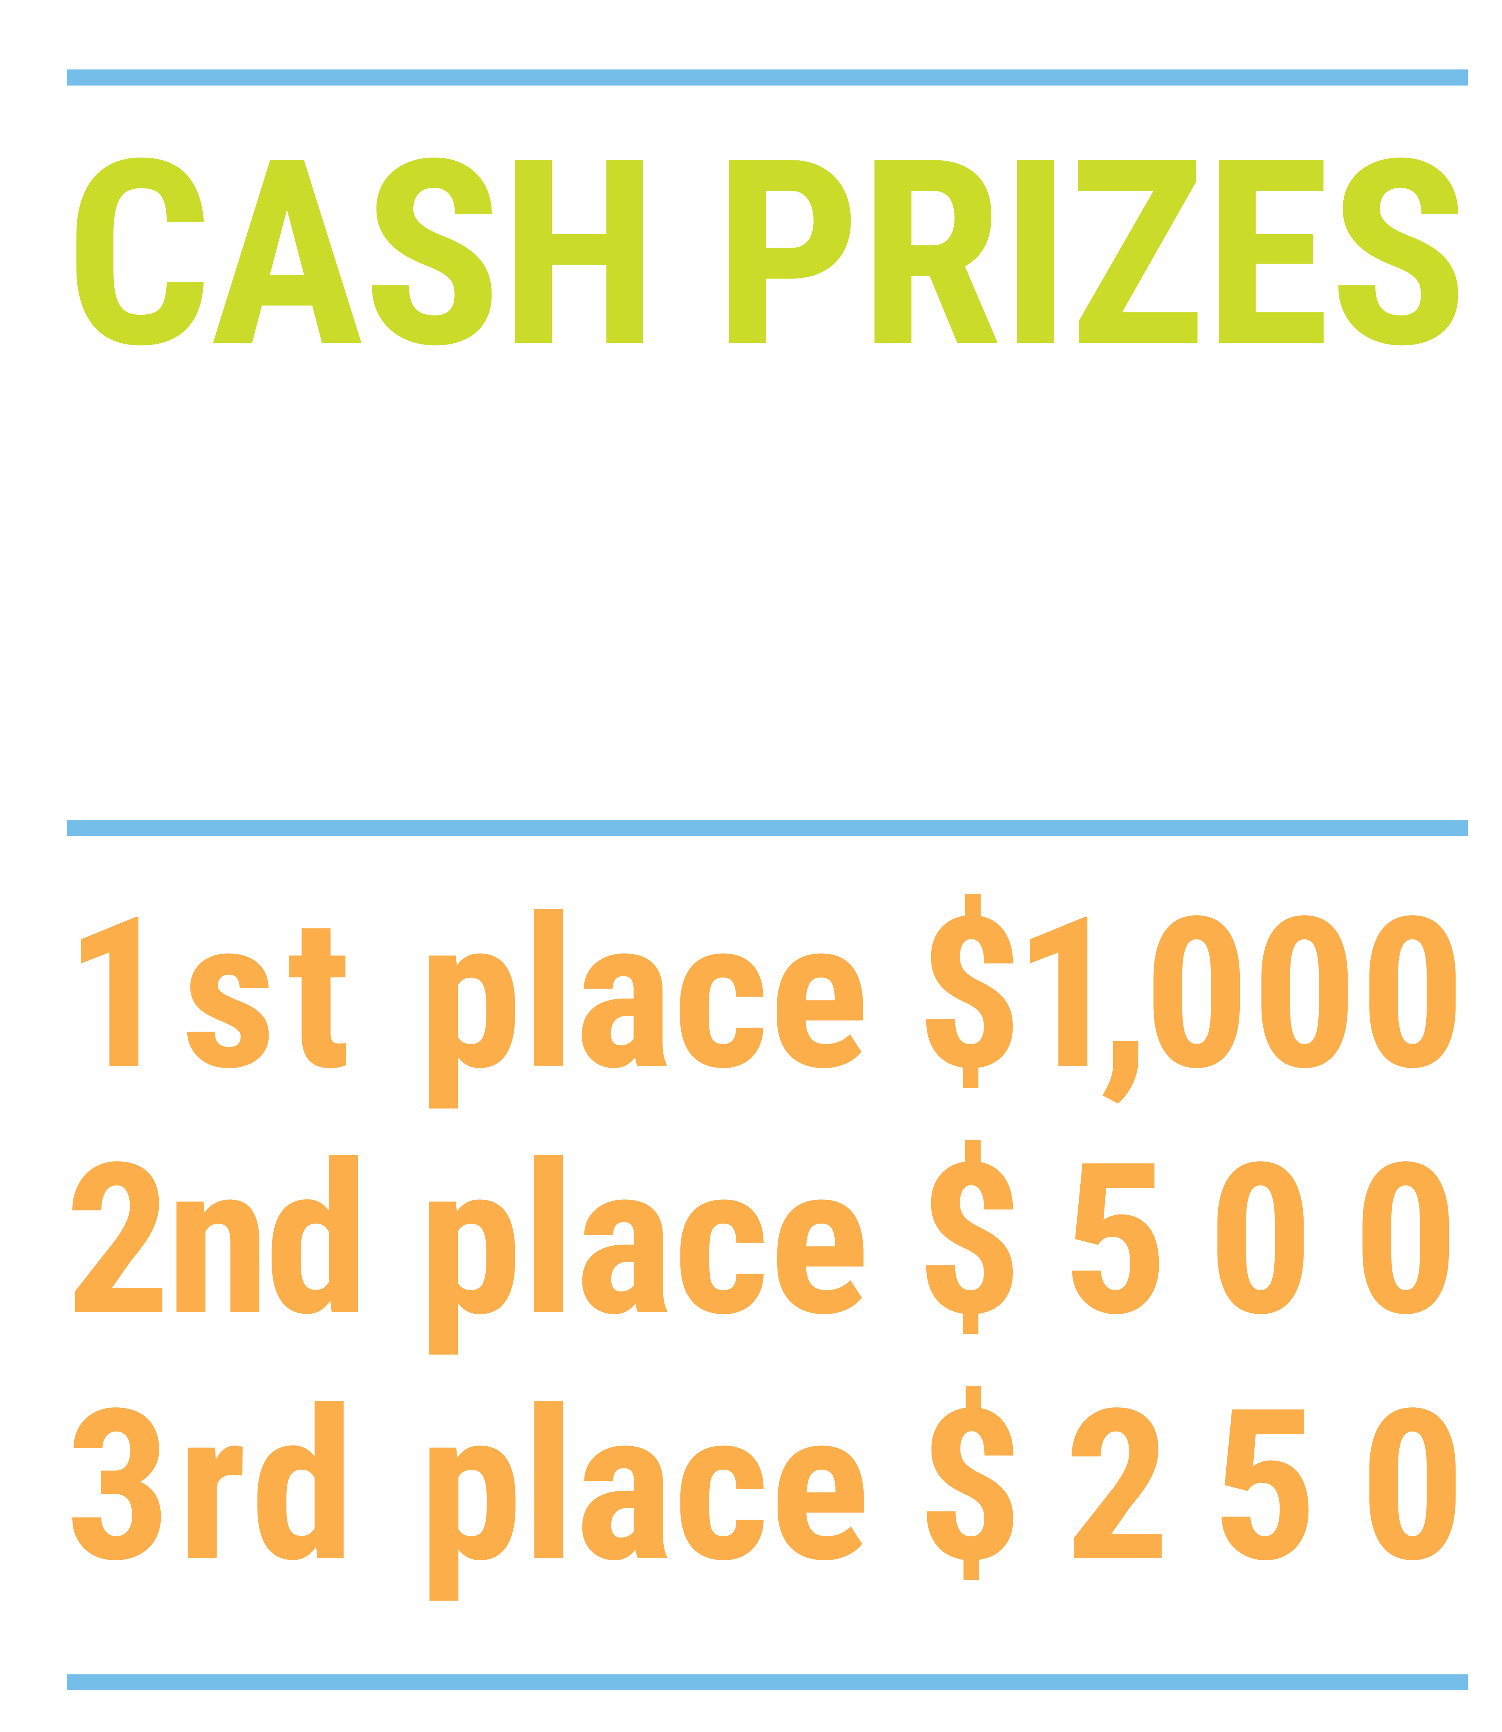
We’ve gone Virtual!
Teach Economics?
Your students may have what it takes to compete in the nation’s only high school economics competition!
Why Play?
• Fun team learning experience
• Great for college applications
• No other challenge like this
• Online participation makes access easy
• Chance for cash prizes
How it Works
Teams register
Teachers enroll team(s) of 3- 4 high school students from the same school. Multiple teams allowed.
Teams compete within their state
Compete to win your state competition for a chance to advance to the National Semi-Finals.
National Semi-Finals: May 3-20, 2021
Teams answer multiple-choice questions on macroeconomics, microeconomics, and international & current events.
National Finals: May 22-24, 2021
Teams analyze an economic issue and present their solution. Top teams engage in the Finals Quiz Bowl where they face-off answering questions to claim the National Title.
Two divisions based on experience level
David Ricardo for first-time competitors who have taken no more than one economics course.
Adam Smith for returning competitors, AP, International Baccalaureate, and honors students.
Register Today at NationalEconomicsChallenge.org

Slide 39
FIND YOUR LOCAL COMPETITION AND REGISTER TODAY!
The National Personal Finance Challenge is a competition that provides high school students with an exciting and motivating opportunity to build, apply, and demonstrate their knowledge of money management.
Through online exams and a personal finance simulation, teams showcase their expertise in earning income, buying goods and services, saving, using credit, investing, as well as protecting and insuring.
Teams of up to four students, with one teacher/coach, can qualify to represent their state at the National Personal Finance Challenge by winning their local competition.
NATIONALS
Semi-Finals: First round elimination via online multiple-choice questions.
Finals: Case study round virtually co-hosted by the Cleveland Fed on June 3.
personalfinancechallenge.org

Slide 40
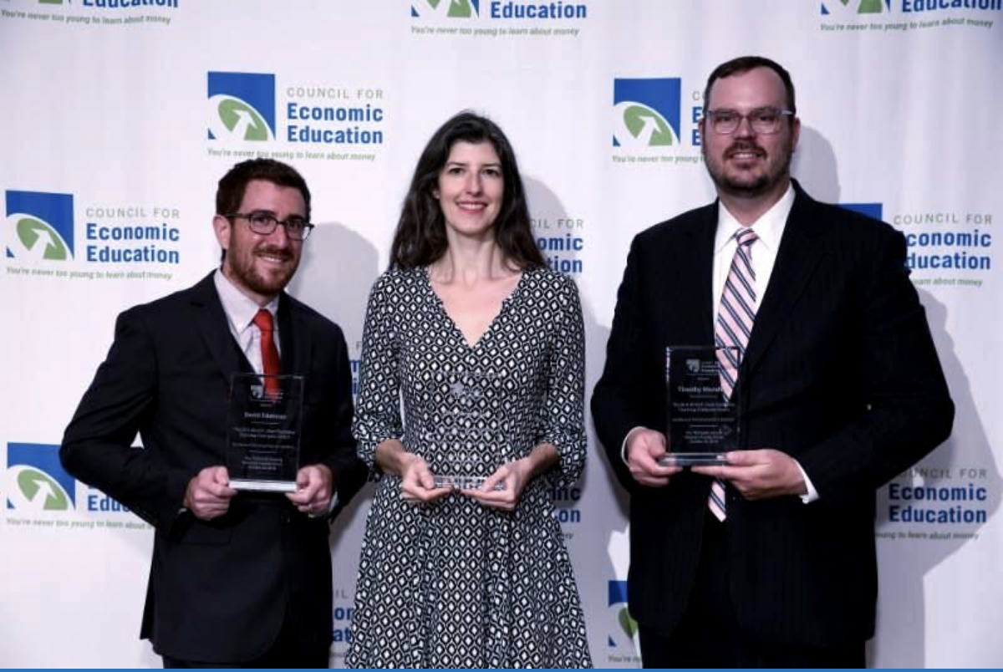
The 2021 Sloan Teaching Champion Award
Winners receive:
A cash award of $5,000
A cash award of $2,500 for their school to support economic education
Recognition at our annual Visionary Awards convening.
This award promotes economic education by honoring three outstanding teachers who incorporate exemplary teaching techniques that improve their students’ economic understanding in and out of the classroom.
This award is open to New York metropolitan area high school teachers of all subjects, not just teachers of economics. Applicants must demonstrate how they integrate economics into their teaching.
Sound like you or someone you know?
Applicants must teach in one of the
Twelve New York state counties (New York, Kings, Bronx, Richmond, Queens, Nassau, Suffolk, Westchester, Putnam, Rockland, Orange and Dutchess)
Eight New Jersey counties (Bergen, Passaic, Essex, Hudson, Middlesex, Union, Morris, Monmouth), or the
Two Connecticut counties (Fairfield and New Haven)
Application will be launched on Friday February 19th 2021
You can access the application here.
CONTACT
Please feel free to e-mail us at rrivera@councilforeconed.org
with any questions you have.

