Slide 1
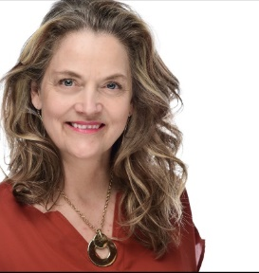
Financial Fitness for Life, Chapter 21: There Is No Free Lunch in Investing Presented by Tawni Hunt Ferrarini, PhD Dec 03, 2020 Tferrarini@Lindenwood.edu * Tawni.org

Slide 2
EconEdLink Membership
You can now access CEE’s professional development webinars directly on EconEdLink.org! To receive these new professional development benefits, become an EconEdLink member. As a member, you will now be able to:
Automatically receive a professional development certificate via e-mail within 24 hours after viewing any webinar for a minimum of 45 minutes
Register for upcoming webinars with a simple one-click process
Easily download presentations, lesson plan materials and activities for each webinar
Search and view all webinars at your convenience
Save webinars to your EconEdLink dashboard for easy access to the event
You may access our new Professional Development page here

Slide 3
Professional Development Certificate
To earn your professional development certificate for this webinar, you must:
Watch a minimum of 45-minutes and you will automatically receive a professional development certificate via e-mail within 24 hours.
Accessing resources:
You can now easily download presentations, lesson plan materials, and activities for each webinar from EconEdLink.org/professional-development/

Slide 5
https://store.councilforeconed.org/

Slide 6
Agenda
Welcome
Investment objectives with attention drawn to risk and return tradeoffs
Seven online practices for good teaching applied to economics
Deep dive into the expected returns on investments and their relationship to various types of risk
Review
Conclusion and references
Thanks to you and our sponsors

Slide 7
Two webinar options
1. Sit back and passively listen to the webinar and take notes
2. Actively participate in the webinar and learn-by-doing using PearDeck

Slide 8
Good Online Teaching Practices
peardeck.com (Level 1, $0)

Slide 9
Objectives
Define investment and link it to growth and prosperity
Establish a relationship between the reward associated with an investment and its risk
Analyze the tradeoff between risks and expected rates of returns attached to different financial investments

Slide 10
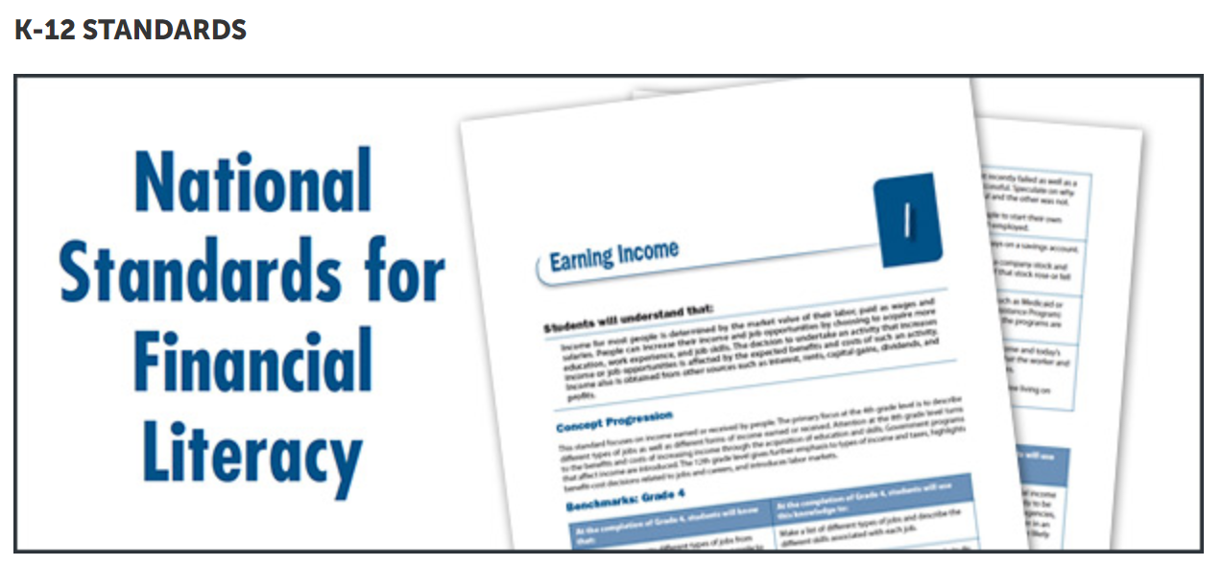
https://www.councilforeconed.org/resource/national-standards-for-financial-literacy/

Slide 11
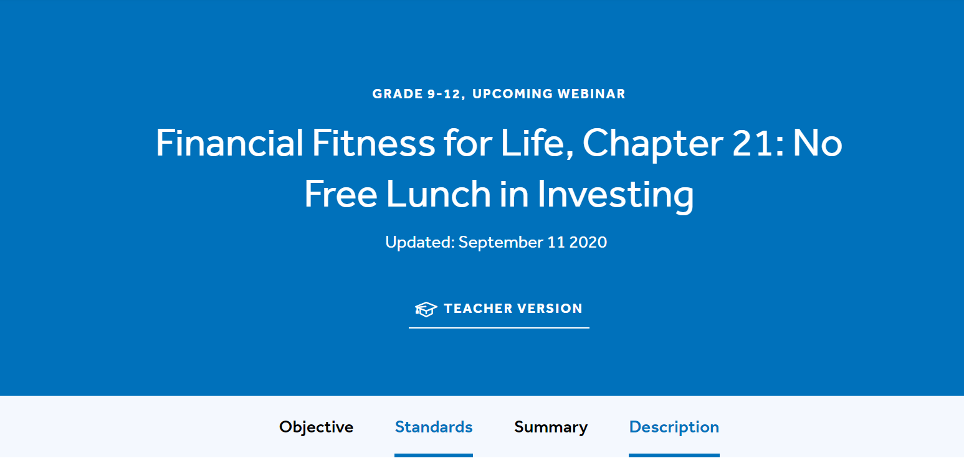
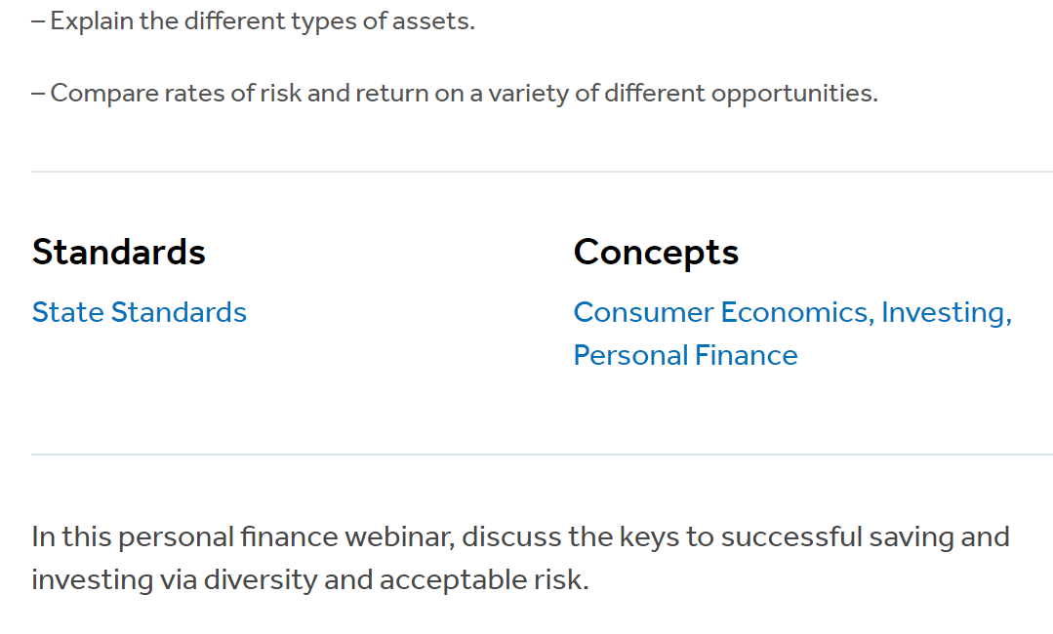
State Standards
Connect to regional and state standards at EconEdLink.org
Search for “Risk and Return”
Choose a lesson
Click on State Standards
NYSed.gov

Slide 12
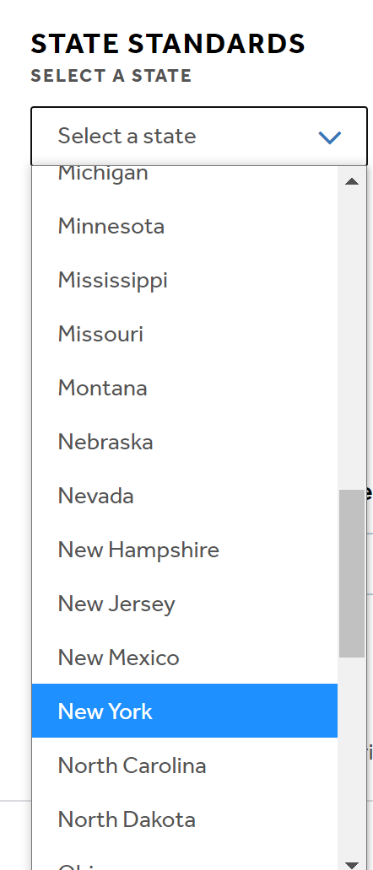
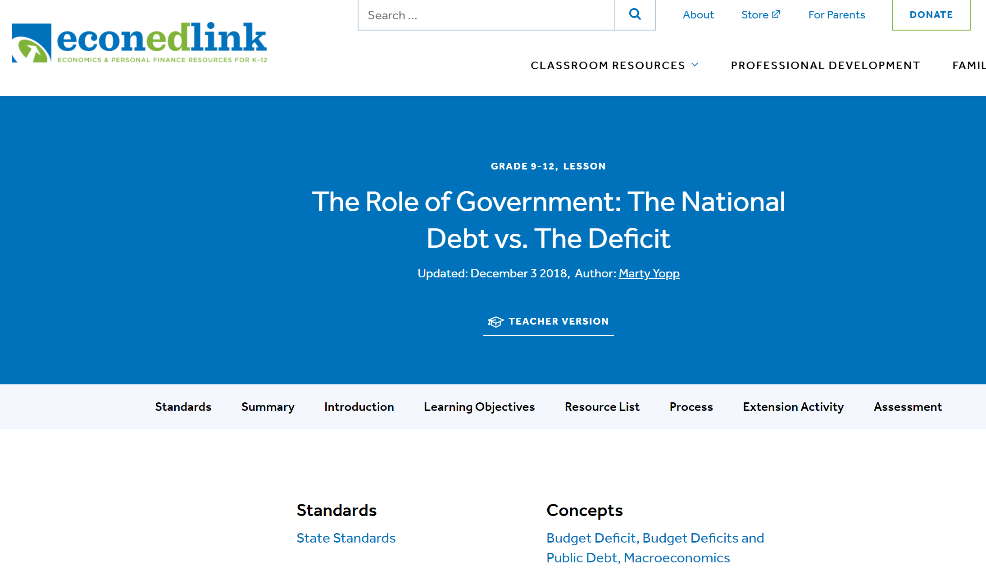
State Standards
Connect to regional and state standards at EconEdLink.org
Search for “Risk and Return”
Choose a lesson
Click on State Standards
NYSed.gov

Slide 13
Bell Ringer
Describe an investment that interests you with respect to its expected return and risk.
SEE BITMOJI. TAKE ACTION!!!!

Slide 14
Active Learning
Activities will lead you to do the following:
Identify the relevancy of investment income
Establish the relationship between the expected rate of return and different types investment risk
Discuss the link between investments choices and their opportunity costs (investment opportunities foregone)
Describe investment options and attach the risks associated with them within a well-diversified portfolio
Investigate how to live comfortably and securely through a well-diversified portfolio that generates future income

Slide 15
Did You Know?
There is way to earn income outside of working at a job that pays an annual salary or hourly wage rate? Outside of running a business? What do you think it is?

Slide 16
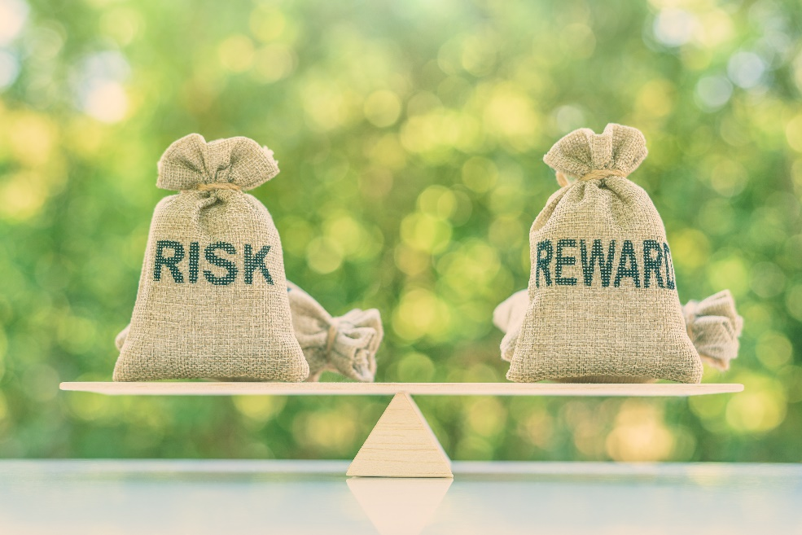
There is no free lunch in investing

Slide 17
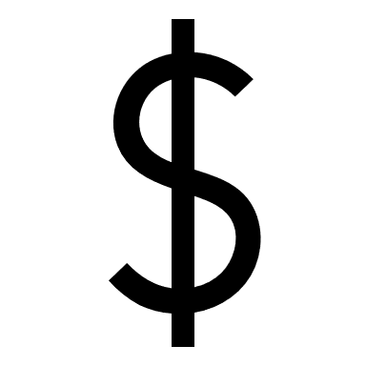
There is no free lunch in investing
Investments generate returns. Through saving and/or investing in other vehicles well-diversified investment portfolios produce interest income, dividend income, and capital gains – on average.
Investments involve risk. That is, there is a possibility that the investor will receive a positive or negative return in the future.
The greater the risk, the greater the potential for reward or loss.
All choices involve some type of risk with some having higher degrees of risk than others.
Choose strategically. Be informed.

Slide 18
How can you turn $1000 into $2000 in ten years?

Slide 19
How can you turn $1000 into $2000 in ten years?
Invest it in an investment portfolio that promises an average rate of return of 7%
The stock market index funds have historically generated 7 percent in returns. See the Rule of 70 for details on the power of compounding interest.
Warning, there have been ups and downs in these returns! So, proceed strategically. Well-diversified investments have positive expected returns, on average. They also have risks.

Slide 20
The Pyramid of Risk and Rewards

Slide 21
EconEdLink
10-min video; Kahoot! Quiz

Slide 22
5 Risks
Liquidity
Inflation
Financial
Market
Fraud

Slide 23
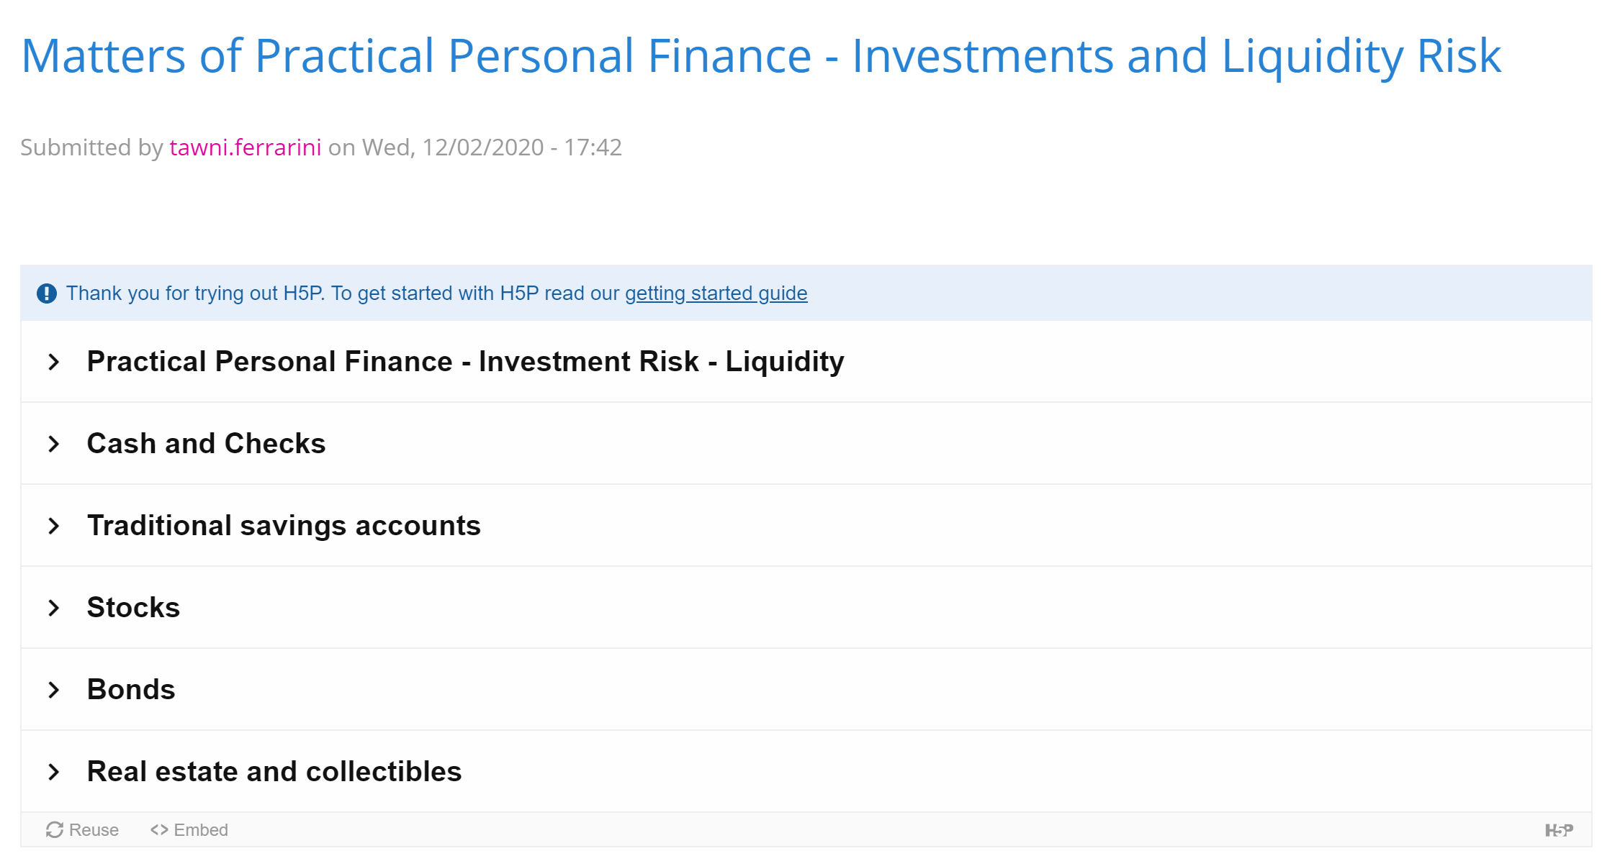
Liquidity Risks
Liquidity involves turning your investment into cash or spendable funds.
Educational Tool
H5P (no money cost)
https://h5p.org/node/1070861

Slide 24
Inflation Risks
Inflation erodes the purchasing power of income that does not increase along with it.
When you invest, you want to protect the quantity of goods and services purchased in the future. This involves determining the real return on your investment.
ECONOMISTS make it REAL.

Slide 25
Real Rates of Return
A certificate of deposit pays 5 percent in one year. This is the nominal rate of return.
Prices across the U.S. economy increase at 3 percent. That is everything, on average, increases by 3 percent. So, a $1.00 today takes $1.03 to buy the same thing in one year.
The real rate of return is 2 percent (=5%-3%)

Slide 26
Long Periods
In general, longer periods increase the likelihood of unanticipated inflation benefiting some at the expense of others.
Future inflation decreases the purchasing power of your initial investment (if a creditor) unless protected.
Consider protecting the value of your investment as the need for that protection against inflation increases.

Slide 27
Financial Risks
There is a financial risk that the business or government in which you invest will not be able to return your investment and/or pay the promised return.
Businesses, local governments, and state agencies can and do declare bankruptcy.
Assess that risk. Know if they’re insured. (Look at pensions.)
U.S. Treasury Bonds are least risky.

Slide 28
Market Risks
Great Recession of 2008
Market risks involve those experiences of loss contributed to factors that affect the overall performance of the financial markets.
Changes in interest rates, security prices (both systematic and unsystematic), foreign exchange rates, commodity prices and industries (transportation, oil, supply chains) and monetary and fiscal policy.
Diversification and hedging of certain assets help manage the unsystematic risks.

Slide 29
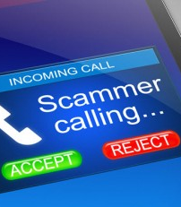
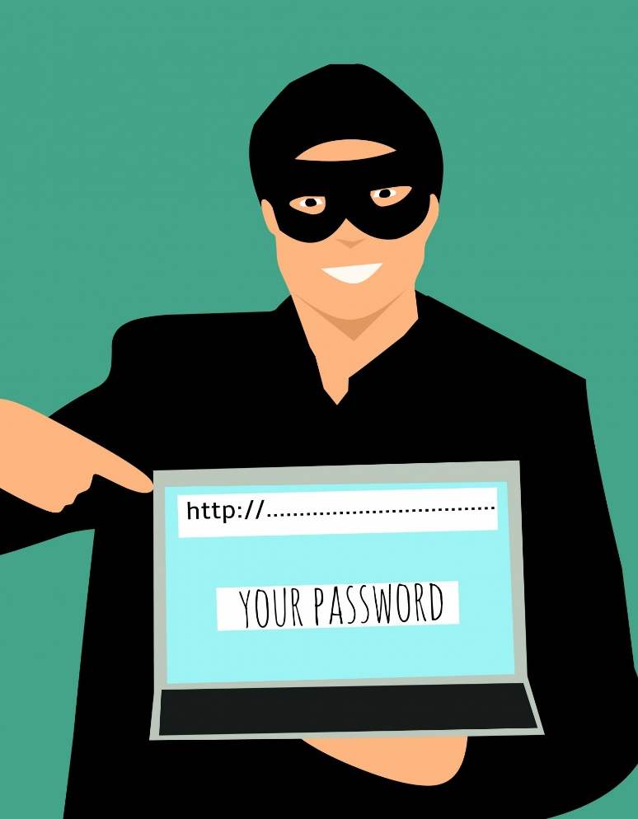
Fraud Risks
If it sounds too good to be true, it usually is!
Fraud risk involves dishonesty, misrepresentation, and the threat of theft.
Emails, solicitation calls, social media personal messages, and other outreach efforts promising $1 million deposited in your bank account or asking for a social security number to manage a transfer of funds often leads into fraud.
Protect yourself. Do nothing.
This Photo by Unknown Author is licensed under CC BY-SA

Slide 30
No such thing as a free lunch? Say what?
What does that mean in the investment world?
A person who is committed to earning investment income has many investment vehicles from which to choose. Choosing one comes at a cost. That cost in economics is its opportunity cost.
Consider the risk-reward tradeoff associated with each investment choice.

Slide 31
Not Consuming, Saving
Can you find a way to save $1 per day? $2? $3?
Seniors in high school? $1000 over the year, including the holidays, birthday and graduation?
Make strategic choices!

Slide 32
Rank the Risks and Returns
$1000 hidden under your mattress for 10 years | Low Risk | Medium Risk | High Risk
Liquidity | 1 | 2 | 3
Inflation | 1 | 2 | 3
Financial | 1 | 2 | 3
Market | 1 | 2 | 3
Fraud | 1 | 2 | 3
Expected Return | Low | Medium | High
$1000

Slide 33
Rank the Risks and Returns
U.S. Treasury Bond | Low Risk | Medium Risk | High Risk
Liquidity | 1 | 2 | 3
Inflation | 1 | 2 | 3
Financial | 1 | 2 | 3
Market | 1 | 2 | 3
Fraud | 1 | 2 | 3
Expected Return (10 year) | Low | Medium | High
$1000

Slide 34
Rank the Risks and Returns
Treasury Inflation-Protected Securities (TIPS) | Low Risk | Medium Risk | High Risk
Liquidity | 1 | 2 | 3
Inflation | 1 | 2 | 3
Financial | 1 | 2 | 3
Market | 1 | 2 | 3
Fraud | 1 | 2 | 3
Expected Return (10 year) | Low | Medium | High
$1000

Slide 35
Rank the Risks and Returns
Amazon.com, Inc. (AMZN) Stock | Low Risk | Medium Risk | High Risk
Liquidity | 1 | 2 | 3
Inflation | 1 | 2 | 3
Financial | 1 | 2 | 3
Market | 1 | 2 | 3
Fraud | 1 | 2 | 3
Expected Return (10 year) | Low | Medium | High
$1000

Slide 36
Rank the Risks and Returns
S&P 500- Index Fund | Low Risk | Medium Risk | High Risk
Liquidity | 1 | 2 | 3
Inflation | 1 | 2 | 3
Financial | 1 | 2 | 3
Market | 1 | 2 | 3
Fraud | 1 | 2 | 3
Expected Return | Low | Medium | High
$1000

Slide 37
Rank the Risks and Returns
Speculative Stocks – Cannabis/Coronavirus | Low Risk | Medium Risk | High Risk
Liquidity | 1 | 2 | 3
Inflation | 1 | 2 | 3
Financial | 1 | 2 | 3
Market | 1 | 2 | 3
Fraud | 1 | 2 | 3
Expected Return | Low | Medium | High
$1000

Slide 38
S&P 500 Before/After Pandemic

Slide 39
S&P 500 Before/After Pandemic
Be diversified across investments, recognizing the risks and returns
Buy and hold
$1000 would have dropped to $660 if sold in March $1000 would have returned to $1000 if held until Aug
$1010 (est) if held until Sept

Slide 40
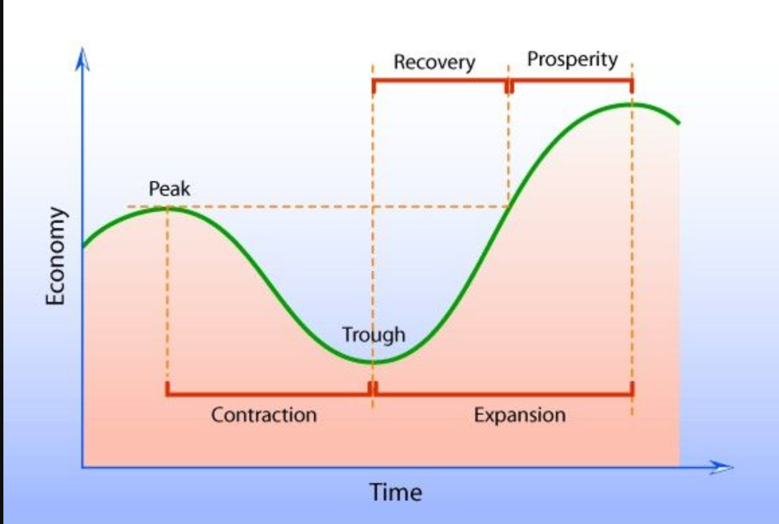
Business Cycle
Citation: https://www.pinterest.com/pin/570549846513119766/

Slide 41
Investing to Grow
As a rule, investment decisions must be made in the context of markets. A better understanding of markets should result in more informed financial decisions.
For example, investors may be offered a chance to buy a bond that pays an interest rate well above that paid by an insured account at a bank. If investors understand that riskier borrowers must pay a higher rate of interest, they know that the bond is probably riskier than the bank account.
Financially illiterate investors who do not understand this risk-reward trade-off may unwittingly take on an inappropriate level of risk and, consequently, experience losses.
Financially literate investors may also decide to take on the risk, but they understand and, more importantly, knowingly accept and plan for the consequences of this risk.
In summary, investors who understand the risk-reward trade-off can make strategic decisions and are more likely to live securely and comfortably in the future.

Slide 42
References
Audio Episode 688: Brilliant vs. Boring @ PlanetMoney (21 min)
Financial Fitness for Life and EconEdLink.org
Interactives (Virtual classroom activities, preparatory interactives, or follow-up reinforcements) H5P Matters of Practical Personal Finance - Investments and Liquidity Risk
Learning Activity Suggestions Critical Review of Podcast ** Short Essay Assignment Summarizing the Risk and Return Tradeoffs ** Case Study – Index Funds vs Actively Managed Funds vs Orlando the Cat
Videos How Expert Are Expert Stock Pickers? @ Marginal Revolution University (03:26)
Visuals and Data FRED St. Louis, FED (Current) ** MeasuringWorth.com (Historic Data) ** Visual Capitalist Ranking Asset Classes by Historical Returns (1985-2020) and The Soaring Value of Intangible Assets in the S&P 500
Notes:
https://www.investopedia.com/terms/b/bureau_of_public_debt.asp
https://h5p.org/
https://www.treasurydirect.gov/govt/resources/faq/faq_publicdebt.htm#DebtMakeup
https://www.pgpf.org/national-debt-clock
https://www.pewresearch.org/fact-tank/2019/07/24/facts-about-the-national-debt/

Slide 43
Wrapping Up
Risk-reward tradeoffs exist in investments
Apply the seven online practices for good teaching to advance students understanding of them
Geek out by reviewing the references
Let’s conclude and express thanks

Slide 44
CEE Affiliates
https://www.councilforeconed.org/resources/local-affiliates/

Slide 45
Financial Fitness for Life, Chapter 2: Using Active Learning Techniques to Explore the Economic Way of Thinking as Applied to Practical Personal Finance Presented by Tawni Hunt Ferrarini, PhD Dec 10, 2020 Tferrarini@Lindenwood.edu * Tawni.org

Slide 46
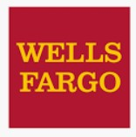
Thank You to Our Sponsors!

