Slide 1

December 2, 2020 Dr. Cheryl Ayers cheryl@mru.org
Free & Engaging Economics Resources for Hybrid Instruction
Welcome!
Please introduce yourself
in the chat box:
Name, State,
Subjects Taught

Slide 2
EconEdLink Membership
You can now access CEE’s professional development webinars directly on EconEdLink.org! To receive these new professional development benefits, become an EconEdLink member. As a member, you will now be able to:
Automatically receive a professional development certificate via e-mail within 24 hours after viewing any webinar for a minimum of 45 minutes
Register for upcoming webinars with a simple one-click process
Easily download presentations, lesson plan materials and activities for each webinar
Search and view all webinars at your convenience
Save webinars to your EconEdLink dashboard for easy access to the event
You may access our new Professional Development page here

Slide 3
Professional Development Certificate & Resources
To earn your professional development certificate for this webinar, you must:
Watch a minimum of 45-minutes and you will automatically receive a professional development certificate via e-mail within 24 hours.
Accessing resources:
You can now easily download presentations, lesson plan materials, and activities for each webinar from EconEdLink.org/professional-development/

Slide 4

Today’s Objectives
Preview Marginal Revolution University (MRU) resources for teaching high school economics.
Explore MRU website and think about how to use/tweak the resources for your subjects and students.

Slide 5
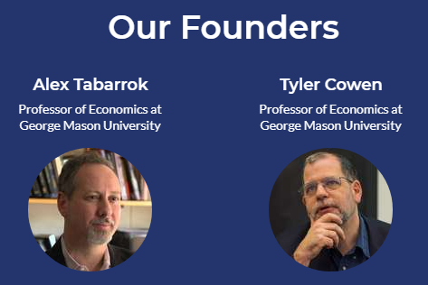
About Us
Marginal Revolution University (MRU)
Online, video-based, nonprofit, economic education platform founded in 2012 by GMU professors Drs. Tyler Cowen and Alex Tabarrok for teachers, students, and lifelong learners worldwide

Slide 6
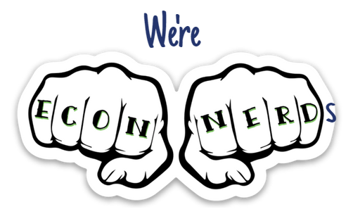
About Us
Our Vision
Economics has the power to positively change the way people view and live in the world because there’s an inner economist in all of us.
Our Mission
To provide a FREE world-class economic education to everyone, everywhere by:
Developing your inner economist with engaging, thought-provoking ways of looking at everyday problems
Entertaining you so you actually want to learn economics (no boring lectures!)
Thinking on the margin: one idea + one person at a time = “Marginal Revolution”
Notes:
Economics is the study of how to get the most out of life. We’re passionate about changing the world through economic education!

Slide 7
FREE MRU
Economic Resources

Slide 8
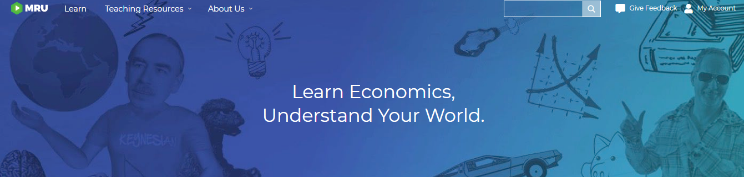
Poll
Have you used MRU resources?
Yes
No
Maybe

Slide 9
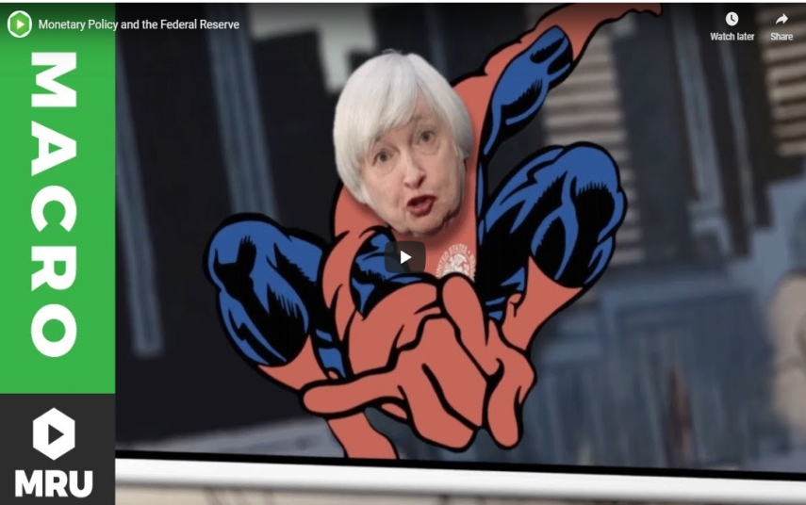
Videos
900+ Short videos with practice questions
Available at MRU.ORG and YouTube
Over 30 million YouTube views and 230K subscribers
High School topics
Microeconomics
Macroeconomics
International economics
Personal finance
When to use videos
Intro class
Main Lesson
Pre-class/Homework
Review/Remediate

Slide 10
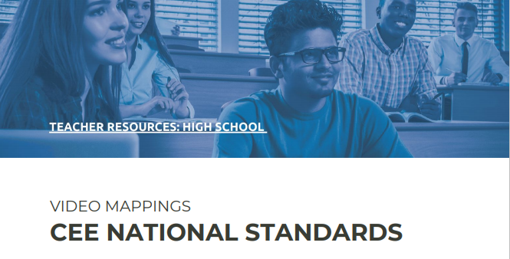
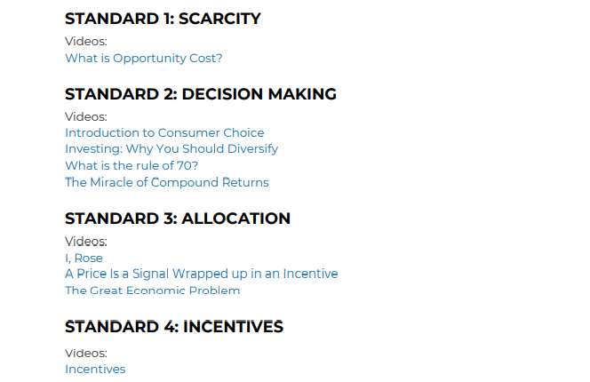
Videos Aligned to CEE Standards

Slide 11
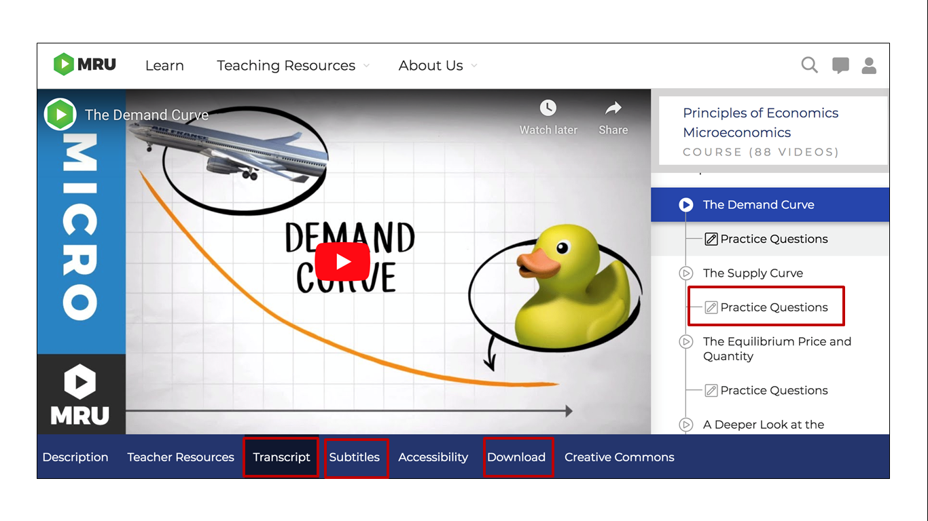
Video Features

Slide 12
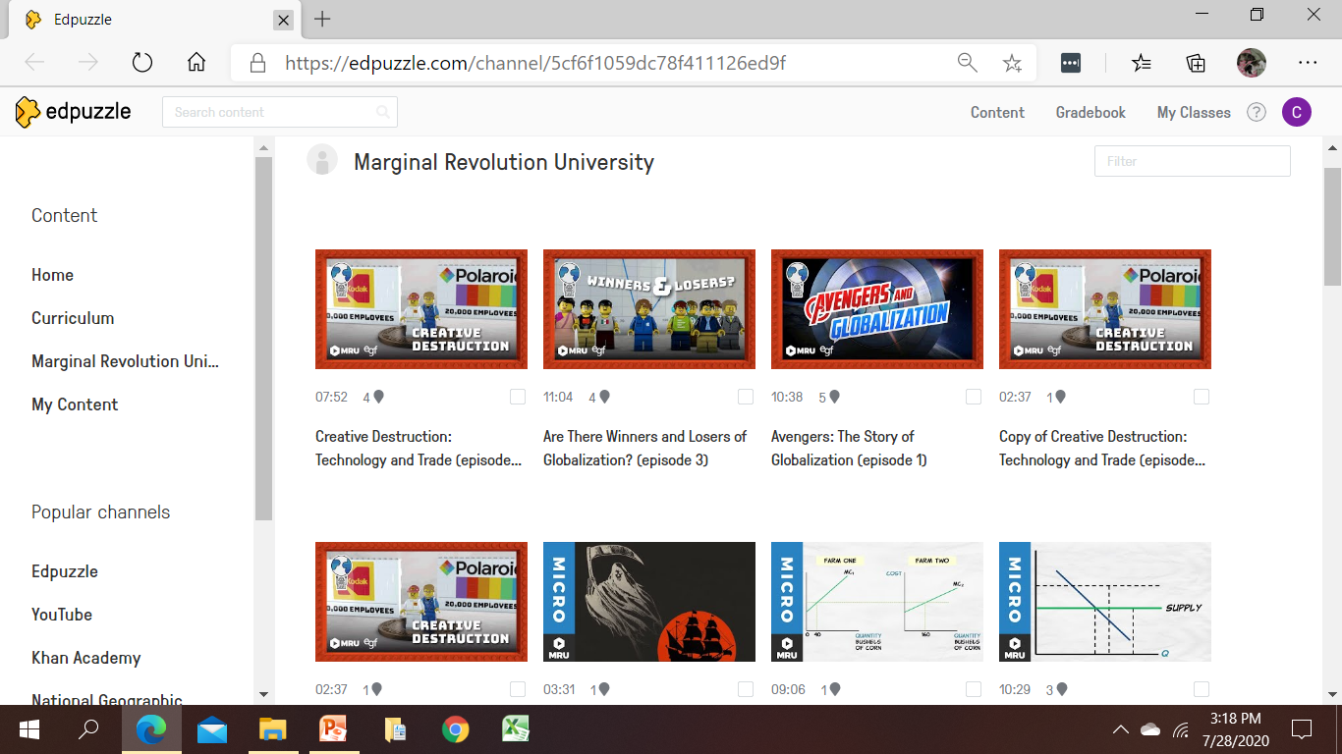
Videos on EdPuzzle
https://edpuzzle.com/channel/5cf6f1059dc78f411126ed9f

Slide 13
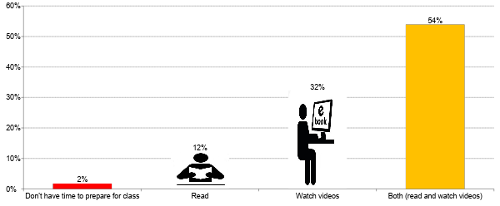
Video Research
The Fight for Students’ Attention Are you more likely to read or watch videos to prepare for class?

Slide 14
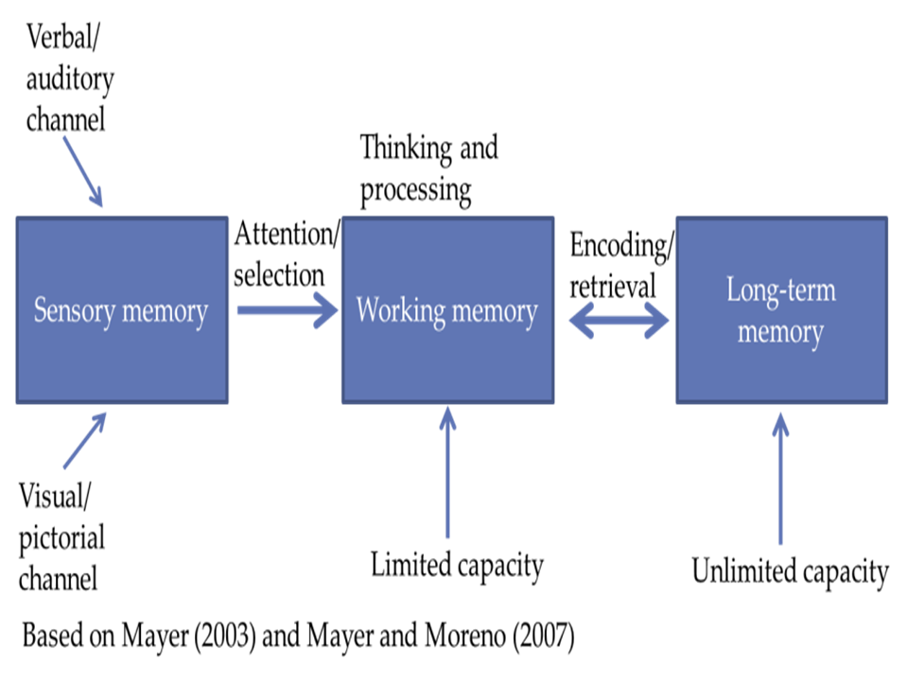
Video Research
Optimizing Learning Auditory + Visual
↑ engagement ↑ motivation ↑ retention (short/long) ↑ transfer of knowledge

Slide 15
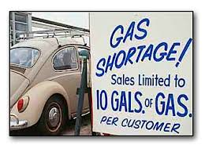
Best-Practices for Using Videos
Review unfamilar concepts before viewing
Create multidisciplinary bell ringer
Shorten videos
Choose segments to eliminate extraneous information unrelated to learning objectives
Segment/Chunk/Pause video flow of new information
Discuss concepts and give other examples
Ask MC and short-answer questions (EdPuzzle)
Redraw video graphs and explain
Respond to social media hashtags
Integrate video content and themes into lesson
Inquiry Questions
What seems to be the problem? How would this make you feel?
When did this happened in history?
What evidence did you use for your answer?
Notes:
Good for ELL and special education students to watch videos more than once with different learning objectives

Slide 16

Notes:
Your weekly guide to the best online media for what you’re teaching, when you’re teaching it.
Resources are synced to your syllabus, so you get resources just-in-time, the week before you’re teaching a concept.

Slide 17
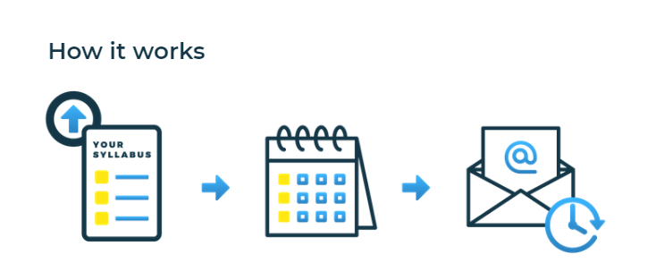
“EconInBox”
Curated Current Events Emails
Sign up
Send course outline
Receive
just-in-time resources

Slide 18
“EconInBox”
Example: Teaching price elasticity (Sept 24), receive resources (Sept 19)
News & Articles
Most Netflix users would pay a lot more for their subscription, survey shows (Yahoo!) Resource: Worksheet
Why you’ll pay 1,000 for Apple’s new iPhone (Slate) Resource: Worksheet
Massive response to sale prompts Build-­A-­Bear to shut down lines, offer vouchers (CNN)
Resource: Multiple Choice Questions
Videos
Shark Tank: Pogo Sticks and Purses
Resource: Worksheet
The Simpson’s: Elephant Rides
Resource: Business revenue worksheet

Slide 19
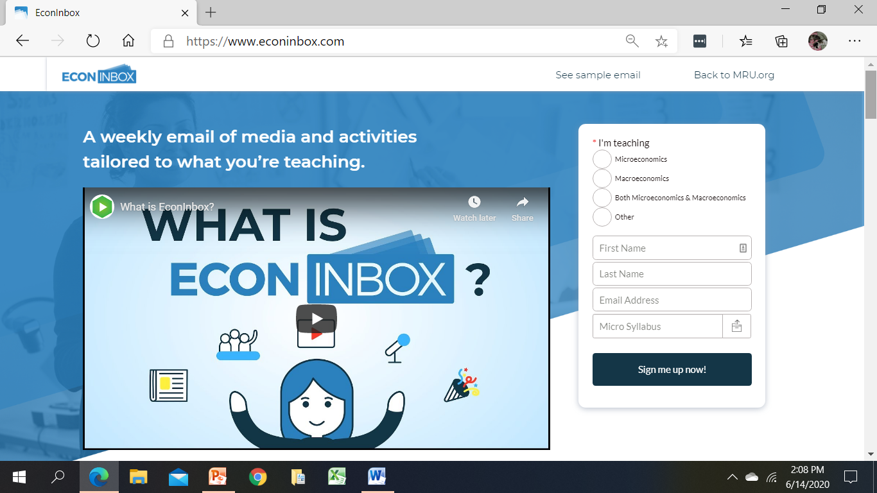
“EconInBox”
https://www.econinbox.com/

Slide 20
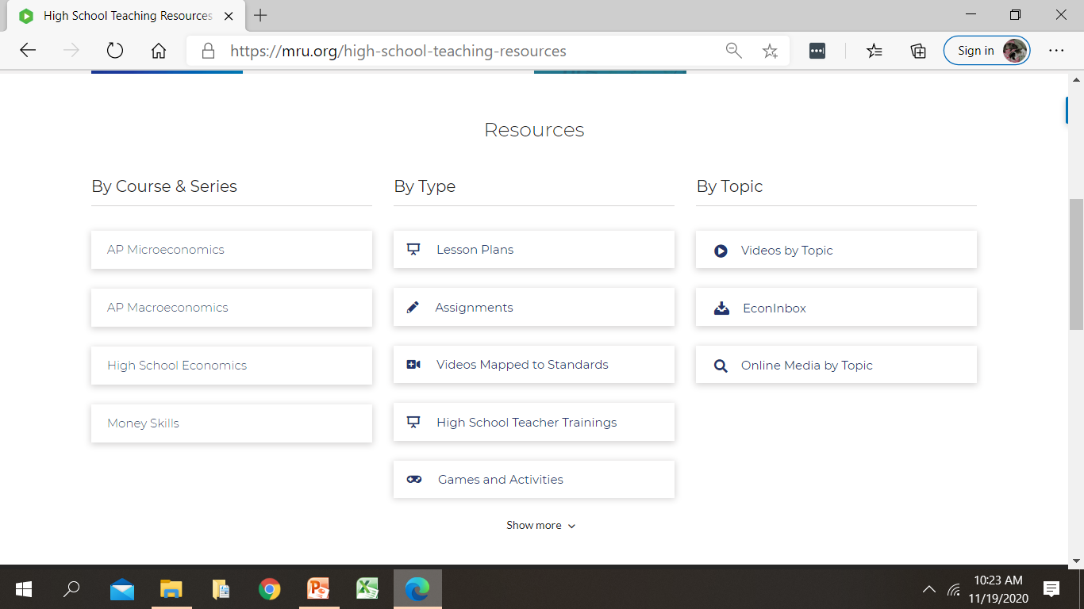
“EconInBox”

Slide 21
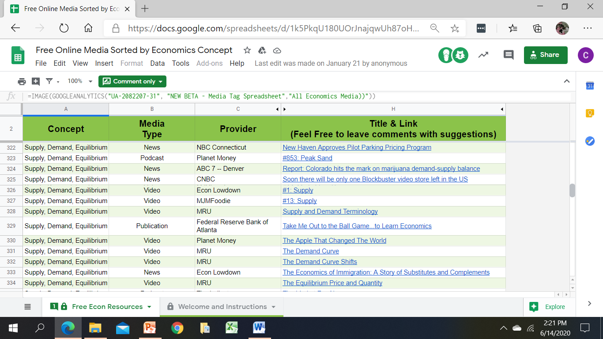
“EconInBox”

Slide 22
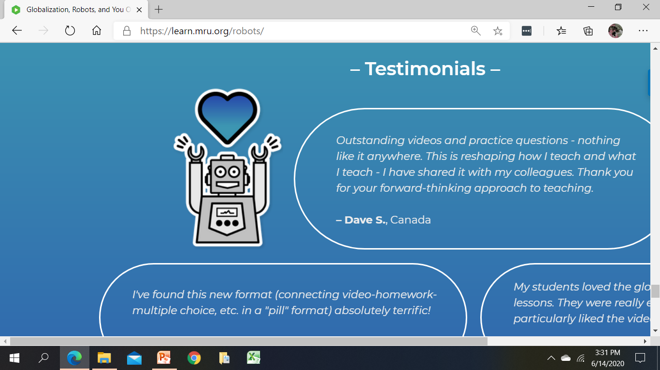
Globalization Robots & You
Sample Curriculum
5-day curriculum (in-class and online versions) of videos, active learning, and games in Google Docs for easy editing!
What is globalization and what is its history?
How is globalization impacting the world?
What is the effect of globalization on my life?

Slide 23
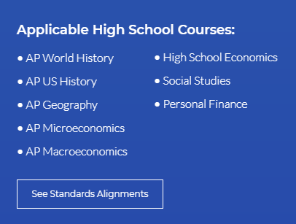
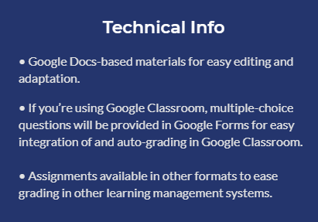
Globalization Robots & You
Curriculum

Slide 24
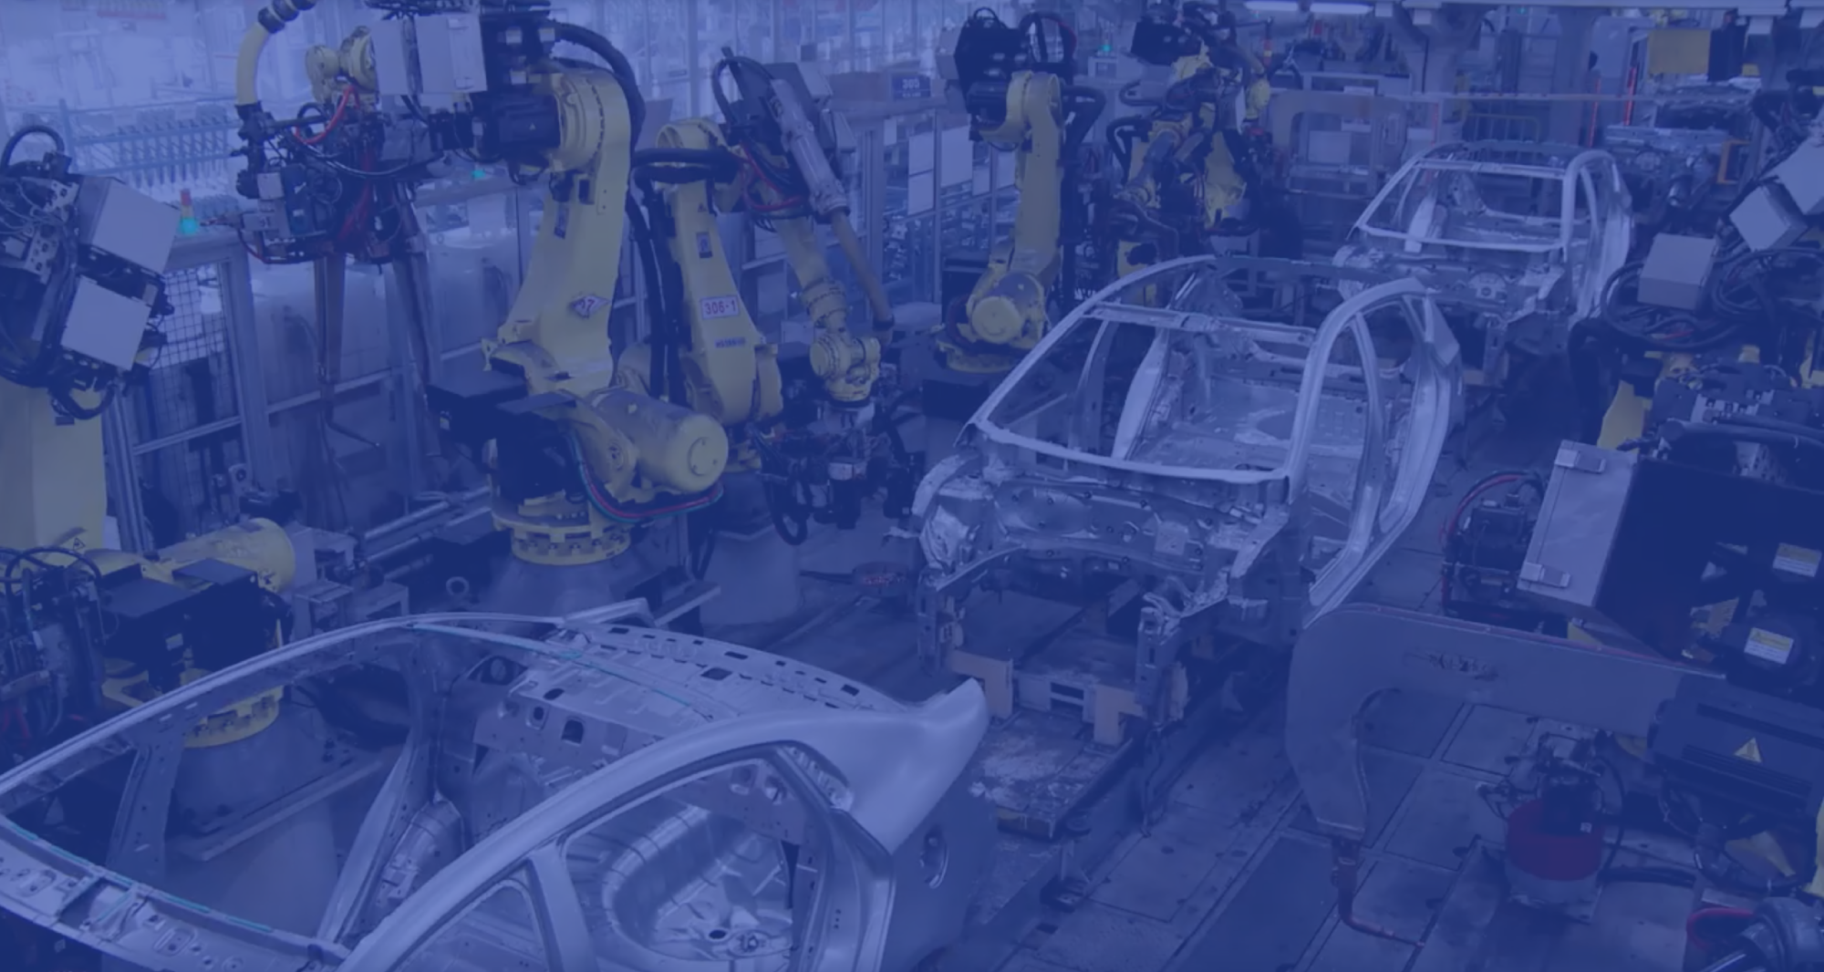
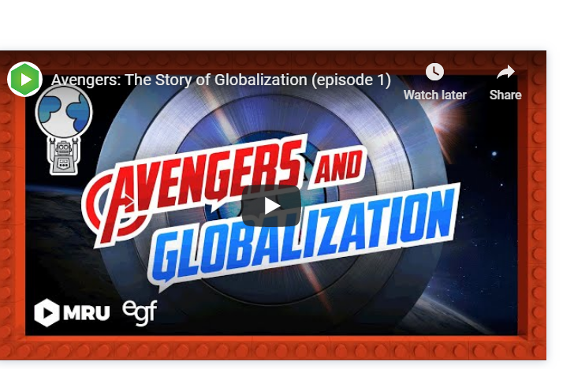
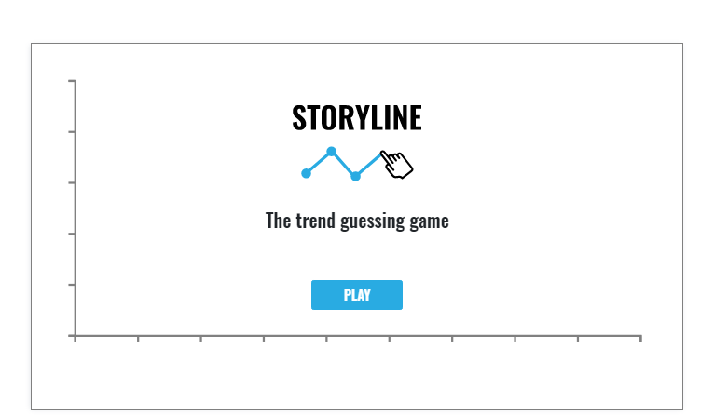
Make more informed decisions about education and careers based on the projected impact of globalization and automation on the U.S. economy’s rapidly changing workforce

Slide 25
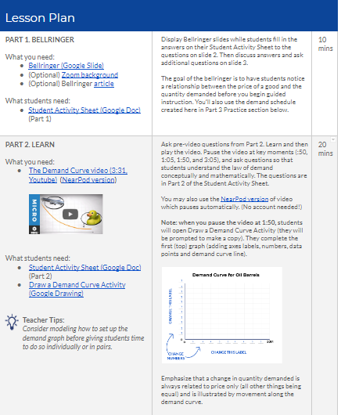
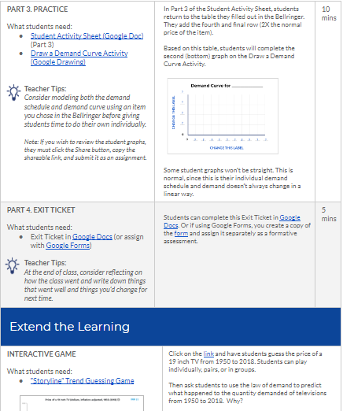
Law of Demand
Lesson

Slide 26
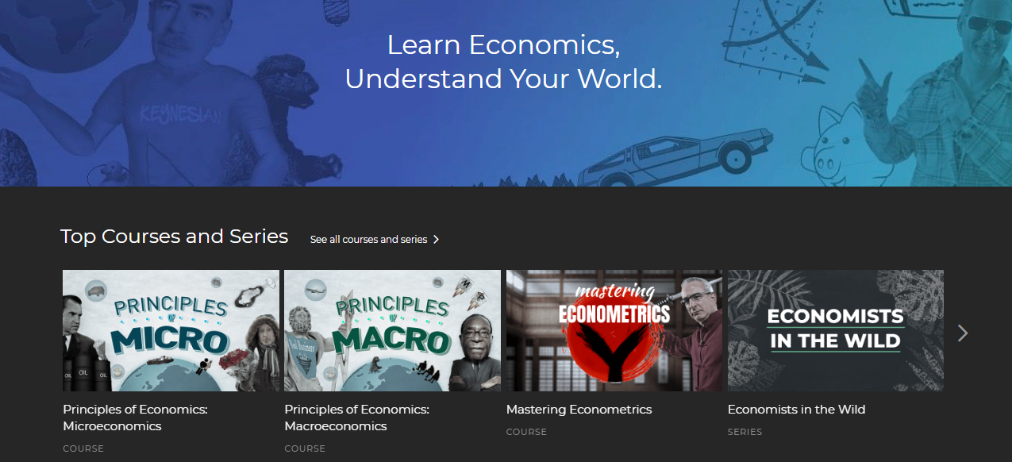
Self-Paced Online Courses
Principles of Micro & Macro

Slide 27
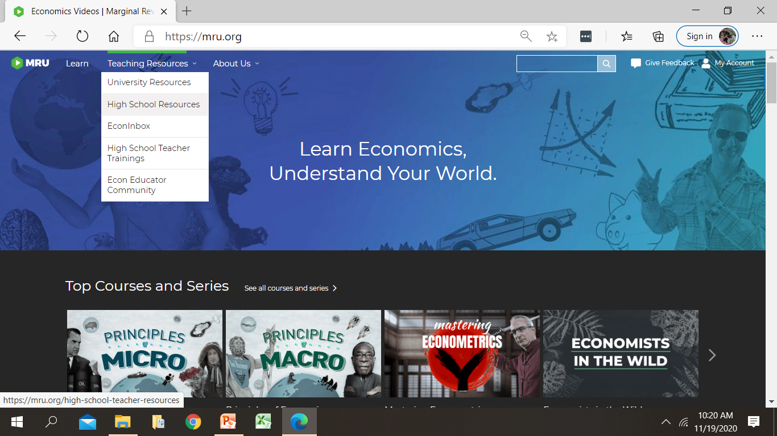
Website Exploration
https://mru.org Teaching Resources High School Resources

Slide 28
Website Exploration
https://mru.org Teaching Resources High School Resources
(scroll down a tad)
Law of Demand Lesson
Globalization, Robots & You
Courses & Series
Search By Topic
Dictionary of Economics
Video Library
How do you plan to use/tweak MRU resources?
Notes:
https://mru.org > Teaching Resources > High School Resources (scroll down)
Resources > By Type > Lesson Plans
Law of Demand Lesson
Globalization, Robots & You
Resources > By Topic > Videos by Topic
Courses & Series
Search By Topic
Dictionary of Economics
Video Library
Resources > By Topic > Online Media by Topic

Slide 29
Questions
or Comments?

Slide 30
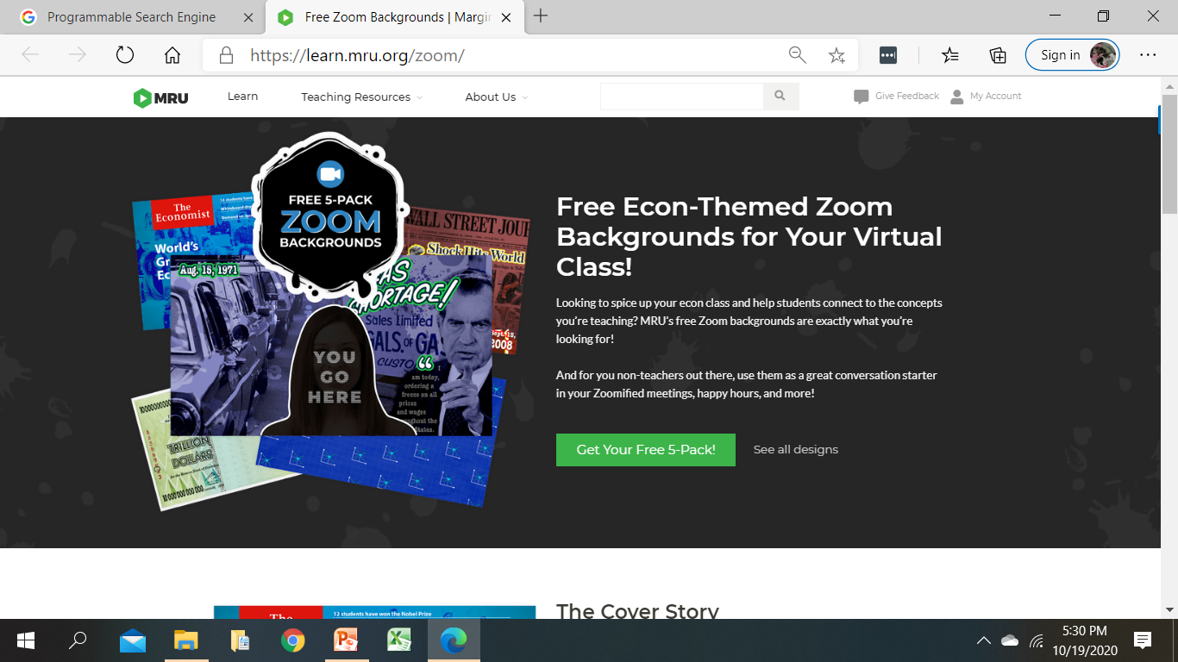


Zoom Backgrounds
https://learn.mru.org/zoom/

Slide 31
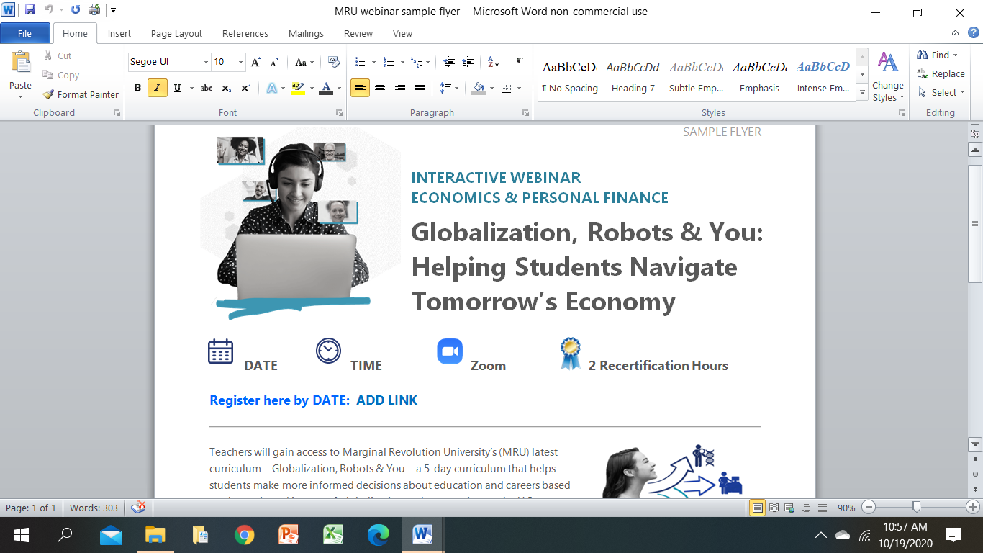
Wrap-Up
Posted on EconEdLink PD Webpage (please share with colleagues)
MRU Videos aligned with CEE National Standards
Informational flyer recapping MRU resources
This PPT presentation
Other CEE-MRU Webinars
MRU Statewide Webinars
Statewide Online Courses (non-streaming video files)
Dec 16 | Globalization, Robots & You Curriculum
Spring | Supply & Demand Interactive Unit Innovative Uses of Videos Women in Economics
Notes:
Happy to align MRU videos to any state’s economic learning standards

Slide 32
Opt-In
Go to MRU.ORG/CEE1
Globalization, Robots & You curriculum
Updates on new videos, lessons, and activities
Notes:
Just released videos:
Externalities & Incentives: Economics of COVID
Women in Economics: Christina Romer

Slide 33


Thank you!
Questions/Feedback
Cheryl ♦ cheryl@mru.org
Stay Connected
@MRevUniversity
facebook.com/mrevuniversity
Join our Teaching Online Econ Facebook Community at COMMUNITY.MRU.ORG

Slide 34
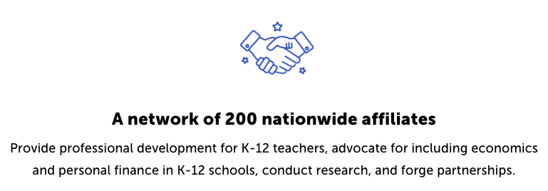
CEE Affiliates
https://www.councilforeconed.org/resources/local-affiliates/

Slide 35




Thank You to Our Sponsors!

