Slide 1
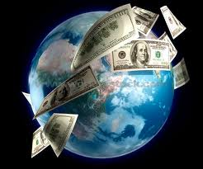
Foreign Exchange: Trade Surplus vs Deficit What Does It All Mean? Theresa Fischer July 2020 ecofisch@gmail.com

Slide 2
EconEdLink Membership
You can now access CEE’s professional development webinars directly on EconEdLink.org! To receive these new professional development benefits, become an EconEdLink member. As a member, you will now be able to:
Automatically receive a professional development certificate via e-mail within 24 hours after viewing any webinar for a minimum of 45 minutes
Register for upcoming webinars with a simple one-click process
Easily download presentations, lesson plan materials and activities for each webinar
Search and view all webinars at your convenience
Save webinars to your EconEdLink dashboard for easy access to the event
You may access our new Professional Development page here

Slide 3
Professional Development Certificate
To earn your professional development certificate for this webinar, you must:
Watch a minimum of 45-minutes and you will automatically receive a professional development certificate via e-mail within 24 hours.
Accessing resources:
You can now easily download presentations, lesson plan materials, and activities for each webinar from EconEdLink.org/professional-development/

Slide 4
Agenda
Balance of Payments –> Deficit and Surplus
The establishment of the Foreign Exchange Market
What is the difference between a Fixed exchange rate and a Floating Exchange rate?
What causes the currency of a nation to appreciate or depreciate?
The benefits of a depreciate currency vs appreciated currency

Slide 5
Objectives
What should students know about Trade and the Forex exchange?
How does Fiscal and Monetary Policy affect the exchange rate of a nation?
How does exchange rates affect RGDP and Employment?

Slide 6
National Standards
STANDARD 5: TRADE . Voluntary exchange occurs only when all participating parties expect to gain. This is true for trade among individuals or organizations within a nation, and among individuals or organizations in different nations
STANDARD 7: MARKETS AND PRICES . . A market exists when buyers and sellers interact. This interaction determines market prices and thereby allocates scarce goods and services.
STANDARD 8: ROLE OF PRICES . Prices send signals and provide incentives to buyers and sellers. When supply or demand changes, market prices adjust, affecting incentives.

Slide 7
State Standards
Standard 4: Economics Students will use a variety of intellectual skills to demonstrate their understanding of how the United States and other societies develop economic systems and associated institutions to allocate scarce resources, how major decision-making units function in the United States and other national economies, and mechanism

Slide 8
Assessment Questions
How does the Balance of Payments Account show debits and credits?
Why was the FOREX market established?
What can cause the currency of a nation to depreciate or appreciate? What are the benefits of both?
How can fiscal or monetary policy affect the value of the dollar and trade?

Slide 9
References
The Federal Reserve Bank of Dallas
Advanced Placement Economics Macroeconomics published by CEE
AP Macroeconomics College Board (YouTube) -- > Special thanks to Matt Romano, Jen Raphael, Martha Rush
McConnell and Brue – Economics 21st edition

Slide 10
International Capital Flows… Using Balance of Payments ….Showing Current Account and Financial Account
Martha Rush – YouTube video https://www.youtube.com/watch?v=qaTLVoYm_no&feature=youtu.be&hd=1

Slide 11
What are International Capital Flows?
We are talking about Money not Capital goods!
When American buy imported goods such as a cars from Japan, then capital (money) flows from the United States to Japan
When Japan buys wheat and agricultural products from the United States, then capital (money) flows into the United States

Slide 12
Current Account
Transactions do not create liabilities
Farmer Bill sells wheat to European food processor; the food processor pays him
There is no long-term relationship here. Payment is made and there is an exchange of wheat for the payment

Slide 13
Financial Account
This account create liabilities
For example: IBM sells a bond to an investor in Germany. IBM will have to pay interest and repay principle in the future. This is a long-term relationship.

Slide 14
Balance of Payments
Current Account + Financial Account = 0
If it doesn’t then there is a change in government reserves
A foreign transaction counts as a “credit” if the USD is used
A foreign transaction counts as a “debit” if a foreign currency is used.

Slide 15
Balance of Payments
Current Account Imports Exports Tourisms Net income on Foreign Investments Net Transfer Payments | Financial Account Purchase of Real Assets abroad (hotels factories, etc. ) Purchases of Financial Assets aboard such as stocks and bonds.

Slide 16
Practice Questions
 | Credit | Debit | Current Acct | Financial Acct
Entrepreneur invests $50 million to develop a theme park in Malaysia
BMW pays $1 m to the US shipper for transporting cars
A Brazilian investor buy $50,00 US Treasuries bonds
Sam Boney US ice rink magnate buys stock in a Chilean ice rink chain
Advanced Placement Economics Macroeconomics

Slide 17
Answers
 | Credit | Debit | Current Acct | Financial Acct
Entrepreneur invests $50 million to develop a theme park in Malaysia |  | x |  | x
BMW pays $1 m to the US shipper for transporting cars | x |  | x
A Brazilian investor buy $50,00 US Treasuries bonds | x |  |  | x
Sam Boney US ice rink magnate buys stock in a Chilean ice rink chain |  | x |  | x

Slide 18
Questions
Suppose Rankinland has a current account deficit. Rankinland’s currency is called the bera…
(i) What will initially happen to the current account deficit in Rankinland solely due to the change in the real GDP from part (b)(iv)? Explain.
(ii) What will happen to the international value of the bera solely due to the change in the real GDP from part (b)(iv)? Explain.
AP Macroeconomics FRQ 2012

Slide 19
Answers
One point is earned for stating that the current account deficit will increase
One point is earned for explaining that the increase in real GDP increases income, which causes imports to increase and net exports to decrease
One point is earned for stating that the international value of the bera will decrease
One point is earned for explaining that the decline in the international value of the bera is due to an increase in the supply of the bera

Slide 20
Questions

Slide 21
Answers

Slide 22
Questions
Assume that the real interest rate of the euro zone increases relative to the real interest rate of the United States. Draw a correctly labeled graph of the foreign exchange market for the euro, and show the impact of the change in the real interest rate in the euro zone on each of the following:
(i) Demand for the euro. Explain.
(ii) Value of the euro relative to the United States dollar
(iii) Assume that the United States current account balance is zero. Based on the change in the value of the euro identified in part (d)(ii), will the United States current account balance now be in surplus, be in deficit, or remain at zero?
AP Macroeconomics FRQ 2013

Slide 23
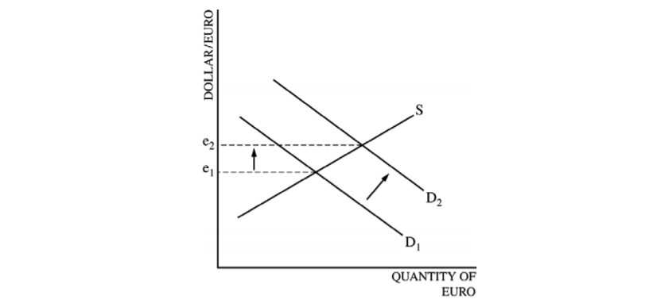
Answers
(i) Shift the demand curve to the right and showing an increase in the value of the euro.
(ii) Demand for the euro increases because the higher real interest rate in the euro zone leads to higher returns for financial investments in the euro zone, attracting funds from the United States to the euro zone.
(iii) United States current account will be in surplus.

Slide 24
What are the challenges in teaching Forex?
1. Students who travel never see currency exchange. The method of payment world-wide is the use of credit cards
2. It is hard to envision floating exchange rates and putting (supplying) currency in the world market to obtain another currency
3. Understanding the graph

Slide 25
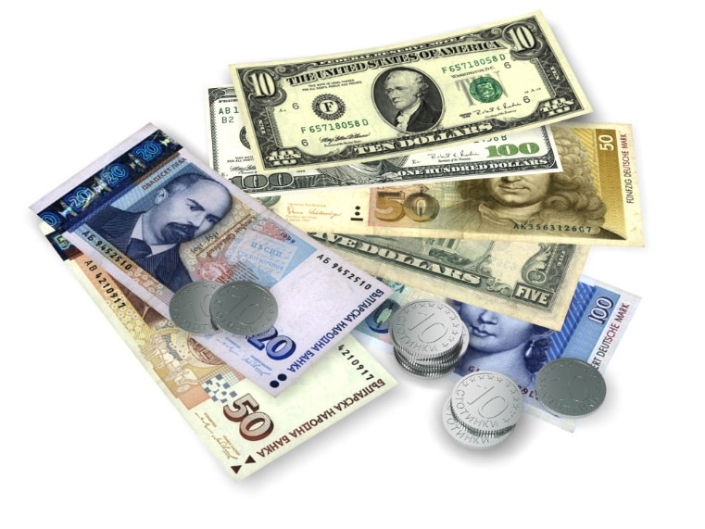
What are the determinants of Exchange Rates?
Demand for a nation’s exports
Relative interest rates
Political stability
Relative level of income
Relative prices ( theory of purchasing power parity)
Speculation

Slide 26
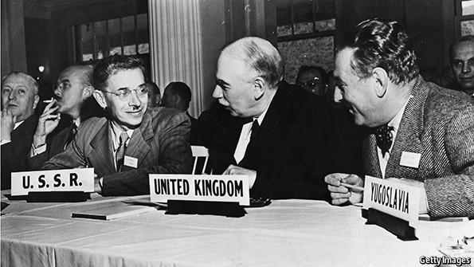
The Bretton Woods Agreement
An agreement reached in July 1944 between 44 countries to restructure the international financial system, post-war World War II.
Date | GBP : USD
27 December 1945 | £1.00 : US$4.03
18 September 1949 | £1.00 : US$2.80
17 November 1967 | £1.00 : US$2.40
The US Dollar become the world’s central currency, linked to the value of gold. The exchange rates of most major currencies were fixed against the US dollar.
The agreement prevented countries from devaluing their currencies to seek an unfair trade advantage.
World trade among developed countries grew rapidly in the 1950s and 1960s, boosting world output and raising the standard of living, especially in Europe and Japan.

Slide 27
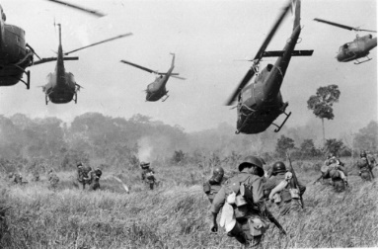
The demise of Bretton Woods
By the 1970s, the cost of the Vietnam War and the running of trade deficits put the US Dollar under pressure.
This led to a steady flow of US dollars (and therefore gold) out of the US. By 1971, the US only had reserves of gold sufficient to cover 22% of the US dollars in issue.
It has been estimated that the true market price of gold in 1971 should have been US$103 per ounce.
Before the collapse of Bretton Woods, the French central bank was buying US dollars with French francs, and converting the US dollars into gold at US$35 per ounce.
15th August 1971, President Nixon announces the end of the gold standard for the US dollar
Nixon ends gold standard

Slide 28
Introducing the Foreign Exchange Market
The foreign exchange market refers to the trading of one currency for another.
It is by far the busiest and most active of the financial markets, with turnover comfortably exceeding that of bonds and equities.
It is also known as:
The forex market
The FX market
Source: http://www.xe.com
Most currencies are allowed by their
central banks to “float” - exchange rates
between one currency and another can
vary.
The value of one currency versus another
will depend on the economic health of
the issuer
This creates risks for companies operating
internationally
Interest rates and the balance of payments are key determinants

Slide 29
Who participates in the Forex market and why?
Those purchasing goods and services from another country
Those purchasing financial assets (securities, currency, etc.) from another country

Slide 32
Currency Quotes
Trading of foreign currencies clearly involves selling one currency and buying another, the two currencies involved are described as ‘pairs’.
Base Currency
The first currency quoted in a pair
It is always equal to one unit of that currency
Price at which a pair is bought and sold is the exchange rate
Counter or Quote Currency
The second currency quoted in a pair
1 : 0.75
USD
In this case $1 is worth £0.75
GBP
When the exchange rate is being quoted, the name of the each currency is abbreviated to a three letter reference
Most commonly quoted currency pairs:
USD
JPY
Eur
USD
USD
CHF
GBP
USD
Eur
GBP

Slide 33
How is an exchange rate expressed numerically?
Dollar to Chinese Yuan
1 dollar costs 6.99 Chinese yuan
6.99 yuan per dollar
6.99 yuan buys 1 dollar
Euro to Mexican Peso
1 euro costs 25.7 pesos
25.7 peso per euro
25.7 peso buys one euro
Dollar to the Japanese Yen
1 dollar costs 107.18 Japanese yen
107.18 yen per dollar
107.18 yen buys 1 dollar

Slide 36
Exchange Rate Practice
The Price of South Korean won (KRW) in Indian rupees (INR) changes
From : 1 KRW = .090 INR
To: 1 KRW = .062 INR
Which currency has appreciated?
Which currency has depreciated?

Slide 37
Exchange Rate Practice

Slide 38
How will an exchange rate change affect prices?

Slide 40
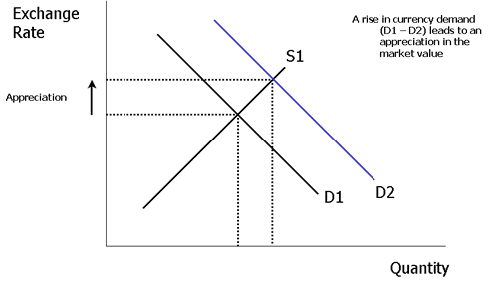
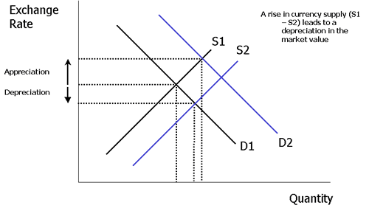
Floating Exchange Rates
Changes in market demand and market supply of a currency cause a change in value.
A rise in the demand for sterling (perhaps caused by a rise in exports or an increase in the speculative demand for sterling) leads to an appreciation in the value of the pound.
Changes in currency supply also have an effect. In the diagram above there is an increase in currency supply (S1-S2) which puts downward pressure on the market value of the exchange rate.

Slide 44
Italians buy US Smart Phones

Slide 45
US purchases French cheese

Slide 46
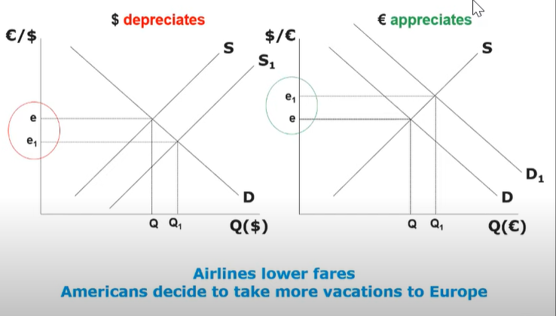
What will happen to the value of the dollar and the value of the Euro when more Americans want to vacation to Europe?

Slide 47
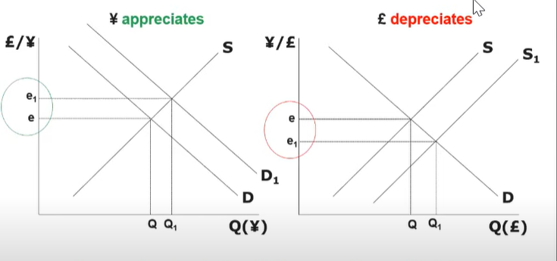
What happens to the value of the Pound and the Yen when interest rates in the Japan are higher than they are in the UK?

Slide 48
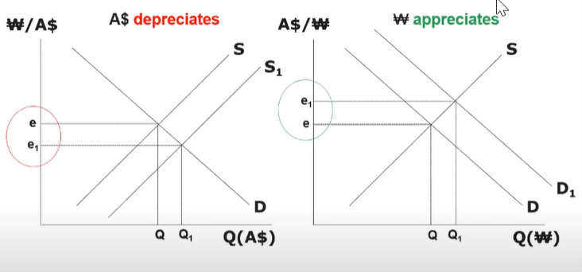
Inflation in Australia is higher than in South Korea. What will happen to their currency?

Slide 53
How does Fiscal Policy affect trade?

Slide 54
How does Monetary Policy affect trade?

Slide 55
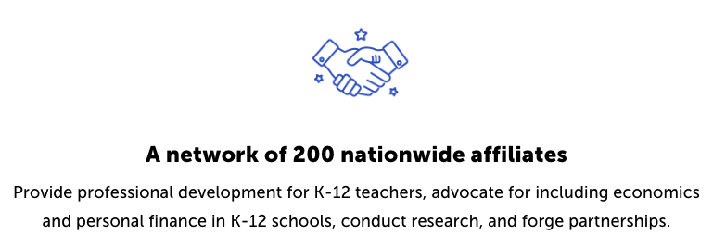
CEE Affiliates
https://www.councilforeconed.org/resources/local-affiliates/

Slide 56
Thank You to Our Sponsors!

Slide 57
The Conference is your pathway to learn about the opportunities to incorporate personal finance and economics into your K-12 classroom and to exchange ideas with hundreds of peers.
Register by August 15, 2020 to receive the early bird special discount: $79 Early Bird ($99 thereafter)
Register Today >>>
https://www.councilforeconed.org/events/conference

