Slide 1
Evaluating the Great Society Program
Tuesday 3/17/20
Matthew Gherman
Edward R. Murrow High School
mgherman@schools.nyc.gov

Slide 2
EconEdLink Membership​
You can now access CEE’s professional development webinars directly on EconEdLink.org! To receive these new professional development benefits, become an EconEdLink member. As a member, you will now be able to: ​
Automatically receive a professional development certificate via e-mail within 24 hours after viewing any webinar for a minimum of 45 minutes​
Register for upcoming webinars with a simple one-click process ​
Easily download presentations, lesson plan materials, and activities for each webinar ​
Search and view all webinars at your convenience ​
Save webinars to your EconEdLink dashboard for easy access to the event​
You may access our new Professional Development page here

Slide 3
Professional Development Certificate
To earn your professional development certificate for this webinar, you must:​
Watch a minimum of 45-minutes and you will automatically receive a professional development certificate via e-mail within 24 hours.​
Accessing resources: ​
You can now easily download presentations, lesson plan materials, and activities for each webinar from EconEdLink.org/professional-development/

Slide 4
What is a Great Society?
"America can be a great society"
- President Lyndon B. Johnson, 1964
“Let’s Make America Great Again”
–President Ronald Reagan 1980
"Make America Great Again!"
- President Donald Trump campaign slogan, 2016

Slide 5
Opening Discussion
Panel Discussion Question:
What does a “Great Society” mean to you? What are the qualities of a great society? Please type in first one-two qualities that come to your mind.

Slide 6
Great Society Speech
“The Great Society rests on abundance and liberty for all. It demands an end to poverty and racial injustice, to which we are totally committed in our time. But that is just the beginning. The Great Society is a place where every child can find knowledge to enrich his mind and to enlarge his talents. It is a place where leisure is a welcome chance to build and reflect, not a feared cause of boredom and restlessness. It is a place where the city of man serves not only the needs of the body and the demands of commerce but the desire for beauty and the hunger for community.”
– President Lyndon Johnson, 1964

Slide 7
Excerpt Questions:
What is the purpose of this speech?
Who do you think the intended audience is?
What are the historical circumstances?
Is this reliable?
According to President Johnson, what is a great society?

Slide 8
Goals (Learning Objectives) for this webinar
What does the Great Society Program create?
Compare/Contrast Point of View on its long term impacts on America.

Slide 9
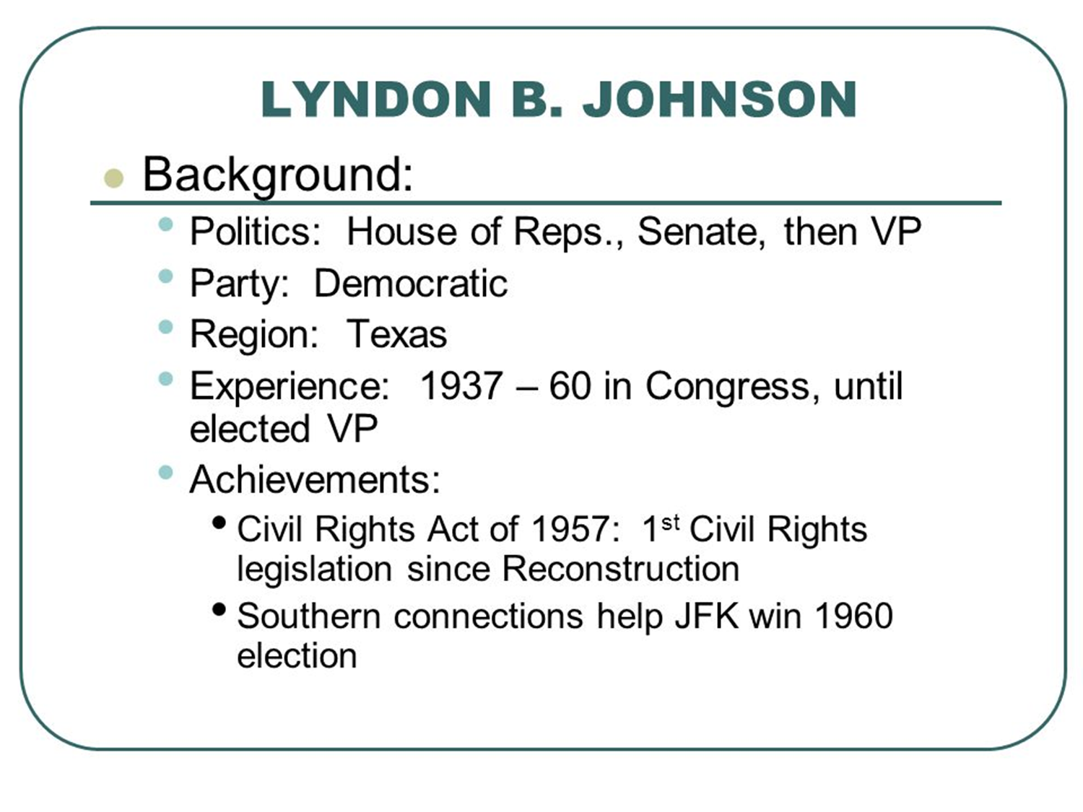

Slide 10
Building on Kennedy
Kennedy had eight goals in his New Frontier, most of which Congress rejected:
Increased federal aid for education. Defeated.
Medical care for the elderly. Defeated during the Kennedy administration, but eventually enacted as Medicare and Medicaid.
Increase in the minimum wage. Passed.
Urban reforms. Modest success.
Civil rights. None. Despite the lingering myth that JFK was a strong proponent of civil rights, his administration saw no major civil rights legislation. It was actually brother Robert Kennedy, JFK's attorney general, who was committed to civil rights. JFK, afraid of losing the always tenuous support of Southern Democrats, put civil rights on the back burner once he was in office.
End to poverty. No.
Major tax cuts. Defeated.
Cold War goals. Yes, Kennedy's term saw both increased expenditures on defense and money for the new space program.

Slide 11
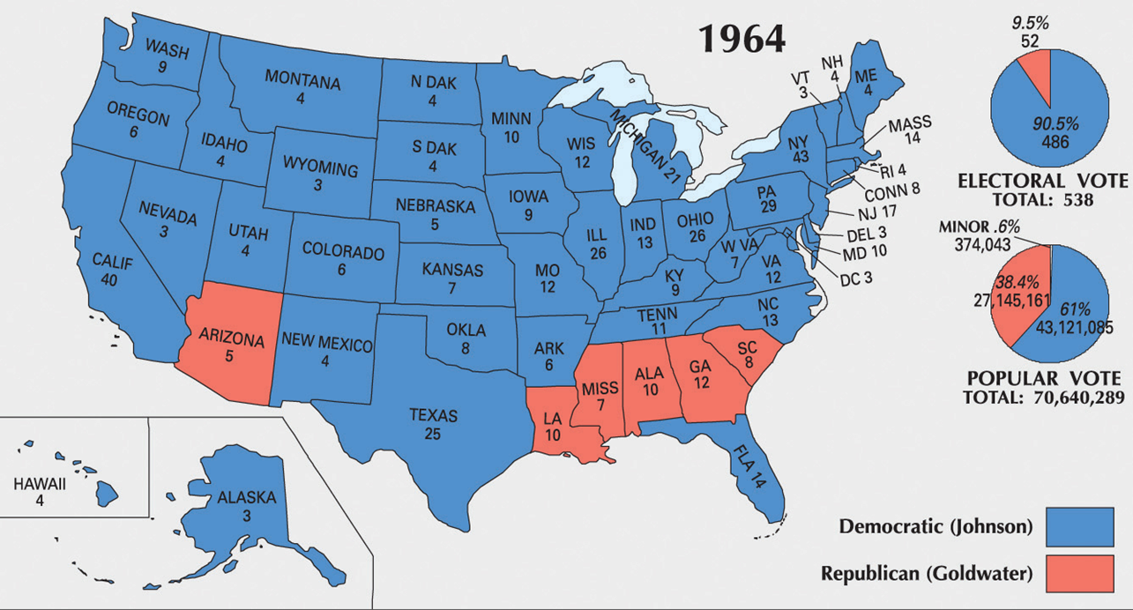
Election of 1964

Slide 12
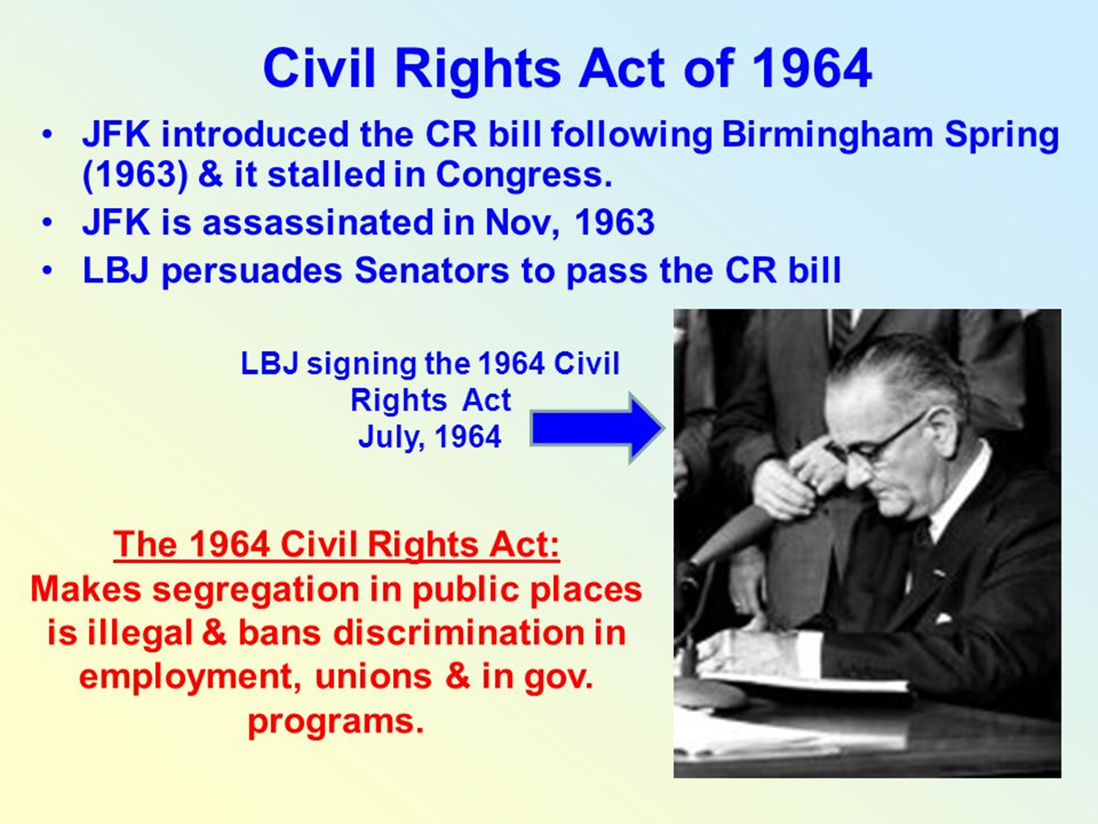

Slide 13
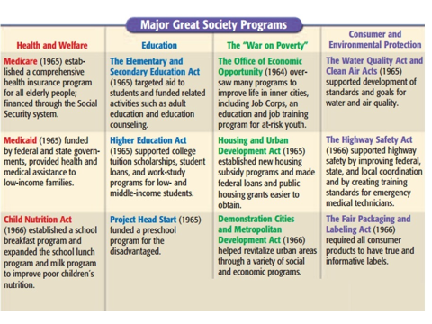

Slide 14
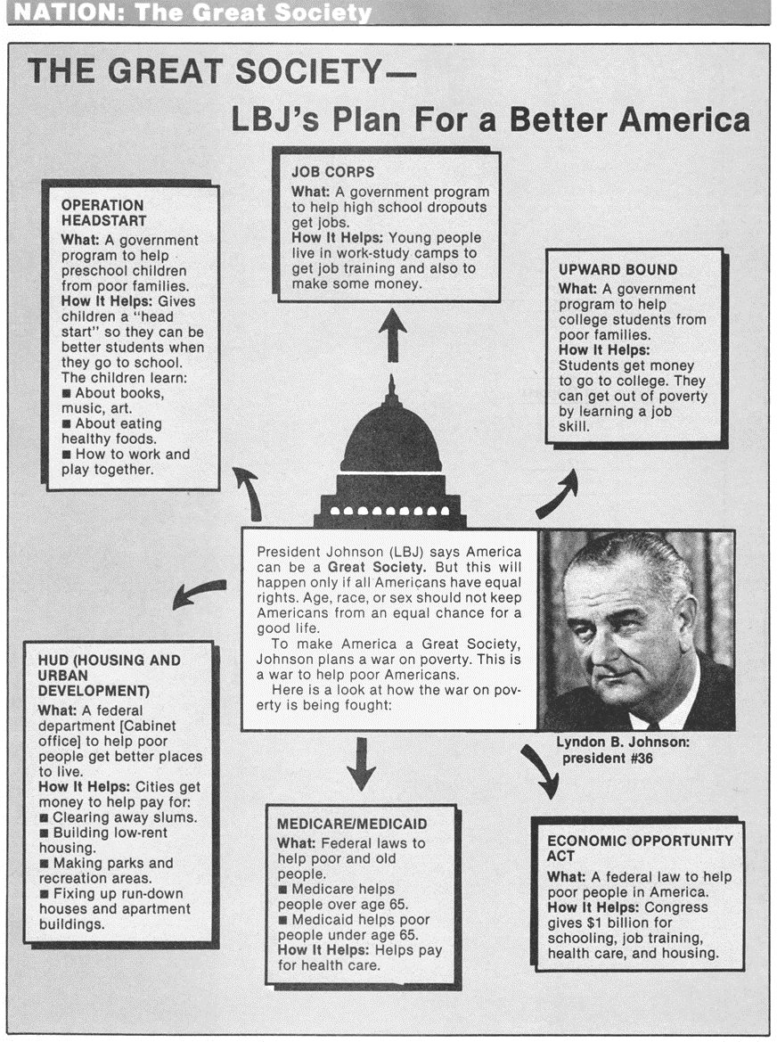

Slide 15
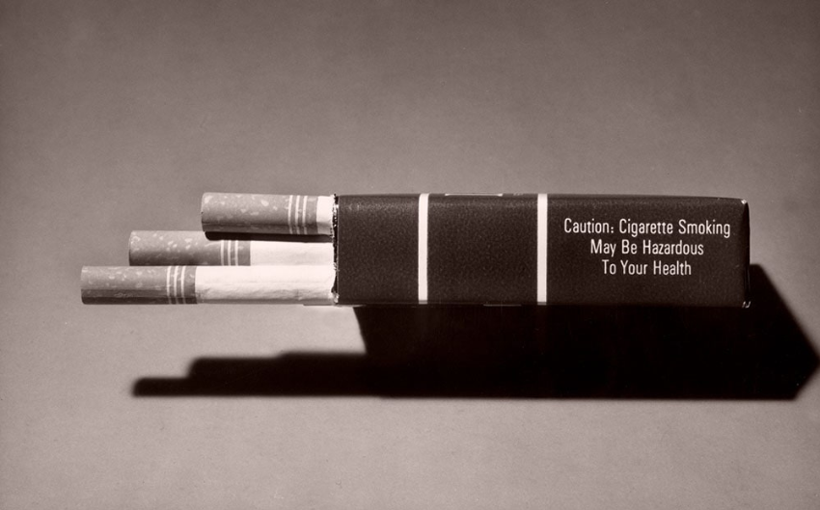

Slide 16
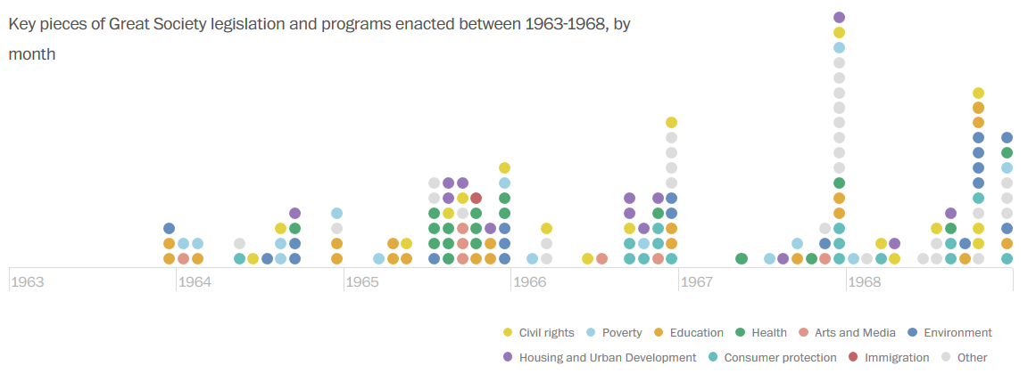

Slide 17
The VISTA Program (Volunteers in Service to America)
Meant as a domestic peace corps, aiding poor citizens in rural and impoverished areas.
Volunteers served in communities throughout the U.S., focusing on educational programs and vocational training for the nation's underprivileged classes.
✓ VISTA put young people with skills and community-minded ideals to work in poor neighborhoods and rural areas to help people overcome poverty.

Slide 18
Office of Economic Opportunity
Set up in 1964, this was the directing agency in President Johnson’s “War on Poverty”.
Branches included:
Project Head Start to provide education for pre-schoolers from low-income families
Project Upward Bound to assist high school students from low-income families to attend college
Job Corps to provide vocational training for high school dropouts.

Slide 19
Elementary & Secondary Education Act
✓ This 1965 measure provided more than $1 billion in federal aid to education, with the greatest share going to school districts with large numbers of students from low-income families. ✓ Sections of the bill required that schools accepting the money be integrated

Slide 20
Medicare and Medicaid
Amendments to the Social Security Act provided health insurance and some types of health care to those over age 65.
A Medicaid program provided states with funds to help the needy. It was set up to finance health care for welfare recipients, those who were living below the poverty line.
Both created “entitlements”, that is, they entitled certain Americans to benefits. Today, most of these programs are part of the U.S. budget.

Slide 21
Department of Housing & Urban Development
This cabinet post was meant to oversee federal efforts to improve housing and aid economic development of cities. Its first head, Robert C. Weaver, was the first African American to hold a cabinet post.
A program called “Model Cities” authorized federal subsidies (money) to many poor cities. This department was also meant to oversee federal efforts to improve housing and aid economic development of cities.

Slide 22
Civil Rights Act of 1964
protection of voting rights for all Americans
opening of public facilities (restaurants, hotels, stores, restrooms) to people of all races
a commission to protect equal job opportunities for all Americans
✓ outlawed race discrimination in public accommodations, including motels that refused rooms to African Americans.

Slide 23
Voting Rights Act 1965
Put an end to literacy tests – test of a person’s ability to read and write that had often been misused to bar African American voters.
Authorized federal examiners to register voters in areas suspected of denying African Americans the right to vote.
✓ Directed the attorney general to take legal action against states that continued to use poll taxes in state elections.

Slide 24
Impacts

Slide 25
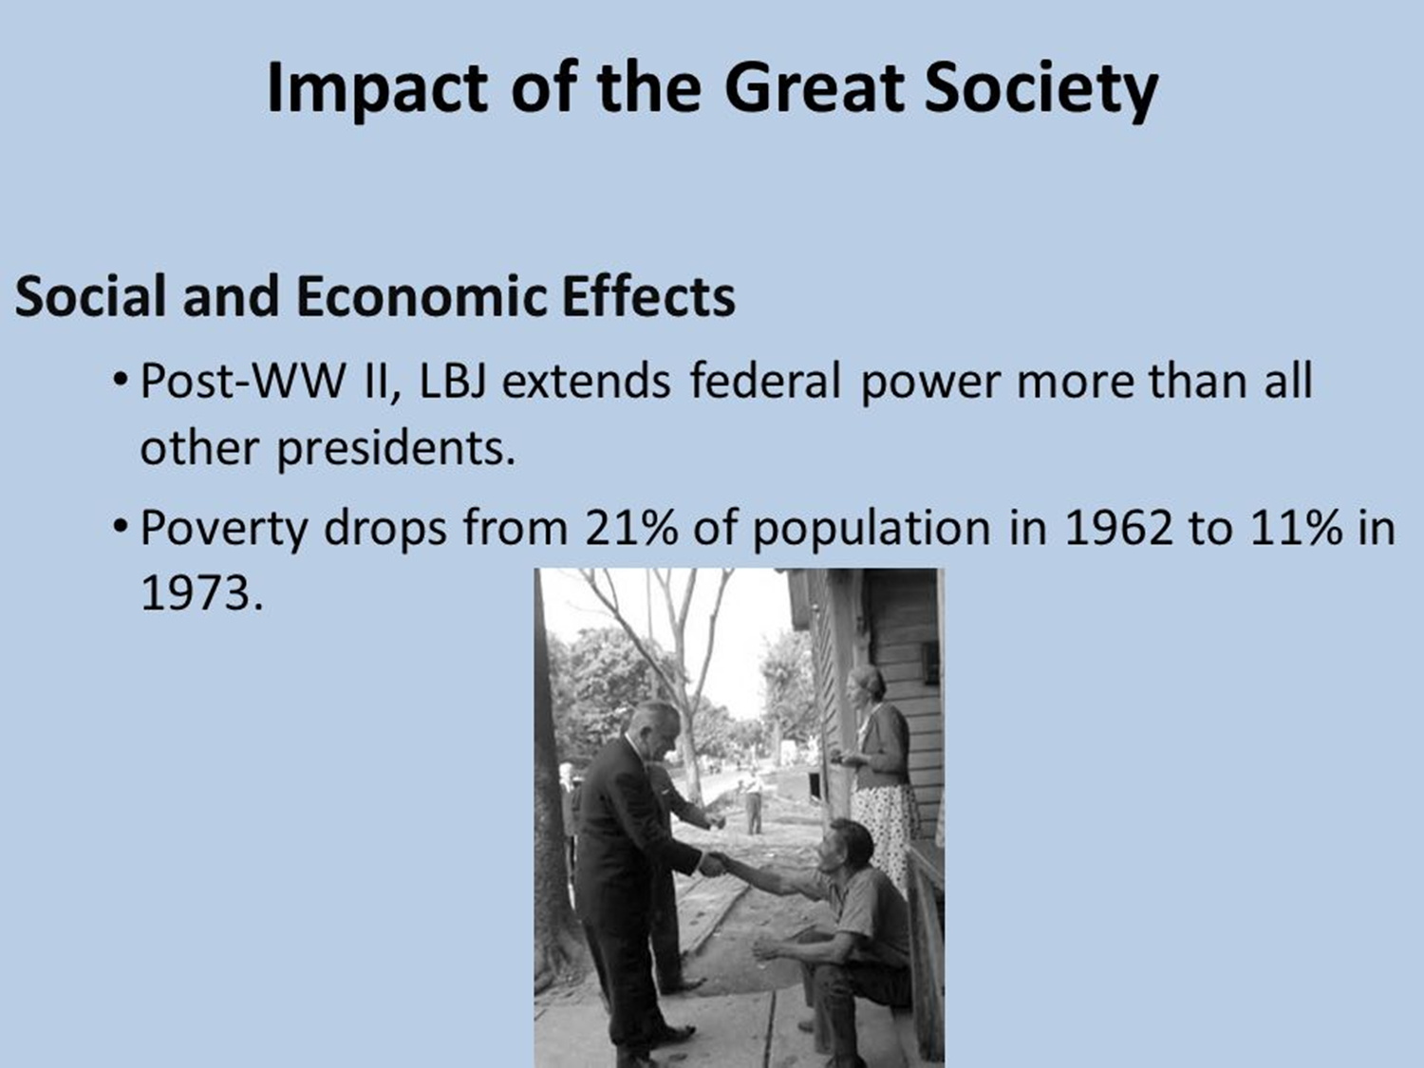

Slide 26
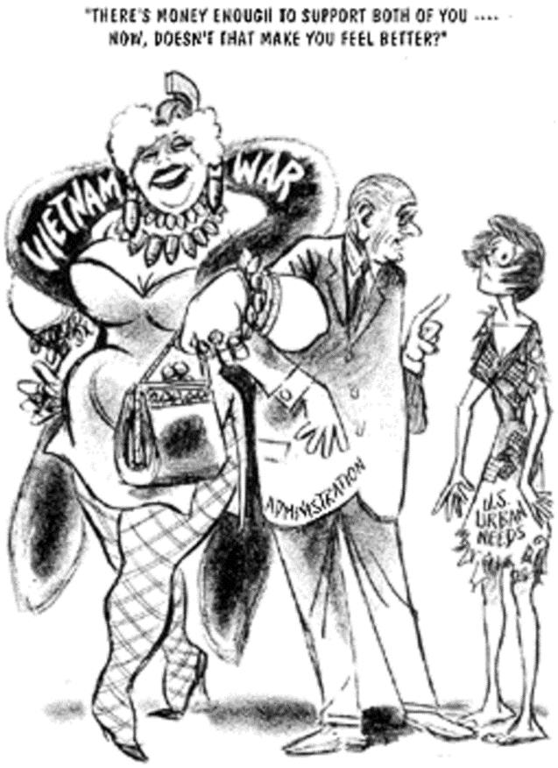

Slide 27
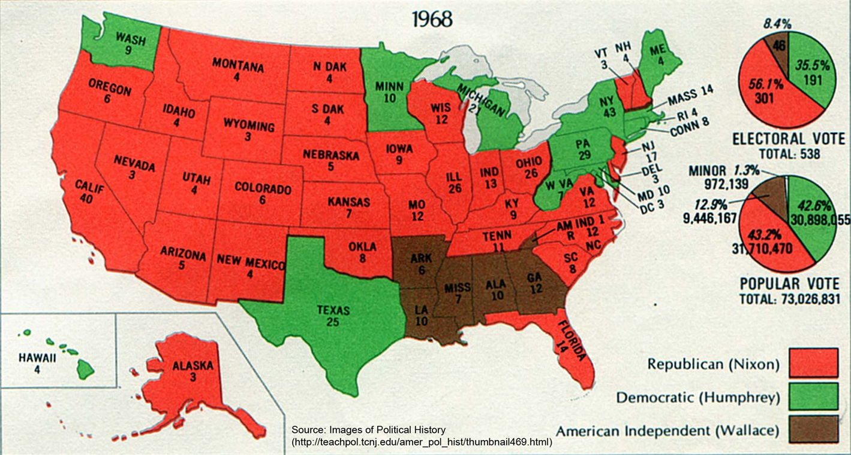
Election of 1968

Slide 28
Activity #1
Compare/Contrast original vs. actual speech
Original: http://apps.washingtonpost.com/g/page/politics/lbj-speechwriter-richard-goodwins-first-draft-of-the-great-society-speech/1035/
Presented: https://teachingamericanhistory.org/library/document/great-society-speech/
What are the changes? Why do you think he made these changes? Do you agree/disagree with these edits?

Slide 29
Activity #2: Great Society Handout
Great Society Handout

Slide 30
Activity #3
Compare/Contrast the perspectives of the Great Society Program
To what extent has the Great Society been more of a positive or negative influence on American Society?

Slide 31
Positive Highlights
“The anti-discrimination laws that were passed in the 1960s have probably done more to reduce economic inequality than have government programs,” -- Diana Furchtgott-Roth, the Labor Department’s chief economist for President George W. Bush
“. . . What I think has not worked is thinking that that was enough, that just that input would do the job. That’s why things like accountability and No Child Left Behind — fast-forward 40 years — were important, to deliver on the promise.” – Margaret Spelling, Education Secretary President George W. Bush Admin.

Slide 32
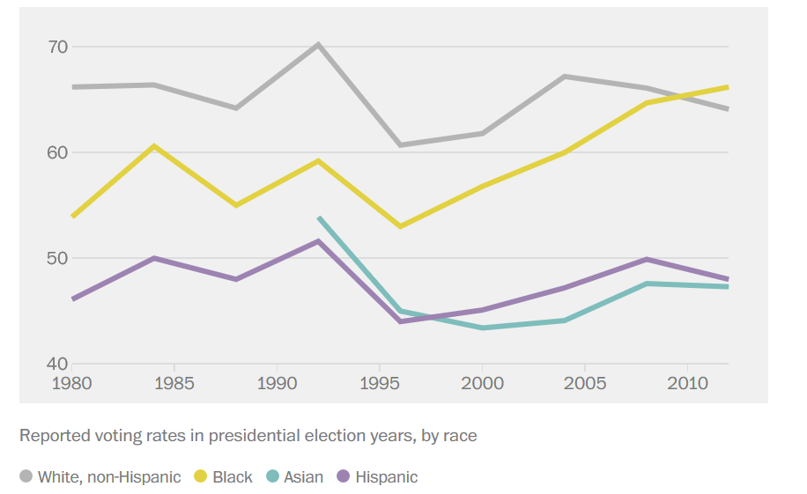
Positive Highlights

Slide 33
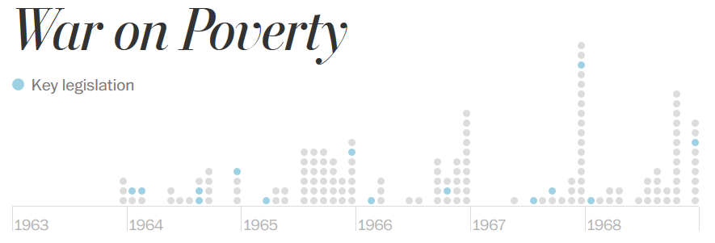

Slide 34
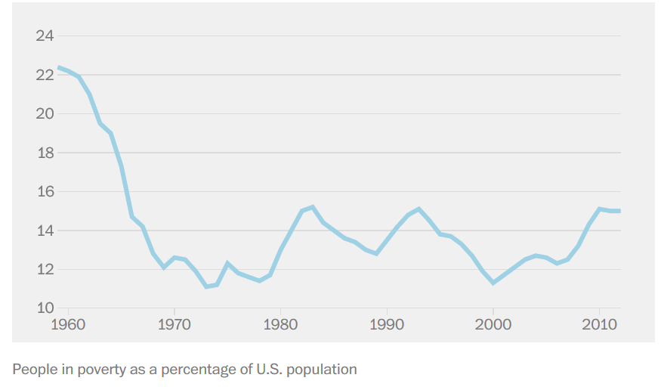

Slide 35
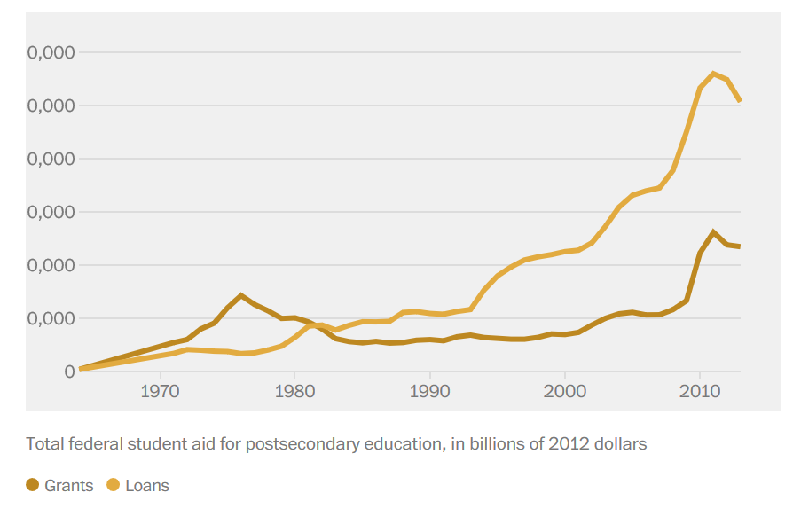

Slide 36
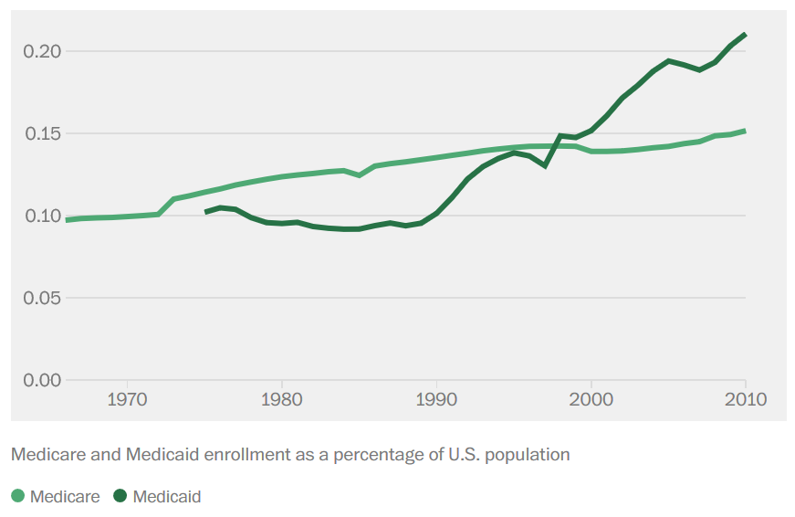

Slide 37
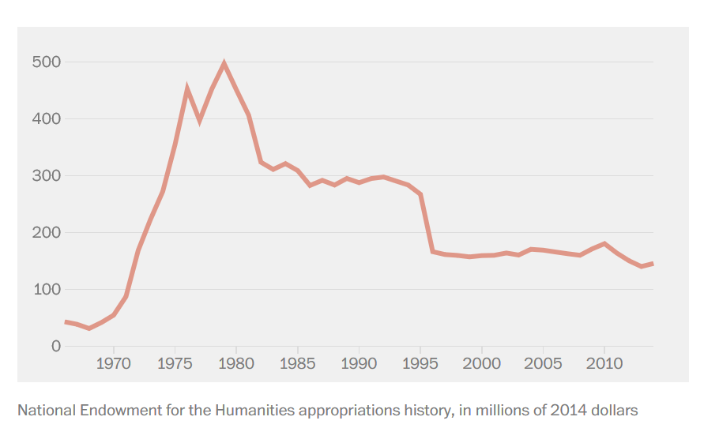

Slide 38
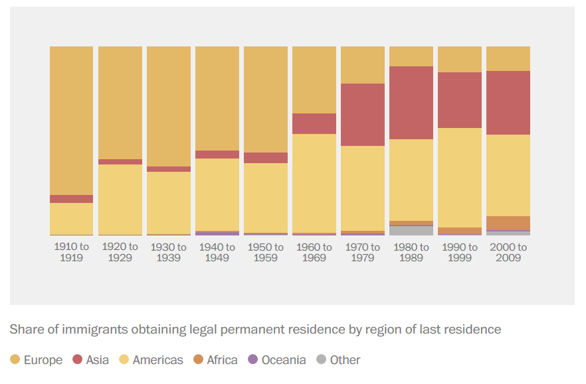

Slide 39
Negative Highlights
““central political error of our time…the flawed notion that government and bureaucracy..were the “primary vehicle for social change.” – President Ronald Reagan, 1983
“The welfare system is more like a ‘safety bog’ than a safety net.” – Robert Rector, Heritage Society
LBJ's increased government spending; added $42 billion, or 13%, to the national debt (double added by JFK). It was almost double the amount added by JFK. Since Johnson, every President has increased the national debt by at least 30%.
Federal and state spending on social welfare is approaching $1 trillion a year, $17 trillion since the Great Society was launched, not to mention private charity.

Slide 40
Negative Highlights
“the results of our experimentations in expanding government were not generous…[There were] profound sources of the unexpected tragedies of the Great Society endeavor which had looked upon the private sector as little more than a ’milk cow.’ Worse yet, she argues, the 1960s experiment and its 1970s aftermath suggest that the social democratic compromise of the Great Society came close enough to socialism to cause economic tragedy.” – Amity Shales, The Great Society: A New History

Slide 41
Negatives Continued
67.3 million Americans — from college students to retirees to welfare beneficiaries — depend on the federal government for housing, food, income, student aid or other assistance.
The United States reached another milestone in 2010. For the first time in history, half the population pays no federal income taxes.
It did not effect wide-scale cash transfers or establish a minimum family income. It did not extend quality medical care and educational opportunity to all Americans. It did not save urban America from blight or depressed rural areas from further decline.

Slide 42
Gov’t simply cannot replace private sector
But one of the reasons that the Great Society came up short of its sweeping goals is that the guiding philosophy behind its original formation made assumptions about the American economy that would prove unsustainable in future years.
LBJ’s domestic programs were based on neo-Keynesian ideas in the early postwar period that experts could grow the economy in perpetuity while sustaining low unemployment and inflation.
By that assumption, if government equipped people with the tools to help themselves and provided an even playing field, opportunity would be widely shared
A series of supply shocks in the food and energy sectors, Americans faced more than a decade of runaway inflation. Inflation was accompanied, in turn, by rising unemployment, particularly in the manufacturing sector, which for many years had formed the backbone of America’s prosperous, postwar middle class. Stagflation—the combination of high unemployment and inflation began to set in.

Slide 43
Gov’t Spending and Economic Shocks
“In effect, it disappointed liberal aspirations and only confirmed the worst of conservative fears that government programs could not solve broader social and economic problems.”
Stagnant wages since the early 1970s, a sharp rise in single-parent households, and receding benefits like employer-based health care and pensions
Experts lost control of the economic levers, and increasingly it has become clear that all the education and training in the world will not help poor people in urban ghettos, declining coal towns in Appalachia or midsized cities in the Midwest. Poor people need jobs and income, not qualitative assistance to help them capture prosperity that no longer exists.

Slide 44
Resources
https://www.thebalance.com/president-lyndon-johnson-s-economic-policies-3305561
https://www.politico.com/magazine/story/2018/01/28/lbj-great-society-josh-zeitz-book-216538
https://www.nationalreview.com/magazine/2020/01/27/the-forgotten-failures-of-the-great-society/
https://www.washingtonpost.com/wp-srv/special/national/great-society-at-50/
https://www.washingtonpost.com/wp-srv/special/national/great-society-at-50/

