Slide 1
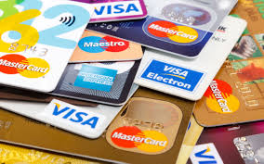
Personal Finance 102: Plastic Money, Credit Reports and Scores
Doug Young
CEO – Head Coach
THE WISER CHOICE
Economic and Financial Coaching
doug.n.young@gmail.com
Notes:
Both

Slide 2
EconedLink Membership
You can now access CEE’s professional development webinars directly on EconEdLink.org! To receive these new professional development benefits, become an EconEdLink member. As a member, you will now be able to:
Automatically receive a professional development certificate via e-mail within 24 hours after viewing any webinar for a minimum of 45 minutes
Register for upcoming webinars with a simple one-click process
Easily download presentations, lesson plan materials, and activities for each webinar
Search and view all webinars at your convenience
Save webinars to your EconEdLink dashboard for easy access to the event
You may access our new Professional Development page here

Slide 3
Professional Development Certificate
To earn your professional development certificate for this webinar, you must:
  Watch a minimum of 45-minutes and you will automatically receive a professional development certificate via e-mail within 24 hours.
Accessing resources:
  You can now easily download presentations, lesson plan materials, and activities for each webinar from EconEdLink.org/professional-development.

Slide 4
Agenda
Facts and Figures on Credit Cards
The Five Plastic Money Cards –
  Cost/Benefit analysis of each
  Which impact your credit?
What is a Credit Report?
What is a Credit Score?
How can I improve my score?
Who are credit reports and scores used?

Slide 5
Objectives
The plus and minuses of using plastic money cards.
The ways to access and obtain credit.
Identify advantages and disadvantages of using credit.
Make decisions about the wise use of credit.
What is a credit history, and how is it used?
How a person’s credit history affect their future decisions?
What steps can a person take to protect their credit history?
How to build and improve a credit score.
How credit scores are used to determine interest rates on loans.

Slide 6
National Standards – Using Credit
Standard Four
FM.3 CREDIT AND LOANS
Unit Description This unit explores issues related to establishing credit, obtaining loans, and taking steps to prevent identity theft. Students will be aware of the positive and negative implications of borrowing money and will develop the knowledge necessary to protect their financial identity.
Essential Question How can students establish a credit history and protect themselves from identity theft? Unit Content 1.
  Sources of Credit:
  3. Getting Credit
  Risks Associated with Credit
  Understanding Credit Cards
  Credit Card Options and Protections

Slide 7
N.Y.S. Financial Management: Module 2
#5. Understanding Credit Cards Students will:
  Describe the difference between a debit card and credit card
  Explain the advantages vs. disadvantages of using a credit card
  Explain how balance transfers affect credit
  Discuss the true cost of purchases when making only the minimum payment on a credit card statement.
#6. Credit Card Options and Protections Students will:
  Identify various options associated with credit cards
  Define terms associated with credit cards (advances, limits, minimums due, et al.
  Identify components associated with cash advances
  Develop the ability to read, understand, and interpret credit card bills/statements
  Recognize consumer protections provided by federal legislation

Slide 8
Test Yourself
The moment you take out a loan, you’re starting to a build credit history.
A car loan doesn’t count on your credit report.
Your credit score is directly related to your credit history.
Your credit score rarely changes.
Credit reporting agencies can have inaccuracies in their reports.
A credit card is a type of loan.
A debit card is backed by a bank loan.
Write your PIN on your card so you don’t lose or forget it.
Impulse buying is one of the hazards of carrying a credit card.
All credit cards usually have the same annual percentage rate (APR) for purchases, cash advances and balance transfers.

Slide 9
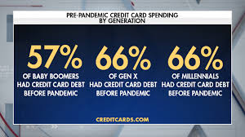
The Trillion Dollar US Credit Card Bubble Nobody’s Talking About

Slide 10

A New Class: The Asset Poor
An asset-poor household is one in which a sudden halt in income would have serious consequences immediately. Asset poverty is a measure of whether a household can support itself using savings or other available assets for 12 weeks at a poverty-level income.
Asset Poverty Rates by Race in the United States
African American | Hispanic | Native American | Asian | White
43.2% | 39.0% | 34.5% | 23.1% | 16.6%

Slide 11
Quick Facts
American credit card debt hit $1 trillion this year, surpassing 2008 crisis highs.
Delinquencies are at four-year highs, while delinquencies at small banks hit record rates.
Credit card interest rates are at all-time highs, making it harder than ever to pay back.

Slide 12
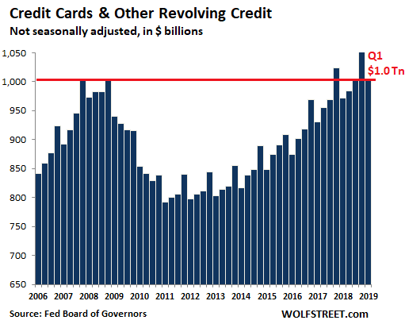

Slide 13
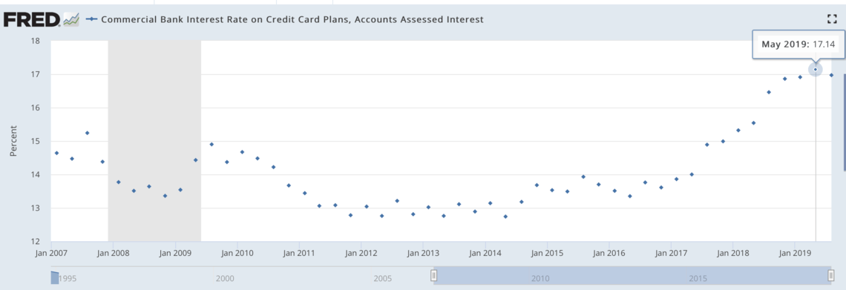
Credit card interest rates hit record highs in 2019.
Source: Federal Reserve Bank of St. Louis

Slide 14
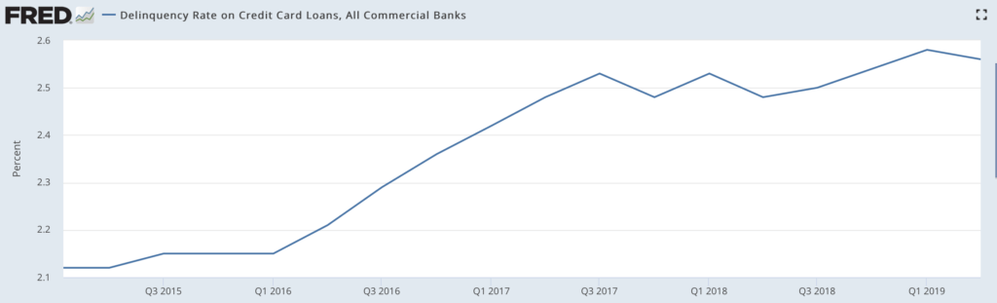
Delinquencies hit four-year high. Source: Federal Reserve Bank of St. Louis

Slide 15
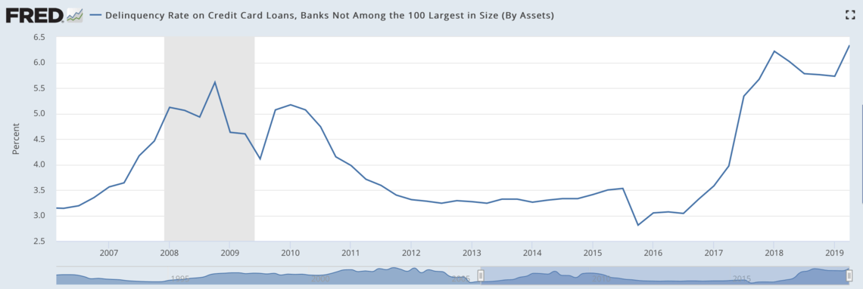
Credit card delinquencies at small banks hit all-time highs.
Source: Federal Reserve Bank of St. Louis

Slide 16
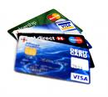

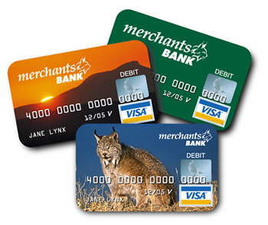
The Five Plastic Money Cards:
The Good, Bad and Ugly
All Cards
Are Not
The Same!
Notes:
Brian

Slide 17

Gift Card
Notes:
Brian
What every store loves to see people buy.
It’s a win-win for the company and store selling them.
What is the negative to the consumer? Sounds like a win to me, free money!

Slide 18
Gift Cards
Benefits:
  Like free money as they make great gifts.
  Not replaceable but can be hard to lose.
  Some need to be activated to be used but if lost, you lost the gift.
  Useful for controlling and monitoring the spending of younger shoppers by limiting amounts and restricting the locations where the card may be used.
Costs:
  If you lose the card, its lost money.
  After purchases are made there may be small balances left
  Some gift cards have time limits.
  Some allow consumers to reload, which means this "wasted-small balance" aspect of gift cards is not present.
  Sometimes fees associated with transactions like this.
  Reloadable cards may carry monthly charges as well.

Slide 19
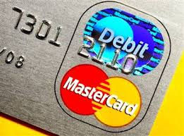
Debit Cards: The Pay Now Card
Notes:
Brian
Costs
Mistaken for credit cards (authorization issues).
Some have monthly or pre-transaction fees.
Many now have zero-liability for unauthorized purchases.
Dispute concerning purchases usually handled by consumer.
Can drain your account if PIN and account number stolen.
Benefits
Widely accepted.
Good as a check
Fast, easy payment process.
Easier qualification.
No bulky checkbook or large sums of cash.

Slide 20
Debit Cards
Benefits
  It’s tied directly to a checking account, so money is withdrawn from your account.
  Consumers concerned with debt load can limit their spending.
  Can manage purchases, checks and bill paying from your smartphone.
  You won't need to think about interest rates.
  Be aware of fees and other charges when you monitor your account.
  Zero liability for unauthorized purchases on your debit card as long as you notify your financial institution immediately.
  Federal law mandates that financial institutions replace funds for losses resulting from fraudulent use within 10 business days of notification.
  Possible dispute resolution options should an issue arise with a debt purchase.
Costs
  Does not impact your credit report or score.
  Deduction on cards at hotels, car rentals, etc. depleting fund balance.
  Some financial institutions offer overdraft protection, and they’ll cover your check or debit transaction so it doesn’t bounce.
  May be charged fees for overdrawing your account.
  Need to balance your account regularly to avoid added fees.
  Usually, no interest on balance
  If someone gets your PIN, you could have yore account depleted.
https://www.practicalmoneyskills.com/assets/downloads/pdfs/PracticalMoneyGuides-DebitCardBasics.pdf

Slide 21
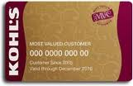
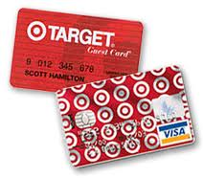

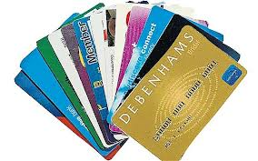
Store Cards
Notes:
BRIAN
Sales, Sales, Sales: 20 -30% Discounts
A.P.R.’s Start at @19.8%
All charge cards will show up on your credit report.
Too many have an adverse effect on your credit score.

Slide 22
Store Cards
Benefits
  Discounts and special offers (10-20%).
  Easier access to credit.
  They can help build credit.
  Great way to start a credit history for a person.
Costs:
  Higher interest rates (Average @18.9%).
  Less versatility.
  Limited rewards.
  Lower credit limits.
  Lack flexibility of general use Visa or MasterCard.
https://www.creditkarma.com/credit-cards/i/when-to-open-store-credit-card/

Slide 23

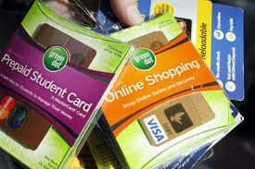
Pre-Paid Money Cards
https://www.practicalmoneyskills.com/assets/downloads/pdfs/PracticalMoneyGuides-DebitCardBasics.pdf
Costs: Benefits:
https://www.practicalmoneyskills.com/assets/downloads/pdfs/PracticalMoneyGuides-PrePaidCardBasics.pdf
Notes:
Doug
Costs:
Mistaken for credit cards and used in place sometimes.
Do not pay interest on fund balance.
Many now have zero-liability for unauthorized purchases.
Dispute concerning purchases usually handled by consumer.
Using an ATM, may cost you two fees (ATM & bank).
Credit score will not be improved by using them.
Fee structures vary and some fees are excessive.
Shop around and compare for hidden fees.
Benefits:
Can pay household bills with the card.
Safer than cash and most deposits are FDIC insured.
If networked branded (VISA, Plus, NYCE logo), accepted wherever these accounts are accepted.
No credit check or ChexSystems verification to open.
Most allow for direct deposit and transferring of funds
Can use ATM’s for withdrawals.
Cash back with purchases.
Can be less expensive than check cashing, money orders, or checking account fees.
Most cannot be overdrawn, and fees are easier to figure out.
Account updates are accessible online, by phone, or texting.
Funds loaded are immediately available.

Slide 24
Pre-Paid Cards
Benefits
  Many different type of pre-paid cards. Beware!
  It’s your money for purchases or pay bills online or by phone (Fees).
  Looks and acts like a debit card with restrictions (know them).
  Reloadable (not all).
  Zero liability protection (not all).
  Withdraw cash from an ATM or bank (Fees)?
  Can receive wages or funds by direct deposit to the card (not all).
Costs
  No Credit Involved.
  Fees (Check closely)
  Adding Funds (sometimes costly)
  No interest on balance.
  Using to pre-pay instantly goes against you account.

Slide 25

Credit Cards The Cornerstone of the U.S. Economy
https://www.practicalmoneyskills.com/assets/downloads/pdfs/PracticalMoneyGuides-DebitCardBasics.pdf
Beware of “MAXING OUT”
Let’s hear from some credit card victims.
Notes:
DOUG

Slide 26
Credit Cards
Benefits
  Able to buy needed items immediately.
  Earn rewards for purchases.
  Offer more security than other options (fraud and lost of cash).
  Return policy of goods (Key point).
  Credit building
  Convenience (also a liability)
  Travel benefits and currency conversions
Costs
  Know the terms (rates) and conditions (Gottcha’s).
  Fixed or variable rates?
  Fees, limits and other charges (10 plus?).
  Easy to overspend leading to increased debt.
  Multiple ways to hurt your credit.
  Can impact ability to get jobs, loans and other

Slide 27
Types of Expenses Contributing to Credit Card Debt
Notes:
DOUG

Slide 28
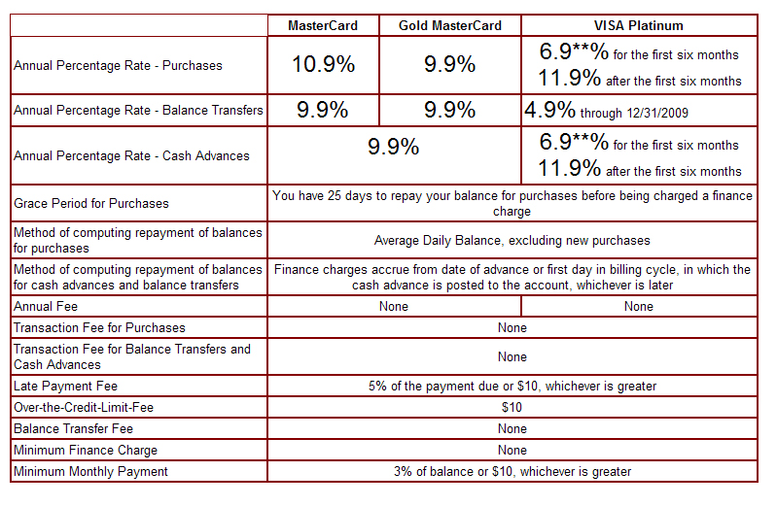
The New and Improved Schumer Box
How Credit Card Companies Make Their Money: “Let Me Count the Ways!”
Notes:
DOUG
1. Application Fee Zero - $50.00
Annual Fee Zero - $50.00
A.P.R. Zero – 34%
Cash advance for APR (checks) @ 19.95% minimum
Balance transfer APR @ 19.95%
Processing Fee Zero –4%
Late Fees $37.00
Over the Limit Fee @$37.00 (Business charge cards only)
Foreign Currency transaction Zero - @3%
Cash Advances (NYCE, Plus) Greater of $3 or 3% of advanced cash
Minimum Finance Change @$0.50
Institution Charge 1.5% - 3% of bill and $.50 processing fee

Slide 29
Fees to Look for When Shopping for a Plastic Money Card
 | Credit Card | Debit Card | Pre- Paid Money | Store Card | Gift Card
Opening Fee
Annual Fee
Activation Fee
A.P.R.
Monthly Fee
Point of Sale Fee
ATM Withdrawal Fee
Transfer Fee
Transaction Fee
Late Fee
Re-Loading Fee
Deposit Fee
Monthly Statement Fee (Pap)
Credit Reportable Fee
Grace Period
Finance Charges
Balance Inquiry Fee
Balance Transfer Fee
Cash Advance Fee
Card Re-load Fee
Second Card Fee
Late Payments Fee
Over the Limit Fee
Cancellation Fee
For. Currency Fee
Check Cashing Fee
Pay Bills Fee
Credit Check Fee
Over Draft Protection

Slide 30

What’s a Credit Report?
  From age 18 on, agencies collect data about your spending habits.
  Monitor your ability to handle risks (i.e. installment loans and revolving charge accounts)
  Impacts: amount you can borrow and the interest rates on that loan.
  Who Can Access Your Report?
    Creditors
    Collection agencies
    Insurance companies
    Employers
    Landlords
    www.howmanyofme.com
Notes:
BRIAN

Slide 31
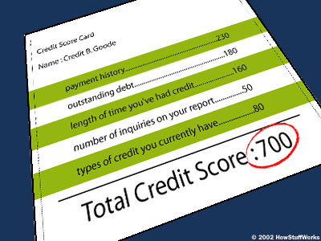
What is in a Credit Report?
Personal Data
Public Records (liens, judgments, secured loans, foreclosures, bankruptcies, etc.)
Collection Accounts (defaults and lateness)
Credit Information (open accounts, date account was opened, payment status)
Inquiries (approved requests and others seeking credit information)
Notes:
DOUG

Slide 32
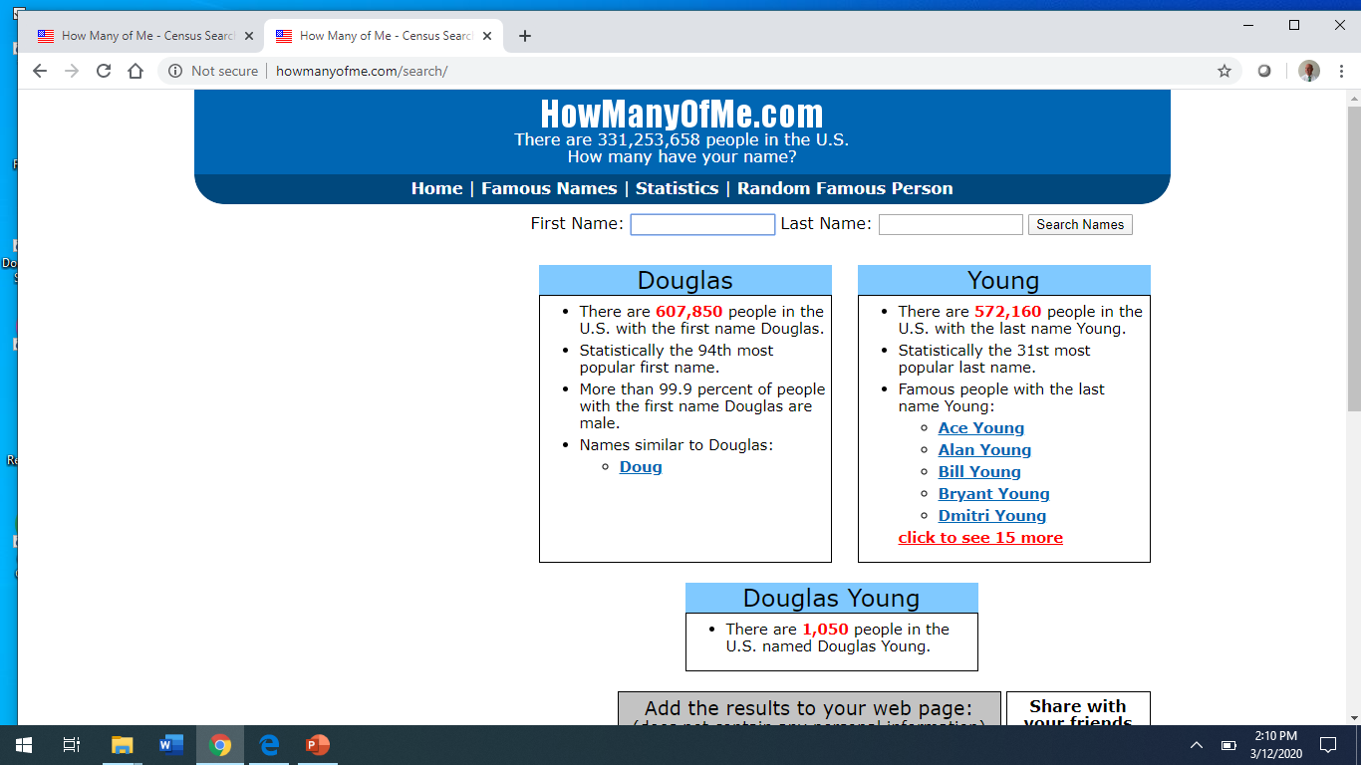

Slide 33
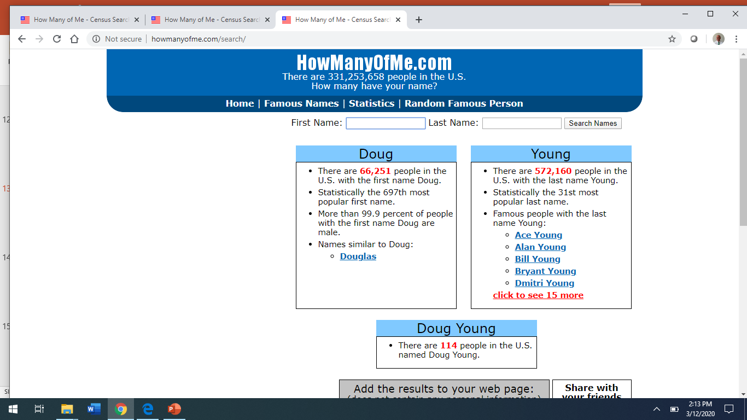

Slide 34
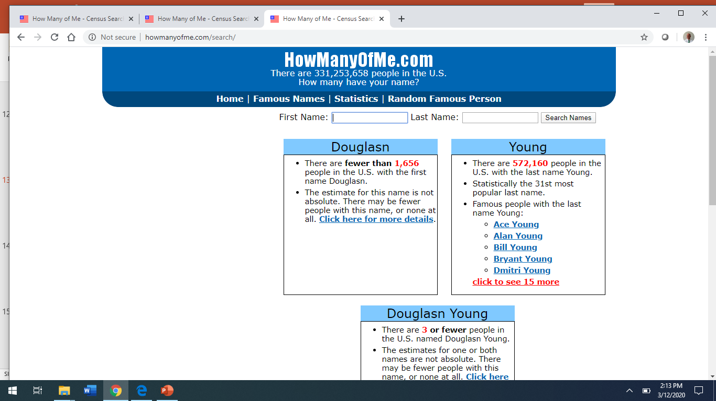

Slide 35
How Long Does the Information Remain On A Credit Report?
TYPE LIMITATION
Suits & Judgments 7 years
Tax Liens – Paid 7 years from payment
Tax Liens – Unpaid No limitation
Charged to Profit & Loss 7 years
Criminal Record Limitations No limitations
Other adverse information 7 Years
Late Payments 7 Years
Debt Collections 7 Years
Bankruptcy 10 Years
Notes:
DOUG

Slide 36
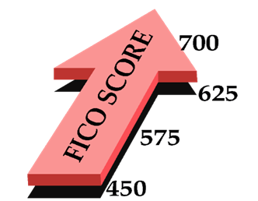
Improving Your FICO Credit Score
http://www.whatsmyscore.org/estimator/
Notes:
BRIAN
Ever wonder why you can go online and be approved for credit with in 60 seconds? Or get pre-qualified for a car without anyone even asking you how much money you make? Or why you get one interest rate on loans, while your neighbor gets another? The answer is credit scoring.

Slide 37
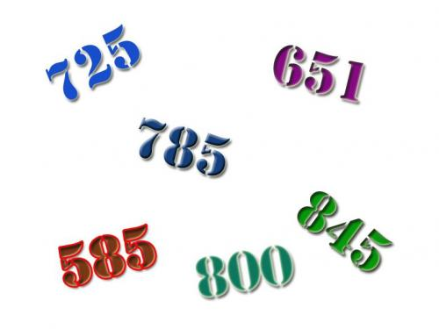
What is a Credit Score?
A tool created from your credit report which can assess your
  financial status, history, and debt repayment record.
Credit rating is determined by three bureaus that all banks, employers,
companies you deal with check to see if you are a good risk.
Two most commonly used credit scores are the:
  FICO 8.0 (Fair Isaac Corp.), which ranges from 300 – 850.
  Vantage 3. 0 (Experian), scores go from 501 - 990.
Notes:
37
BRIAN

Slide 38

What doesn’t Count in a Score.
The scoring model doesn't look at:
race
sex
income
education
marital status
job or length of employment at your job
whether you've been turned down for credit
length of time at your current address
whether you own a home or rent
information not contained in your credit report
age
Notes:
BRIAN
A lender may consider all those factors when deciding whether to approve a loan application, but they aren't part of how a FICO score is calculated.

Slide 39
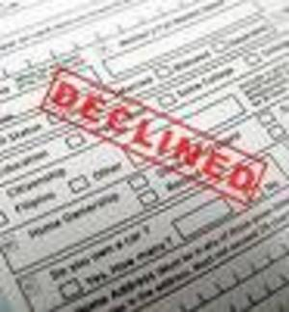
Why is a Credit Score
Important?
  There are many different credit scores:
    Used by mortgage lenders; auto dealerships; and insurance companies for homeowners, life and health policies.
  A poor credit score can affect a person’s ability to:
    obtain or qualify for edit cards, car loans and mortgages.
    utility and cell phone services (no down payment or deposit).
    rent or lease a house or apartment.
    obtain government-sponsored student loans.
    obtain private student loans with low rates.
Notes:
BRIAN

Slide 40
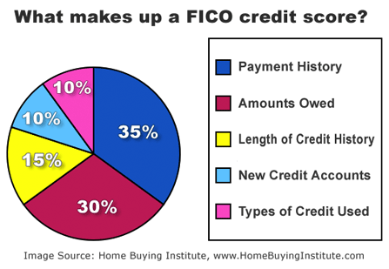
Notes:
DOUG
Key factors of your score
Just what goes into the score? Everything in your credit report, with different kinds of information carrying differing weights, says Fair Isaac Corp. Public Affairs Manager Craig Watts. The FICO-scoring model looks at more than 20 factors in five categories. (The VantageScore relies on slightly different factors. The Bankrate feature "New Vantage credit score now online" compares the FICO score with VantageScore. )
1. How you pay your bills (35 percent of the score)
The most important factor is how you've paid your bills in the past, placing the most emphasis on recent activity. Paying all your bills on time is good. Paying them late on a consistent basis is bad. Having accounts that were sent to collections is worse. Declaring bankruptcy is worst.
2. Amount of money you owe and the amount of available credit (30 percent)
The second most important area is your outstanding debt -- how much money you owe on credit cards, car loans, mortgages, home equity lines, etc. Also considered is the total amount of credit you have available. If you have 10 credit cards that each have $10,000 credit limits, that's $100,000 of available credit. Statistically, people who have a lot of credit available tend to use it, which makes them a less attractive credit risk.
"Carrying a lot of debt doesn't necessarily mean you'll have a lower score," Watts says. "It doesn't hurt as much as carrying close to the maximum. People who consistently max out their balances are perceived as riskier. People who never use their credit don't have a track history. People with the highest scores use credit sparingly and keep their balances low."
3. Length of credit history (15 percent)
The third factor is the length of your credit history. The longer you've had credit -- particularly if it's with the same credit issuers -- the more points you get.
4. Mix of credit (10 percent)
The best scores will have a mix of both revolving credit, such as credit cards, and installment credit, such as mortgages and car loans. "Statistically, consumers with a richer variety of experiences are better credit risks," Watts says. "They know how to handle money."
5. New credit applications (10 percent)
The final category is your interest in new credit -- how many credit applications you're filling out. The model compensates for people who are rate shopping for the best mortgage or car loan rates. The only time shopping really hurts your score, Watts says, is when you have previous recent credit stumbles, such as late payments or bills sent to collections.
"Then, looking for new credit will be seen as an alarm because statistically, before people declare bankruptcy and default on everything, they look for a life preserver," Watts says. Also, if you have a very young credit file, an inquiry can count for more than if you've had credit for a long time.

Slide 41

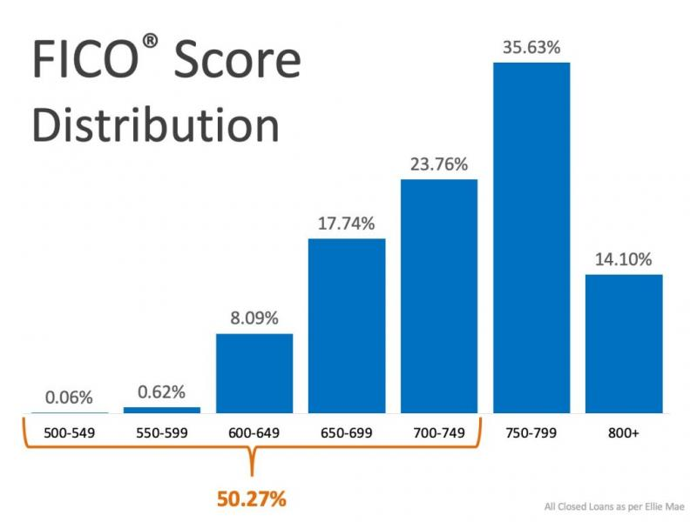
Distribution of FICO
Fair Isaac reports that the American public's credit scores break out along these lines:
CNBC shares that the average national FICO® score has reached an all-time high of 706

Slide 42
CREDIT BUREAU RISK SCORE REASON CODES | EQUIFAX | TRANS UNION | EXPERIAN
Amount owed on accounts is too high | 1 | 1 | 1
Level of delinquency on accounts | 2 | 2 | 2
Too few bank revolving accounts | 3 | 3 | 3
Too many bank or national revolving accounts | 4 | 4 | 4
Too many accounts with balances | 5 | 5 | 5
Too many consumer finance company accounts | 6 | 6 | 6
Account payment history is too new to rate | 7 | 7 | 7
Too many recent inquiries last 12 months | 8 | 8 | 8
Too many accounts recently opened | 9 | 9 | 9
Proportion of balances to credit limits is too high on bank revolving or other revolving accounts | 10 | 10 | 10
Amount owed on revolving accounts is too high | 11 | 11 | 11
Length of time revolving accounts have been established | 12 | 12 | 12
Time since delinquency is too recent or unknown | 13 | 13 | 13
Length of time accounts have been established | 14 | 14 | 14
Lack of recent bank revolving information | 15 | 15 | 15
Lack of recent revolving account information | 16 | 16 | 16
No recent non-mortgage balance information | 17 | 17 | 17
Number of accounts with delinquency | 18 | 18 | 18
Too few accounts currently paid as agreed | 19 | 19 | 19
Length of time since derogatory public record or collection is too short | 20 | 20 | 20

Slide 43
How Much Will My FICO Score Drop?
        Alex Blanca
Current FICO Score 680 780
Score after one of these is added to the credit report
One inquiry for a new credit card 675 (5) 775 (5)
A new charge card (additional hit) 665 (15) 760 (20)
Maxing out credit card 660 (20) 745 (35)
A 30-day delinquency 610 (70) 680 (100)
Settling a debt 625 (55) 665 (115)
Foreclosure 585 (95) 630 (150)
Bankruptcy 540 (140) 550 (230)
Notes:
DOUG

Slide 44
What Rate Will Your Score Get You?
FICO Score | 30-year fixed-rate mortgage | 36-month new auto loan | 15-year home equity loan | Credit Card APR
740 | 5.0% | 6.4% | 8.1% | 7.3%
720 | 5.2% | 6.4% | 8.4% | 10.0%
700 | 5.2% | 7.9% | 8.9% | 15.0%
680 | 5.4% | 9.9% | 9.7% | 15.0%
660 | 5.6% | 9.9% | 11.2% | 18.0%
What is APR? APR is the Annual Percentage Rate on a loan or a credit card.
It is interest rate that will determine how much you pay in interest each year.
Notes:
DOUG

Slide 45
How much will you pay?
A home theater system for $1,000, when purchased on credit card and each month you pay minimum payment will actually cost
FICO Score | Credit Card APR | You will pay off the balance in about | You will end up paying an interest of | You will end up paying an estimated total of
740 | 7.3% | 5 years
680 | 15.0% | 7 years
660 | 18.0% | 8 years
https://www.bankrate.com/calculators/credit-cards/credit-card-payoff-calculator.aspx
Notes:
DOUG
We made the following assumptions for our calculations:
You make no more charges.
Minimum payment: For this estimate, we assume that your minimum payment is 2 % of your current balance each month or $20, whichever is greater. Your credit card issuer may calculate your minimum payment differently. We do not know whether the minimum payment on your bill represents only a percentage of your total balance or includes amounts that vary from month to month (such as fees).
We also assume that you make only the minimum payment each month, that the payment is on time, and that it is credited on the last day of the month. We assume that the final payment pays the balance in full.
New activity: We assume that you do not use your credit card for any additional transactions and that you are not assessed any fees while you are paying the balance down.
APR: For this estimate, we assume that the highest APR on which you have a balance applies to your entire balance. Using the highest APR on which you have a balance means that the actual time it will take you to pay off your balance may be shorter than the calculated estimate but should not be longer. This assumption is necessary because we do not know how your payments will be applied when you have balances with different APRs. We also assume that the APR for your account will not change.
Account status: We assume that your account is not past due and that your balance does not exceed the credit limit for your account.
Interest calculation: We assume that your interest is calculated by applying a monthly rate to the average daily balance. The monthly rate is calculated by dividing the APR by twelve. We also assume that you are charged interest each day in the month.

Slide 46
How much will you pay?
A home theater system for $1,000, when purchased on a credit card. Each month you pay the minimum.
What will the actually total cost be?
FICO Score | Credit Card APR | You will pay off the balance in about | You will end up paying an interest of | You will end up paying an estimated total of
740 | 7.3% | 5 years | $196 | $1,196
680 | 15.0% | 7 years | $620 | $1,620
660 | 18.0% | 8 years | $893 | $1,893
Notes:
DOUG
We made the following assumptions for our calculations:
You make no more charges.
Minimum payment: For this estimate, we assume that your minimum payment is 2 % of your current balance each month or $20, whichever is greater. Your credit card issuer may calculate your minimum payment differently. We do not know whether the minimum payment on your bill represents only a percentage of your total balance or includes amounts that vary from month to month (such as fees).
We also assume that you make only the minimum payment each month, that the payment is on time, and that it is credited on the last day of the month. We assume that the final payment pays the balance in full.
New activity: We assume that you do not use your credit card for any additional transactions and that you are not assessed any fees while you are paying the balance down.
APR: For this estimate, we assume that the highest APR on which you have a balance applies to your entire balance. Using the highest APR on which you have a balance means that the actual time it will take you to pay off your balance may be shorter than the calculated estimate but should not be longer. This assumption is necessary because we do not know how your payments will be applied when you have balances with different APRs. We also assume that the APR for your account will not change.
Account status: We assume that your account is not past due and that your balance does not exceed the credit limit for your account.
Interest calculation: We assume that your interest is calculated by applying a monthly rate to the average daily balance. The monthly rate is calculated by dividing the APR by twelve. We also assume that you are charged interest each day in the month.

Slide 47
IT’S GONNA TAKE ME HOW LONG?
1. Debt - $10,000 Interest Rate – 8.9% Payment - $200/month
Cost - $2,541 Months - 63 Years – 5.25
2. Debt - $10,000 Interest Rate -12.9% Payment - $100/month Cost - $4,423 Months – 73 Years – 6+
3. Debt - $10,000 Interest Rate - 12.9% Payment - $100/month
  Months: Can’t cover the costs of the principal and Interest.
4. Debt - $10,000 Interest Rate – 12.9% Payment - $150/month
Cost - $7.691 Months – 118 Years – 9.8
Debt - $5,000 Interest rate - 14.9%. Payment - $100/month
Cost - $2,858 Months - 79 Years: 6.5
Debt - $10,000 Interest rate - 23.9%. Payment - $200/month
Cost - $45,582 Months - 278 Years: 23.2

Slide 48
What Affects a Credit Score
Scenario #1 - My credit score is between:
  (545 – 549)
Scenario #2 - My credit score is between:
(550 – 565)
Scenario #3 - My credit score is between:
(720 – 770)
What conclusions you can make from the above stats?
What advice would you give people who wanted to make sure their credit score was a good one?

Slide 49
Role Playing Scenario 1
Landlord:
You are the landlord of a very nice apartment. You had some trouble in the past with tenants who did not pay their rent on time and in one case you actually had to evict the person who was renting form you.
A renter is asking to rent your apartment. You want to make sure that he/she can afford the cost. Ask them some background questions about their job, present residence, why are they moving, etc. Remember they should only spend 30% of their income on rent. You are asking for $1,000 per month.
Renter:
You have just moved to this area and have found an apartment that you really like. You think you can afford it as you make $38,000 a year. You have never had an apartment and think you could afford to live on your own.
Landlord: Do you rent this apartment to this renter?
Before a final decision, you decide to check the renter’s credit history and find that they are behind on two of their credit cards and that they had a car repossessed by the auto dealer a year ago. What is your decision now?

Slide 50
Role Playing Scenario 2
Employer: You are interviewing two candidates for a job at your accounting firm. This person will receive payments from your customers at an off-site location with little supervision. In addition, payments are often made in cash rather than check, so having a person with the highest degree of honesty and integrity is essential.
The candidates have similar backgrounds and you are having a hard time deciding so you pull the credit reports on both candidates. Unfortunately, they BOTH have had some financial difficulty and their reports shows late payments and defaults. You speak to them individually abut their reports and see if you can get any information that will help you decide.
Candidate One: You are very excited and hopeful as this is your second call back for the job. You know the employer has pulled your credit report and it is not good. Two years ago you got injured on a job and were unable to work for several months and fell behind on your bills.
Since then you have gotten back on your feet and are working hard to make payments every month to reduce your debt, but you know you have not caught up.
Candidate Two: You are very excited and hopeful as this is your second call back for the job. You know the employer has pulled your credit report and it is not good. When you were younger you went on a spending spree using your credit cards like many young people and fell behind on your bills. You went to a money management class and were told that bad things only stay on your credit report for 7 years. You then decided to stop using your cards until these debts fade in into the past and drop off your report.
Employer: Which candidate do you hire for your company?

Slide 51
Pandemic Websites for Financial Help
9 things to know about the COVID-19 stimulus bills
https://www.fidelity.com/learning-center/personal-finance/coronavirus-stimulus-package
Coronavirus Credit Card Payment and Debt Relief Options
https://mail.google.com/mail/u/0/#inbox/FMfcgxwHMZQpqjtrZflLgdtTZFWbgBzg
Here’s How To Contact Your Student Loan Servicer During Coronavirus
https://www.forbes.com/sites/zackfriedman/2020/03/29/contact-student-loan-servicer-during-coronavirus/#1cd0c2c314ad
Housing And Public Utilities | Benefits.gov
https://mail.google.com/mail/u/0/#inbox/FMfcgxwHMZQpqjtjPRWPQLrRrxdQqLKk

Slide 52
Lessons from EconedLink
What is Credit? https://www.econedlink.org/resources/what-is-credit/
Making Credit Choices - https://www.econedlink.org/resources/making-credit-choices/
Shopping for a Credit Card - https://www.econedlink.org/resources/shopping-for-a-credit-card/
Credit Reports and Scores - https://www.econedlink.org/resources/credit-reports-and-credit-scores/
Credit Decisions Video and Quiz - https://www.econedlink.org/resources/credit-decisions-video-and-quiz/
Building Good Credit Scores - https://www.econedlink.org/resources/building-good-credit-scores/
Debit Cards versus Credit Cards - https://www.econedlink.org/resources/debit-cards-vs-credit-cards/
Establishing Credit - https://www.econedlink.org/resources/establishing-credit/

Slide 53
Assessment Strategies
Have students DEBATE whether gift cards are a good gift knowing people lose, over spend or leave money on the card.
Have students CALCULATE the cost of paying the minimum payment on a $10,0000 store card debt.
Have students EXPLORE. “Ask CFPB” for various questions on debit card fees.
Have students use the Federal Reserve credit card tools to COMPARE two different credit card solicitations.
Have students RESEARCH how much money Justin Bieber received to endorse his Pre-Paid Money Card.
Have students SAVE on their phones a reminder on their 18th birthday that repeats every year to go to annualcreditreport.com and CHECK their credit score.
Have them download a savings app for their phone. AND USE IT!

Slide 54
Test Yourself - Answers
1. True: The moment you take out a loan, you’re starting to build your credit history.
2. False: A car loan doesn’t count on your credit report.
3. True: Your credit score is directly related to your credit history.
4. False: Your credit score rarely changes.
5. True: Credit reporting agencies can have inaccuracies in their reports.
6. True: A credit card is a type of loan.
7. False: A debit card is backed by a bank loan.
8. False: It’s a good idea to write your PIN on your card so you don’t lose or forget it.
9. True: Impulse buying is one of the hazards of carrying a credit card.
10. False: All credit cards usually have the same annual percentage rate (APR) for purchases, cash advances and balance transfers.

Slide 55
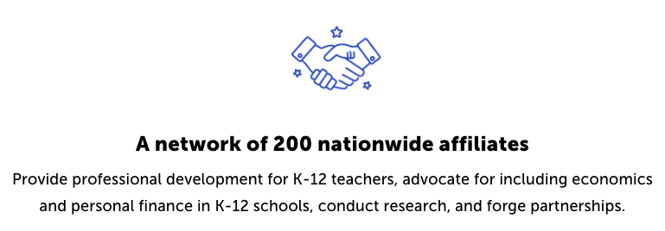
CEE Affiliates
https://www.councilforeconed.org/resources/local-affiliates/

Slide 56

Questions & Answers
www.creditscorequiz.org
Notes:
BRIAN
Let’s open the floor to questions

