Slide 1
Charting a Course for the Federal Budget and the National Debt
Notes:
Lesson Revision Author: Joel W. Miller (Jan. 2019)
*Teachers, see lesson notes in the Slides Notes within this presentation.

Slide 2
The Fiscal Ship
Part #1 – Understanding Challenges of the Federal Budget
Notes:
This lesson involves three parts (with optional extension activities in part IV):
Understanding Challenges of the Federal Budget (Slides 1-17)
Determining Values and Evaluating Policy Options (Slides 18-27)
Playing the Fiscal Ship Game (Slides 19-
Extension Activity A. Reading- Congressional Budget Office, “The Budget and Economic Outlook 2018 to 2028,” April, 2018
Extension Activity B.

Slide 3
Federal Budget
The taxing and spending plan of the national government
A budget deficit occurs in years the government's outlays (spending) are greater than its revenues (tax receipts)
Budget deficits increase the National Debt (the total unpaid borrowed funds, carried by the federal government).
A budget surplus would decrease the size of the National Debt.
Answer
#4 Now
Notes:
TEACHER NOTE: Prompt students to answer questions #1-3 from this Slide before advancing to Slide 4.
Also, you may tell students a budget surplus—although less common–occurs in years the government's outlays (spending) is less than its revenues (tax receipts).

Slide 4
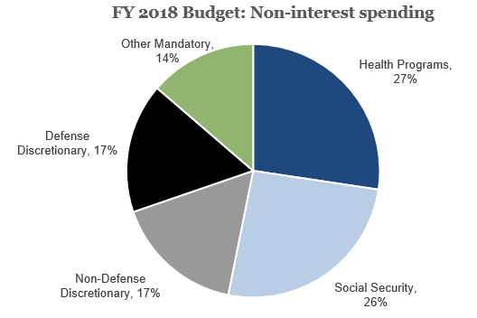
Federal Budget
FY 2018 Non-interest spending
 | % of GDP | Share
Health Programs | 5.2 | 27%
Social Security | 4.9 | 26%
Non-Defense Discretionary | 3.2 | 17%
Defense Discretionary | 3.2 | 17%
Other Mandatory | 2.6 | 14%
Source: Congressional Budget Office
Image credit: Vivien Lee (Senior Research Assistant- Hutchins Center on Fiscal and Monetary Policy, The Brookings Institution)
Notes:
About half of mandatory spending is spending on programs primarily aimed at the elderly. Social Security pays a monthly old-age benefit to those reaching retirement age (minimum 62), whereas Medicare pays for the health care expenses for those 65 and older. Social Security and Medicare also provide benefits to disabled individuals and families of retired, disabled, and deceased workers.
Next up is Medicaid, the health care program for the poor run jointly by the state and federal governments, and income security programs like unemployment insurance and food stamps. “Other mandatory programs” include an array of much smaller programs that range from federal government and military retirees’ benefits to veterans’ pensions. And last but not least, a portion of mandatory spending goes to interest payments on the federal debt.
Image credit: Vivien Lee (Senior Research Assistant- Hutchins Center on Fiscal and Monetary Policy, The Brookings Institution)

Slide 5
The federal government has run a deficit for much of the last century.
Source: FRED Economic Data, Federal Reserve Bank of St. Louis
Notes:
Source: https://fred.stlouisfed.org/series/FYFSGDA188S

Slide 6
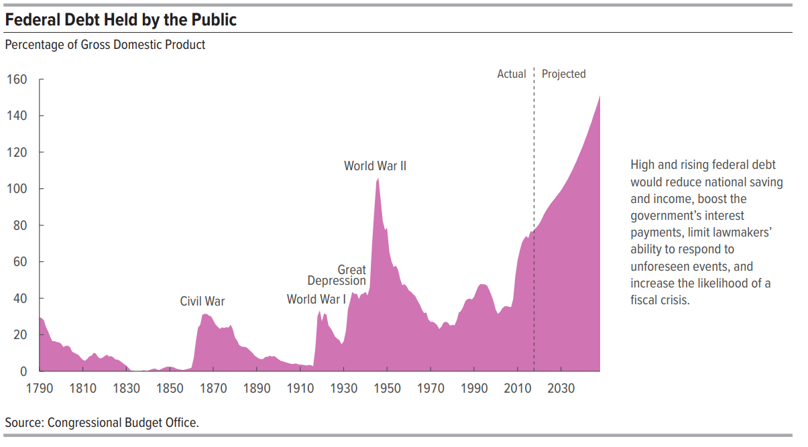
A yearly deficit adds to the national debt.
Source: Congressional Budget Office
Notes:
Source: https://www.cbo.gov/system/files?file=2018-06/53919-2018ltbo.pdf (page 8)

Slide 7
The National Debt
Notes:
See updated data: http://www.usdebtclock.org/

Slide 8
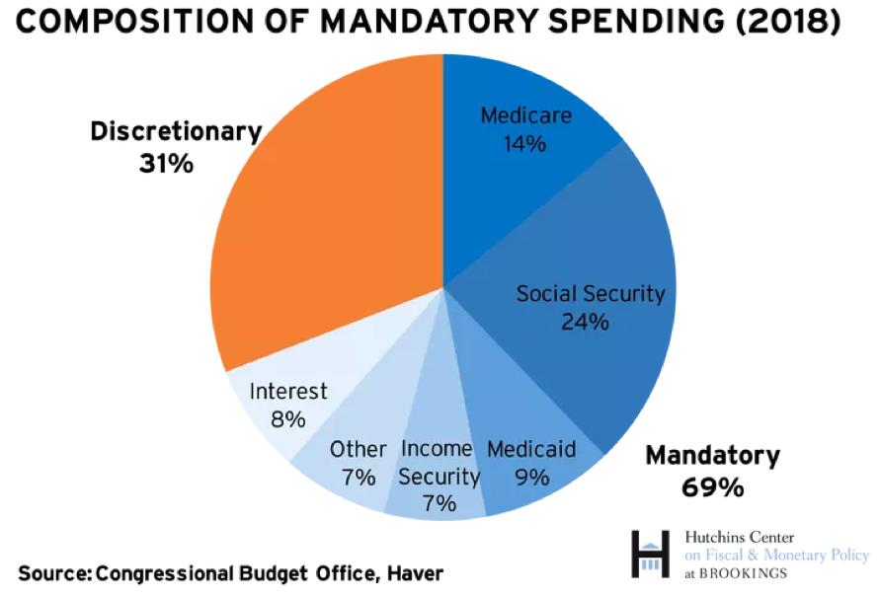
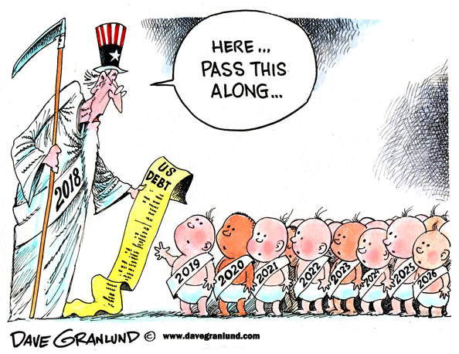
Interest on the National Debt
Notes:
Source: https://www.brookings.edu/blog/up-front/2018/12/13/the-hutchins-center-explains-federal-budget-basics/
Cartoon: http://www.davegranlund.com/cartoons/2018/12/27/new-year-and-us-debt/
TEACHER NOTE:
The government has borrowed a lot: The federal debt held by the public amounted to slightly over $15 trillion by the end of 2018, a sum equivalent to roughly 76 percent of the U.S. economy. This level of debt is very high by historical standards. The only previous experience with debt this high was at the end of World War II. As a result, a sizable part of the budget goes to pay interest on that debt—in 2018, interest consumed almost 8 percent of all federal spending. This is more than what the federal government spent on unemployment benefits, higher education, food and nutrition assistance programs, and pollution control taken together.

Slide 9
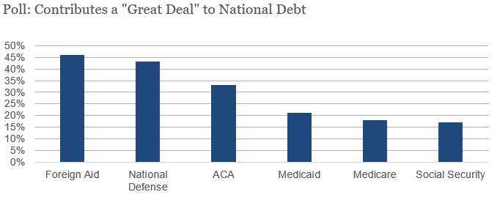
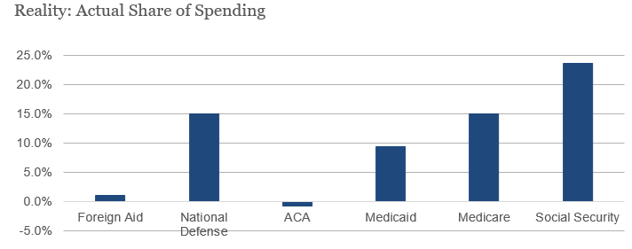
Misconceptions about the budget:
Source: Office of Management and Budget, Congressional Budget Office
Notes:
Sources: Vivien Lee, Brookings Institute
https://www.politico.com/f/?id=0000015a-819f-d2c6-a7db-d9bfcf110001
https://www.cbo.gov/system/files?file=115th-congress-2017-2018/costestimate/52939-hr1628amendment.pdf

Slide 10
The Long-Term Federal Budget Outlook
The long-term federal budget outlook has worsened dramatically in recent years
Federal debt as a % of GDP is higher than at any time since WWII
The CBO projects that growing budget deficits will push debt well above its current high level, and in 25 years federal debt will exceed 100% of GDP and still be on an upward path
Notes:
TEACHER NOTE:
The Extension Activity “CBO Long-term Outlook” Reading goes into more depth on the budget outlook. See handout at end of the lesson plan for more information on the subject.

Slide 11
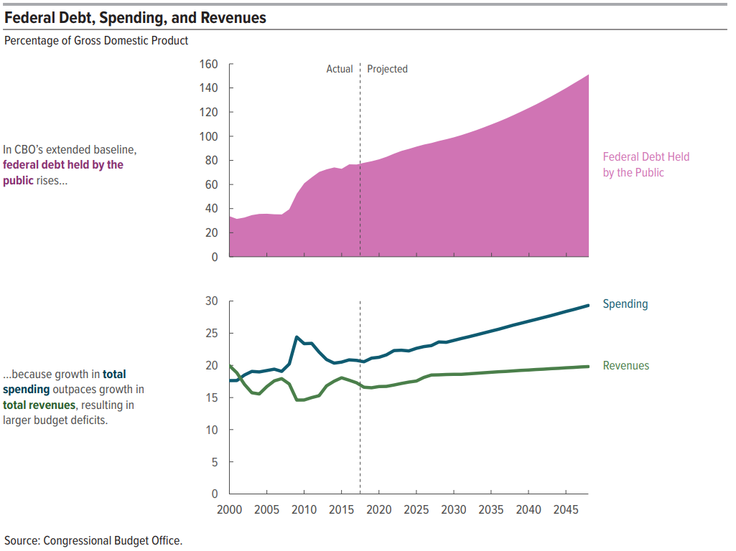
Challenge #1: Growing Budget Deficits
Source: Congressional Budget Office
Notes:
TEACHER NOTE:
That expectation of slower economic growth in the future is attributable to several factors— most notably, slower growth of the labor force. Projected growth in output is also held down by the effects of changes in fiscal policy under current law—above all, by the reduction in private investment that is projected to result from rising federal deficits. (CBO, The 2018 Long-Term Budget Outlook p. 4)

Slide 12
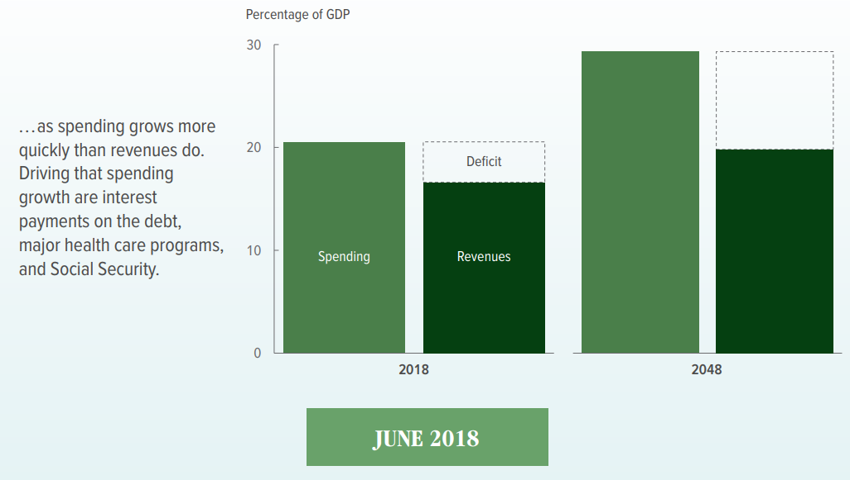
Larger deficits increase interest rates which decreases private investment
Notes:
(CBO, The 2018 Long-Term Budget Outlook)

Slide 13
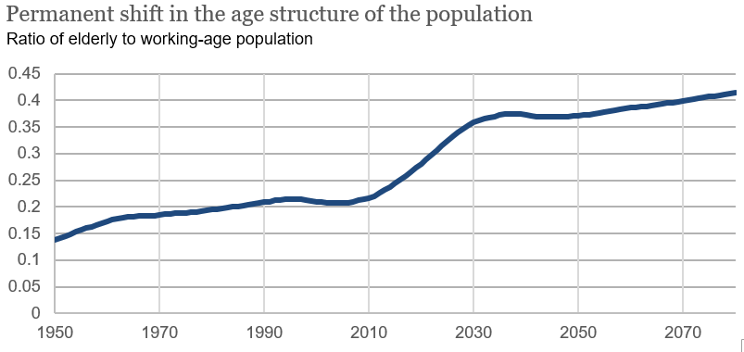
Challenge #2: Population Aging
Source: Social Security Administration
Image credit: Vivien Lee (Senior Research Assistant- Hutchins Center on Fiscal and Monetary Policy, The Brookings Institution)
Notes:
SSA, intermediate assumptions https://www.ssa.gov/oact/TR/2011/lr5a2.html
Image credit: Vivien Lee (Senior Research Assistant- Hutchins Center on Fiscal and Monetary Policy, The Brookings Institution)

Slide 14
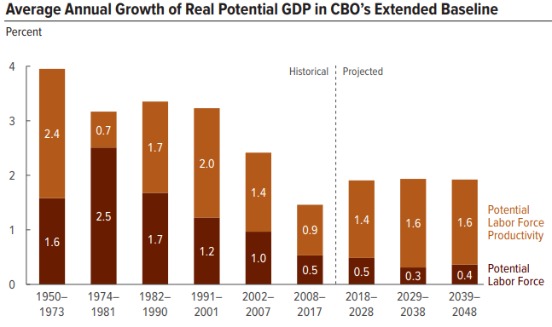
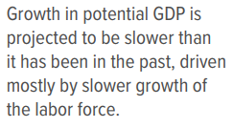
Challenge #2: Population Aging
Source: Congressional Budget Office
Notes:
(CBO, The 2018 Long-Term Budget Outlook)
“Permanent shift in the age structure of the population.” Ration of elderly to working-age population is increasing as fertility rates fall and life expectancies increase.

Slide 15
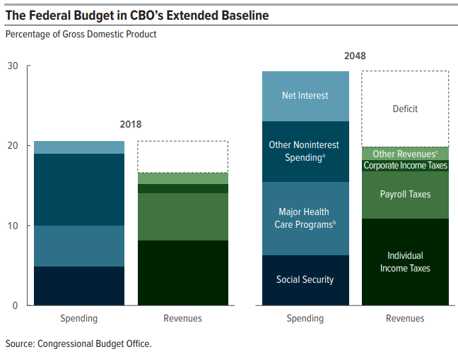
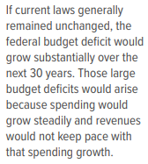
Challenge #3: Increased Costs for Major Health Care Programs
Source: Congressional Budget Office
Notes:
The extended baseline generally reflects current law, following CBO’s 10-year baseline budget projections through 2028 and then extending most of the concepts underlying those baseline projections for the rest of the long-term projection period.
Consists of all federal spending other than that for Social Security, the major health care programs, and net interest.
Consists of spending for Medicare (net of premiums and other offsetting receipts), Medicaid, and the Children’s Health Insurance Program, as well as outlays to subsidize health insurance purchased through the marketplaces established under the Affordable Care Act and related spending.
Consists of excise taxes, remittances to the Treasury from the Federal Reserve System, customs duties, estate and gift taxes, and miscellaneous fees and fines.
*It is important to emphasize that CBO numbers are what would happen under current law, which is not necessarily what is likely to happen (For instance, the law might say that certain tax cuts will expire. But historically, Congress usually doesn’t let tax cuts expire. CBO must estimate what is said under current law—that the tax cuts will expire. This is not the same of what CBO expects will happen).

Slide 16
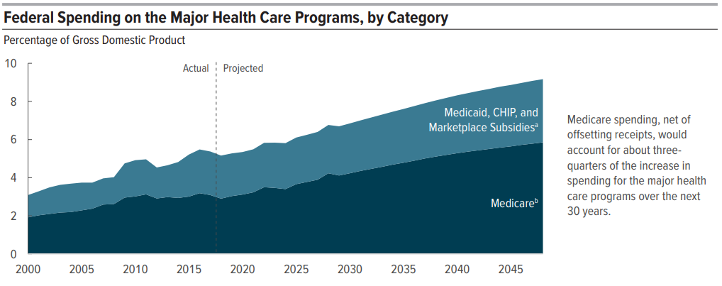
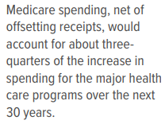
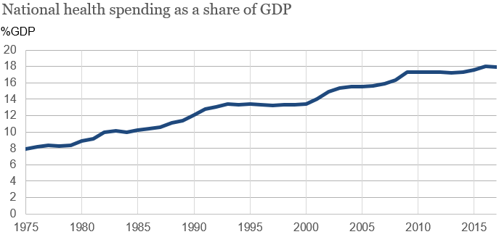
Notes:
Source: (CBO, The 2018 Long-Term Budget Outlook)
The extended baseline generally reflects current law, following CBO’s 10-year baseline budget projections through 2028 and then extending most of the concepts underlying those baseline projections for the rest of the long-term projection period.
CHIP = Children’s Health Insurance Program; GDP = gross domestic product.
“Marketplace Subsidies” refers to spending to subsidize health insurance purchased through the marketplaces established under the Affordable Care Act and insurance provided through the Basic Health Program, as well as spending to stabilize premiums for health insurance purchased by individuals and small employers.
Refers to net spending for Medicare, which accounts for offsetting receipts that are credited to the program. Those offsetting receipts are mostly premiums paid by beneficiaries to the government.
*It is important to emphasize that CBO numbers are what would happen under current law, which is not necessarily what is likely to happen (For instance, the law might say that certain tax cuts will expire. But historically, Congress usually doesn’t let tax cuts expire. CBO must estimate what is said under current law—that the tax cuts will expire. This is not the same of what CBO expects will happen).

Slide 17
What consequences do a large and growing federal debt have?
Significant negative consequences of a large and growing federal debt:
Reduce national savings and income in long-term
Increase the government’s interest costs, putting more pressure on the rest of the budget
Limit lawmaker’s ability to respond to unforeseen events
Increase the likelihood of a fiscal crisis, a situation in which the interest rate on federal debt rises abruptly, dramatically increasing the cost of government borrowing.
Notes:
(CBO, The 2018 Long-Term Budget Outlook p. 8)
TEACHER NOTE:
Large amount of federal borrowing would draw money away from private investment in productive capital over the long term
↑ federal spending on interest payments → ↑taxes, ↓ spending on benefits/services, or both

Slide 18
The Fiscal Ship
Part #2 – Determining Values and Evaluating Policy Options

Slide 19
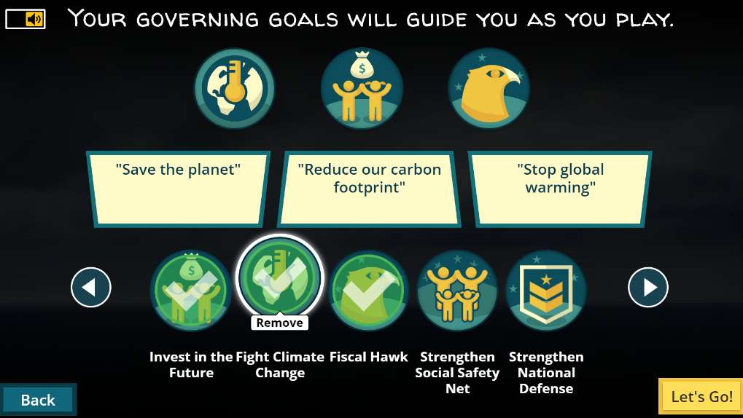
See Handout #2: Select Your Governing Goals
Before we begin the game, you’ll select your governing goals. The goals are your aspirations and values – the ones that shape the kind of country we live in. Select 3 of the 10 goals.
Notes:
TEACHER NOTES:
See the 10 goals on the next three slides. Read through the goal choices and allow students to select their goals.

Slide 20
Fiscal Ship Governing Goals Select 3 out of the 10
Reduce Inequality: The disparity between Americans who have the most and the least income is growing, mirrored by disparities in education, health, and family structure. You want to narrow the widening gaps in incomes and well-being at the top and the bottom.
Strengthen National Defense: Projections of current policies show defense spending, measured as a share of the economy, falling over the next decade and then plateauing. You’d bolster the U.S. military by providing it with more personnel and more arms. (To reach fiscal sustainability, you’ll have to pay for these somehow.)
Fight Climate Change: You want to use government policies to promote a cleaner, healthier environment, reduce greenhouse gas emissions and avoid the damage that could be caused by global climate change.
Strengthen Social Safety Net: You believe it’s important for the federal government to give a hand up to those in poverty and protect those at risk of falling down the income ladder when times are tough. You want to expand and protect programs that protect the vulnerable.
More Goals to Select from on the next two slides…

Slide 21
Fiscal Ship Governing Goals Select 3 out of the 10
Tax Cutter: You believe lower taxes will boost economic growth and want to allow Americans to keep more of what they earn. Your goal is to substantially reduce federal tax revenues as a share of the economy. (To reach fiscal sustainability, you’ll have to cut spending, too.)
Shrink Government: You believe that we’re better off with a leaner federal government, shifting responsibilities to the private, non-profit and state and local sectors. Spending on general government operations and federal programs (other than health and retirement benefits) is projected under current policy to decline over the next decade. You’d reduce it more.
Shield the Elderly: Under current policy, about 60% of the increase in federal spending over the next decade will go to Social Security, Medicare, Medicaid and other major health programs, much of that for the growing number of people who will be over age 65. You want to protect benefits for senior citizens.
More Goals to Select from on the next slide…

Slide 22
Fiscal Ship Governing Goals Select 3 out of the 10
Invest in the Future: You believe in planting seeds today that will be harvested in years to come. You want policies to increase, above what’s currently projected, government and private investment in children and young adults and in education, infrastructure and research that will pay off in the future. (To reach fiscal sustainability, you’ll have to pay for these somehow.)
Fiscal Hawk: You’re not satisfied with restraining the projected increase in the federal debt so that in 25 years it’s roughly where it is today, measured as a share of the overall economy. To put the government and the economy on a sounder footing, you want to reduce it substantially below today’s levels.
Rein in Entitlements: Spending on retirement, health and other government benefits, much of that for the elderly, account for two-thirds of non-interest spending today and threaten to squeeze out spending on everything else—from equipping soldiers with modern gear to repairing old bridges to pursuing cures for cancer. You want to restrain this spending to make room for other priorities.

Slide 23
Your governing goals – Pair-and-Share Turn to a neighbor and discuss the following questions…
Partner #1 Explain:
Which goals did you choose?
Why did you choose these goals?
Partner #2 Explain:
Which goals did you choose?
Why did you choose these goals?
Discuss together and record your answers on Handout #3, question #3.
Do your goals work together so achieve a common objective?
Do they balance both revenues and expenditures so that you will be able to put the country on a sustainable fiscal path?
Are there any inherent contradictions in your selected goals that make policy-making difficult during the game?

Slide 24
Budget Policies are Affected by Values
During the Fiscal Ship game you will be making policy decisions using your own values. But before we play, begin to think about how your values may align with those of other policy-makers and with other voters.
Which of the following groups do your values most closely align?
“Centrists”
“Conservatives”
“Progressives”
See the next slide for suggested goals for each role…
Notes:
Teacher Note:
Thinking about the three common political views only serves to provide some consistency during policy evaluating. This is a skill they will be applying when they play the Fiscal Ship game.

Slide 25
Suggested Goals for a “Centrist”
Strengthen national defense
Invest in the future
Rein in entitlements
Notes:
Teacher note on the centrist political party platform: http://uscentrist.org/platform/positions
*Centrists do not like to be called “moderates” but you may want to explain that their “reasonable policy pursuits” often fall somewhere between conservative and progressive stances.

Slide 26
Suggested Goals for a “Conservative”
Rein in entitlements
Shrink government
Tax cutter

Slide 27
Suggested Goals for a “Progressive”
Reduce inequality
Invest in the future
Strengthen the social safety net

Slide 28
Evaluate Policy Options in the Game
Policy Options on the Fiscal Ship
Based on your political strategy: Centrist, Conservative, or Progressive, highlight options you agree with in GREEN (good) and those you absolutely disagree with in YELLOW (yucky), or simply place a ‘+’ or ‘—’ by the policies if they do (or do not) align with your three governing goals.
Notes:
Teacher Note:
Some policies could debatably be categorized into more than one view point. Allow the student to decide which policies they favor given their governing goal and values. The importance of this exercise is to practice carefully weighing how policies align with governing goals. Thinking about the three common political views only serves to provide some consistency during policy evaluating. This is a skill they will be applying when they play the Fiscal Ship game.

Slide 29
Example of Policy Evaluation
EDUCATION
Eliminate student loan subsidies
Eliminate the Department of Education
Free tuition at public colleges
Limit Pell grants to neediest students
Preschool for four-year-olds
Slash interest rates on existing student debt
Two years of community college tuition-free
Conservative view
Conservative view
Progressive view
Centrist view
Progressive view
Centrist view
Progressive view
Notes:
Teacher Note:
Some policies could debatably be categorized into more than one view point. Allow the student to decide which policies they favor given their governing goal and values. The importance of this exercise is to practice carefully weighing how policies align with governing goals. Thinking about the three common political views only serves to provide some consistency during policy evaluating. This is a skill they will be applying when they play the Fiscal Ship game.

Slide 30
Completely Evaluate Policies for all Categories
Next Stop… Game Time!
Notes:
This will likely be the end of day 1. The game can be completed in 20-30 mins, with discussion time post-game requiring 10-15 mins.

Slide 31
The Fiscal Ship
Part #3 – Playing the Game

Slide 32
You need to captain the U.S.S. Federal Budget to avoid the stormy seas of debt.
Your mission is to pick from a menu of tax and spending options to reduce the debt from projected levels over the next 25 years and keep the debt level no higher than it is today.
But budget decisions aren’t only about fiscal sustainability. They also shape the kind of country we live in. To win the game, you need to find a combination of policies that match your values and priorities AND set the budget on a sustainable course.

Slide 34
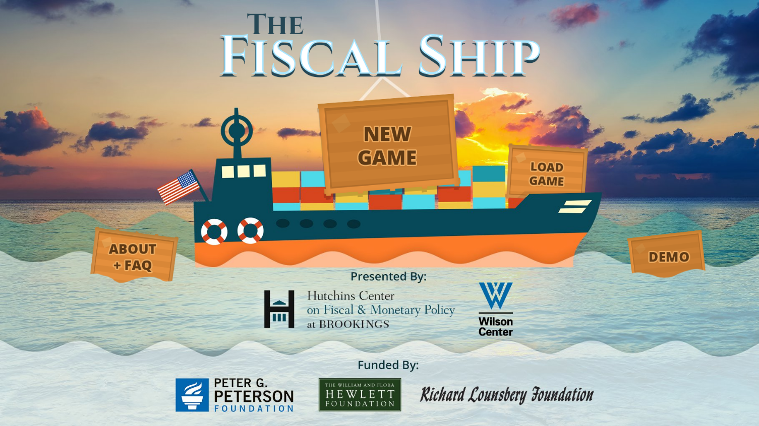
Watch how to play the game (clip length 1:38)
https://www.youtube.com/watch?v=QSWUcaT4GGA
Notes:
https://www.youtube.com/watch?v=QSWUcaT4GGA

Slide 35
Post-Game Class Discussion
How difficult was it to pursue your goals while also hitting the debt target?
Which of your goals were most difficult to achieve?
Which of your policy choices had the largest impact on your fiscal target? Which barely moved the line?
Were you surprised by the magnitude of any policy choices?
What do you think the political obstacles would be to hitting the debt target?
What do you think would be the impact on the American middle class of the choices you made?
Did the game make you reevaluate your initial governing goals?

Slide 36
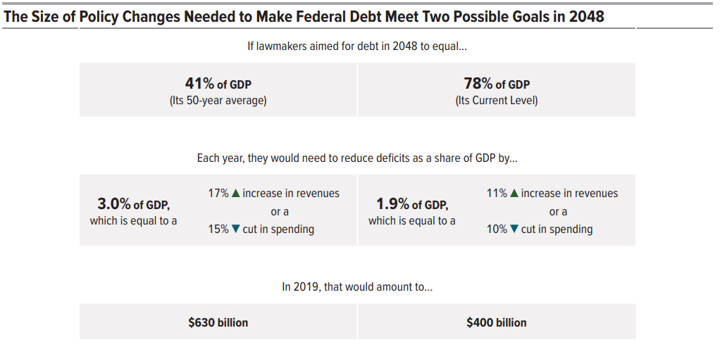
What are the solutions?
Note: Federal budget spending increased from $3.982 trillion in FY 2017to $4.407 trillion in FY 2018…an increase of 10.67%*
Notes:
Note the fiscal actions required to decrease debt to GDP ratios to past average and those actions required just to maintain recent debt to GDP levels.
Taxes values are for households in the middle fifth of the income distribution. Under current law, their taxes are projected to average $12,000.
* Source: https://www.thebalance.com/current-u-s-federal-government-spending-3305763

Slide 37
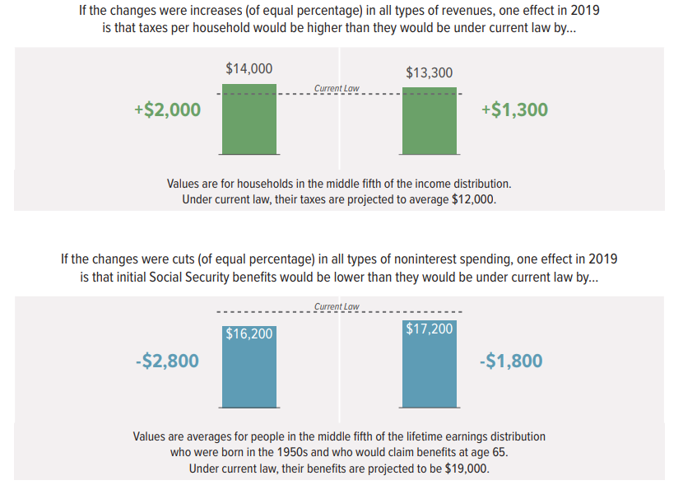
Notes:
Note the fiscal actions required to decrease debt to GDP ratios to past average and those actions required just to maintain recent debt to GDP levels.

Slide 38
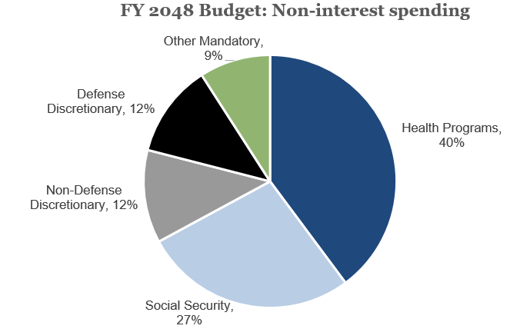
Non-interest spending | FY 2018 |  | FY 2048
 | % of GDP | Share | % of GDP | Share
Health Programs | 5.2 | 27% | 9.2 | 40%
Social Security | 4.9 | 26% | 6.3 | 27%
Non-Defense Discretionary | 3.2 | 17% | 2.8 | 12%
Defense Discretionary | 3.2 | 17% | 2.8 | 12%
Other Mandatory | 2.6 | 14% | 2.1 | 9%
Source: Congressional Budget Office
Notes:
This slide presents data that supplement information in CBO’s June 2018 report The 2018 Long-Term Budget Outlook.
*It is important to emphasize that CBO numbers are what would happen under current law, which is not necessarily what is likely to happen (For instance, the law might say that certain tax cuts will expire. But historically, Congress usually doesn’t let tax cuts expire. CBO must estimate what is said under current law—that the tax cuts will expire. This is not the same of what CBO expects will happen).

Slide 39
Sources and Resources
The budget outlook for 2018 to 2028 in 11 slides:
https://www.cbo.gov/system/files?file=115th-congress-2017-2018/presentation/53729-2018-budget-outlook.pdf
The 2018 Long-term budget outlook:
https://www.cbo.gov/system/files?file=2018-06/53919-2018ltbo.pdf
Pew Survey of Political Typology Report:
http://www.people-press.org/quiz/political-typology/
Extension Article:
https://www.brookings.edu/blog/up-front/2018/12/13/the-hutchins-center-explains-federal-budget-basics/
Special Thanks:
Andrea Mozo, Director of Educational Technology (Council for Economic Education), Mike Raymer (Director, Georgia Council on Economic Education), and Louise Sheiner (The Robert S. Kerr Senior Fellow -Economic Studies Policy Director - The Hutchins Center on Fiscal and Monetary Policy , The Brookings Institution) and Vivien Lee (Senior Research Assistant - Hutchins Center on Fiscal & Monetary Policy, The Brookings Institution).
Notes:
This lesson was revised for CEE by Joel Miller in January 2019 using federal budget resources available through FY 2018.

